Slide 1
GAIN summer 2022
Computational tools workshop
9:00-10:45 AM, August 1,2,4,5

Slide 2
Overview:
Monday: Organizing/sharing code and output with R markdown
Tuesday: Data visualization tools and tricks, tutorial
Thursday: Overview of High Performance Computing, UNR pronghorn
Friday: Data science careers: life outside of academia (visiting data scientist Dr. Johan Grahnen)

Slide 3
Organizing and sharing code and output
Code is written in text, but useful mediums exist to annotate and detail workflows:
Markdown (.md): lightweight markup language that can be used to add formatting elements to plaintext text documents and to annotate code.
R markdown and Jupyter notebooks: Using markdown interspersed with code blocks to annotate code and display output.

Slide 4
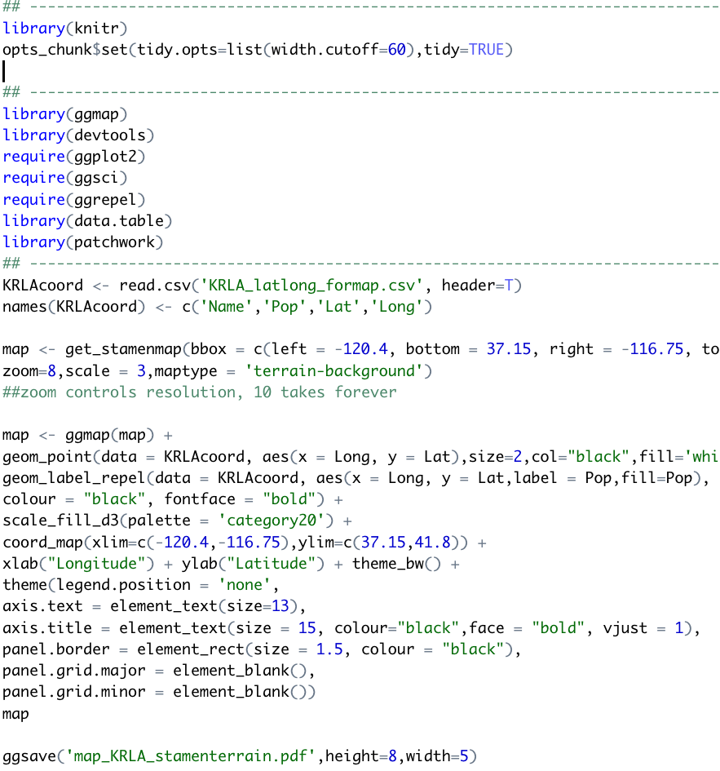
R script:
Code in text, maybe with some lines commented out

Slide 5
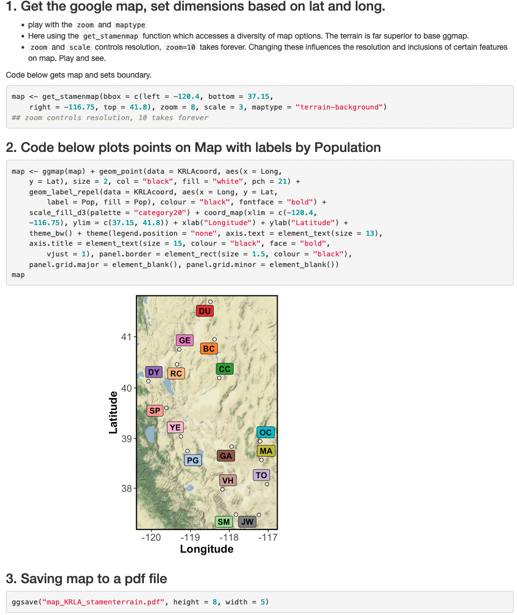
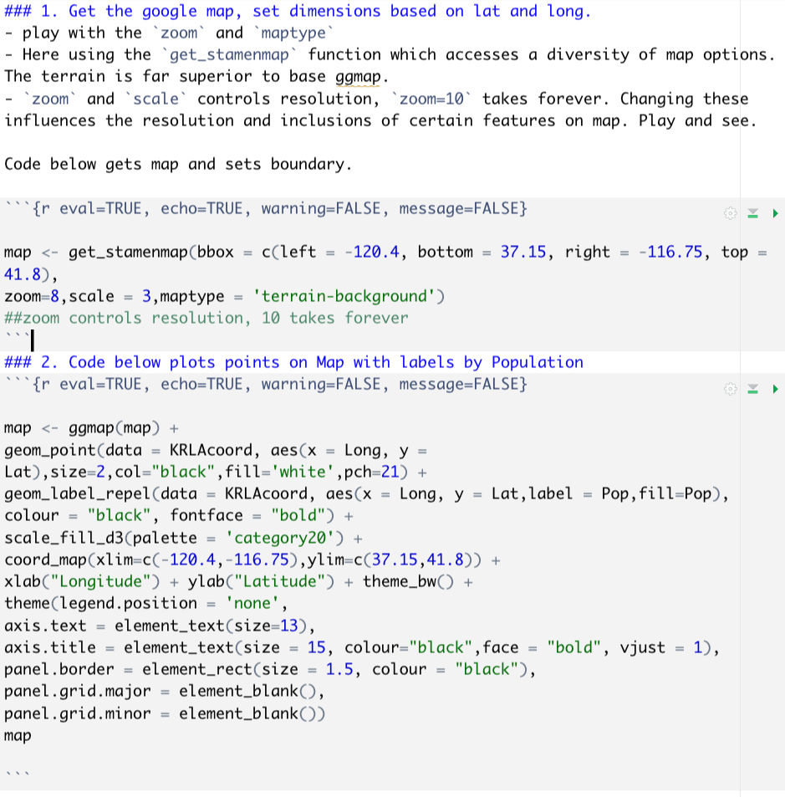
R markdown below
Rendered html

Slide 6
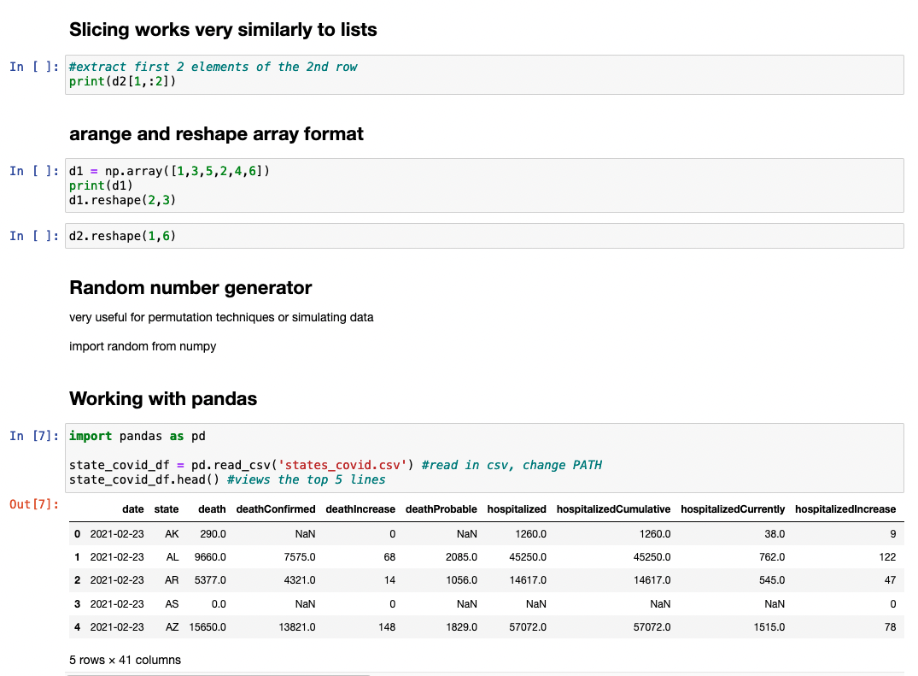
Jupyter
notebooks:
Python code and output with explanations, notes, or annotations written in markdown

Slide 7
R markdown
File format for interleaving markdown text and code blocks
Useful for explaining and displaying both code and its output
Can work with R, python, bash, and latex
Excellent for teaching, sharing, and organizing workflows

Slide 8
Why use R markdown?
Creates clear and easily reproducible record of analyses and results
Excellent for organizing, sharing, and reproducing workflows
Presents code along with output (graphs, tables, etc.) with conventional text to explain it in quality rendered document
E.g., supplemental material for paper submission including all code and output.
day1_Rmd/Rmd examples/Rmd_report_example.html

Slide 9
R markdown: basic elements
Rstudio is a user-friendly GUI (graphical user interface) to run R and to render and view R markdown.
R
- R: https://www.r-project.org/
Rstudio
https://rstudio.com/products/rstudio/download/
It is possible to set up R Jupyter Notebook but RStudio interface is more user friendly

Slide 10
R markdown: basic elements
.Rmd is common file extension, but these files are just text
Rstudio used to edit .Rmd text and to process/display rendered markdown
Can work with R, python, bash, and latex
Excellent for teaching, sharing, and organizing reproducible workflows.

Slide 11
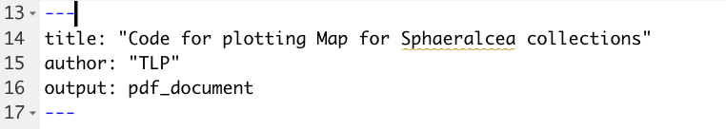
Building an R markdown document
1. YAML header

Slide 12
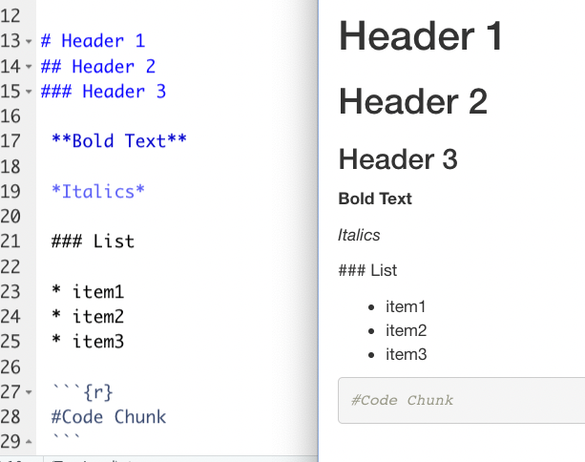
Building an R markdown document
.rmd file
Rendered document
Text written in Markdown syntax
Appears formatted in rendered document (html or pdf)

Slide 13
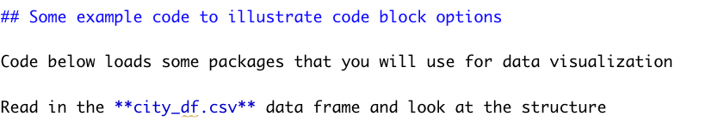
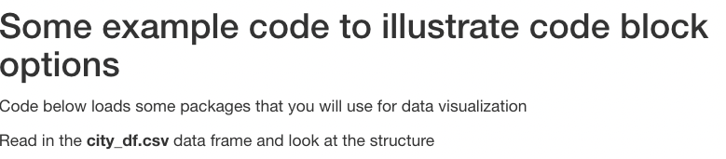
Building an R markdown document
Markdown text example:
Rendered markdown from above will produce below

Slide 14
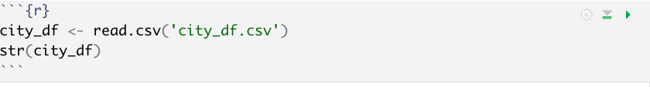
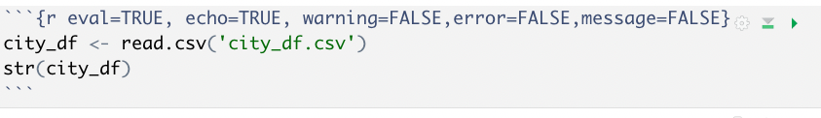
Building an R markdown document
Code (R or python, for example) embedded in code blocks, surrounded by ```{r} ```
With option flags:

Slide 15
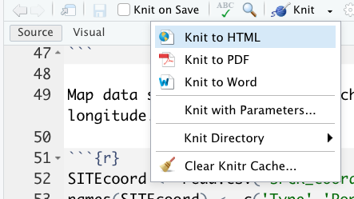
Processing document into html or pdf
Markdown text converted to pdf or html using knitr in R
From prompt:
- rmarkdown::render('knitr_example.Rmd’)
From Rstudio:
- knit dropdown menu

Slide 16
Extract just the R code from R Markdown to R script
Command below will extract just the r code and export to a r script purl.R
knitr::purl("purl.Rmd")

Slide 17

R markdown is not just for R. Handles Python just as easily

Slide 18
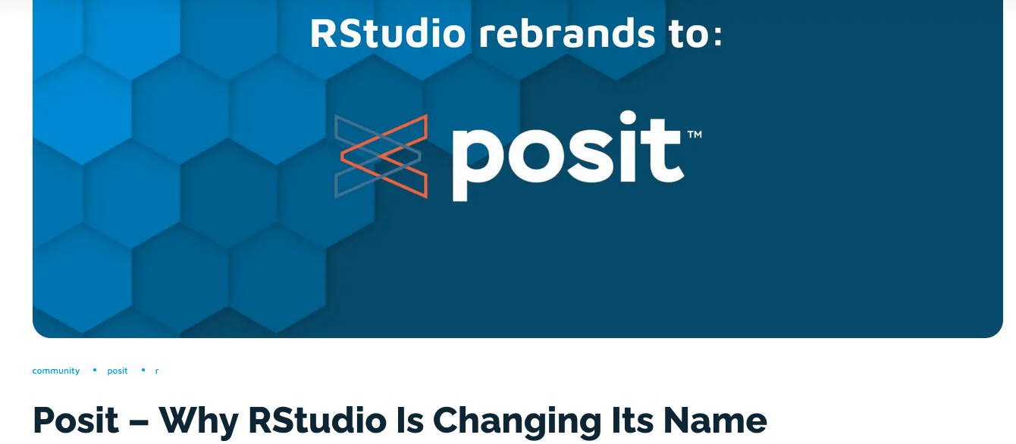
Merging R markdown, python, and VS code

Slide 19
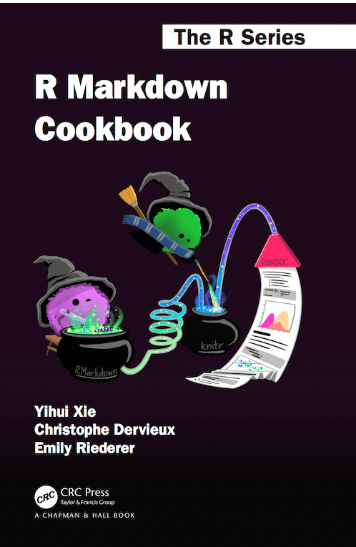
R markdown cookbook is free online:
https://bookdown.org/yihui/rmarkdown-cookbook/
Other useful topics:
- embedding latex
- bibliography manager
- tables
- it goes on and on and on

Slide 20
Workshop course page contents for day 1
R markdown tutorial (in `Rmd tutorial` directory)
R markdown examples
- raw markdown documents
- rendered (knitr processed) documents
R markdown cheat sheet

Slide 21
Day 2: Data visualization workshop
Trevor Faske
- Primer, tutorial, and data in day2 directory
- Look over ggplot2 cheat sheet

