Slide 1

Formation GIT
Laurent Kappel
Groupe SII
65, rue de Bercy - 75012 Paris
Tél : 01 42 84 82 22 - Fax : 01 42 84 30 82

Slide 2


GIT : SCM
Panorama des SCM
GIT: not an evolution
GIT Avantages
Git is Distributed

Slide 3
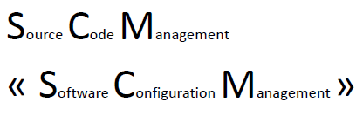












GIT: SCM
« branch »
« merge »

Slide 4
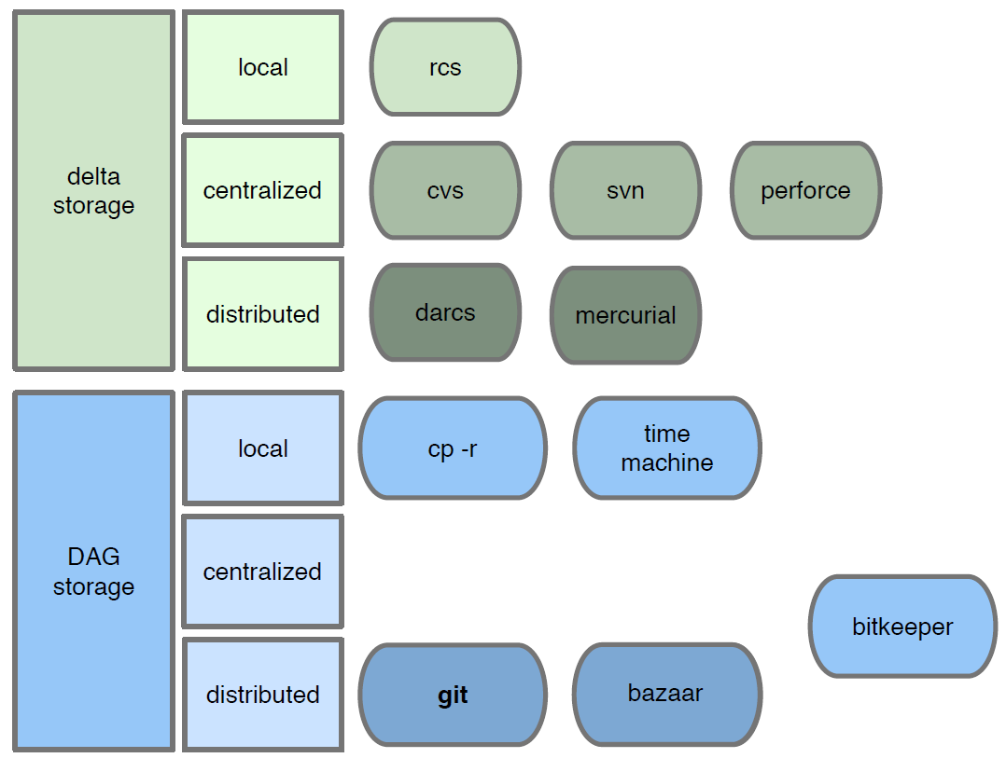
Panorama des SCM

Slide 5

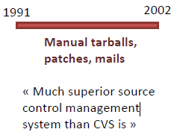
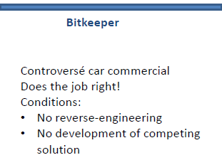


Un peu d’histoire…

Slide 6
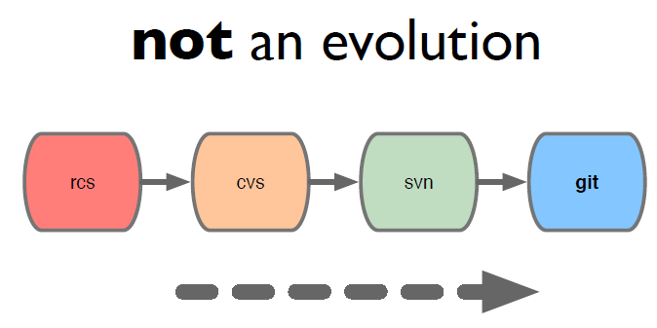
not an evolution

Slide 7
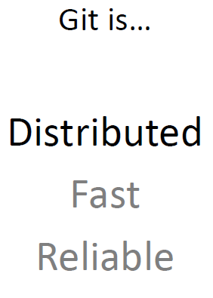
GIT Avantages

Slide 8
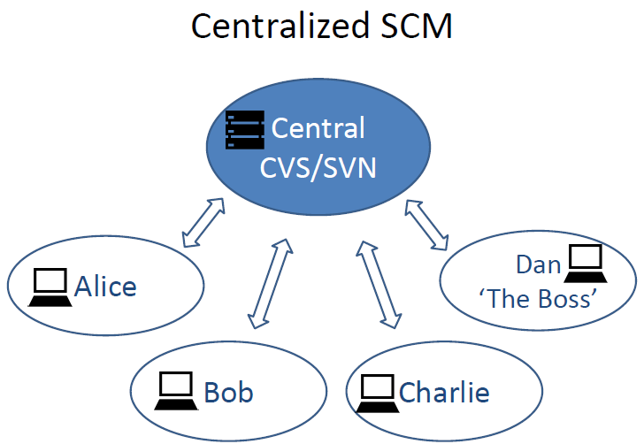
Centralized SCM
Network
(slow)
Single Point
of Failure
Access
Rights?

Slide 9
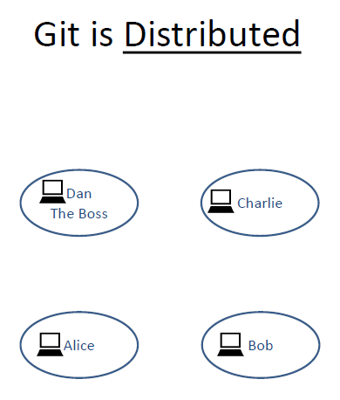

Git is Distributed
No a priori structure
Git ≠ Anarchy

Slide 10
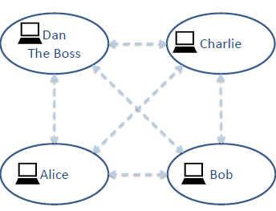
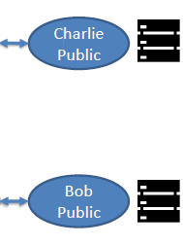
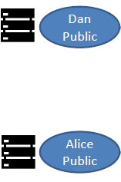
Git is Distributed
A very common practice:
Sharing via user-owned repos
RD/WR
READ
ONLY

Slide 11
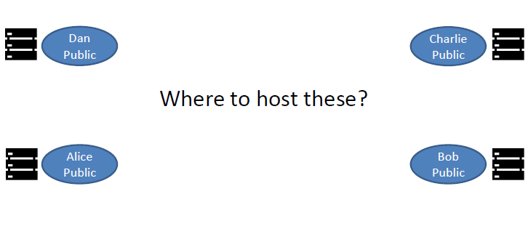
Git is Distributed
A very common practice:
Sharing via user-owned repos

Slide 12
Git is Distributed
A very common practice:
Sharing via user-owned repos
RD/WR
READ
ONLY

Slide 13
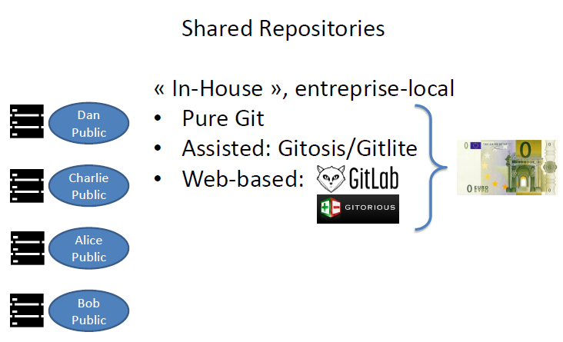
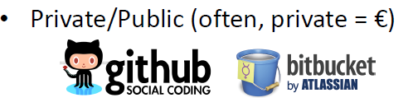
Git is Distributed
Hosted

Slide 14
Distributed Workflow Example

