Slide 1

Airline Reservation System
Tasleen Pasricha
Northeastern University

Slide 2
Roles in the project
Admin (Credentials hard coded : admin, admin)
Can create/update/delete a passenger
Can create/update/delete a flight
Can create/update/delete a carrier
Can create/update/delete a flight crew
Passenger
Can book a flight
Can cancel a reservation
Can check all the bookings made by all the users

Slide 3
Architecture
Three tier architecture
Business logic – Contains all the individual classes
Presentaion logic- Contains all the windows forms
DataLayer Logic- Contains the data access layer holding all the methods to link with the database

Slide 4
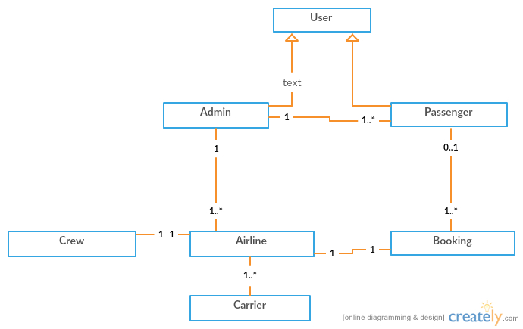
Airline UML DIAGRAM

Slide 5
IMPORTANT POINTS IN THE PROJECT
Unique name for the flight
Unique name for the date/time for a particular flight
Unique destination/arrival at a particular time
Unique carrier
Economy/Economy Plus/Business Class seats and their prices available for the users
End user can see all the booking made by the users and the prices on clicking show bookings button
End user can check for the availability of flight depending on the airline
End user can book and cancel the flight booked by the person.

Slide 6
Logging feature added using Log4Net which retrieves the date in a file saved in bin folder of the project.
Log files traces majorly three features: the log info feature which is logged for informational purposes, Log debug used for logging the trace during debugger mode and debug trace which gives the trace when any exception is caught or handled.
Used SQL server database to save data in the tables and use basic CRUD operations in a GenericDAL class which has all the connectivity with the database.

Slide 7
