Slide 1
Divvy Bike Share Data
A Time Series Modeling Approach Comparing Neural Networks and Box-Jenkins Family Models
Authors: Earl Hammond and Patrick Sullivan

Slide 2
Introduction
The Chicago Department of Transportation owns the city’s bike sharing program, called “Divvy”.
The Divvy system is operated by Motivate, a privately held bike share operating company.
Customers check out and return bikes from any of the city’s over 500 stations.

Slide 3
Data Gathering: Sourcing Data from Divvy Public Data
Field | Meaning
trip_id | ID attached to each trip taken
starttime | day and time trip started, in CST
stoptime | day and time trip ended, in CST
bikeid | ID attached to each bike
tripduration | time of trip in seconds
from_station_name | name of station where trip originated
to_station_name | name of station where trip terminated
from_station_id | ID of station where trip originated
to_station_id | ID of station where trip terminated
usertype | "Customer" is a rider who purchased a 24-Hour Pass; "Subscriber" is a rider who purchased an Annual Membership
gender | gender of rider
birthyear | birth year of rider
Divvy releases detailed data semiannually
https://www.divvybikes.com/system-data
The following fields are available.
We chose a particular station that had a consistent number of interesting checkouts.
This station is also of particular interest to one of the authors (Patrick Sullivan) because it is close to his home.
We chose to focus on arrivals only
Arrivals and departures forecasts at a particular are valuable to Divvy operators who need to rebalance bikes from one station to another throughout the day

Slide 4
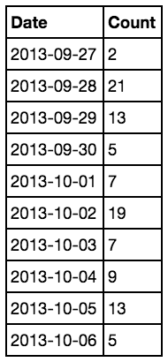
Data Preparation: Aggregation
Divvy trips occur at irregular intervals.
Evaluated two aggregation intervals
Hourly
Daily
Hourly aggregation resulted in sparse data sets
Selected Daily so that longer forecast periods were possible

Slide 5
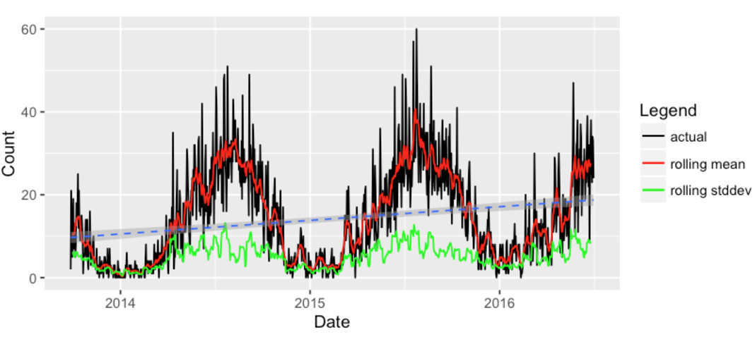
Exploratory Analysis: Time Series Plots
Inconsistent mean
Inconsistent variance
Positive trend
Contains seasonality

Slide 6
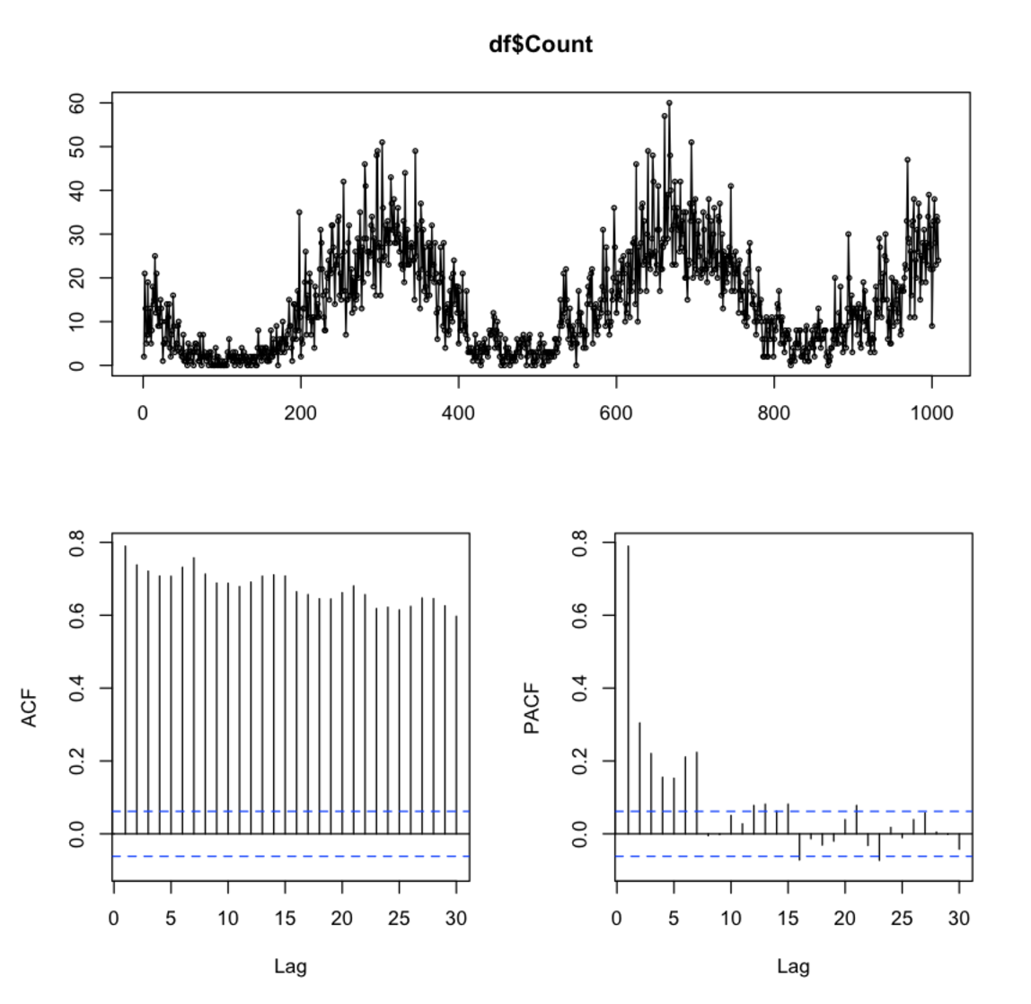
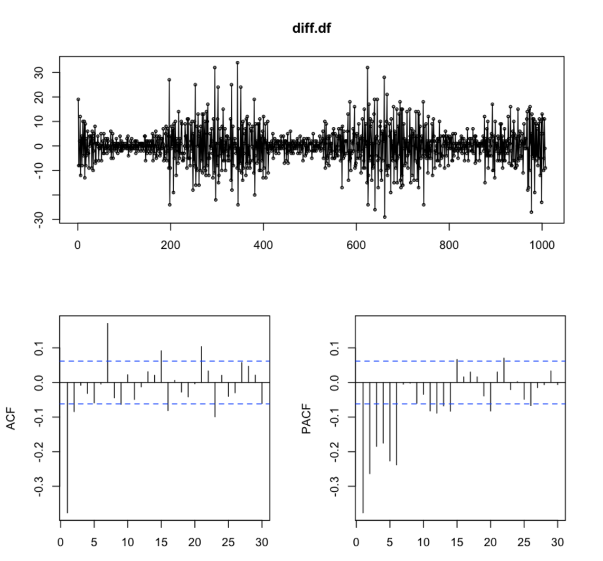
Exploratory Analysis: Auto Correlation
Original
First-Order Difference

Slide 7
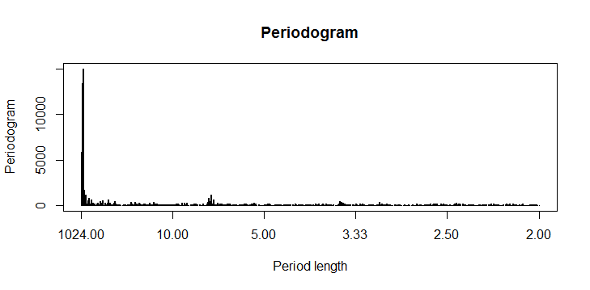
Exploratory Analysis: Seasonality
Spectrum capped at 15000 to allow comparison
Time series plots suggest clear yearly seasonality
Weekly seasonality is also likely
ACF and PACF plots suggest seasonality
Periodogram confirms weekly and yearly seasonalities
Peaks at:
341 days
7.01 days

Slide 8
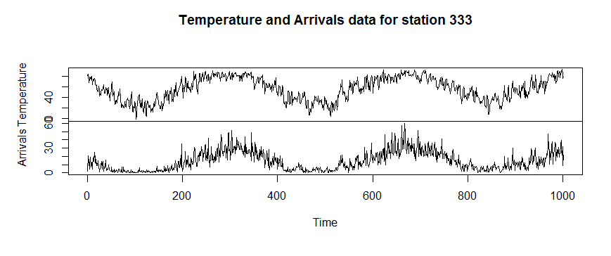
Modeling: Regression with ARMA Errors: Use Weather To Capture Seasonality
Exploratory analysis showed multiseasonality. We expect bike ridership to depend on the weather, so our first model is a linear regression based on temperature. Exploratory charts suggest that regression on temperature will capture yearly seasonality.

Slide 9
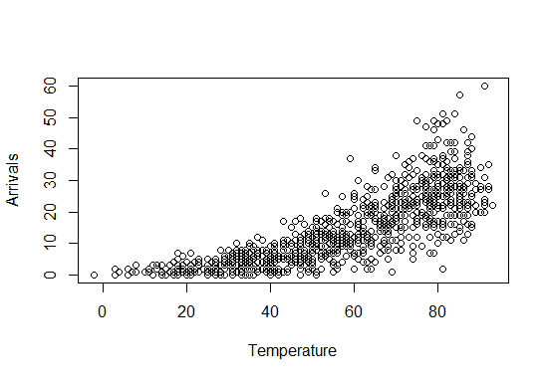
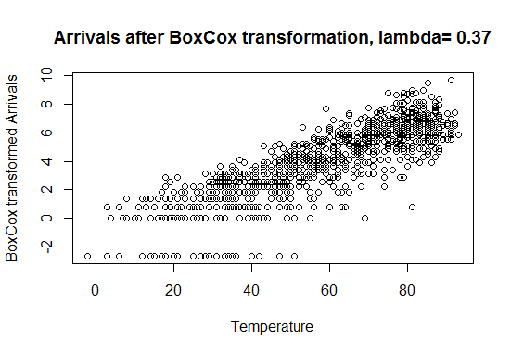
Modeling: Regression with ARMA Error: Data Requires Transformation
Begin with plot of Arrivals and Temperature
Visual inspection suggests a non-linear relationship
Therefore, we try a BoxCox transformation with lambda about 0.37 (found using Guerrero’s method as implemented in R)

Slide 10
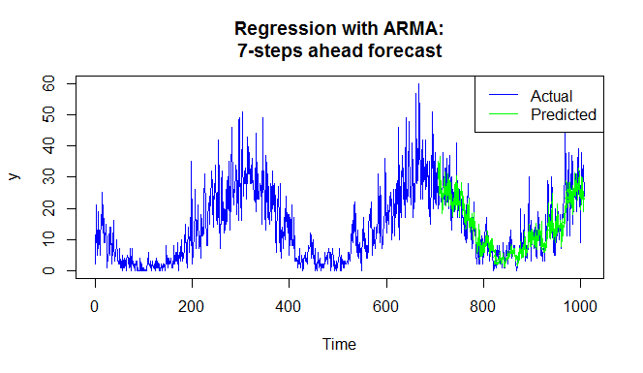
Modeling: Regression with ARMA Error: Analyze Model Fit
We fit an arima model to all training sets with daily maximum temperature as a regressor
The RMSE for all predictions across all models was: 5.64

Slide 11
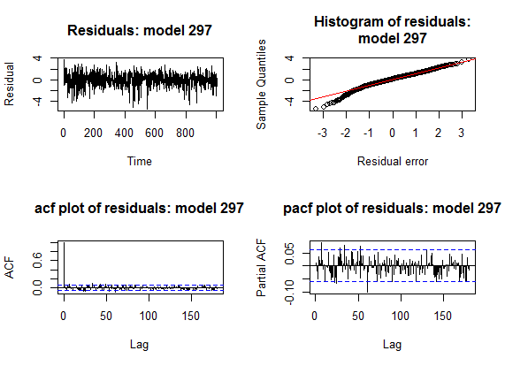
Modeling: Regression with ARMA Error: Analyze Model Residuals
We picked the model fit on the largest training set (from all models found in cross-validation) to analyze residuals
Residuals for this model show a skewed distribution
Box-Ljung p-values justify a conclusion that residuals are auto-correlated
Box-Ljung test p-value: 0.005

Slide 12
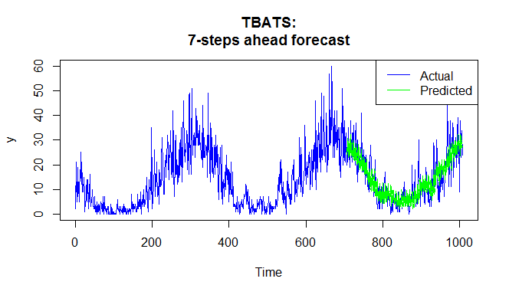
Modeling: TBATS Multiseasonality
Since our periodogram suggested multiseasonality, we next fit a TBATS model.
The chosen models were very consistent across all cross-validation models
Box-cox transformation: none
AR(1) error model
Damping parameter: 1 or very close
The final RMSE across all fitted models was 6.20.

Slide 13
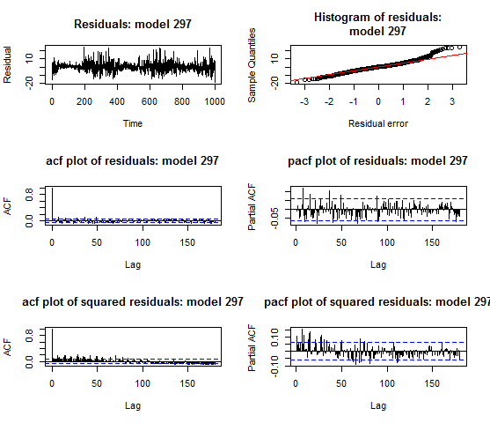
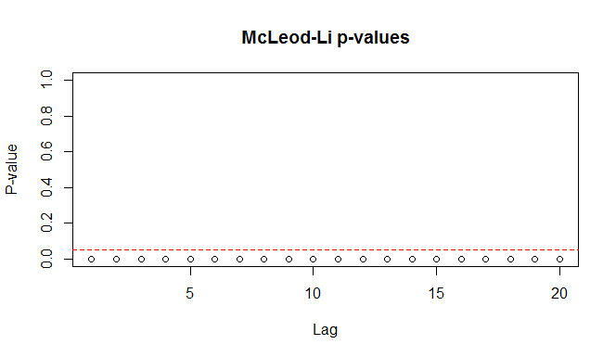
Modeling: TBATS Multiseasonality
Again, we picked the final model, fit on the largest data set to analyze residuals.
Residuals plot shows deviation from normal with a fat tail and conditional variance
McLeod-Li test confirms this
The null hypothesis is independent residuals

Slide 14
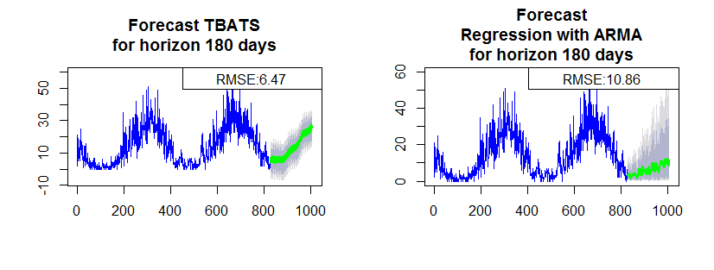
Modeling: TBATS and Regression Over Long Horizon
Visual inspection shows that TBATS appears better than regression with ARMA over a longer forecast horizon (180 days)

Slide 15
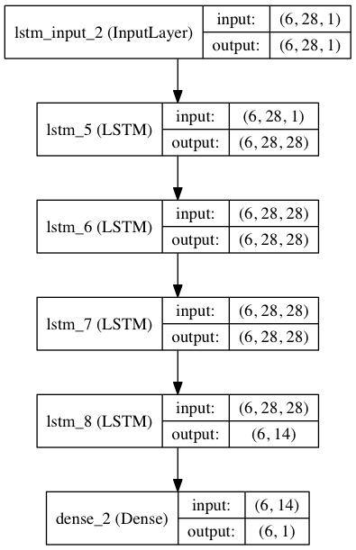
Modeling Neural Networks
LSTM recurrent network
Two approaches
Time Steps(n=28)
Time Steps with Memory (n=28)
LSTM is sensitive to scale, so all data is normalized
Used 10% dropout at each LSTM layer

Slide 16
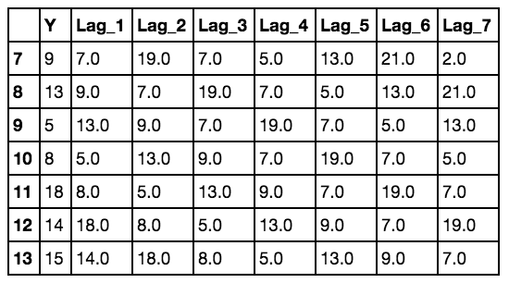
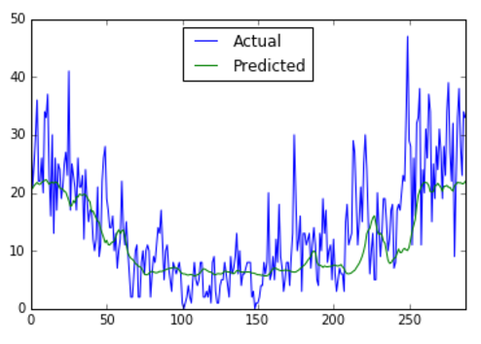
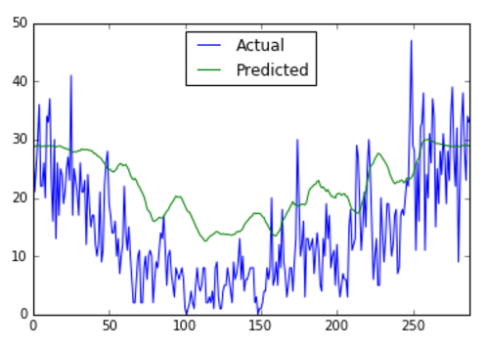
Modeling Neural Networks
Steps
Normalize data
Create a “lagged” data set
Split into train and test (70/30)
Train network
Epochs=100
Batch size=6
Lags=28
1-Day Forecast with Memory
1-Day Forecast

Slide 17
Model Evaluation
Rolling forecasting origin was used for cross validation
70/30 train-test split
Models were retrained after each time step
Used 7-day forecast period
Model | RMSE
Regression with ARMA | 5.64
TBATS | 6.20
Neural Networks | 7.04

Slide 18
Conclusions
Takeaways
Potential Improvements
Divvy trip data contains multiple seasonality
LSTM network performed poorly
Regression with ARMA performed best over the forecast horizon
However, TBATS may be better for long horizons
Regression with ARMA
Account for day-of-week seasonality
TBATS
Handle heteroscedasticity
LSTM Network
Account for seasonality in LSTM network with dummy variables
Increase sample size
Tune number of lagged features

