Slide 1
Campaign Manager
Contributors
David Dornbrack
Terrell R. Payne
Zachary W. Janouskovec
Ernest C. King

Slide 2
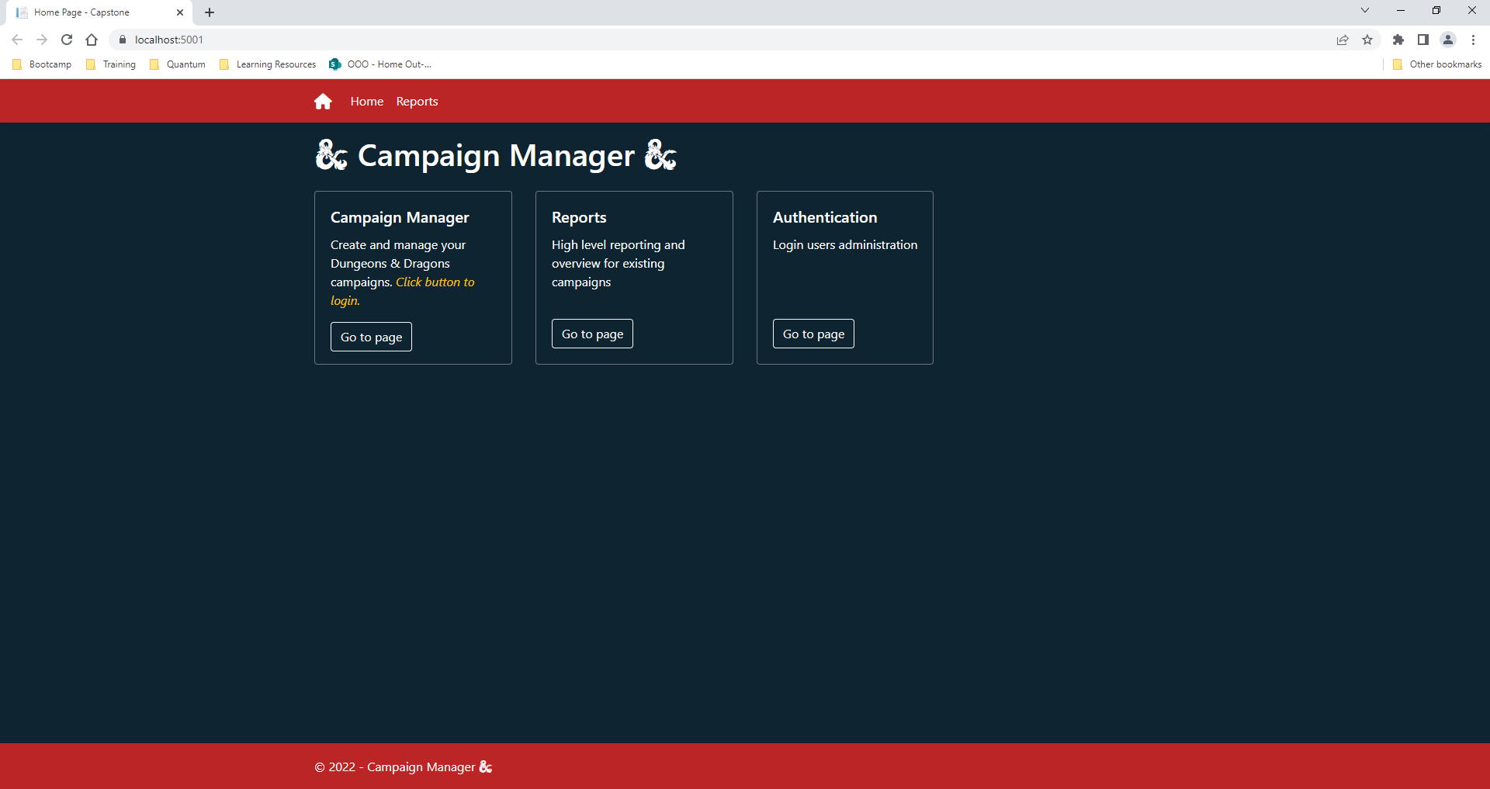
ASP Index
Notes:
This is the ASP index page that your are taken to when first starting the C# Web Application. The reports page gives links to reports available to the administrator using the ASP application

Slide 3
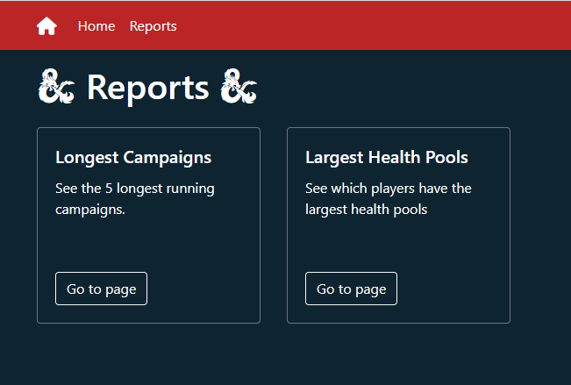
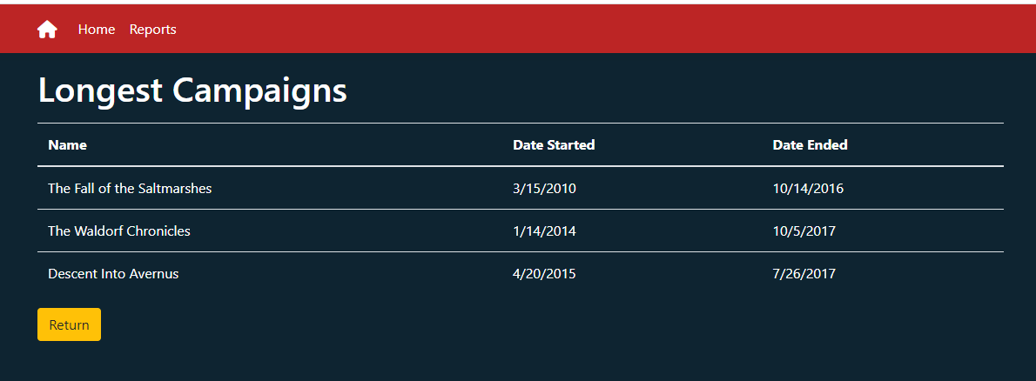
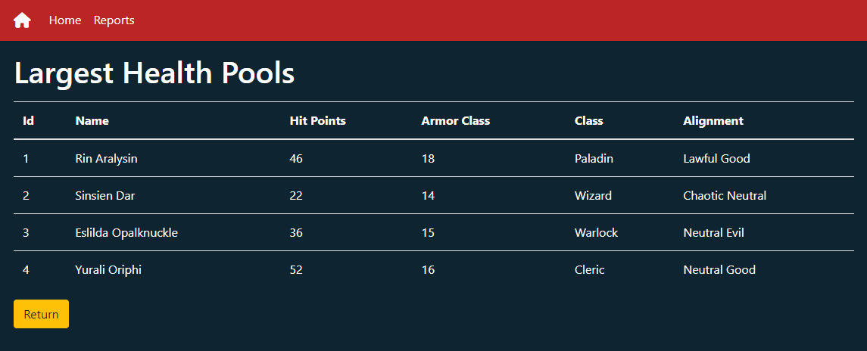
ASP Reports
Notes:
The reports page provides a link to the Longest campaigns, and the Largest Health Pools. This is helpful for the regular D&D players because it provides information about the campaigns in one report, and it provides the health pools information to quickly check what characters are not needing healing.

Slide 4
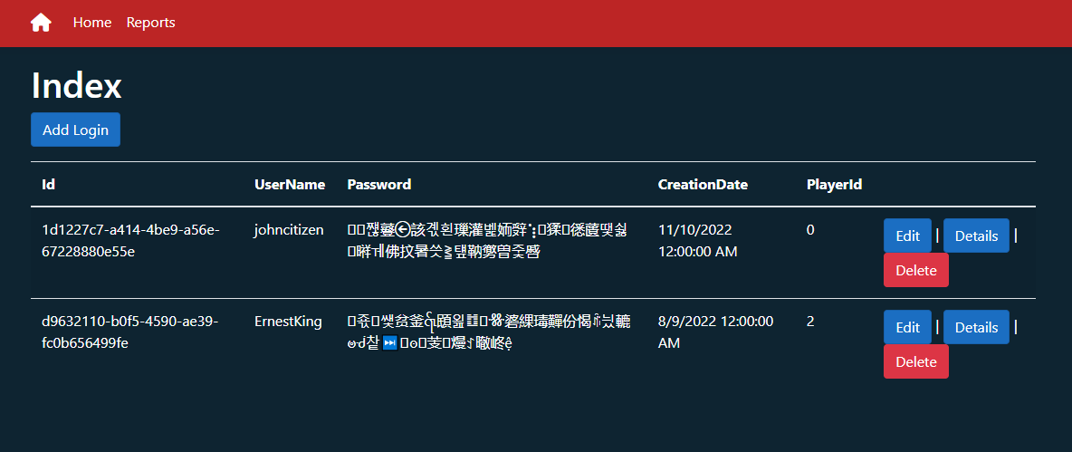
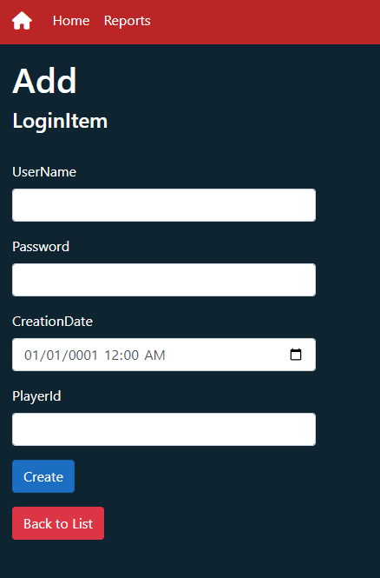
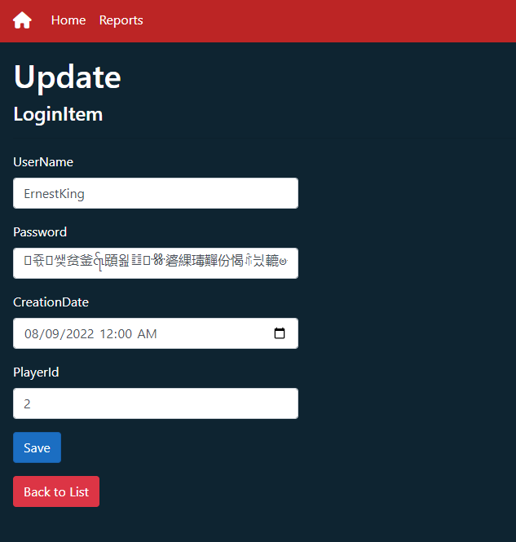
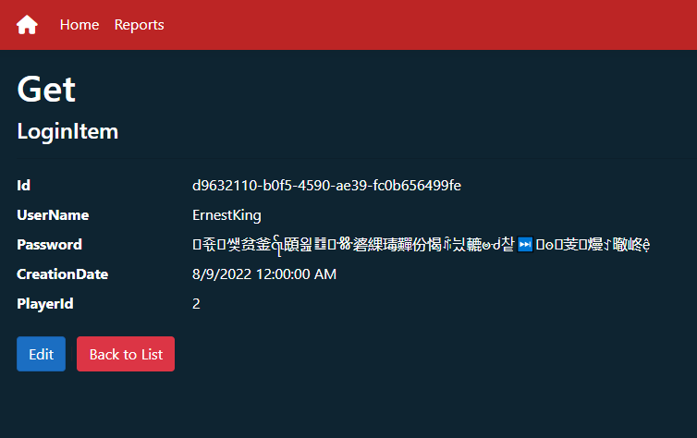
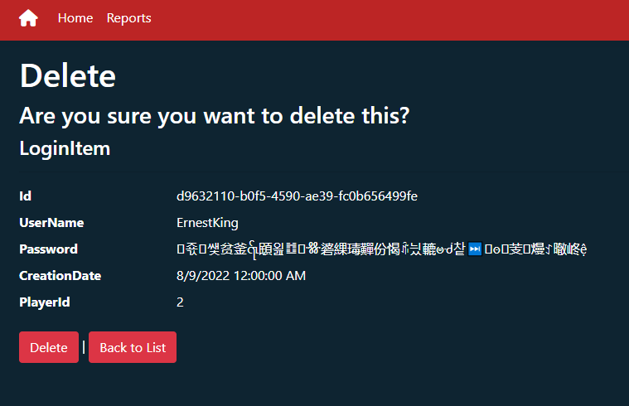
Login Management
Notes:
This login page on the ASP side allows the admin to add new users to the site

Slide 5
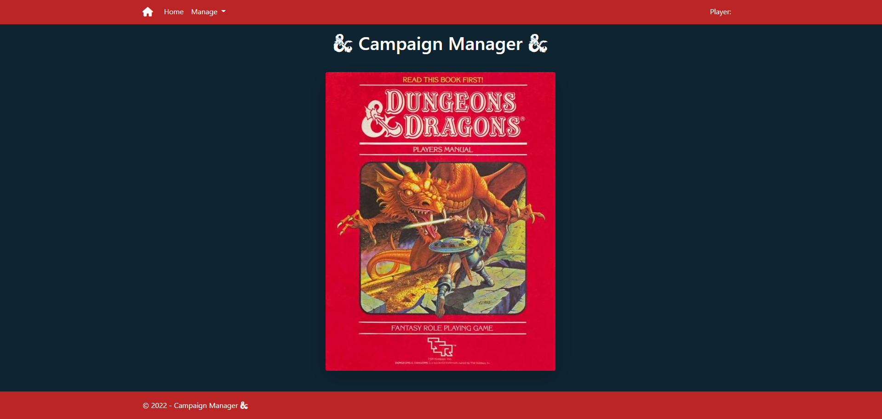
Angular index

Slide 6
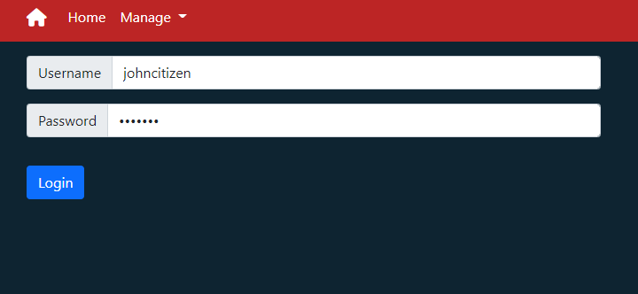

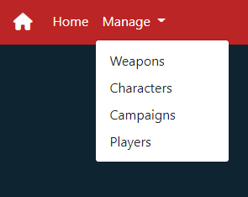
login
Notes:
Once you login you are provided the ability to logout from any of the Angular pages
The option to login is removed from view on the menu Manage since the user is already logged in
The player ID is tied to the Login from the SQL side and passed through C# to Angular to use through the application

Slide 7
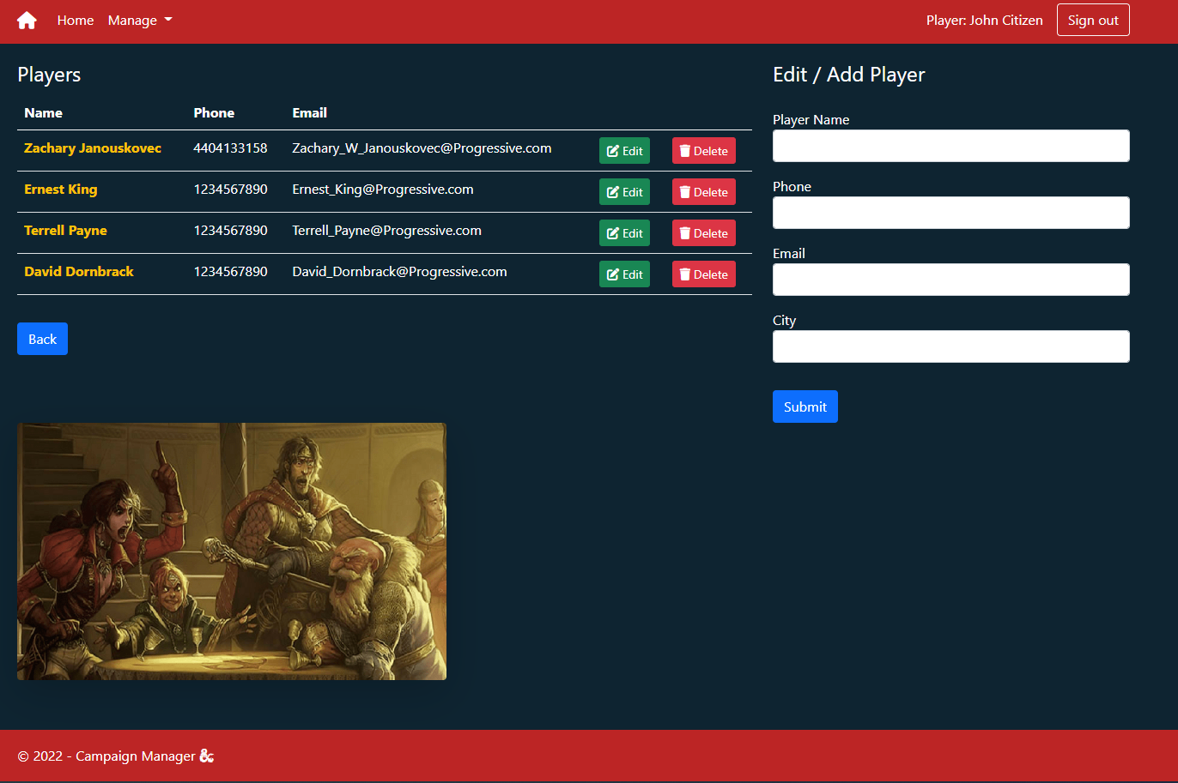
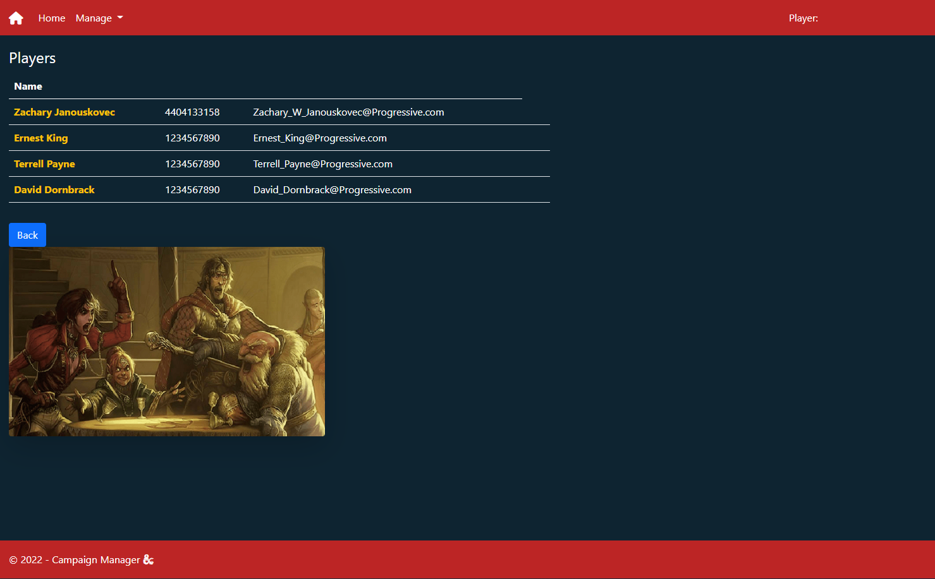
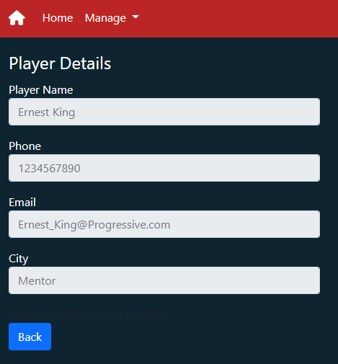
Players page
Notes:
On the players page we provide the form to create a new player, the options to delete, and edit a player
If signed out, then the player list will show
You can click into the details of a player by selecting their name

Slide 8
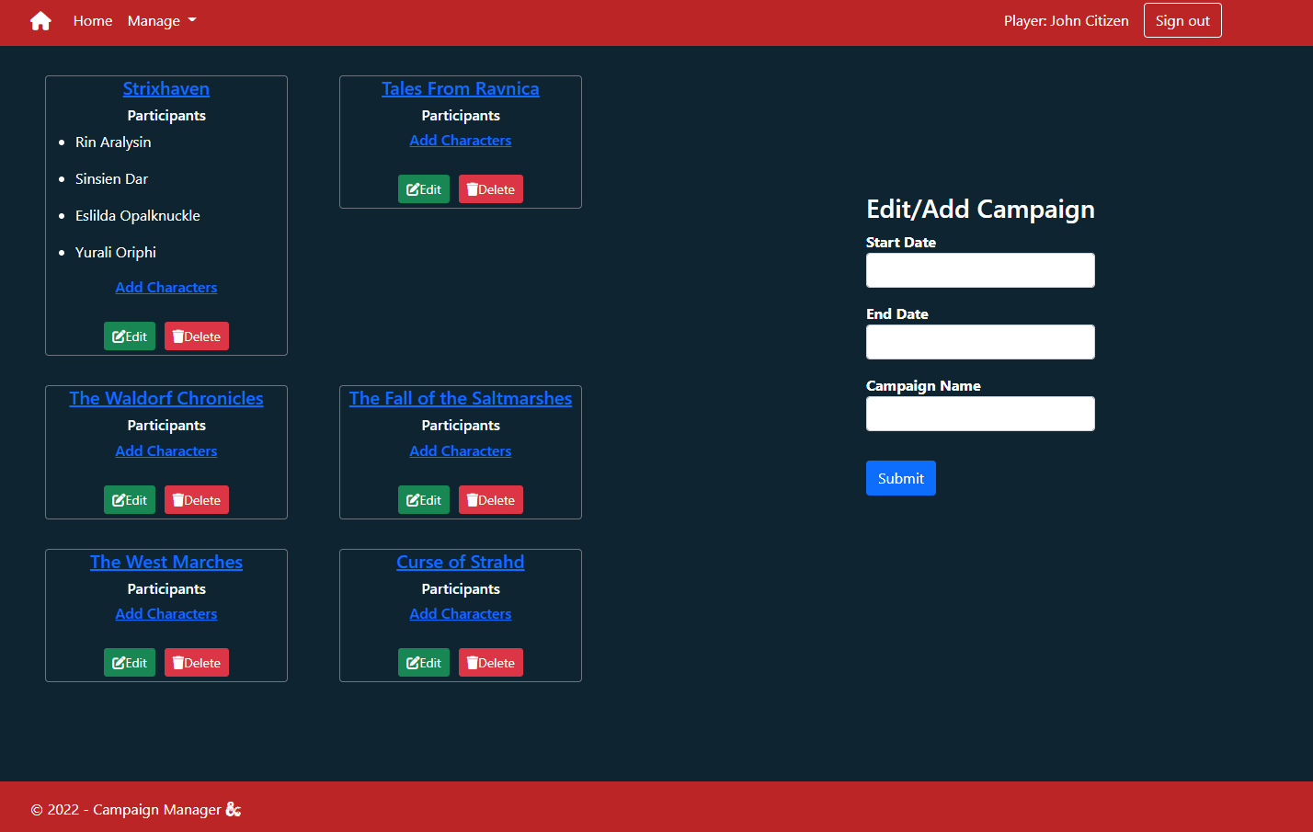
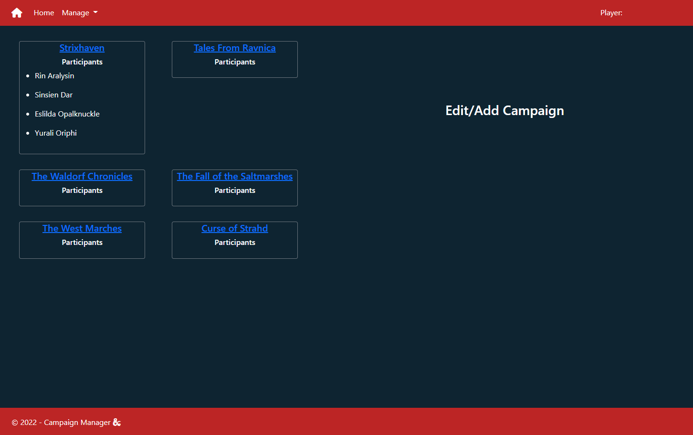
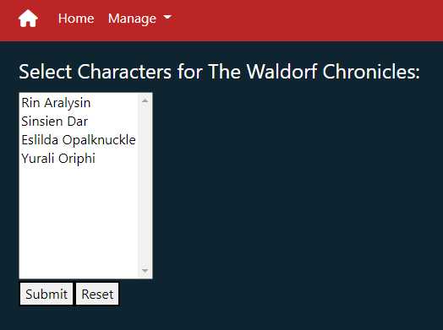
Campaign page

Slide 9
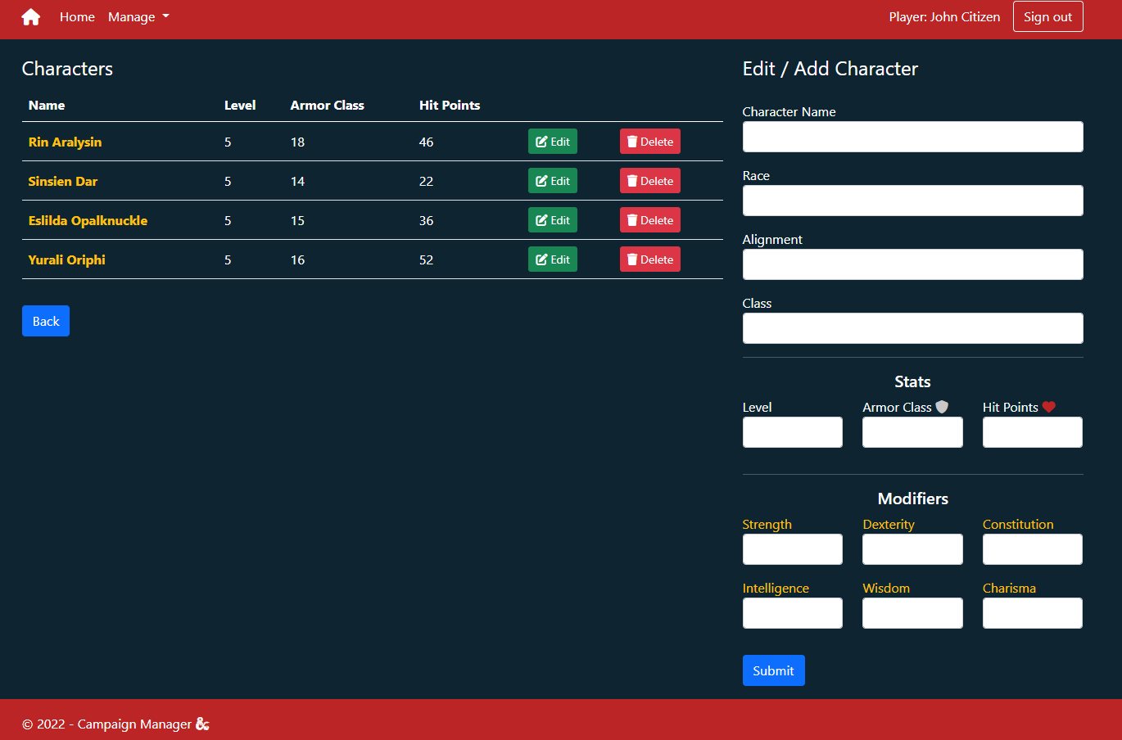
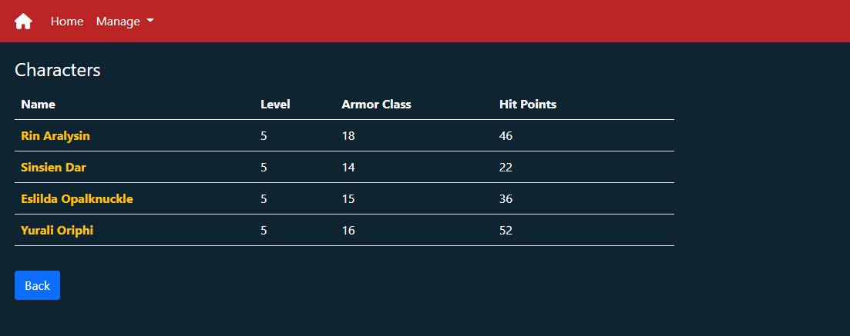
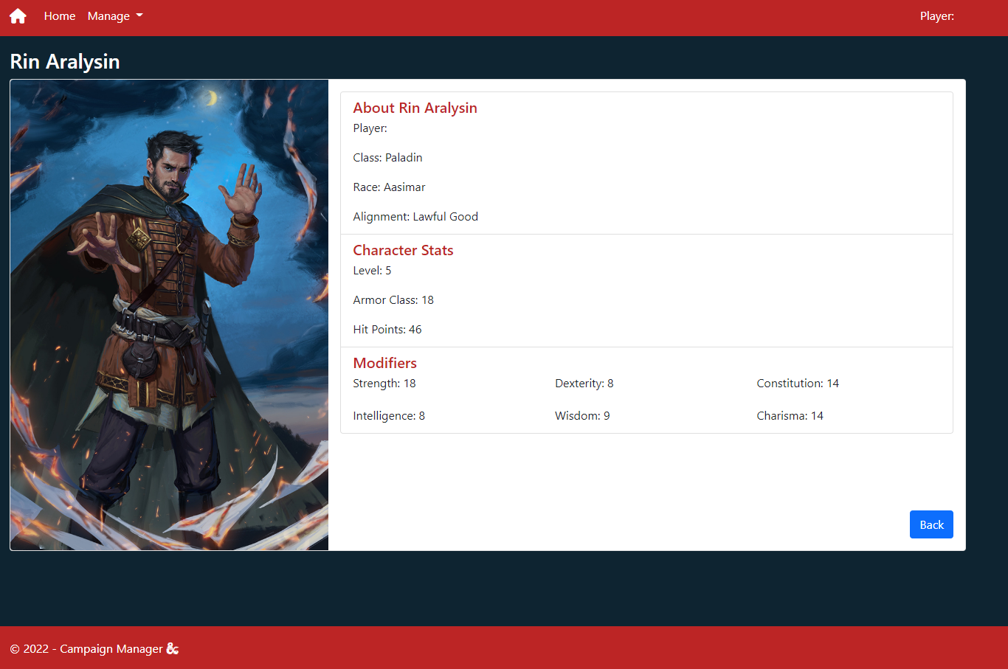
Character page

Slide 10
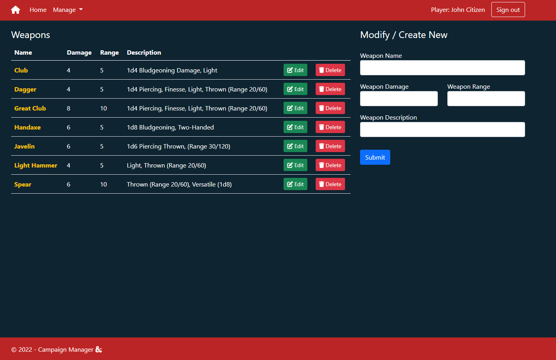
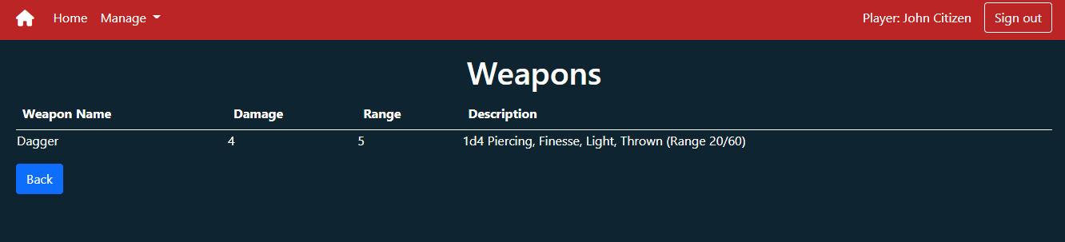
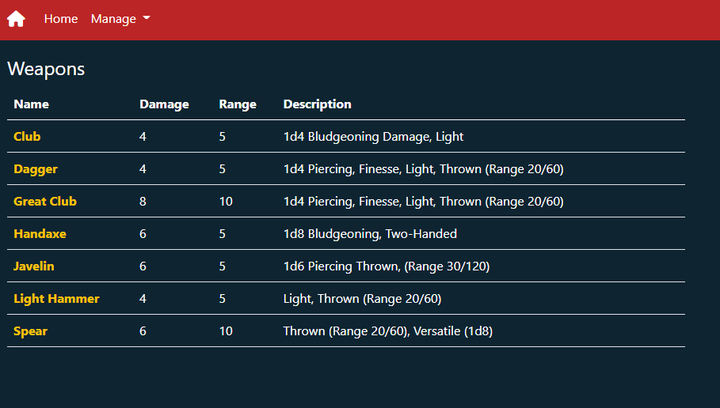
Weapon page
Notes:
We built the weapon page to allow for quick view of the various weapons added to the database
If logged in the ability to create a new weapon, edit a weapon or delete a weapon are easily available

Slide 11
Additional Stuff Added Not Taught in Class:
EF Update method: _context.Entry(ObjectToUpdate).CurrentValues.SetValues(UpdatedObject);
SQL: PwdEncrypt(), PWDCOMPARE()

