Slide 1
Campaign Manager
Contributors
David Dornbrack
Terrell R. Payne
Zachary W. Janouskovec
Ernest C. King

Slide 2
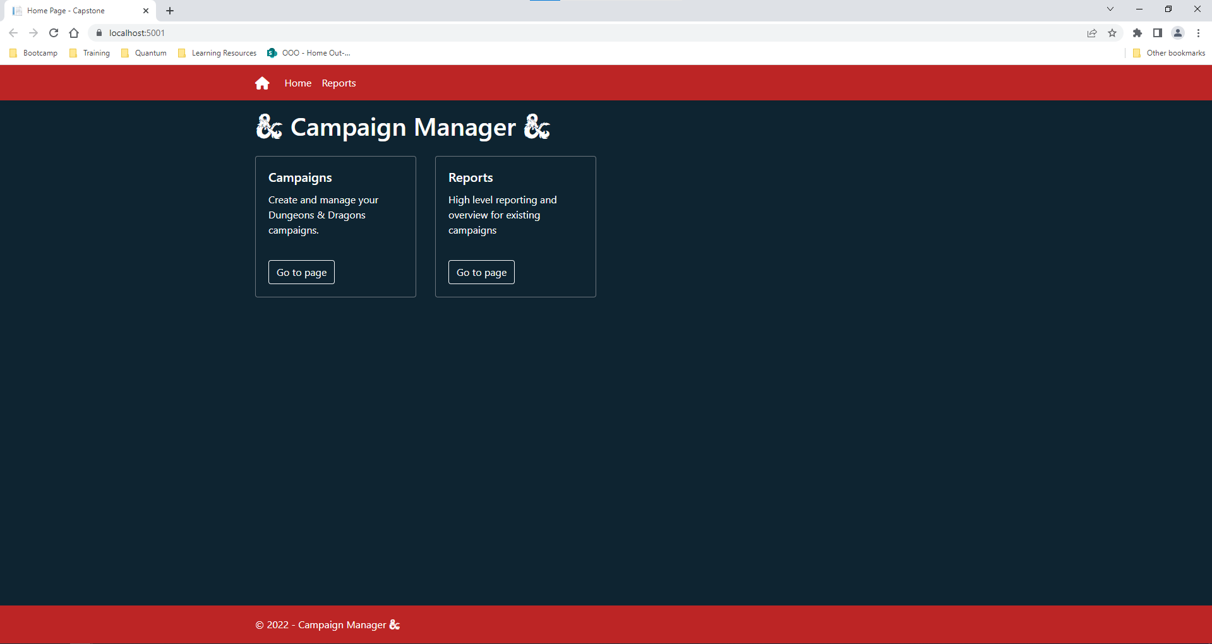
ASP Index
Notes:
This is the ASP index page that your are taken to when first starting the C# Web Application. The reports page gives links to reports available to the administrator using the ASP application

Slide 3
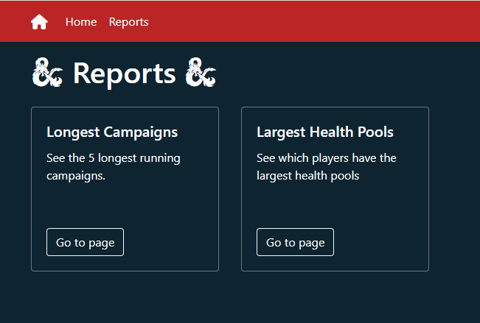
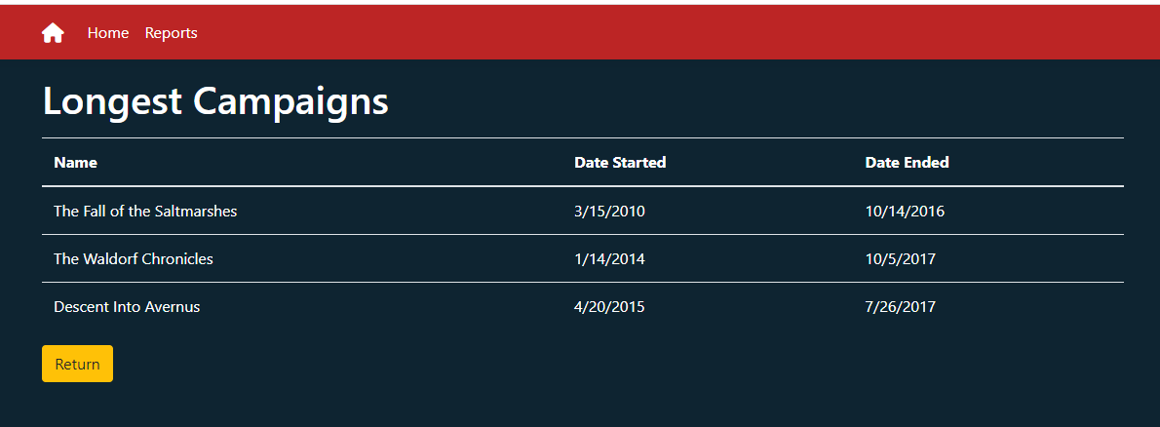
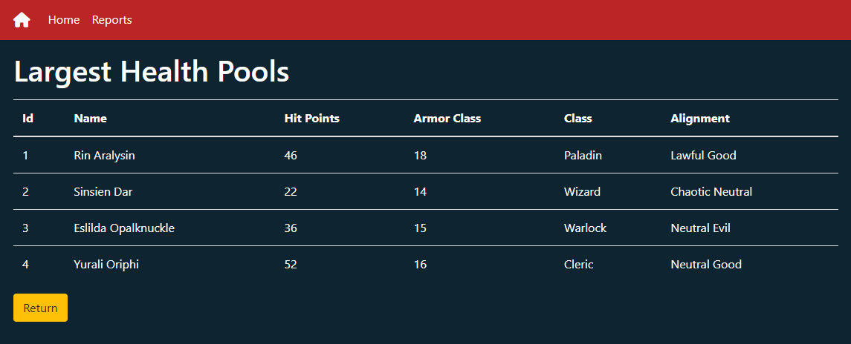
ASP Reports
Notes:
The reports page provides a link to the Longest campaigns, and the Largest Health Pools. This is helpful for the regular D&D players because it provides information about the campaigns in one report, and it provides the health pools information to quickly check what characters are not needing healing.

Slide 4
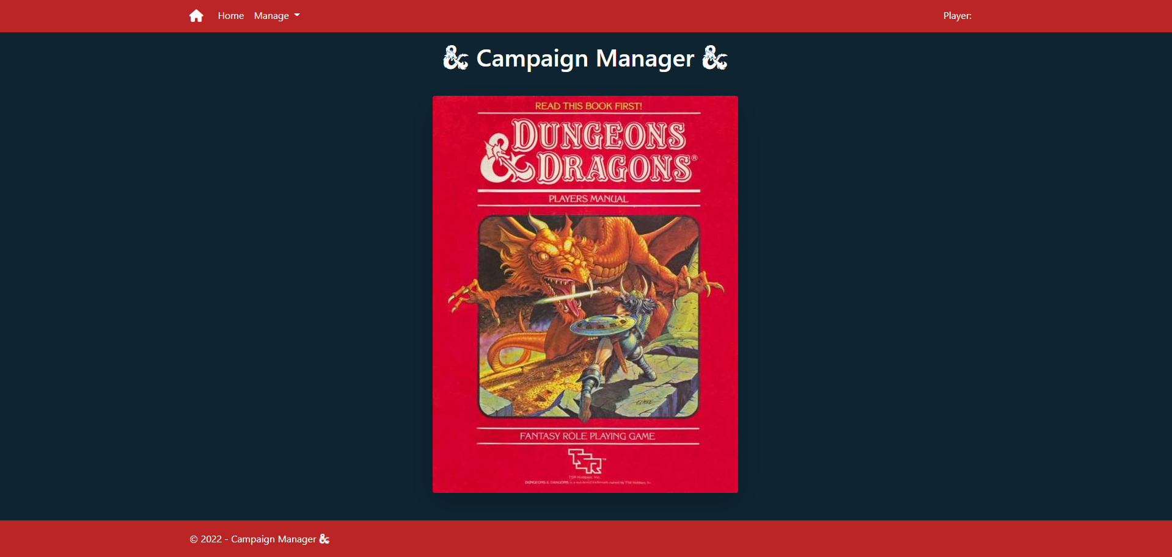
Angular index

Slide 5
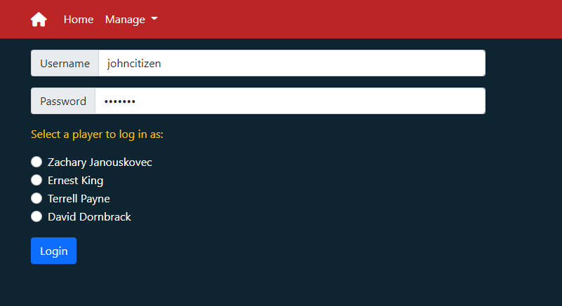

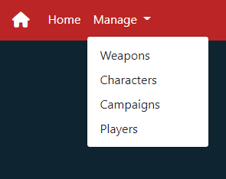
login
Notes:
With the login page we provided the option to select the player you are logging in as
Once you login you are provided the ability to logout from any of the Angular pages
The option to login is removed from view on the menu Manage since the user is already logged in

Slide 6
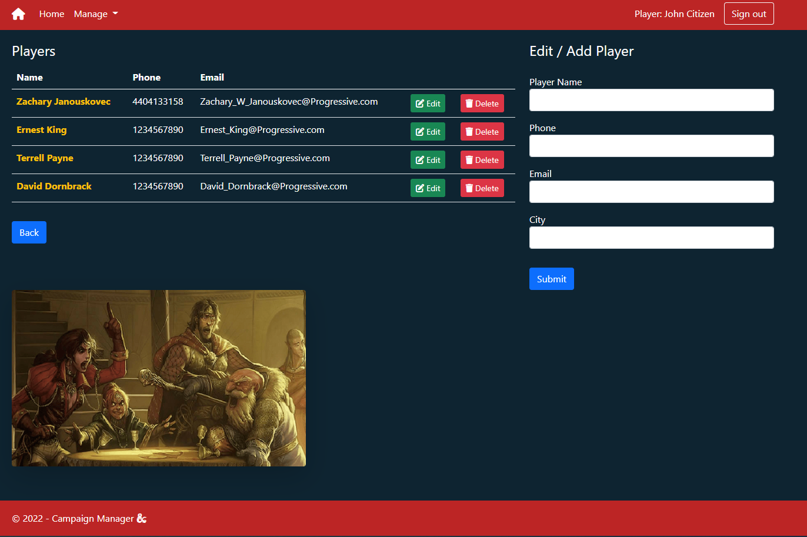
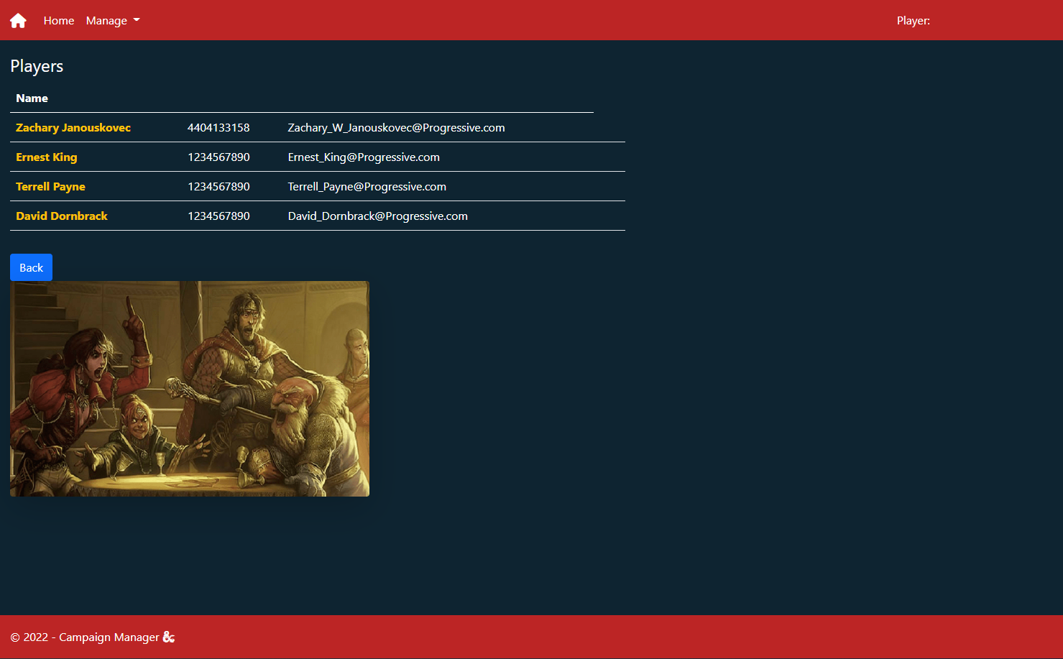
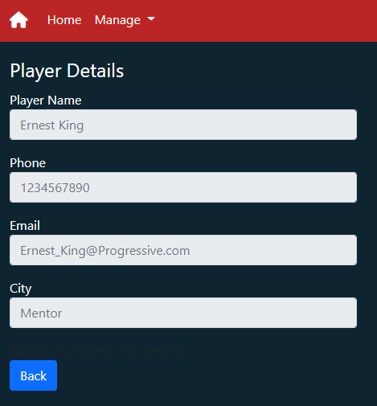
Players page
Notes:
On the players page we provide the form to create a new player, the options to delete, and edit a player
If signed out, then the player list will show
You can click into the details of a player by selecting their name

Slide 7
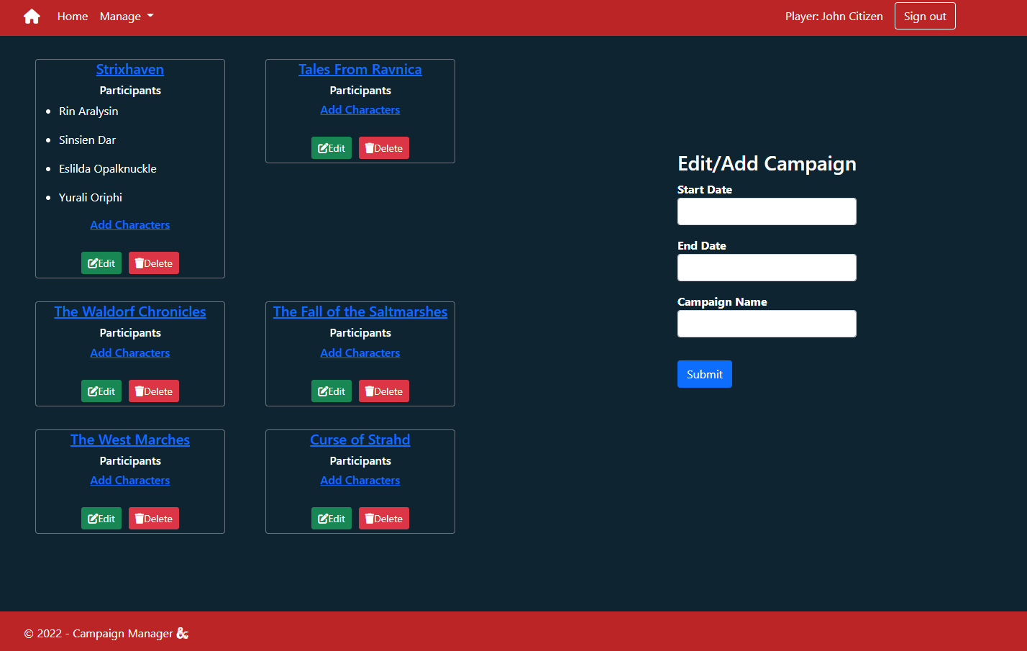
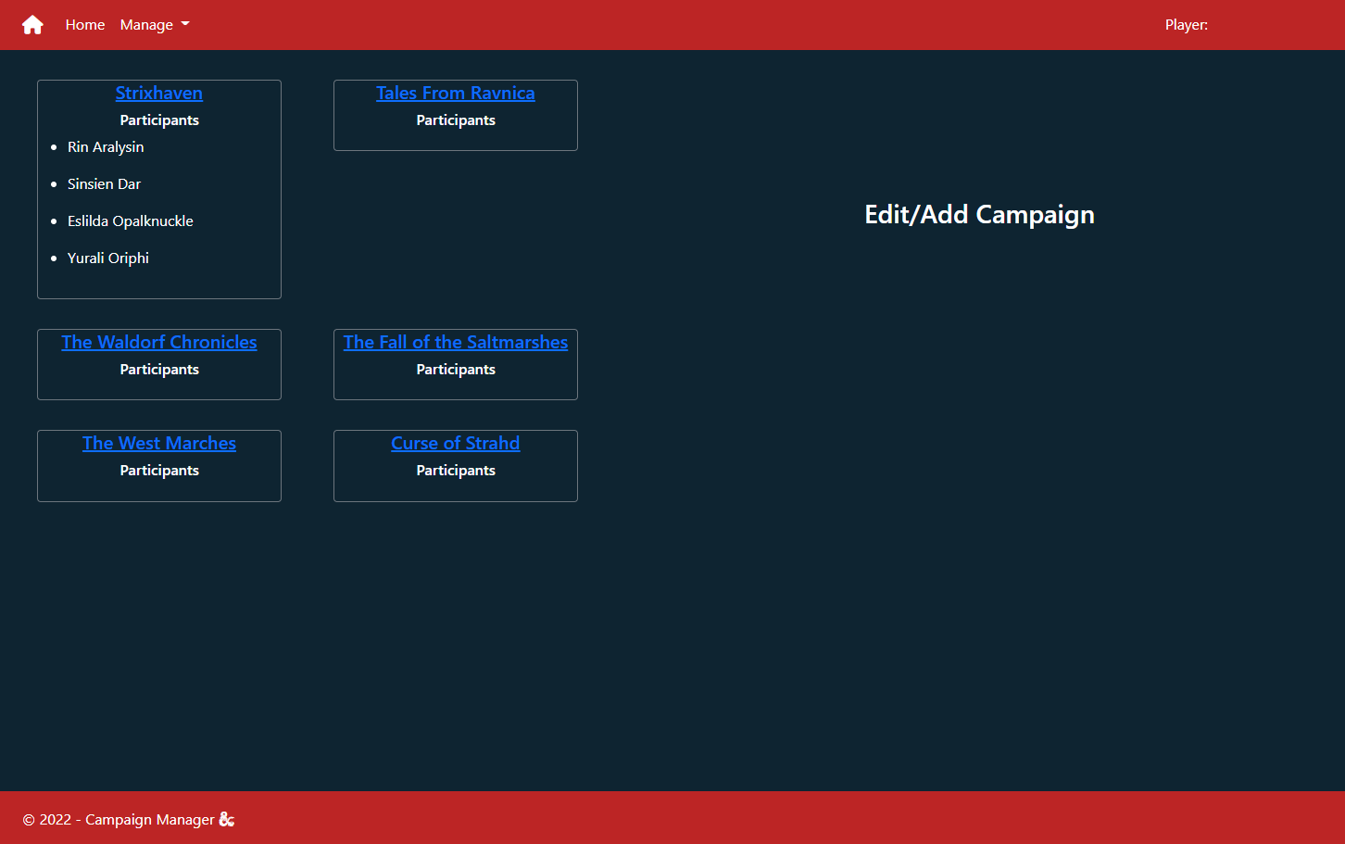
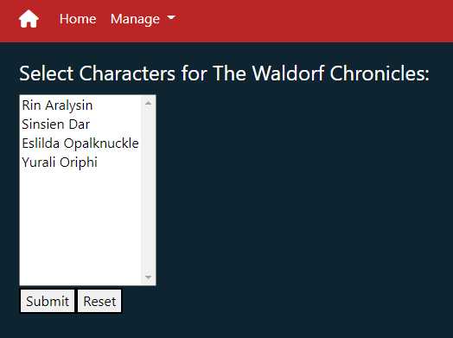
Campaign page

Slide 8
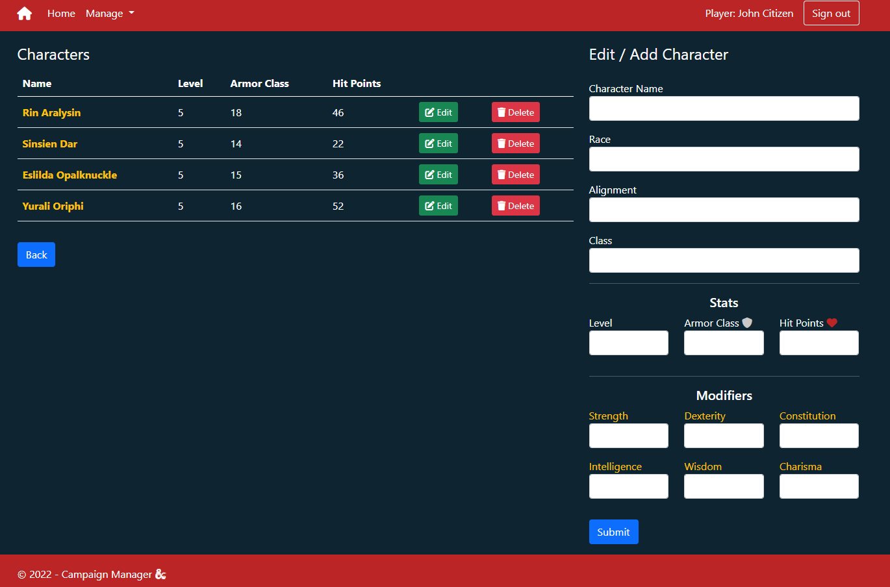
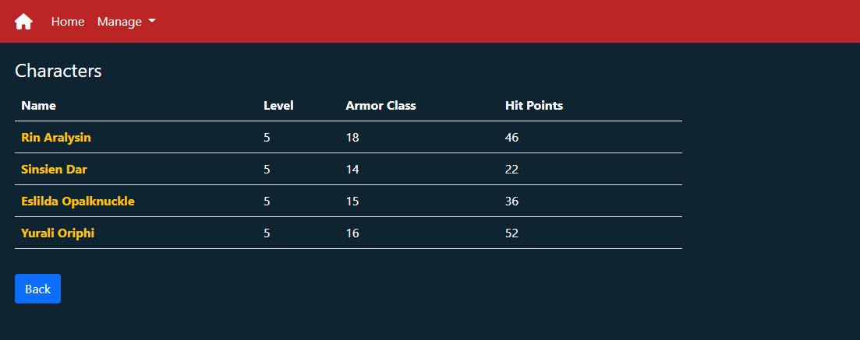
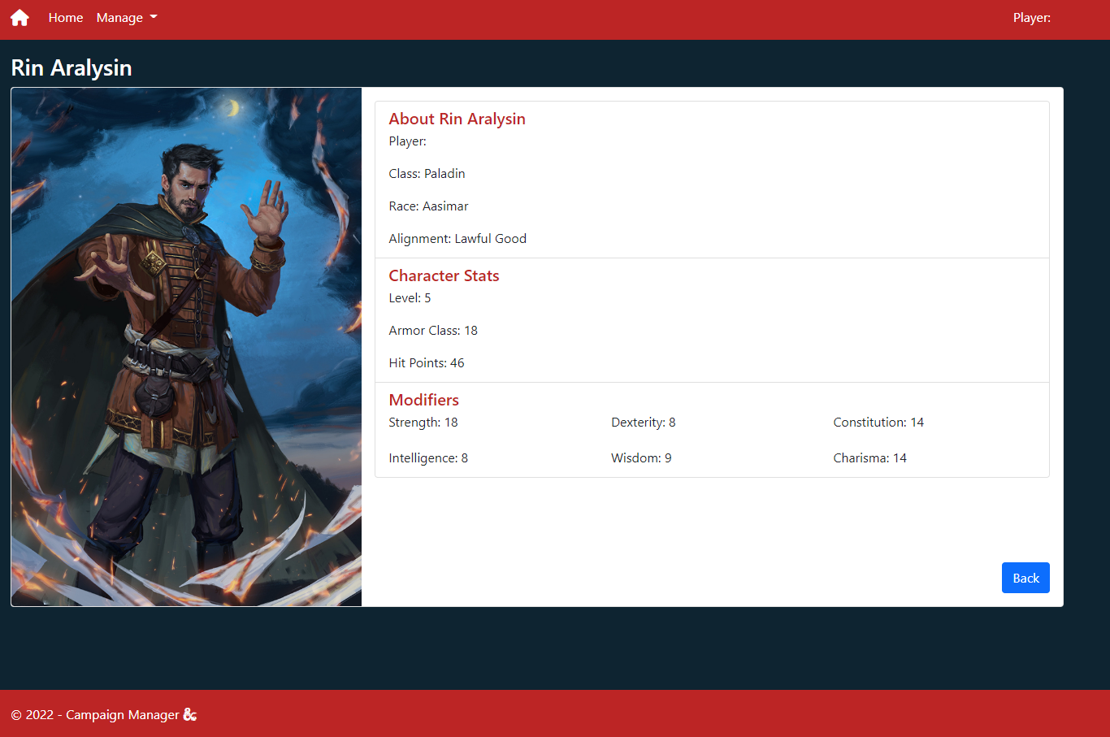
Character page

Slide 9
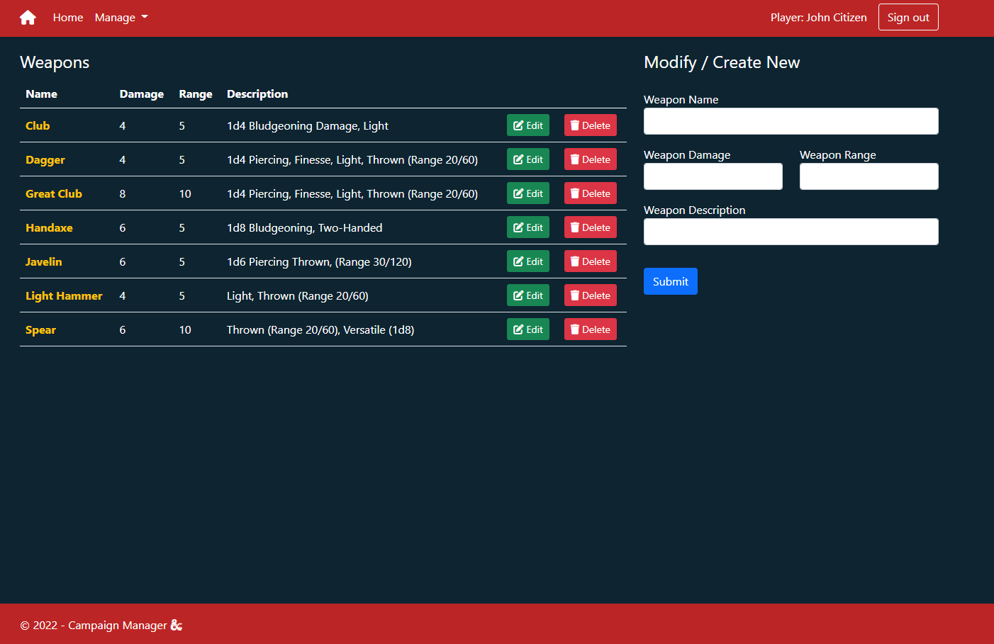
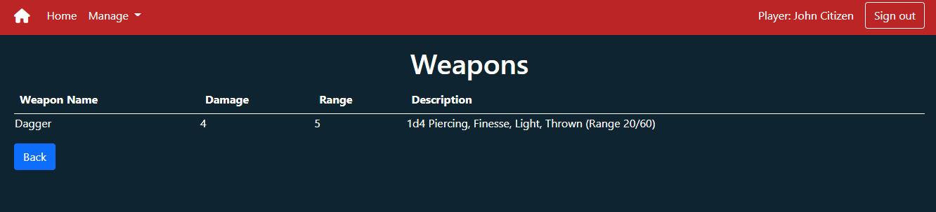
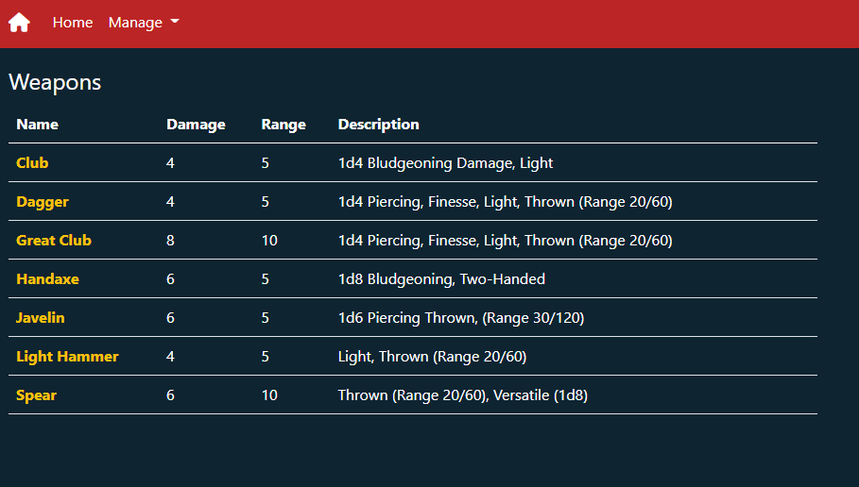
Weapon page
Notes:
We built the weapon page to allow for quick view of the various weapons added to the database
If logged in the ability to create a new weapon, edit a weapon or delete a weapon are easily available

Slide 10
Additional Stuff Added Not Taught in Class:
EF Update method: _context.Entry(ObjectToUpdate).CurrentValues.SetValues(UpdatedObject);
SQL: PwdEncrypt(), PWDCOMPARE()

