Slide 1
FRE LABS
The Art of the Possible
March 2026

Slide 2
THE STRATEGIC UNLOCK

Slide 3
PERMISSION TO MOVE FAST
• Net new flavor development through FDA requires 18+ months and significant capital
• FRE LABS creates a parallel track: license, white-label, and test without touching the regulatory pipeline
• New flavors, new packaging, new product experiences — all under a sub-brand that absorbs creative risk
• If a LABS experiment works, graduate it to core FRE. If not, clean exit — zero brand dilution
• FRE LABS gives the brand permission to play offense
Source: Internal FRE brand strategy, March 2026

Slide 4
NEW TERRITORY, NEW CONSUMERS
• Core FRE owns mint, wintergreen, and high-strength — the performance consumer
• LABS opens flavor-forward territory: fruit, citrus, dessert, coffee
• Lower strength options (3mg, 4mg) create entry points for consumers who self-select out of core FRE
• Expands the addressable market without repositioning the master brand
• Different flavors attract different segments — a wider net for the FRE ecosystem

Slide 5
THE CREATIVE SANDBOX
• New packaging concepts and limited-edition design language
• Collab cans with athletes, artists, brands — 500–1,000 unit runs
• Visual experimentation that would be too risky under core FRE
• Test concepts in market before committing to full production
• The sub-brand is the buffer — LABS absorbs all experimentation risk

Slide 6
PROOF OF CONCEPT
THREE COMPANIES. THREE PROVEN MECHANICS.

Slide 7
THE PLAYBOOK ALREADY EXISTS
JONES SODA
LIQUID DEATH
RED BULL EDITIONS
• Community-submitted labels and flavor voting
• Consumers owned the brand — the vote was the marketing
• Mystery flavors drove repeat purchase and social sharing
• Cult following in a commodity category with near-zero ad spend
• Lifestyle brand in the most commodity category (water)
• Artist collabs — every drop is a content event
• Irreverent limited editions create FOMO and earned media
• The can IS the ad — design replaced their media budget
• Sub-brand attracts non-Red Bull consumers
• Doesn't compete with parent — fishes in different ponds
• Graduates new users to core SKU over time
• Editions absorb experimentation risk for the master brand

Slide 8
WHAT'S ALREADY REAL
THIS ISN'T THEORETICAL.

Slide 9
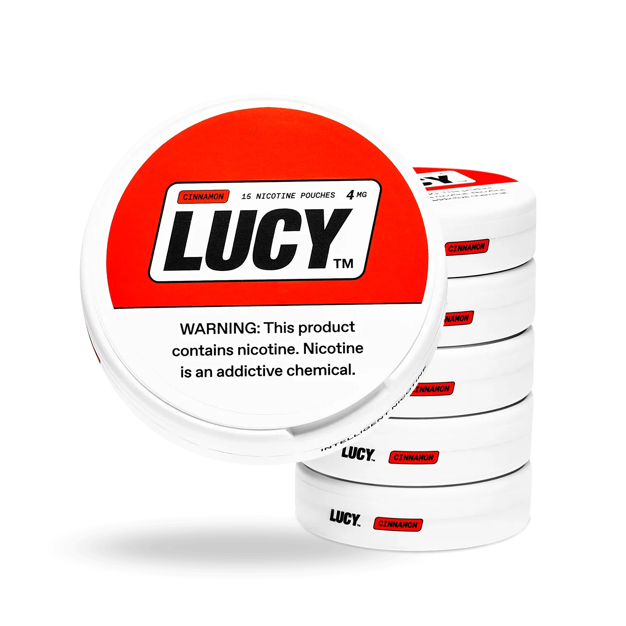
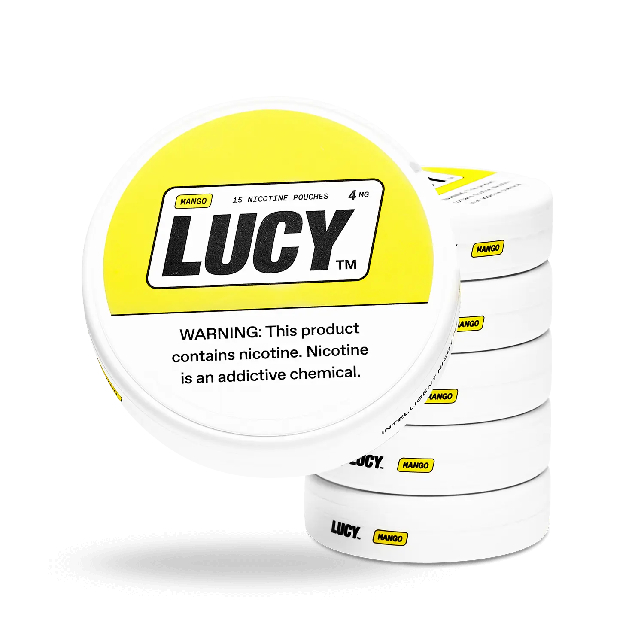
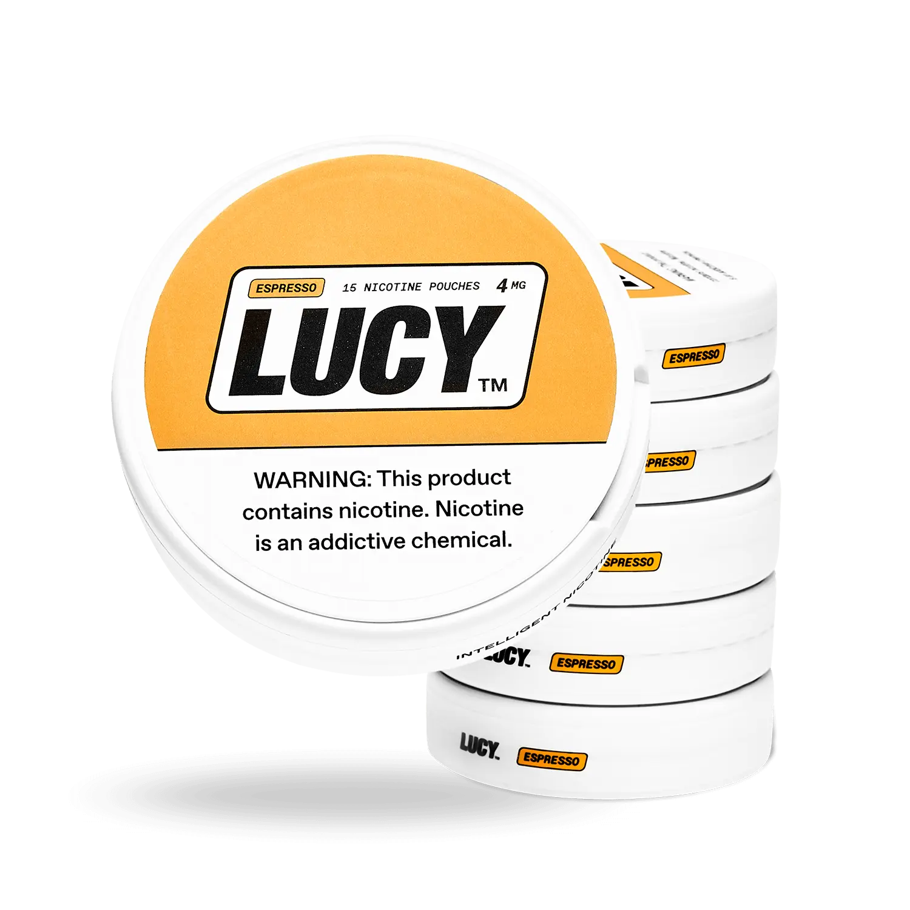
LUCY PARTNERSHIP — LOCKED
• White-label agreement with Lucy — a quality DTC nicotine pouch brand
• 3 flavors: Cinnamon, Mango, Espresso
• 2 strengths: 4mg and 8mg — 6 new SKUs ready to sell
• Online-only distribution under FRE Flavor Labs branding
• Quality product from a brand we believe in
Lucy Nicotine Pouches — partnership secured

Slide 10
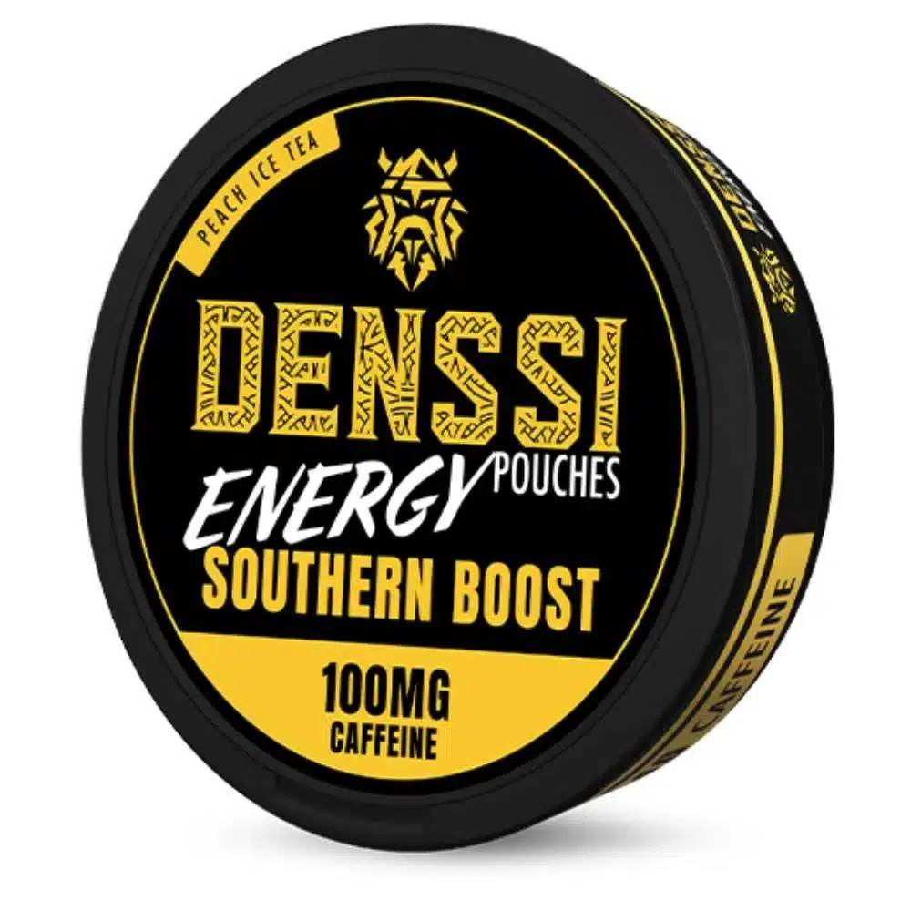
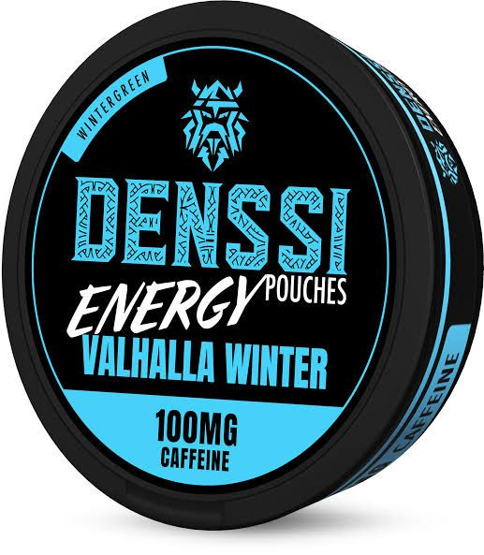
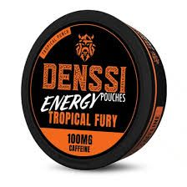
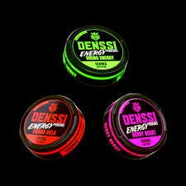
CAFFEINE POUCHES — WIDE OPEN
• DENISSI partnership opens a standalone caffeine pouch category
• European manufacturer with Dallas TX operations
• Competitive landscape mapped: Grinds is the benchmark (9K+/mo Amazon)
• TeaZa has brand recognition but limited retail distribution
• Nobody with real retail muscle has executed well in this space
• Massive whitespace for a well-resourced entrant
DENISSI Energy Pouches — partnership secured

Slide 11
THE GROWTH ENGINE
WHERE WE WANT YOUR THINKING.

Slide 12
STARTER SPARKS
CONSUMER ENGAGEMENT
GROWTH LEVERS
• Flavor voting — zero-cost market research that markets itself
• Custom packaging / co-creation — ownership drives loyalty
• Mystery drops — repeat purchase + social sharing mechanics
• QR-first can design — first-party data capture on every unit
• Early access tiers — scarcity creates status
• Every LABS can is a consumer acquisition tool
• QR scan = data point = funnel entry
• Versioning creates an always-on content calendar
• Collab partnerships generate earned media
• FRE Rewards integration locks in lifetime value

Slide 13
WHAT WOULD YOU BUILD?
The platform exists. The permissions are real. The product is ready.

