Slide 1
Specialty Treatment Analysis
Thomas P. Brennan
Data Engineering Manager, AthenaResearch
July 21, 2014
Notes:
AUDIENCE FOR THIS:
Bull’s Eye is 4-10 Doctors (Core Pitch will be expanded, adapted to other audiences)
Assuming that in the audience that there will be a Physician/Owner and Practice Manager.
They are in Market for EHR and Practice Management System.
Financially, they are doing so-so.. Not a Train Wreck, but room for improvement.
In the meeting, we will introduce them to athena with the PITCH deck, then demonstrate how athena works with the demo. Their time is limited… like most prospects, a little bit wary.
We want to show them that:
We “get” what practices are facing
We are different—Network Based
Our unique model can deliver better results (More Money, More Time, More Control). After the pitch, they will see a demo.

Slide 2
Overview
Understand trends in FDA drug approvals
Traditional vs. Specialty Therapies
Top 10 Specialty Therapies

Slide 3
Specialty Therapies
Specialty drug is not a therapeutic class or an official designation of the FDA. Rather, the term describes some of the latest therapies. These drugs include drugs for rare diseases and large-molecule biologics made from proteins (essentially derived from organic substances or living organisms).
Traditional pharmacy spending grew 2.75 % from 2008 to 2011
Specialty drug therapies averaged 7.5% growth annually over the same period
In 2011, oncology drugs made up about one-third of the total spending on specialty pharmaceuticals, accounting for $30.6 billion

Slide 4
Current FDA Drugs Approvals
499 in 2013
1.5 %
12-month
Δ Q1 & Q2
Forecast 300
approvals
Q3 & Q4 ‘14
http://www.accessdata.fda.gov

Slide 5
Specialty Therapies Market Share

Slide 6
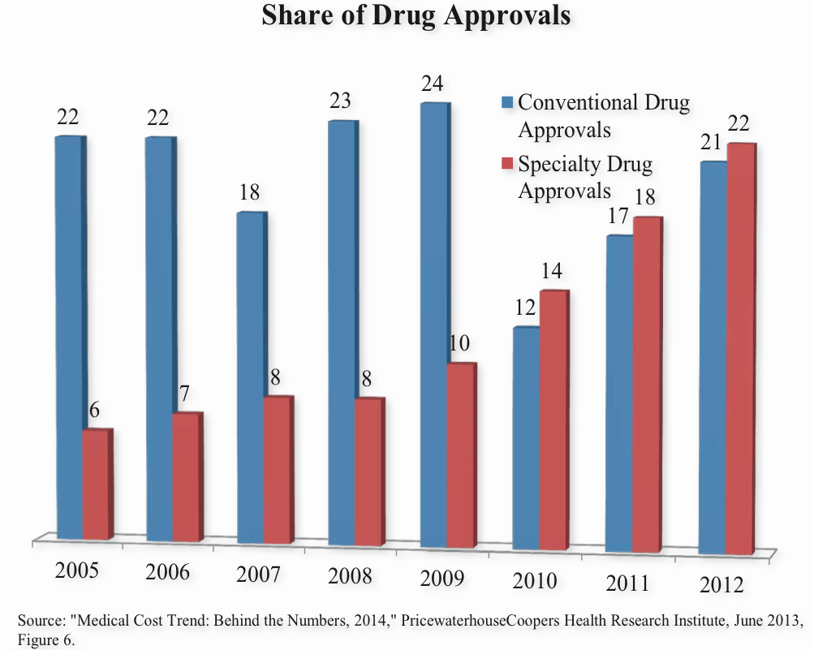
Share of FDA Drug Approvals

Slide 7
Average Specialty Drug Claim
Condition | 2012 | 2013 | Growth
Multiple Sclerosis | 3,583 | 4,137 | 15%
Cancer | 3,682 | 4,023 | 9%
Pulmonary Hypertension | 3,748 | 3,859 | 3%
Respiratory Conditions | 3,344 | 3,759 | 12%
Growth Deficiency | 3,146 | 3,540 | 13%
Inflammatory Conditions | 2,212 | 2,551 | 15%
HIV | 947 | 1,029 | 9%
Anticoagulants | 985 | 957 | -3%
Transplant | 286 | 292 | 2%
Source: Express Scripts Drug Trends Report, 2012 and 2013.

Slide 8
Top 10 Specialist Therapies – by Cost
Drug | Company | Cost (p.a.)
Soliris | Alexion | 409,500
Elaprase | Shire | 375,000
Naglazyme | Bbiomarin | 365,000
Cinryze | ViroPharma | 350,000
Folotyn | Allos Therapeutics | 360,000
Myozyme | Sanofi | 300,000
ACTH | Questcor | 300,000
Arcalyst | Regeneron | 250,000
Cerezyme | Genzyme/Sanofi | 200,000
Fabrazyme | Genzyme/Sanofi | 200,000

Slide 9
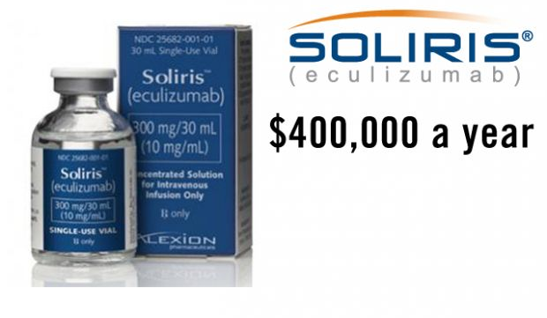
No. 1
Treat paroxysmal nocturnal hemoglobinuria, a rare disorder that causes the breakdown of red blood cells and release of hemoglobin into the urine
Prevalence one to five per one million
Made by Alexion Pharmaceuticals
Approved by FDA in 2007
http://www.takepart.com/photos/most-expensive-prescription-drugs-us

Slide 10
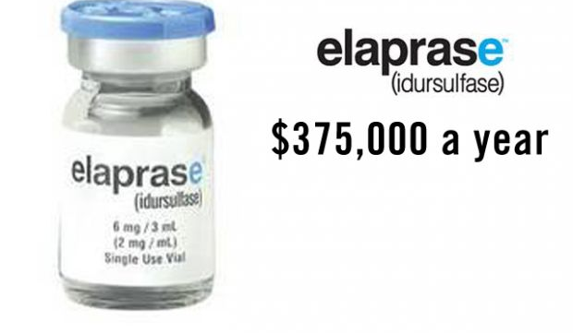
No. 2
Treats an inherited condition called Hunter syndrome, a metabolic disorder in which a key enzyme that breaks down complex sugars is missing or malfunctions.
Prevalence about one in 150,000 people, almost always males.
Elaprase is an injected medication that replaces the missing enzyme.
Manufactured by Shire.
Approved by FDA in 2006

Slide 11
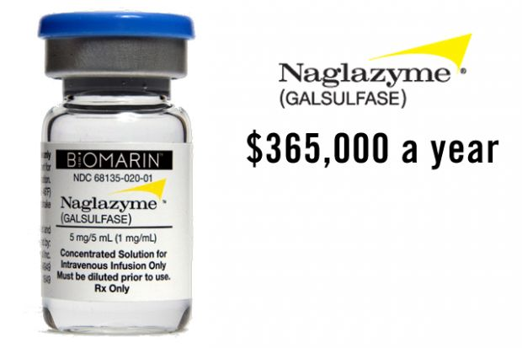
No. 3
This medication is for a rare connective tissue disorder called Maroteaux-Lamy syndrome, which is caused by a deficient enzyme that breaks down large sugar molecules called glycosaminoglycans.
Prevalence one of every 200,000 to 600,000
Naglazyme is made by Biomarin
FDA approved in 2005.

Slide 12
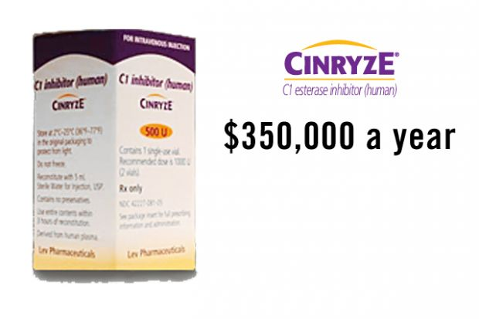
No. 4
Cinryze is used to treat hereditary angioedema, a rare genetic condition that runs in some families and causes life-threatening and painful swelling of the hands, feet, face, genitals, abdomen and throat.
Prevalence one in 10,000 to 50,000 people.
Cinryze is manufactured by ViroPharma
Intravenous medication made from human blood
FDA approved in 2008

Slide 13
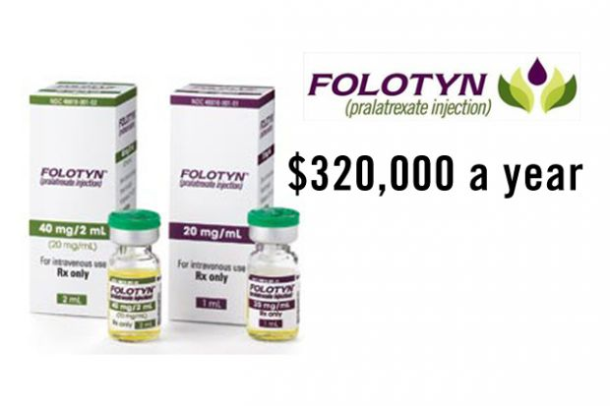
No. 5
This medication is used to treat an aggressive type of cancer of the lymph system, peripheral T-cell lymphoma, which has spread throughout the body
T-cell lymphoma is rare, affecting about one to two people per 100,000.
Folotyn is made by Allos Therapeutics
FDA approved in 2009
The drug, an injection, is thought to kill cancer cells; however studies so far have not shown that it prolongs survival.

Slide 14
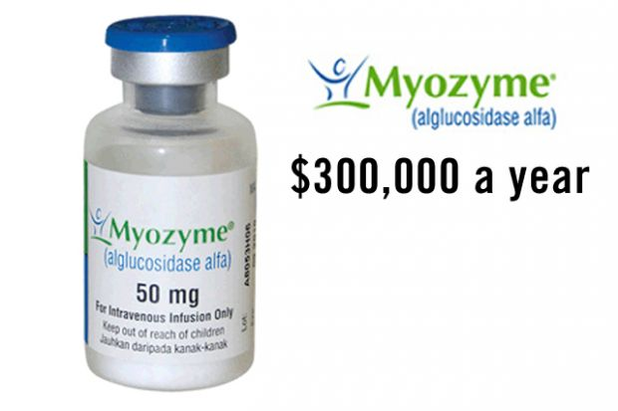
No.6
Treat people with Pompe disease, a rare disorder in which a missing enzyme called acid alpha-glucosidase leads to a build-up of glycogen (a type of sugar) in the blood and eventual deterioration of the heart and skeletal muscles.
Prevalence one in 40,000 newborns.
Made by Sanofi
FDA approved in 2006

Slide 15
Top 20 Specialty Therapies – by sales
Product | Sales ($B) | Indication | 2011 Rank | 2010 Rank
Humira | 3.52 | Rheumatoid arthritis, Crohn's disease | 1 | 6
Enbrel | 3.51 | Rheumatoid arthritis | 2 | 3
Remicade | 3.47 | Rheumatoid arthritis, Crohn's disease | 3 | 2
Neulasta | 3.32 | Oncology | 4 | 5
Rituxan | 3.00 | Rheumatoid arthritis, Oncology | 5 | 7
Copaxone | 2.96 | Multiple sclerosis | 6 | 10
Epogen | 2.77 | Anemia | 7 | 1
Avastin | 2.66 | Oncology | 8 | 4
Atipla | 2.57 | HIV/AIDS | 9 | 8
Truvada | 1.92 | HIV/AIDS | 10 | 11
Revlimid | 1.83 | Oncology | 11 | 17
Lucentis | 1.75 | Macular degenration | 12 | 12
Herceptin | 1.66 | Oncology | 13 | 13
Avonex | 1.56 | Multiple sclerosis | 14 | 15
Gleevex | 1.51 | Oncology | 15 | 18
Enoxaparin | 1.36 | Anti-coagulation | 16 | NM
Procrit | 1.21 | Oncology | 17 | 14
Eloxatin | 1.30 | Oncology | 18 | NM
Lovenox | 1.06 | Anti-coagulation | 19 | 16
Rebif | 1.06 | Multiple sclerosis | 20 | 9

Slide 16
Summary
Significant increase in market share of Specialty Drugs, both in terms of FDA approvals and claims
Stocking and dispensing specialty drugs requires specialist handling
Specialty therapies target rare diseases
Largest therapy growth is seen in inflammatory conditions and multiple sclerosis
Express Scripts report that Specialty Drugs will be up by 67% by 2015, with cancer drugs alone expected to grow by 77%
Hepatitus C spending will grow by 458% by 2015, led by Gilead’s Sovaldi ($84,000 for treatment, $1,000 per pill)

Slide 17
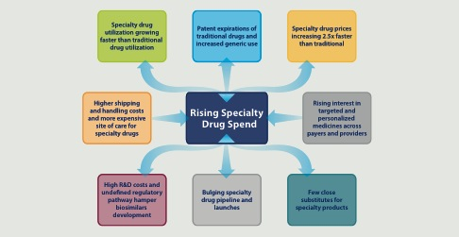
Market Drivers
http://www.imshealth.com/deployedfiles/imshealth/…/5-29-14%20Specialty_Drug_Trend_Whitepaper_Hi-Res.pdf

Slide 18
Questions

