Slide 1
A Distributed Tensor-based Approach for Multidimensional Dictionary Learning
UnB

Slide 2
Problem Statement
Dictionary learning algorithms are able to estimate the basis vectors from a set of training samples
In some applications the dictionary is multidimensional, but traditional methods (MOD and K-SVD) presents poor detection rate for multidimensional analysis
Tensor-based methods (K-HOSVD and T-MOD) can provide better results, but requires more processing time
A Distributed Tensor-based Approach for Multidimensional Dictionary Learning can provide better detection rate over less processing time

Slide 3
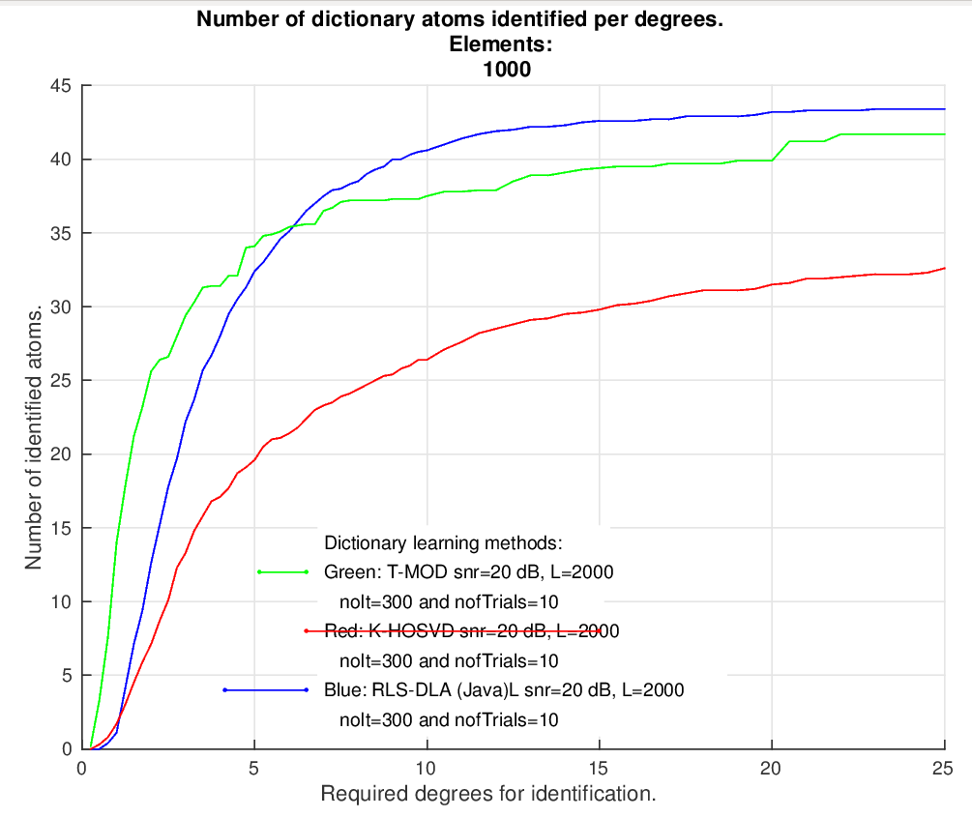
Problem Statement Results

Slide 4
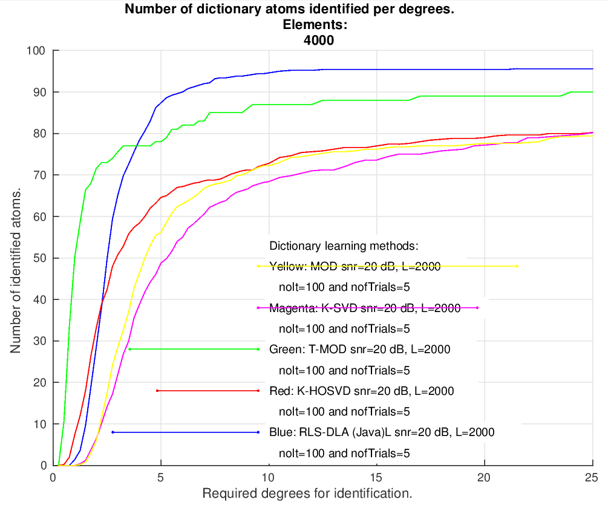
Problem Statement Results

Slide 5
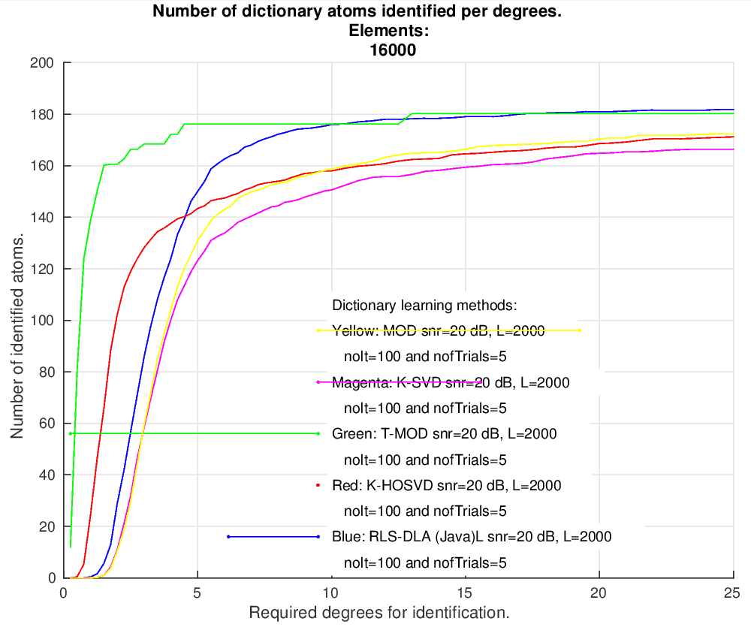
Problem Statement Results

Slide 6
Problem Statement Results
 | Detection Rate
 | 50 atoms of 1000 elements matrix | 100 atoms of 4000 elements matrix | 200 atoms of 16000 elements matrix
RLS-DLA | 70.40% | 93.40% | 86.20%
K-HOSVD | 41.60% | 70.00% | 77.00%
T-MOD | 75.60% | 85.00% | 91.20%

Slide 7
Results
 | Processing Time (seconds)
Matrix Size | 1000 | 4000 | 16000
RLS-DLA | 3.6605 | 10.9183 | 38.0891
K-HOSVD | 16.1826 | 22.5277 | 43.6200
T-MOD | 147.4050 | 271.1198 | 390.9708

Slide 8
Next Steps
Distributed implementation of T-MOD according to Distributed Large-Scale Tensor Decomposition - ICASSP – 2014
Experiments to measure the processing time and detection rate
Write the paper
The deadline is 05/03

