Slide 1



Comparison of Model Order Selection Techniques for High-Resolution Parameter Estimation Algorithms
João Paulo C. L. da Costa, Arpita Thakre,
Florian Roemer, and Martin Haardt
Ilmenau University of Technology
Communications Research Laboratory
P.O. Box 10 05 65
D-98684 Ilmenau, Germany
E-Mail: haardt@ieee.org
Homepage: http://www.tu-ilmenau.de/crl

Slide 2
Motivation
The model order selection (MOS) problem is encountered in a variety of signal processing applications
  including radar, sonar, communications, channel modeling,
  medical imaging, and
  the estimation of the parameters of the dominant multipath components from MIMO channel measurements.
Not only for signal processing applications, but also in several science fields, e.g., chemistry, food industry, stock markets, pharmacy and psychometrics, the MOS problem is investigated.
A large number of model order selection (MOS) schemes have been proposed in the literature. However,
  most of the proposed MOS schemes are compared only to Akaike’s Information Criterion (AIC) [1] and Minimum Description Length (MDL) [1];
  the Probability of correct Detection (PoD) of these schemes is a function of the array size (number of snapshots and number of sensors).
[1]: M. Wax and T. Kailath “Detection of signals by information theoretic criteria”, in IEEE Trans. on Acoustics, Speech, and Signal Processing, vol. ASSP-33, pp. 387-392, 1974.

Slide 3
Motivation
Our first contribution in this work
  Comparison of the state-of-the-art MOS schemes based on the PoD. We consider different array sizes and the noise is assumed Zero Mean Circularly Symmetric (ZMCS) white Gaussian
Since real-valued noise is encountered in sound applications, our second contribution is
  extension of our Modified Exponential Fitting Test (M-EFT) [2] for the case of real-valued Gaussian noise;
Usual in multidimensional problems, the number of sensors may be greater than the number of snapshots. Therefore, our third contribution is
  expressions for our 1-D AIC [2] and 1-D MDL [2].
[2]: J. P. C. L. da Costa, M. Haardt, F. Roemer, and G. Del Galdo, “Enhanced model order estimation using higher-order arrays”, in Proc. 40th Asilomar Conf. on Signals, Systems, and Computers, Pacific Grove, CA, USA, Nov. 2007.

Slide 4

Outline
Data Model
Analysis of the Noise Eigenvalues Profile
Review of the State of the Art of the Model Order Selection (MOS)
  Exponential Fitting Test (EFT)
  Modified EFT (M-EFT)
1-D AIC and 1-D MDL
M-EFT II
Simulations
Conclusions

Slide 5
Outline
Data Model
Analysis of the Noise Eigenvalues Profile
Review of the State of the Art of the Model Order Selection (MOS)
  Exponential Fitting Test (EFT)
  Modified EFT (M-EFT)
1-D AIC and 1-D MDL
M-EFT II
Simulations
Conclusions

Slide 6
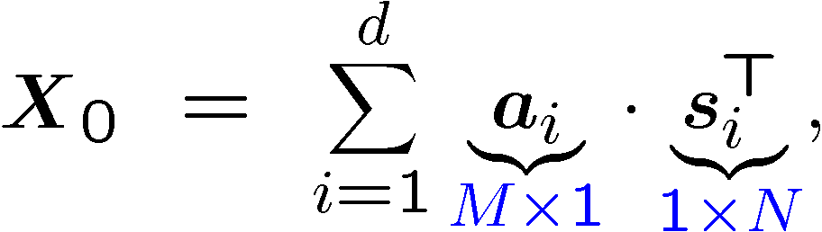

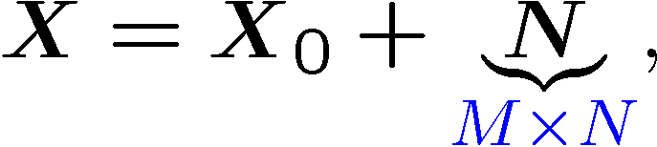


Data model
Noiseless case
Matrix data model
Our objective is to estimate d from the noisy observations .

Slide 7
Outline
Data Model
Analysis of the Noise Eigenvalues Profile
Review of the State of the Art of the Model Order Selection (MOS)
  Exponential Fitting Test (EFT)
  Modified EFT (M-EFT)
1-D AIC and 1-D MDL
M-EFT II
Simulations
Conclusions

Slide 8
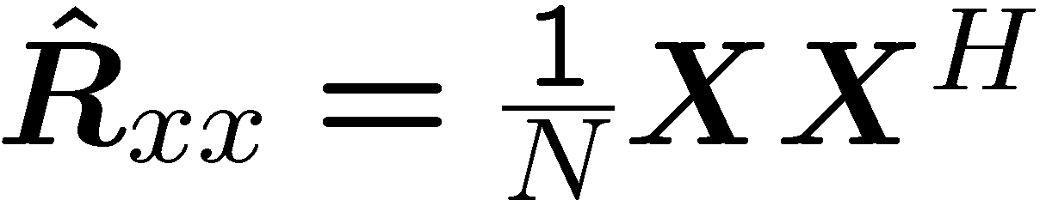
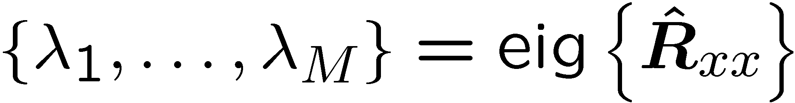
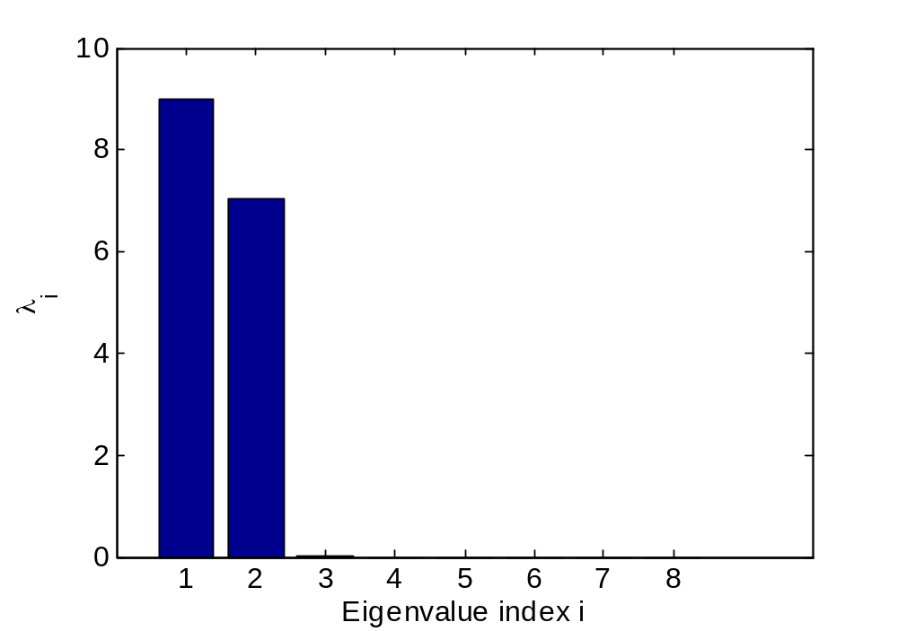
Analysis of the Noise Eigenvalues Profile
The eigenvalues of the sample covariance matrix
d = 2, M = 8
SNR → 1, N → 1
  M - d zero eigenvalues
  d nonzero signal eigenvalues

Slide 9
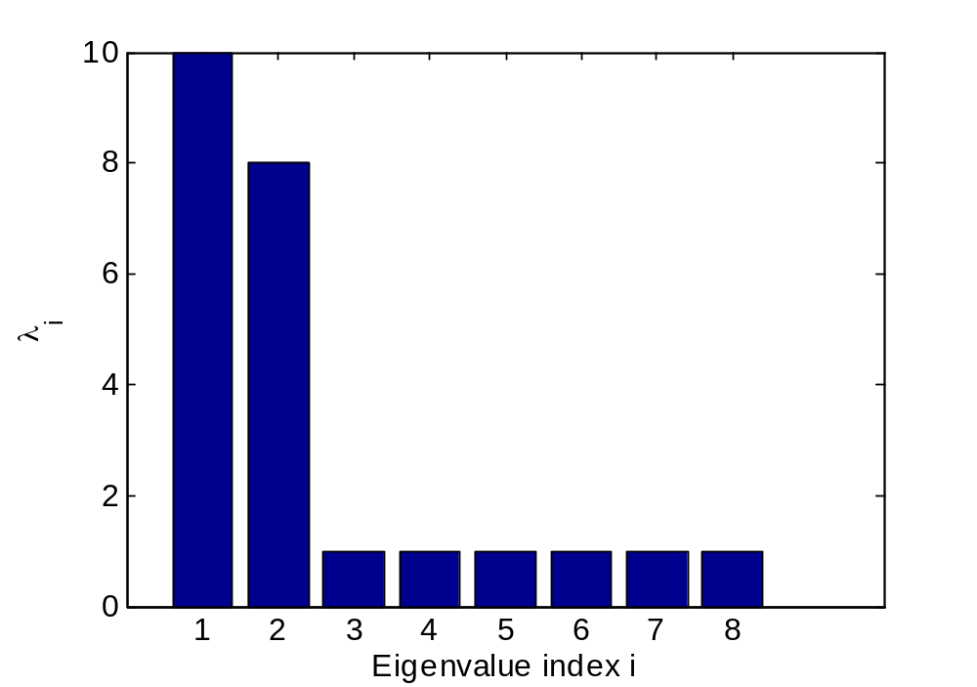
Analysis of the Noise Eigenvalues Profile
The eigenvalues of the sample covariance matrix
d = 2, M = 8, SNR = 0 dB
Finite SNR, N → 1
  M - d equal noise eigenvalues
  d signal plus noise eigenvalues
  Asymptotic theory of the noise [3]
This is the assumption in AIC, MDL
[3]: T. W. Anderson, “Asymptotic theory for principal component analysis”, Annals of Mathematical Statistics, vol. 34, no. 1, pp. 122-148, 1963.

Slide 10
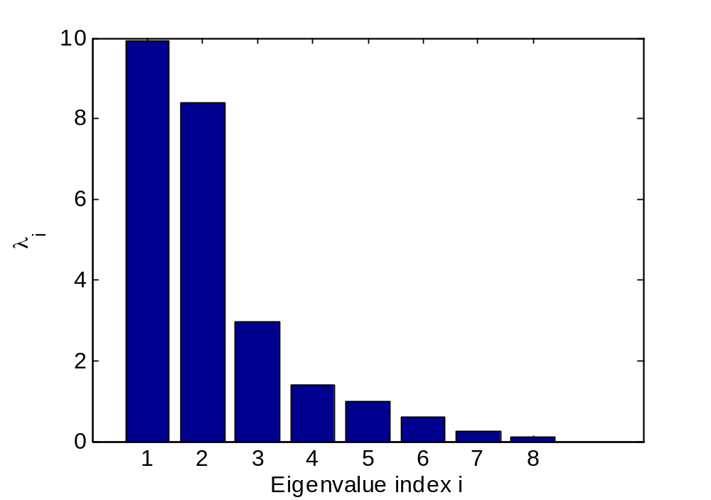
Analysis of the Noise Eigenvalues Profile
The eigenvalues of the sample covariance matrix
d = 2, M = 8, SNR = 0 dB, N = 10
Finite SNR, Finite N
  M - d noise eigenvalues follow a
  Wishart distribution.
  d signal plus noise eigenvalues

Slide 11
Outline
Data Model
Analysis of the Noise Eigenvalues Profile
Review of the State of the Art of the Model Order Selection (MOS)
  Exponential Fitting Test (EFT)
  Modified EFT (M-EFT)
1-D AIC and 1-D MDL
M-EFT II
Simulations
Conclusions

Slide 12
Review of the State of the Art of the MOS
MOS approach | Classification | Scenario | Gaussian Noise | outperforms
EDC [4] 1986 | Eigenvalue based | - | White | AIC, MDL
ESTER [5] 2004 | Subspace based | M = 128; N = 128 | White/Colored | EDC, AIC, MDL
RADOI [6] 2004 | Eigenvalue based | M = 4; N = 16 | White/Colored | Greschgörin Disk Estimator (GDE), AIC, MDL
EFT [7,8] 2007 | Eigenvalue based | M = 5; N = 6 | White | AIC, MDL, MDLB, PDL
SAMOS [9] 2007 | Subspace based | M = 65; N = 65 | White/Colored | ESTER
NEMO [10] 2008 | Eigenvalue based | N = 8*M (various) | White | AIC, MDL
SURE [11] 2008 | Eigenvalue based | M = 64; N = [96,128] | White | Laplace, BIC
- M > N?
Small values of N?
Comparisons in-between?
Notes:
The subspace based MOS schemes require that the matrix A has Vandermonde structure.

Slide 13
Review of the State of the Art of the MOS
[4]: P. R. Krishnaiah, L. C. Zhao, and Z. D. Bai, “On detection of the number of signals in presence of white noise”, Journal of Multivariate Analysis, vol. 20, pp. 1-25, 1986.
[5]: R. Badeau, B. David, and G. Richard, “Selecting the modeling order for the ESPRIT high resolution method: an alternative approach”, in Proc. IEEE International Conference on Acoustics, Speech, and Signal Processing (ICASSP 2004), Montreal, Canada, May 2004.
[6]: E. Radoi and A. Quinquis, “A new method for estimating the number of harmonic components in noise with application in high resolution RADAR”, EURASIP Journal on App. Sig. Proc., pp. 1177-1188, 2004.
[7]: J. Grouffad, P. Larzabal, and H. Clergeot, “Some properties of ordered eigenvalues of a Wishart matrix: application in detection test and model order selection”, in Proc. IEEE Internation Conference on Acoustics, Speech, and Signal Processing (ICASSP 1996), May 1996, vol. 5, pp.2463-2466.
[8]: A. Quinlan, J.-P. Barbot, P. Larzabal, and M. Haardt, “Model Order selection for short data: An Exponential Fitting Test (EFT)”, EURASIP Journal on Applied Signal Processing, 2007, Special Issue on Advances in Subspace-based Techniques for Signal Processing and Communications.
[9]: J.-M. Papy, L. De Lathauwer, and S. Van Huffel, “A shift invariance-based order-selection technique for exponential data modeling”, IEEE Signal Processing Letters, vol. 14, pp. 473-476, July 2007.
[10]:R. R. Nadakuditi and A. Edelman, “Sample eigenvalue based detection of high-dimensional signals in white noise using relatively few samples”, IEEE Trans. of Sig. Proc., vol. 56, pp. 2625-2638, July 2008.
[11]:M. O. Ulfarsson and V. Solo, “Rank selection in noisy PCA with SURE and random matrix theory”, in Proc. International Conference on Acoustics, Speech, and Signal Processing (ICASSP 2008), Las Vegas, USA, Apr. 2008.

Slide 14
Outline
Data Model
Analysis of the Noise Eigenvalues Profile
Review of the State of the Art of the Model Order Selection (MOS)
  Exponential Fitting Test (EFT)
  Modified EFT (M-EFT)
1-D AIC and 1-D MDL
M-EFT II
Simulations
Conclusions

Slide 15
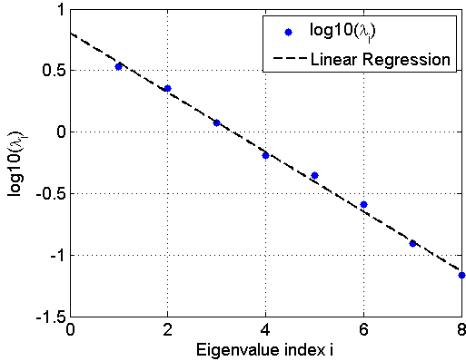
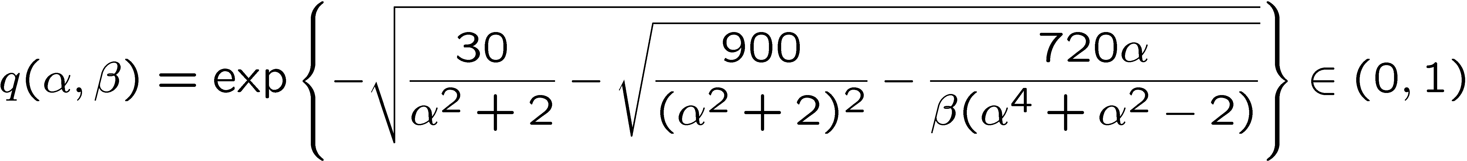
Exponential Fitting Test (EFT)
It was shown in [7,8], that in the noise-only case

Slide 16
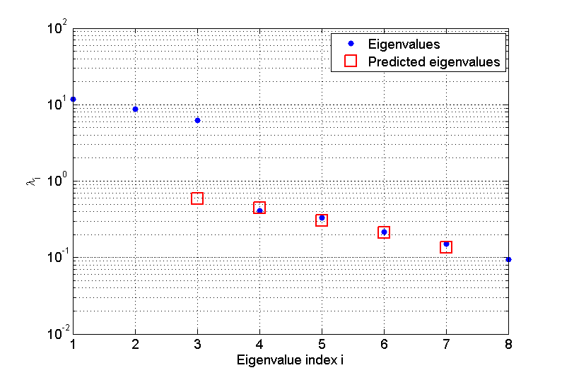
Exponential Fitting Test (EFT)
Observation is a superposition of noise and signal
  The noise eigenvalues still exhibit the exponential profile
  We can predict the profile
  of the noise eigenvalues
  to find the “breaking point”
  Let P denote the number of
  candidate noise eigenvalues.
    choose the largest P
    such that the P noise
    eigenvalues can be fitted
    with a decaying exponential
d = 3, M = 8, SNR = 20 dB, N = 10

Slide 17
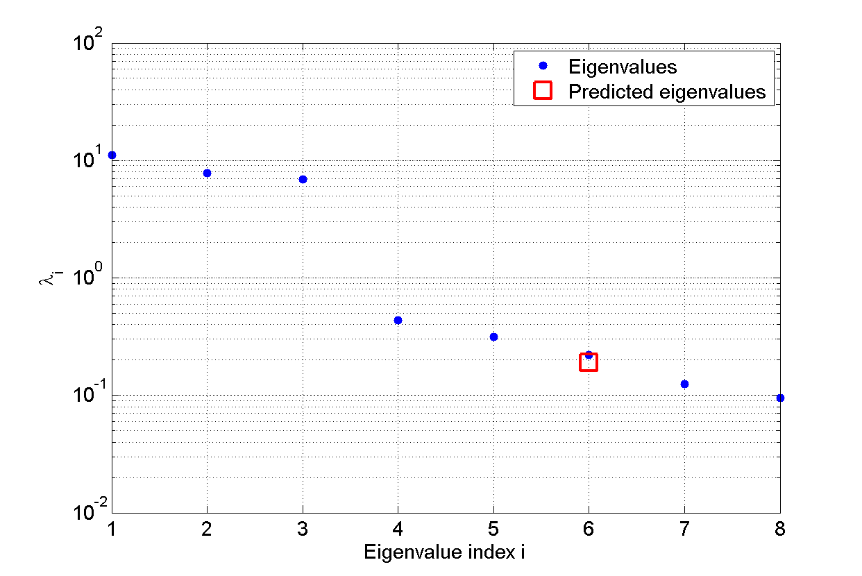
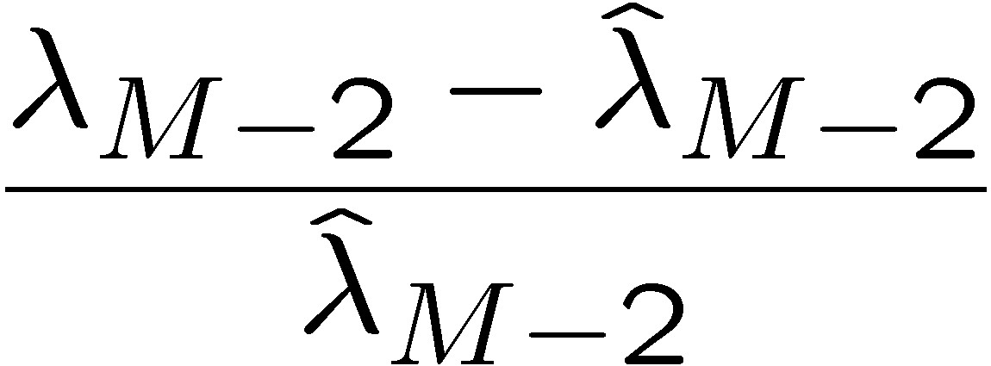
Exponential Fitting Test (EFT)
Finding the breaking point. For P = 2
  Predict λ_{M-2} based on
  λ_{M-1} and λ_{M}
  relative distance
d = 3, M = 8, SNR = 20 dB, N = 10

Slide 18
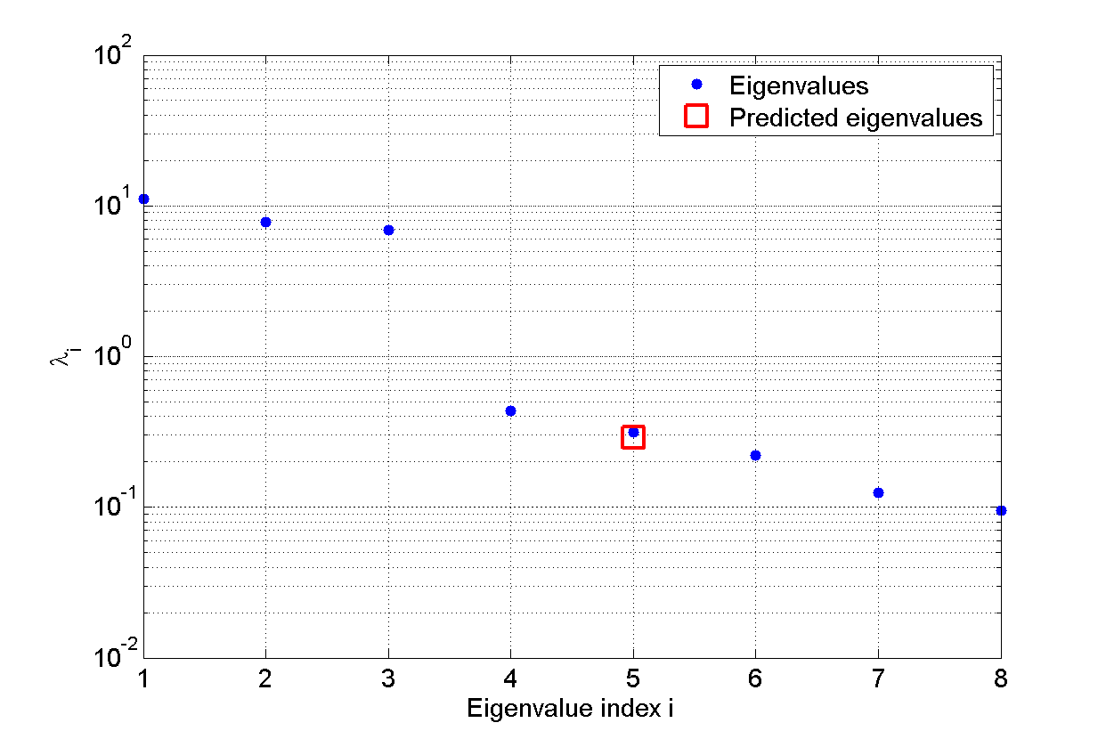
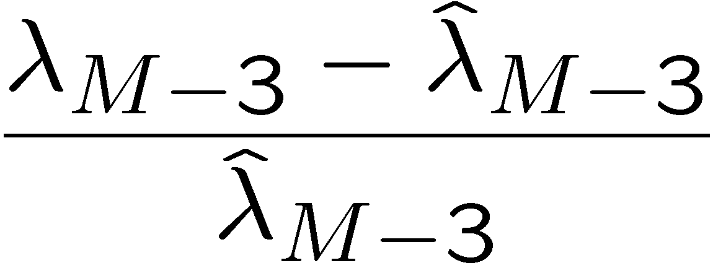
Exponential Fitting Test (EFT)
Finding the breaking point. For P = 3
  Predict λ_{M-3} based on
  λ_{M-2}, λ_{M-1}, and λ_{M}
  relative distance
d = 3, M = 8, SNR = 20 dB, N = 10

Slide 19
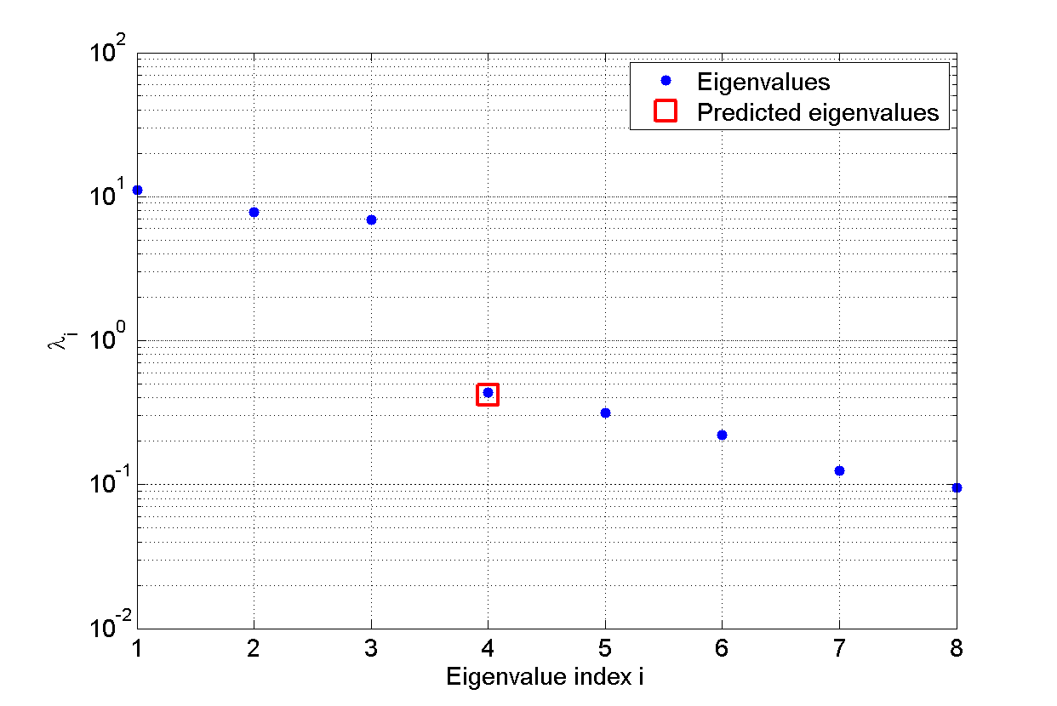
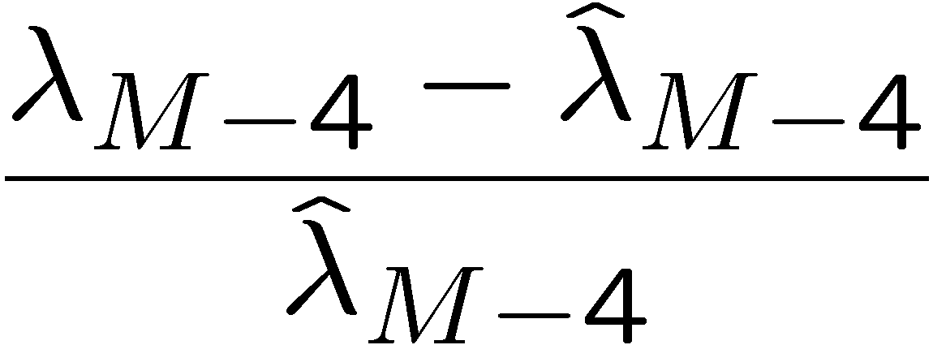
Exponential Fitting Test (EFT)
Finding the breaking point. For P = 4
  Predict λ_{M-4} based on
  λ_{M-3}, λ_{M-2}, λ_{M-1}, and λ_{M}
  relative distance
d = 3, M = 8, SNR = 20 dB, N = 10

Slide 20
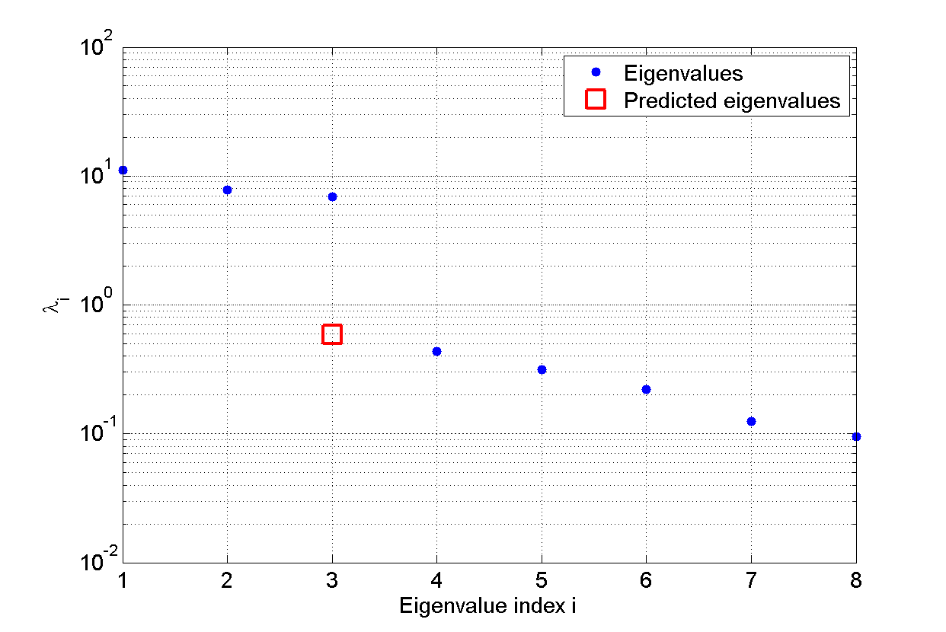
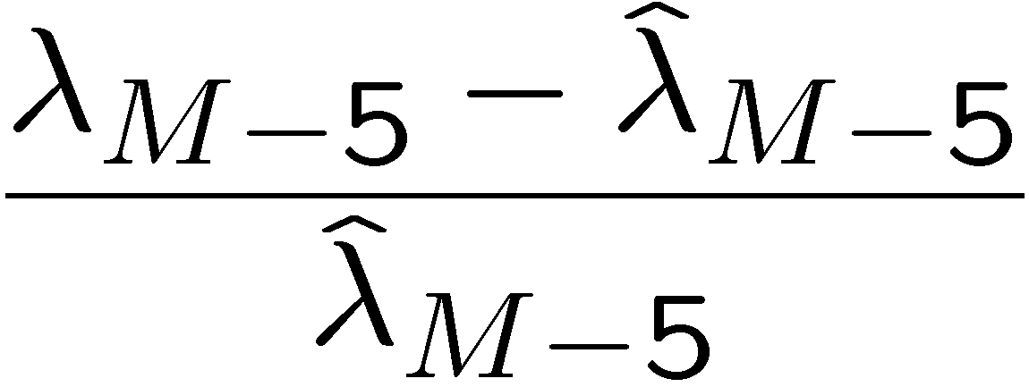
Exponential Fitting Test (EFT)
Finding the breaking point. For P = 5
  Predict λ_{M-5} based on
  λ_{M-4} , λ_{M-3}, λ_{M-2}, λ_{M-1}, and λ_{M}
  relative distance
  The relative distance
  becomes very big, we have
  found the break point.
d = 3, M = 8, SNR = 20 dB, N = 10

Slide 21
Outline
Data Model
Analysis of the Noise Eigenvalues Profile
Review of the State of the Art of the Model Order Selection (MOS)
  Exponential Fitting Test (EFT)
  Modified EFT (M-EFT)
1-D AIC and 1-D MDL
M-EFT II
Simulations
Conclusions

Slide 22
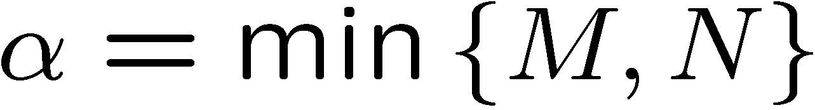


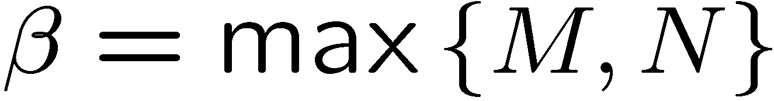
Modified EFT (M-EFT)
Our first modification
  In [7,8], it was assumed that N > M
  The result can be generalized by defining

Slide 23
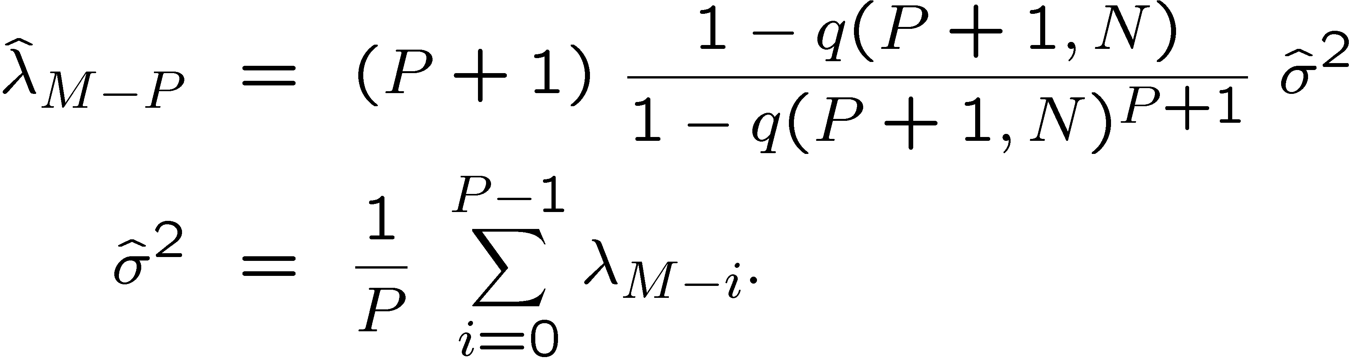
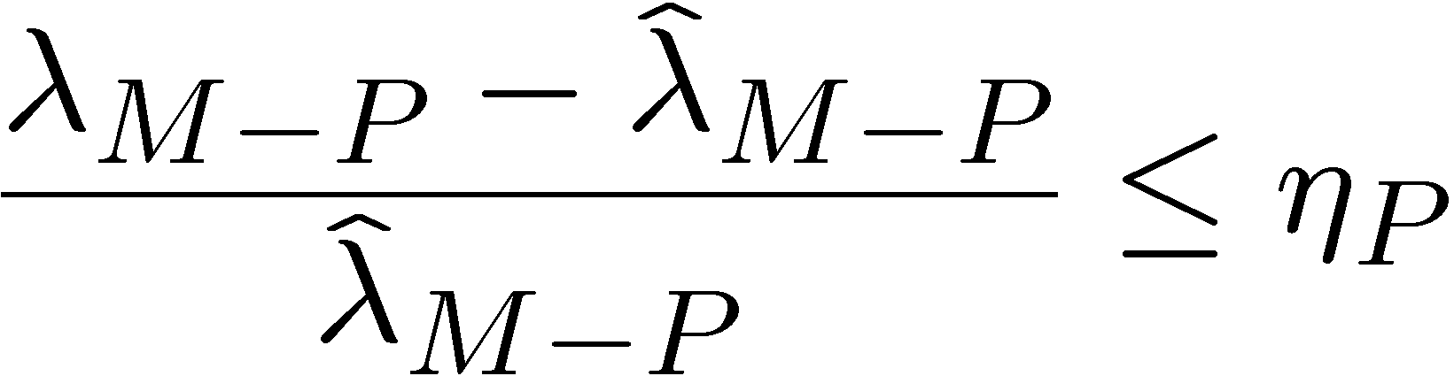
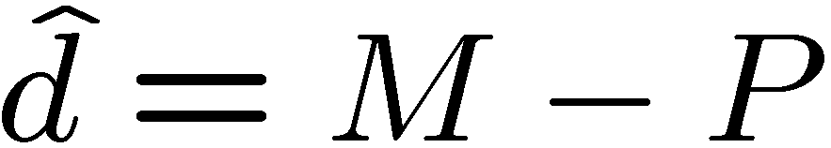
Modified EFT (M-EFT)
(1) Set the number of candidate noise eigenvalues to P = 1
(2) Estimation step: Estimate noise eigenvalue M - P
(3) Comparison step: Compare estimate with observation.
  If set P = P + 1, go to (2).
(4) The final estimate is
(second modification w.r.t. original EFT)

Slide 24


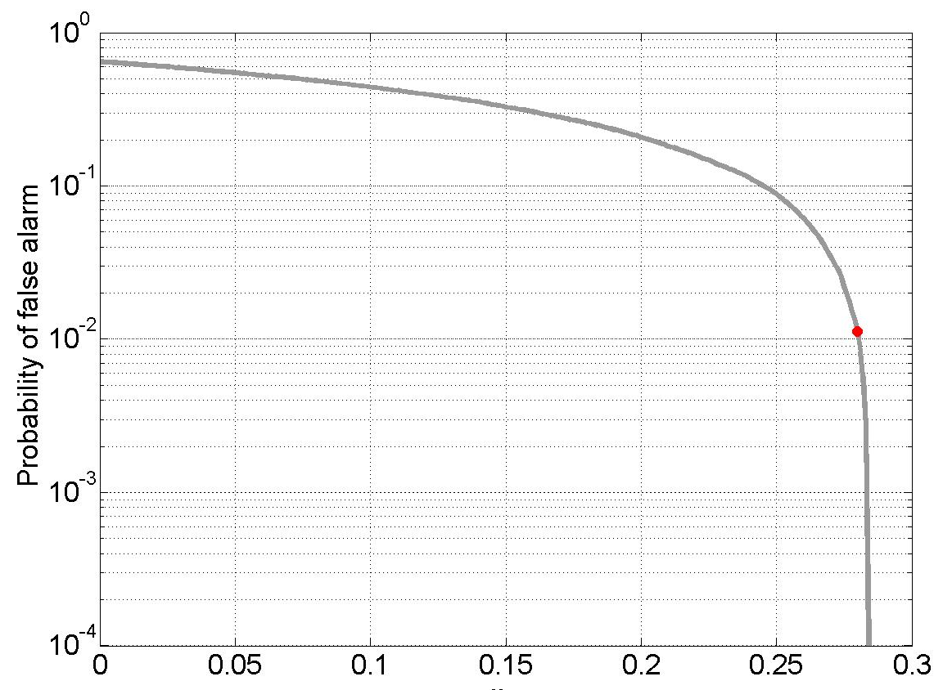
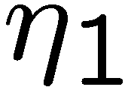
Modified EFT (M-EFT)
Determining the threshold coefficients
  For every P: vary and determine numerically the probability to detect a signal in noise-only data. Then choose such that the desired is met.
  Example:

Slide 25
Outline
Data Model
Analysis of the Noise Eigenvalues Profile
Review of the State of the Art of the Model Order Selection (MOS)
  Exponential Fitting Test (EFT)
  Modified EFT (M-EFT)
1-D AIC and 1-D MDL
M-EFT II
Simulations
Conclusions

Slide 26

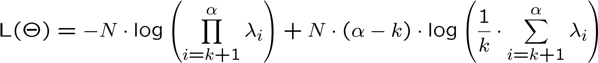
1-D AIC and 1-D MDL
For AIC [12]
For MDL [13]
Similarly to [1], we use the log-likelihood expression for the asymptotic theory of noise for principal component analysis [3] considering that
Free parameters
[12]: H. Akaike, “Information theory and extension of the maximum likelihood principle”, 2nd Int. Symp. Inform.
Theory suppl. Problems of Control and Inform. Theory, pp. 267-281, 1973.
[13]: J. Rissanen, “Modeling by shortest data description”, Automatica, vol. 14, pp. 465-471, 1978.

Slide 27
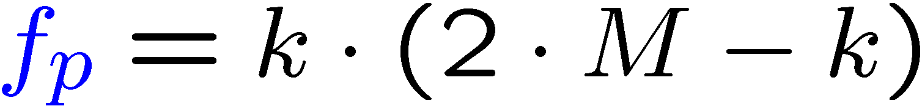
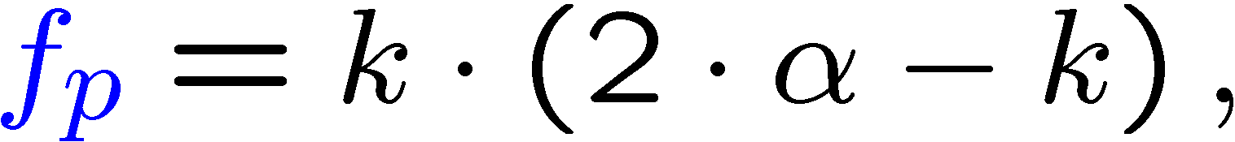
1-D AIC and 1-D MDL
Penalty functions
  According to [1]
  We propose (taking into account also that M > N)

Slide 28
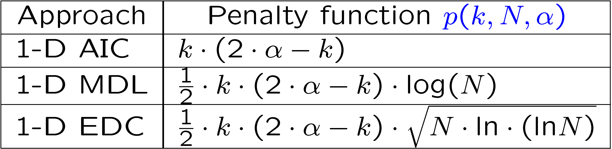
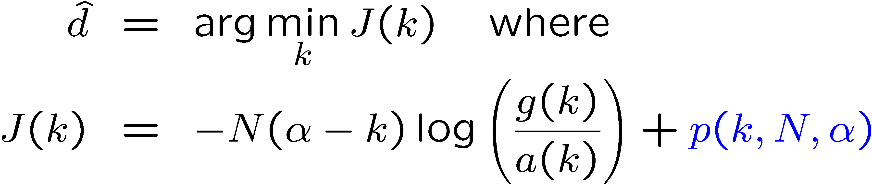
1-D AIC and 1-D MDL
Our proposed expressions

Slide 29
Outline
Data Model
Analysis of the Noise Eigenvalues Profile
Review of the State of the Art of the Model Order Selection (MOS)
  Exponential Fitting Test (EFT)
  Modified EFT (M-EFT)
1-D AIC and 1-D MDL
M-EFT II
Simulations
Conclusions

Slide 30
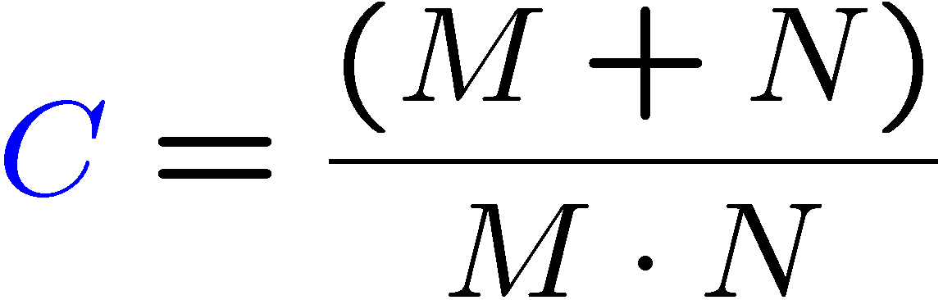
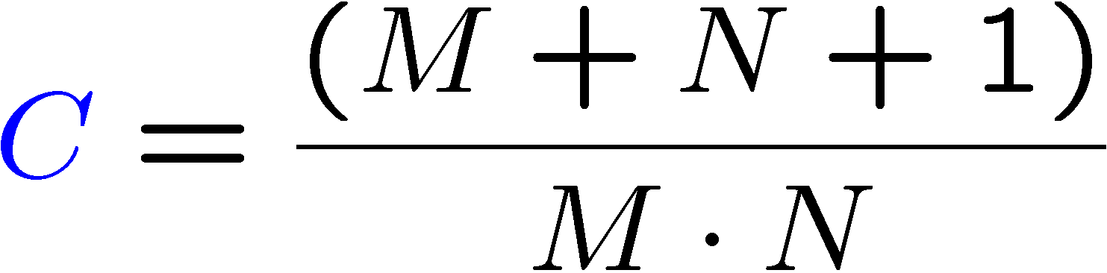
M-EFT II
Deriving q considering that the noise can be both real-valued or complex-valued, we obtain that
where for complex-valued Gaussian white noise
and for real-valued Gaussian white noise

Slide 31
Outline
Data Model
Analysis of the Noise Eigenvalues Profile
Review of the State of the Art of the Model Order Selection (MOS)
  Exponential Fitting Test (EFT)
  Modified EFT (M-EFT)
1-D AIC and 1-D MDL
M-EFT II
Simulations
Conclusions

Slide 32
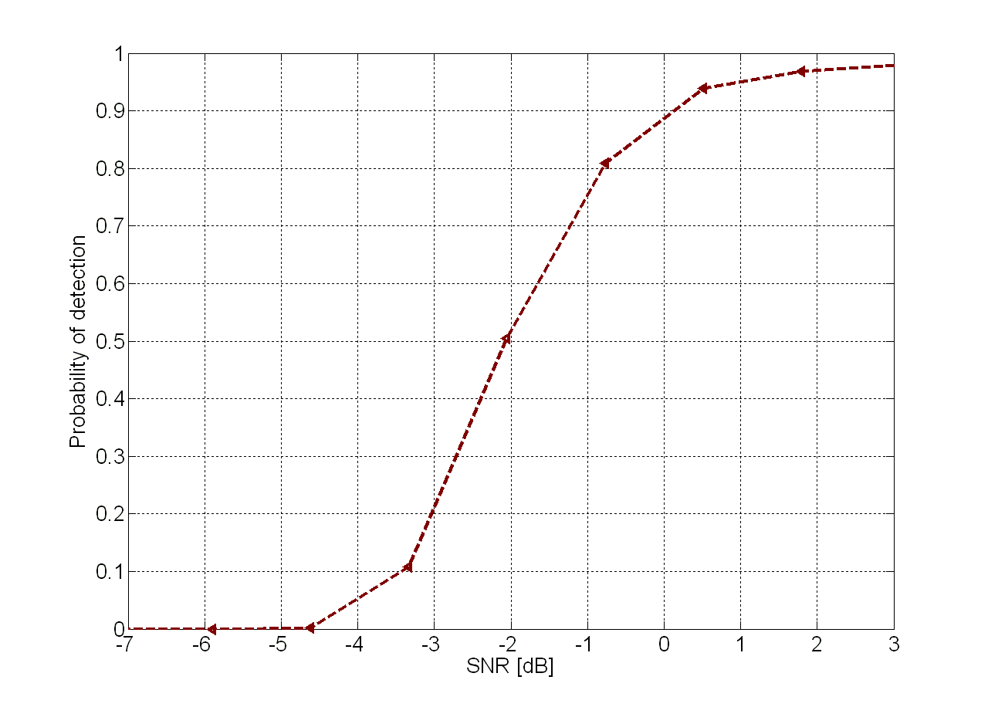
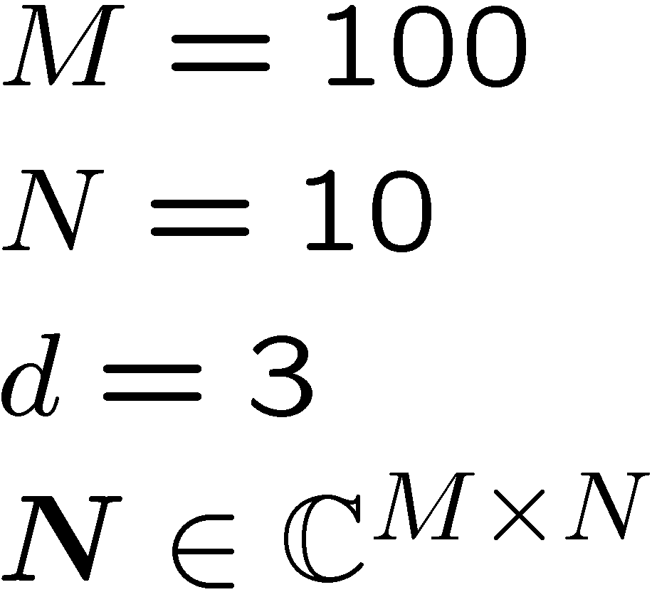
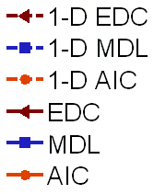
Simulations
According to [5], for M > N, AIC and MDL is used by practitioners. Comparing to our proposed versions.

Slide 33
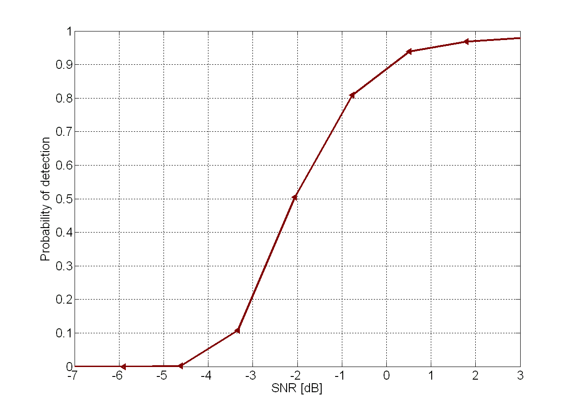
Simulations
According to [5], for M > N, AIC and MDL is used by practitioners. Comparing to our proposed versions.

Slide 34
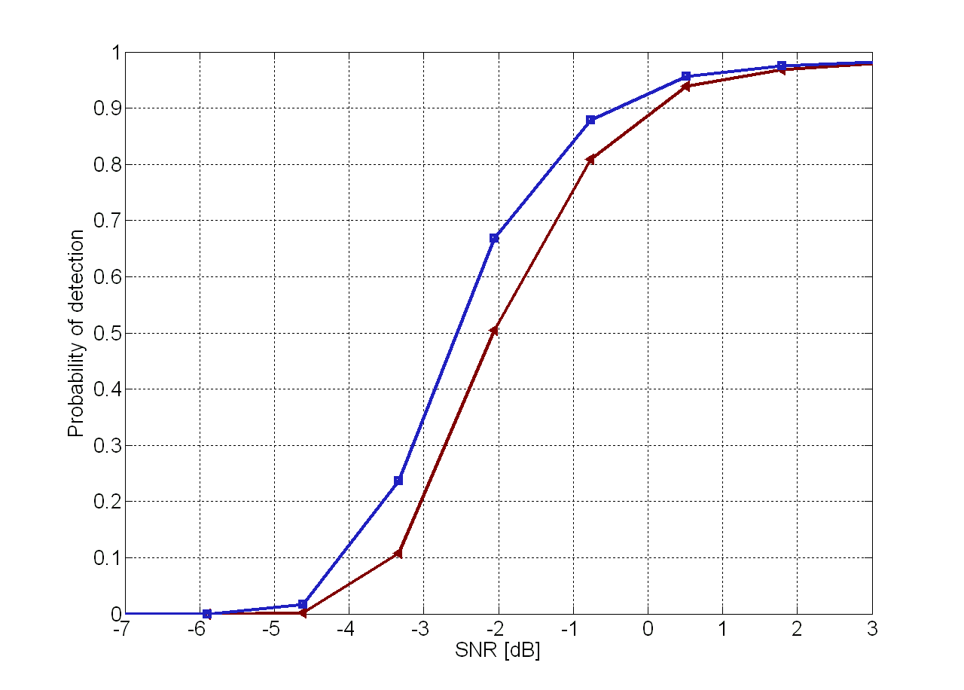
Simulations
According to [5], for M > N, AIC and MDL is used by practitioners. Comparing to our proposed versions.

Slide 35
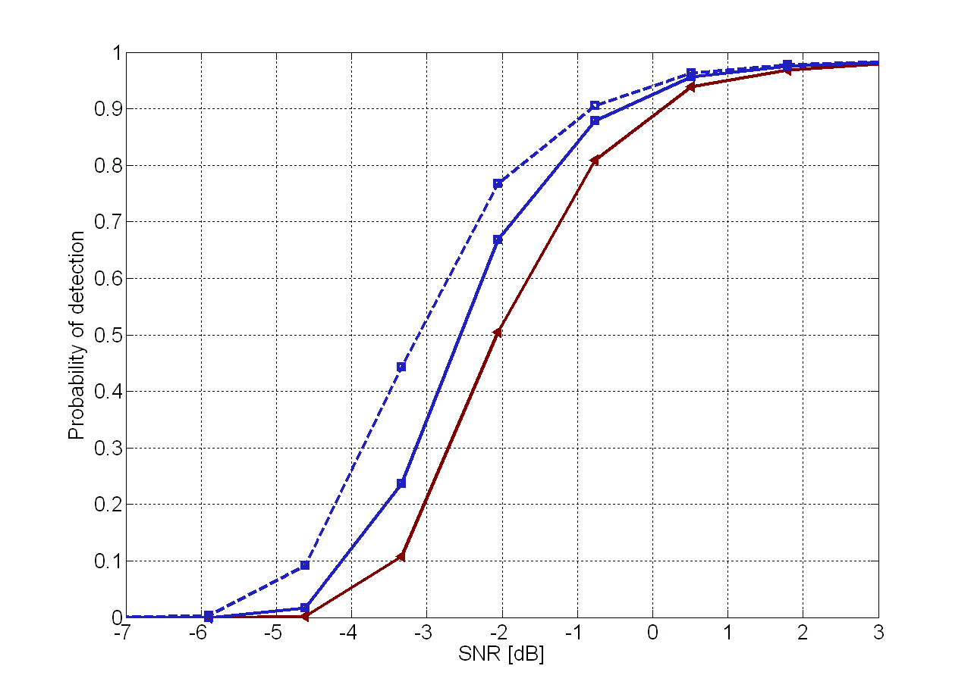
Simulations
According to [5], for M > N, AIC and MDL is used by practitioners. Comparing to our proposed versions.

Slide 36
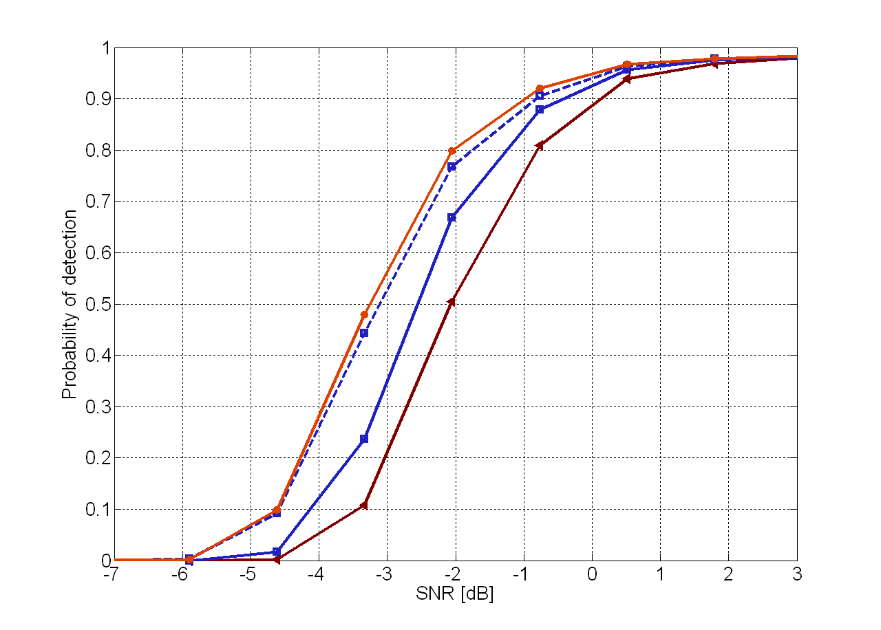
Simulations
According to [5], for M > N, AIC and MDL is used by practitioners. Comparing to our proposed versions.

Slide 37
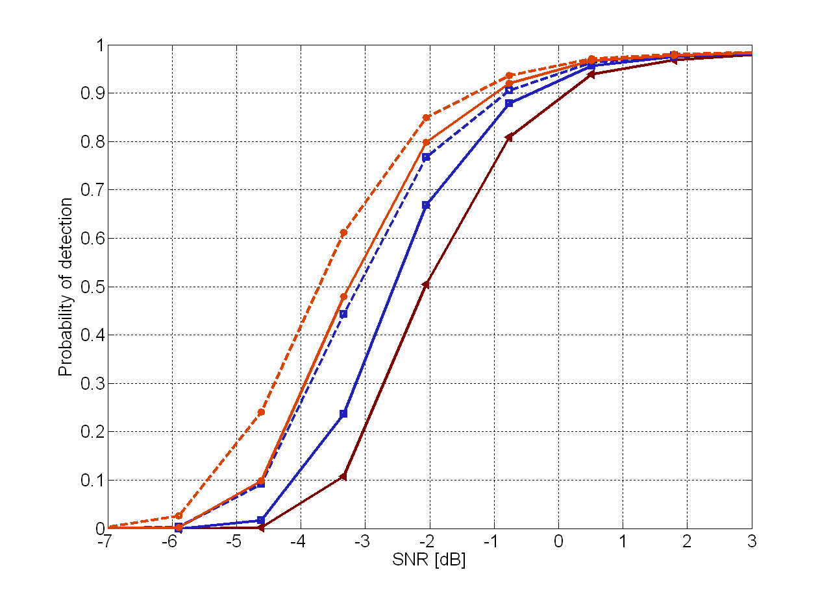
Simulations
According to [5], for M > N, AIC and MDL is used by practitioners. Comparing to our proposed versions.
The greater M, the greater is the improvement.
No gain for 1-D EDC.

Slide 38
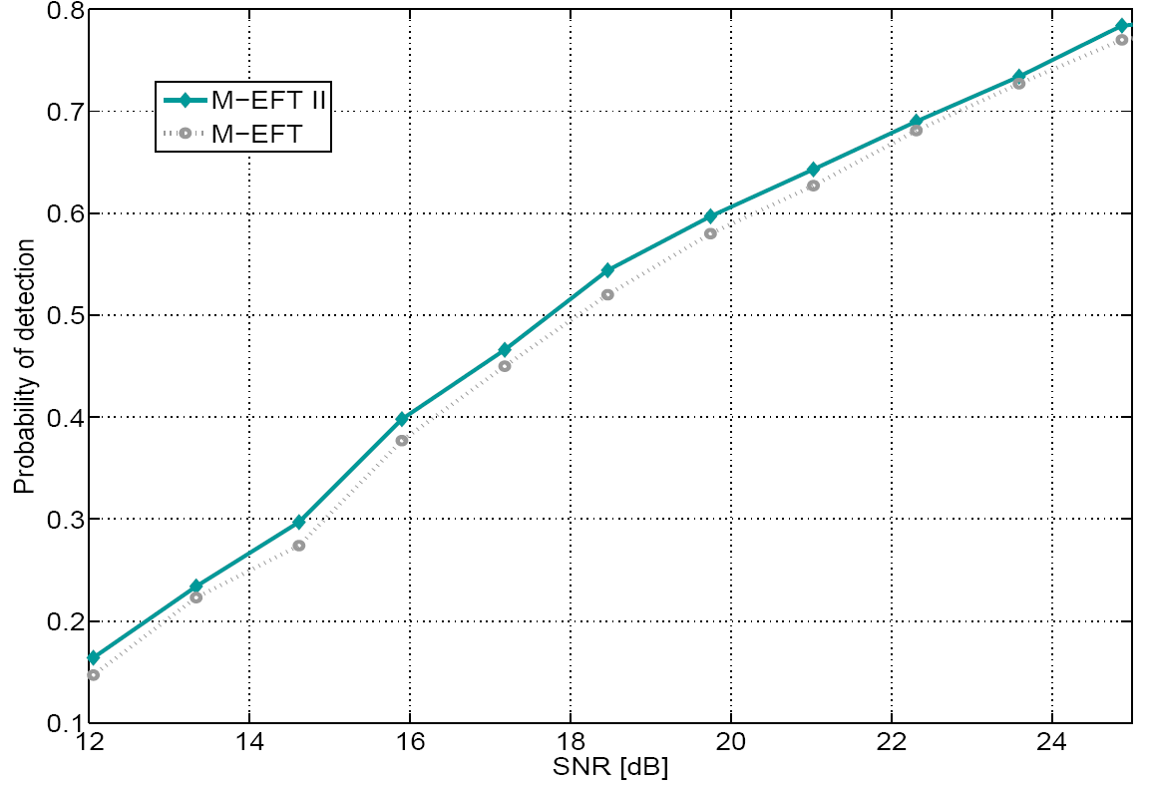
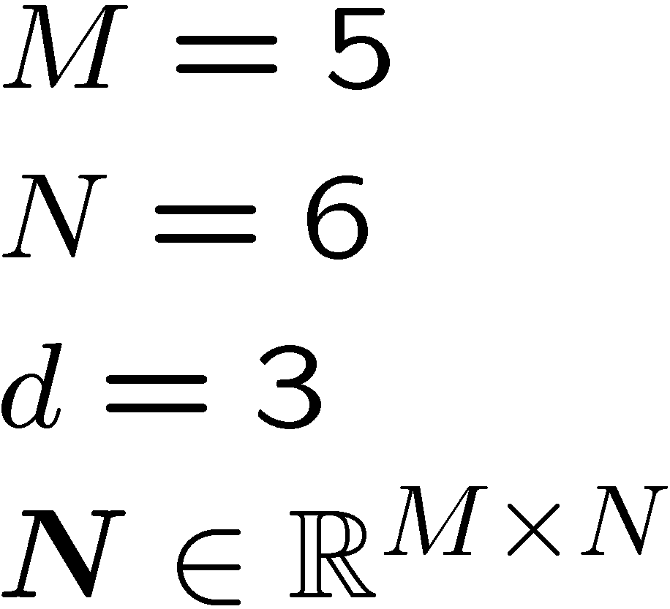
Simulations
Comparing the M-EFT II to M-EFT for the case of real-valued Gaussian white noise.

Slide 39
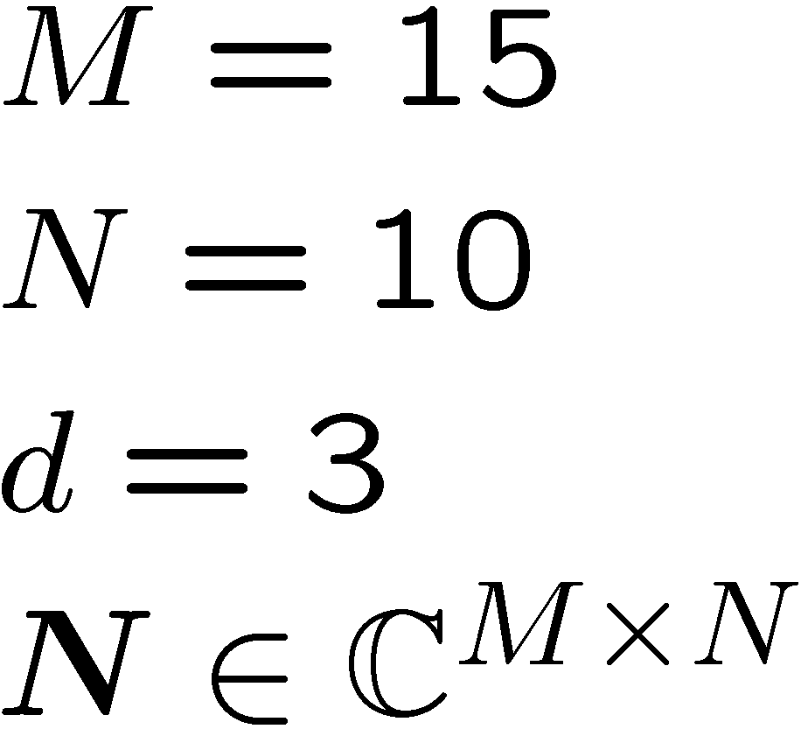
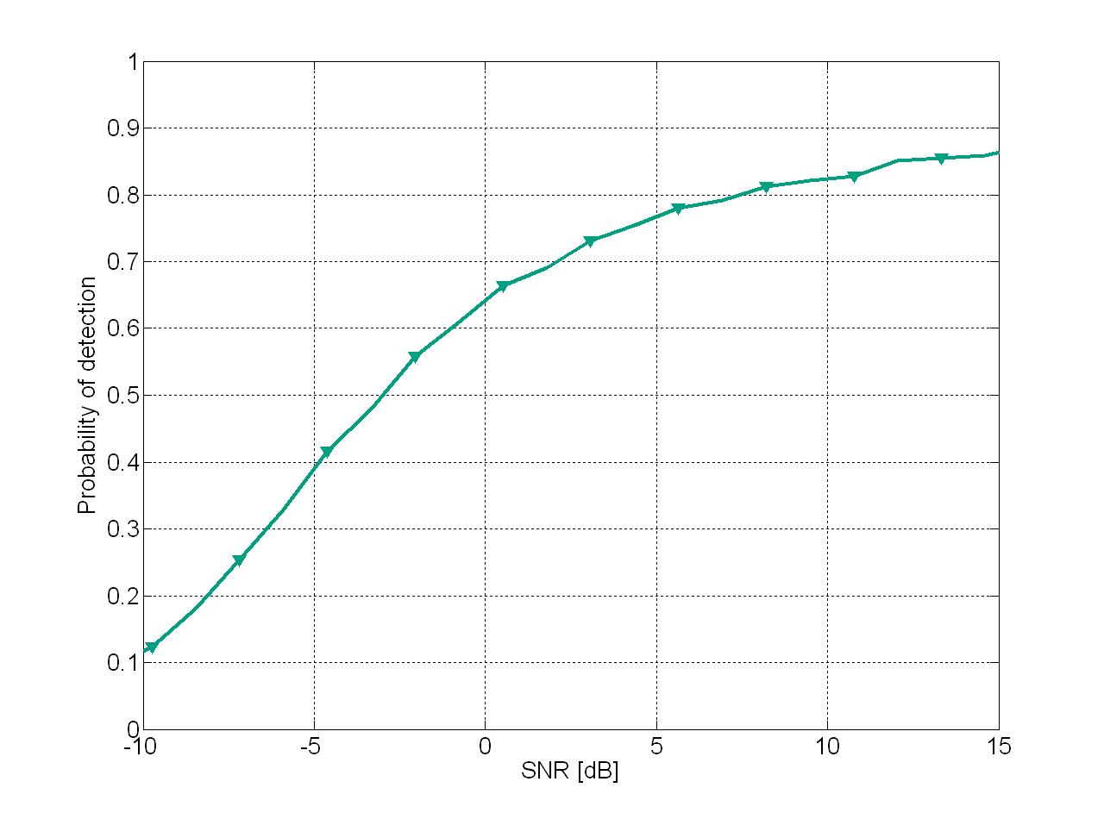
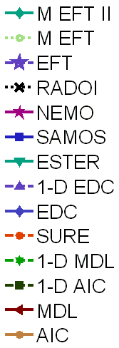
Simulations
Comparing the state-of-the-art model order selection techniques

Slide 40
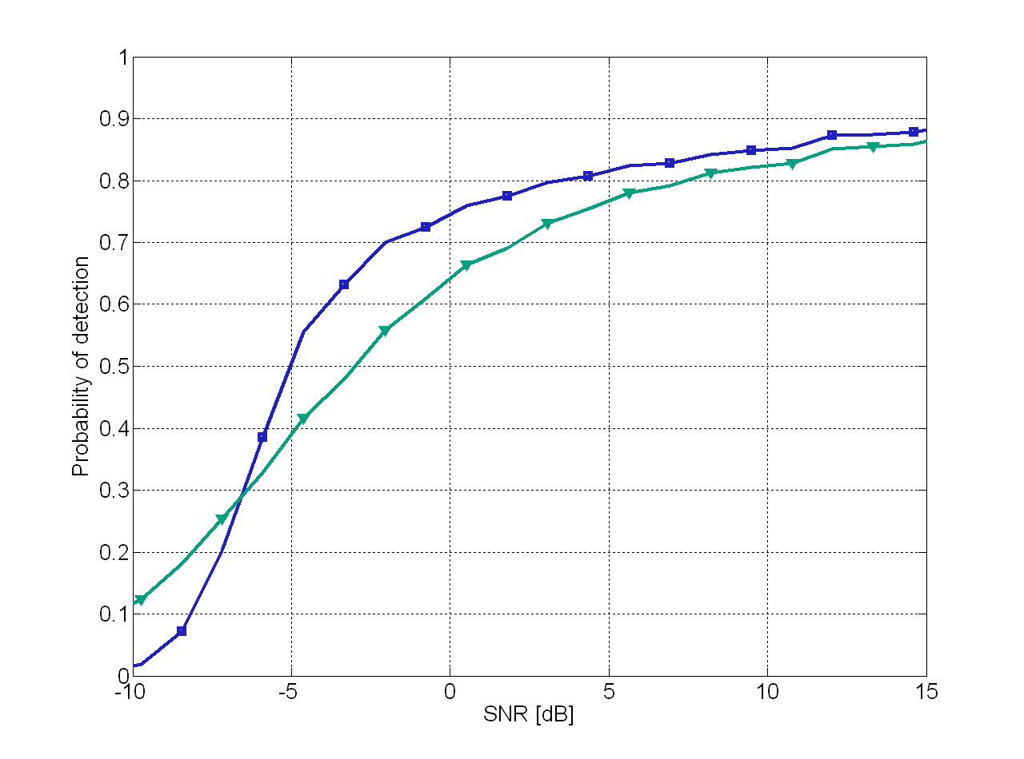
Simulations
Comparing the state-of-the-art model order selection techniques

Slide 41
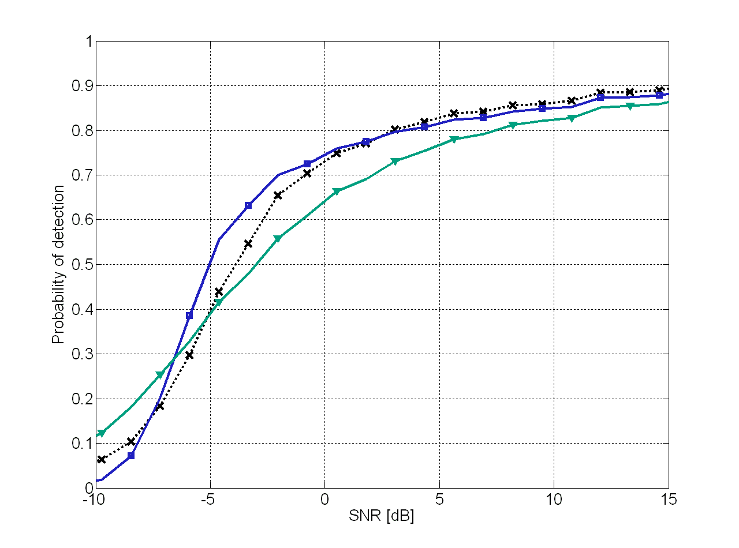
Simulations
Comparing the state-of-the-art model order selection techniques

Slide 42
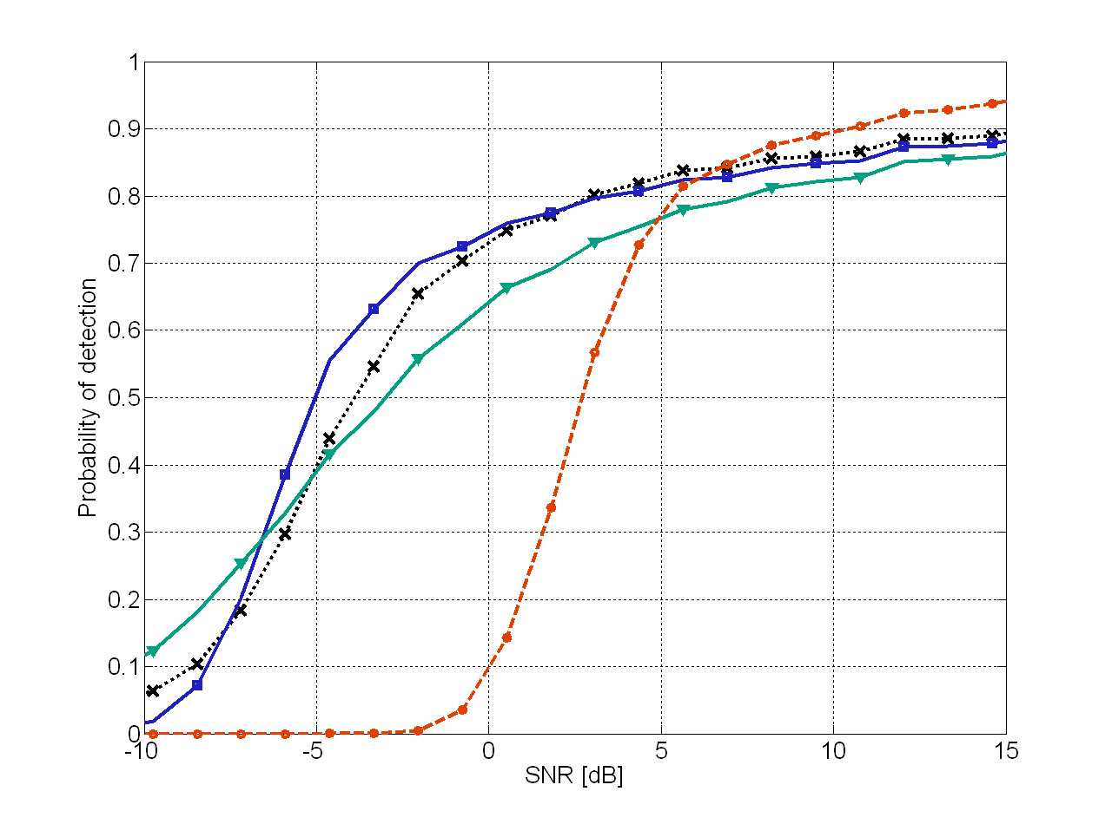
Simulations
Comparing the state-of-the-art model order selection techniques

Slide 43
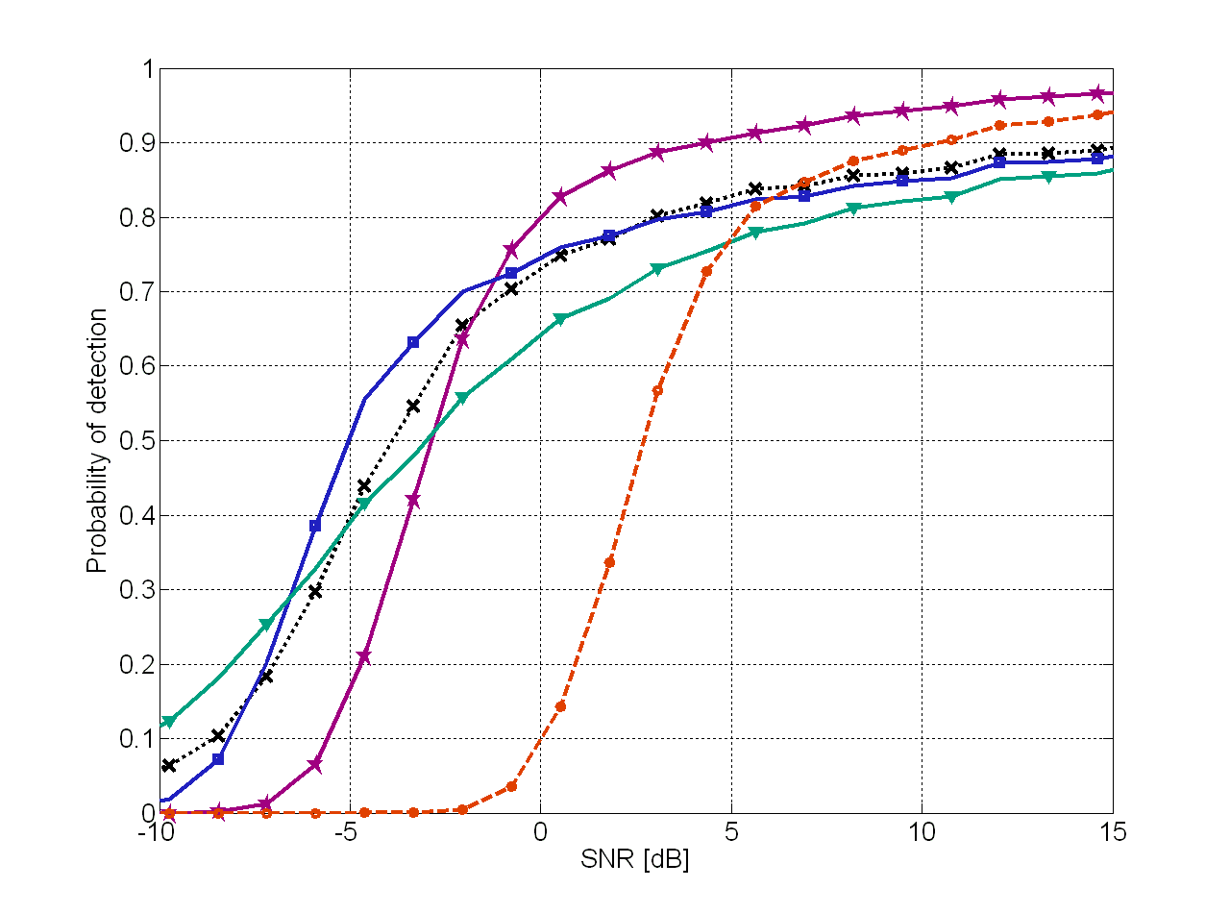
Simulations
Comparing the state-of-the-art model order selection techniques

Slide 44
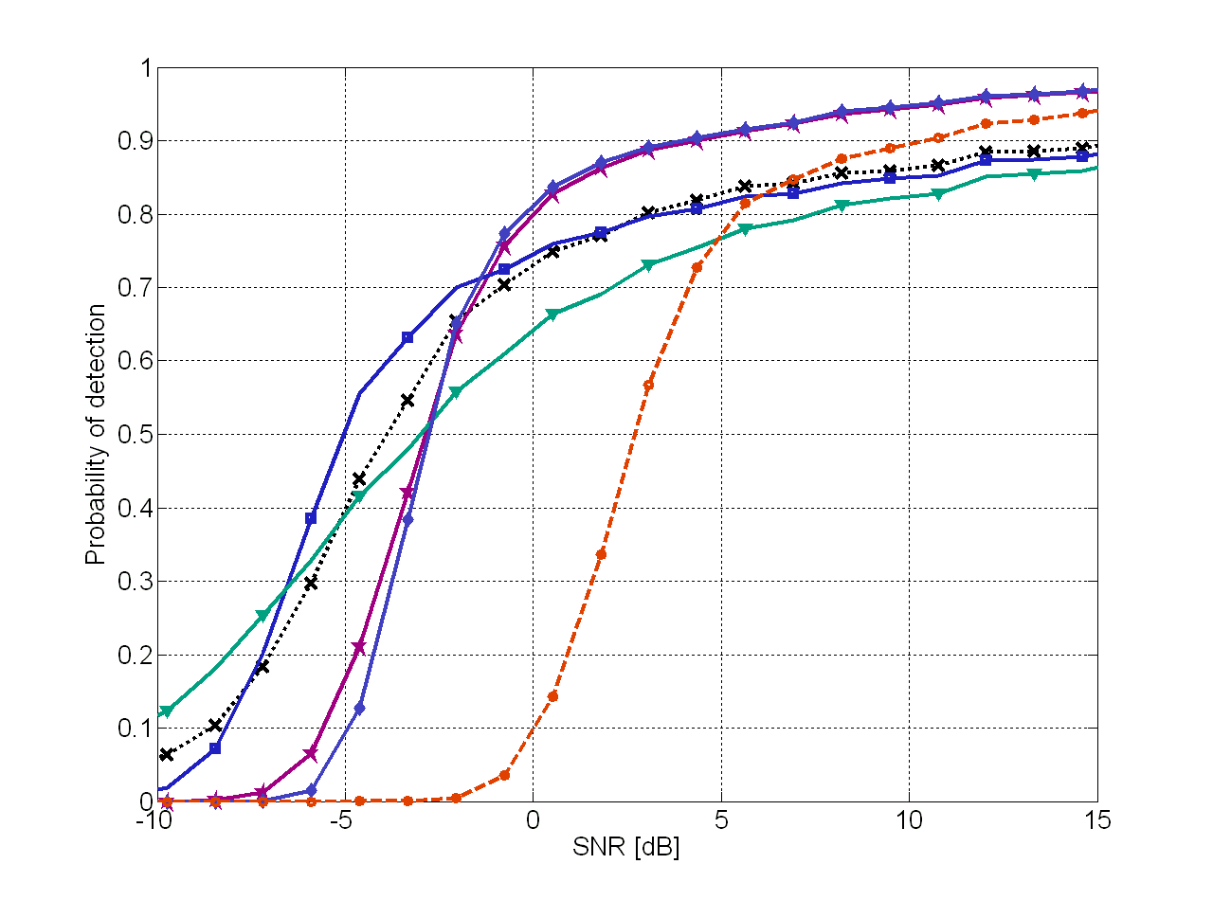
Simulations
Comparing the state-of-the-art model order selection techniques

Slide 45

Simulations
Comparing the state-of-the-art model order selection techniques

Slide 46

Simulations
Comparing the state-of-the-art model order selection techniques

Slide 47

Simulations
Comparing the state-of-the-art model order selection techniques

Slide 48

Simulations
Comparing the state-of-the-art model order selection techniques

Slide 49

Simulations
Comparing the state-of-the-art model order selection techniques

Slide 50

Simulations
Comparing the state-of-the-art model order selection techniques

Slide 51

Simulations
Comparing the state-of-the-art model order selection techniques

Slide 52

Simulations
Comparing the state-of-the-art model order selection techniques

Slide 53

Simulations
Comparing the state-of-the-art model order selection techniques

Slide 54

Simulations
Comparing the state-of-the-art model order selection techniques

Slide 55

Simulations
Comparing the state-of-the-art model order selection techniques

Slide 56

Simulations
Comparing the state-of-the-art model order selection techniques

Slide 57

Simulations
Comparing the state-of-the-art model order selection techniques

Slide 58

Simulations
Comparing the state-of-the-art model order selection techniques

Slide 59

Simulations
Comparing the state-of-the-art model order selection techniques

Slide 60

Simulations
Comparing the state-of-the-art model order selection techniques

Slide 61

Simulations
Comparing the state-of-the-art model order selection techniques

Slide 62

Simulations
Comparing the state-of-the-art model order selection techniques

Slide 63


Simulations
Comparing the state-of-the-art model order selection techniques

Slide 64

Simulations
Comparing the state-of-the-art model order selection techniques

Slide 65

Simulations
Comparing the state-of-the-art model order selection techniques

Slide 66

Simulations
Comparing the state-of-the-art model order selection techniques

Slide 67

Simulations
Comparing the state-of-the-art model order selection techniques

Slide 68

Simulations
Comparing the state-of-the-art model order selection techniques

Slide 69

Simulations
Comparing the state-of-the-art model order selection techniques

Slide 70

Simulations
Comparing the state-of-the-art model order selection techniques

Slide 71

Simulations
Comparing the state-of-the-art model order selection techniques

Slide 72

Simulations
Comparing the state-of-the-art model order selection techniques

Slide 73

Simulations
Comparing the state-of-the-art model order selection techniques

Slide 74

Simulations
Comparing the state-of-the-art model order selection techniques

Slide 75
Outline
Data Model
Analysis of the Noise Eigenvalues Profile
Review of the State of the Art of the Model Order Selection (MOS)
  Exponential Fitting Test (EFT)
  Modified EFT (M-EFT)
1-D AIC and 1-D MDL
M-EFT II
Simulations
Conclusions

Slide 76
Conclusions
1-D AIC and 1-D MDL are fundamental for the following multidimensional extensions R-D AIC and R-D MDL in [2].
A more general expression for the M-EFT rate of the predicted exponential profile is presented considering real-value white Gaussian noise.
After a campaign of simulations comparing the state-of-the-art matrix based model order selection techniques in the presence of white Gaussian noise, the following general rules were obtained
  The best PoD is achieved by M-EFT for all array sizes;
  In case that N >> M, then in general any technique can be applied, since they all have quite close performance. We suggest M-EFT, as well as AIC and MDL.

Slide 77
Thank you for your attention!
Vielen Dank für Ihre Aufmerksamkeit!
Ilmenau University of Technology
Communications Research Laboratory
P.O. Box 10 05 65
D-98684 Ilmenau, Germany
E-Mail: haardt@ieee.org

Slide 78
BACKUP

Slide 79






Data model
Noiseless case
Matrix data model
Our objective is to estimate d from the noisy observations .

