Slide 1


Deterministic Prewhitening to Improve
Subspace based Parameter Estimation Techniques
in Severely Colored Noise Environments
João Paulo C. L. da Costa, Florian Roemer, and Martin Haardt
Ilmenau University of Technology
Communications Research Laboratory
P.O. Box 10 05 65
D-98684 Ilmenau, Germany
E-Mail: haardt@ieee.org
Homepage: http://www.tu-ilmenau.de/crl

Slide 2
Motivation
Colored noise is encountered in a variety of signal processing applications, e.g., SONAR [1], communications [4], speech processing [2].
Without prewhitening the parameter estimation is severely degraded.
Traditionally, stochastic prewhitening schemes [2,3] are applied.
By prewhitening the subspace via our proposed deterministic prewhitening scheme, an improvement of the parameter estimation is obtained compared to the stochastic prewhitening schemes.
[1]: Q. T. Zhang and K. M. Wong, “Information theoretic criteria for the determination of the number of signals in a spatially correlated noise”, IEEE Transactions on Signal Processing, vol. 41, pp. 1652-1662, Apr. 1993.
[2]: P. C. Hansen and S. H. Jensen, “Prewhitening for rank-deficient noise in subspace methods for noise reduction”, IEEE Trans. on Signal Processing, vol. 53, pp. 3718-3726, Oct. 2005.
[3]: M. Haardt, R. S. Thomä, and A. Richter, “Multidimensional high-resolution parameter estimation with applications to channel sounding”, in High-Resolution and Robust Signal Processing, Y. Hua, A. Gershman, and Q. Chen, Eds. 2004, pp. 255-338, Marcel Dekker, New York, NY, Chapter 5.

Slide 3
Motivation
Since the deterministic prewhitening scheme requires the information about the correlation coefficient, we propose also schemes to estimate the phase and magnitude of the correlation coefficient.
In applications like in [4,5], where the noise is severely colored, our determistic prewhitenig scheme provides a very significant improvement.
Although we present here our scheme in conjunction with Standard ESPRIT [6], it is also possible to apply it with all subspace based schemes, e.g., MUSIC, Root MUSIC, and RARE.
[4]: T. L. Cao and D. J. Wu, “Noise-induced transport in a periodic system driven by Gaussian white noises with intensive cross-correlation”, Physics Letters A, vol. 291, pp. 371-375, Dec. 2001.
[5]: T. Liu and S. Gazor, “Adaptive MLSD receiver employing noise correlation”, IEEE Proc.-Comm., vol 53, pp. 719-724, Oct. 2006.
[6]: R. Roy and T. Kailath, “ESPRIT – Estimation of signal parameters via rotational invariance techniques”, in Signal Processing Part II: Control Theory and Applications, L. Auslander, F. A. Grünbaum, J. W. Helton, T. Kailath, P. Khargonekar, and S. Mitter, Eds. 1990, pp. 369-411, Springer-Verlag.

Slide 4
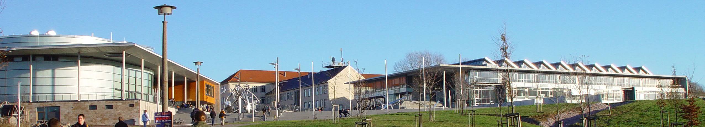
Outline
Data Model
Stochastic Prewhitening
Deterministic Prewhitening
Correlation Coefficient Estimation
Simulations
Conclusions

Slide 5
Outline
Data Model
Stochastic Prewhitening
Deterministic Prewhitening
Correlation Coefficient Estimation
Simulations
Conclusions

Slide 6
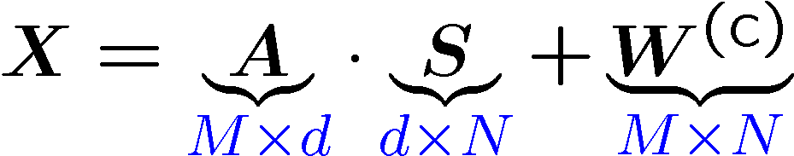
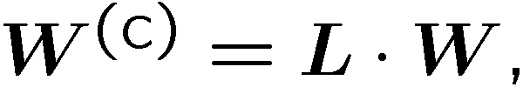
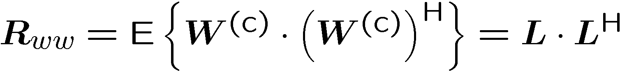
Data model
Matrix data model
The model order d can be estimated based on [7]. (ESTER, SAMOS, or RADOI) We consider it known.
Colored noise model
[7]: J. P. C. L. da Costa, A. Thakre, F. Roemer, and M. Haardt, “Comparison of model order selection techniques for high-resolution parameter estimation algorithms”, in. Proc. 54th International Scientific Colloquium (IWK), Ilmenau, Germany, Sept. 2009.

Slide 7



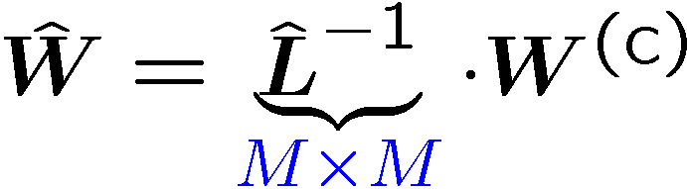




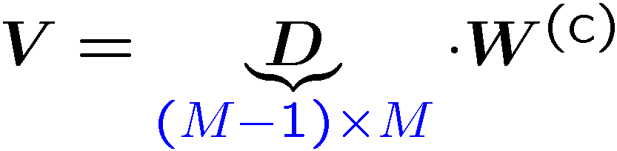
Noise Analysis
Analysis via SVD
Stochastic prewhitening schemes
With colored noise the d main components are more affected.
Deterministic prewhitening scheme

Slide 8
Outline
Data Model
Stochastic Prewhitening
Deterministic Prewhitening
Correlation Coefficient Estimation
Simulations
Conclusions

Slide 9
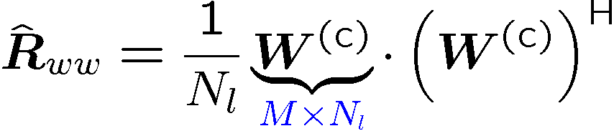
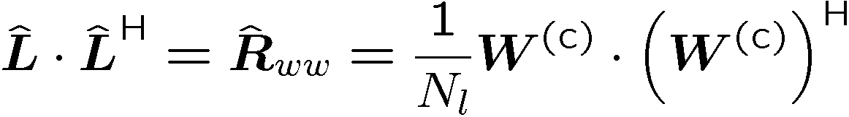


Stochastic Prewhitening
Estimation of the prewhitening matrix via only noise samples [2]
Estimating the prewhitening subspace via matrix inversion [2]
  SVD of the prewhitened data matrix
  Recovering the subspace (low rank approximation)
The recovered subspace can be applied directly to the Standard ESPRIT [6] to obtain the estimated spatial frequencies.
GSVD and GEVD can be applied instead of matrix inversion [2,3].

Slide 10
Outline
Data Model
Stochastic Prewhitening
Deterministic Prewhitening
Correlation Coefficient Estimation
Simulations
Conclusions

Slide 11



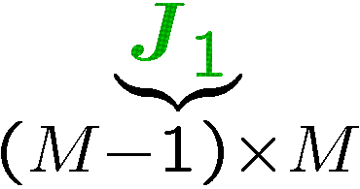
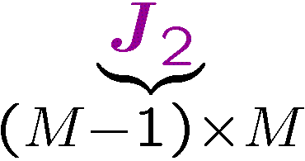
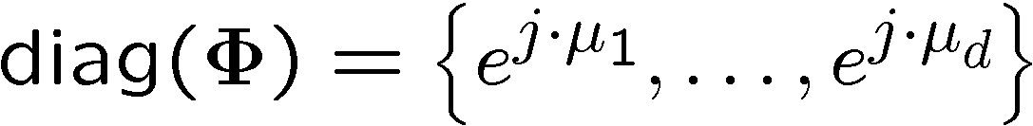



Deterministic Prewhitening
The colored noise is a composition of the noise at the m-th sensor and at the (m+1)-th sensor.
The noise correlation expression [1] can be represented in general by
Selection matrices and
  To estimate the spatial frequencies (ESPRIT)
  To build the prewhitening matrix (deterministic prewhitening)

Slide 12
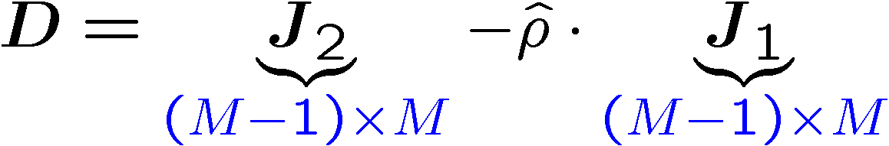

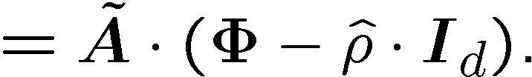
Deterministic Prewhitening
Based on the colored noise model, we can build our prewhitening matrix with the following structure
The correlation coefficient is estimated later.
We assume it known.
The prewhitening matrix is applied in our data model
Proof:

Slide 13


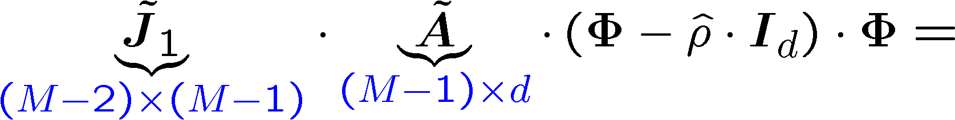
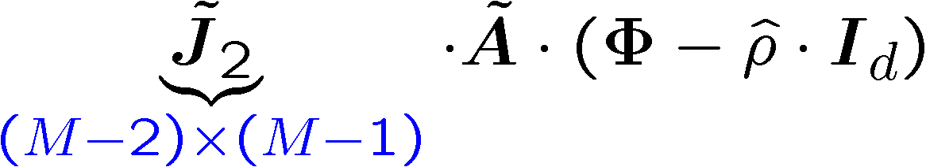
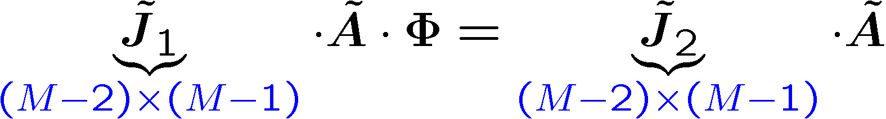
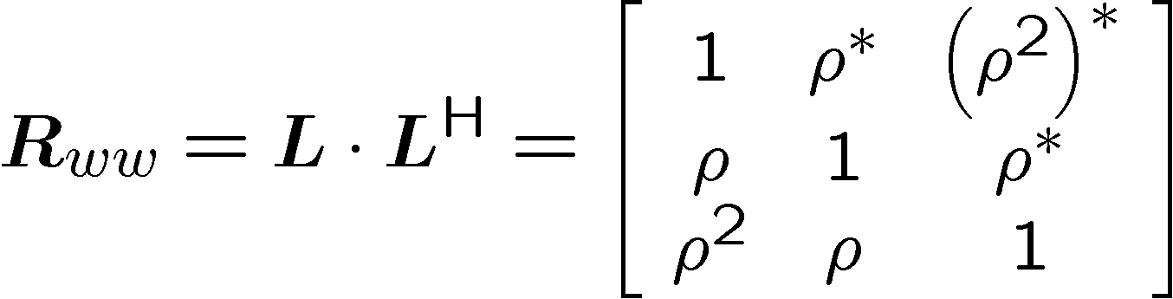
Deterministic Prewhitening
Replacing A by A in the Standard ESPRIT shift invariance equation
The shift invariance
property is satisfied!
Given the noise model in [1], the noise correlation matrix is given by

Slide 14
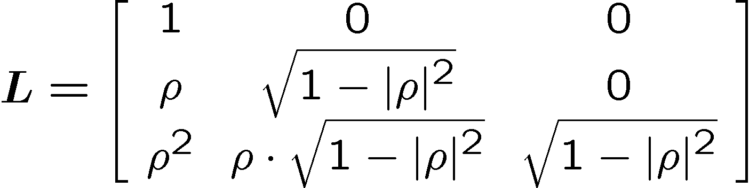
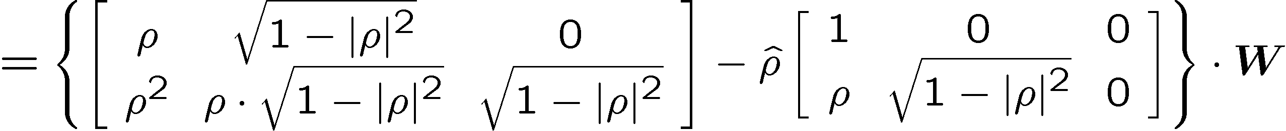
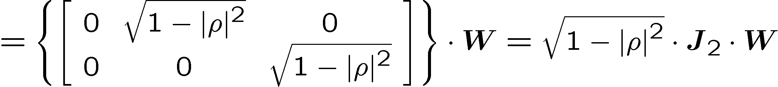
Deterministic Prewhitening
Given the noise model in [1], the noise correlation factor is given by
Applying the deterministic prewhitening matrix

Slide 15
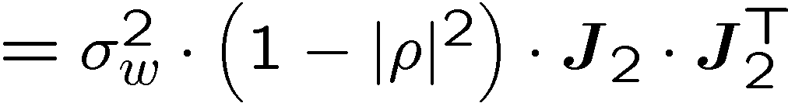
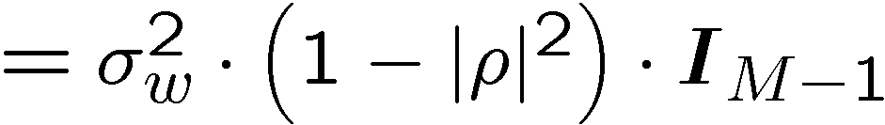
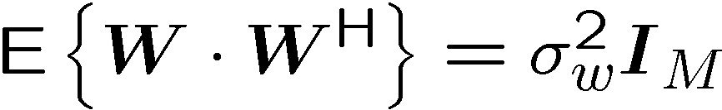
Deterministic Prewhitening
We can prove that the prewhitened noise is white
while for the stochastic prewhitening schemes

Slide 16
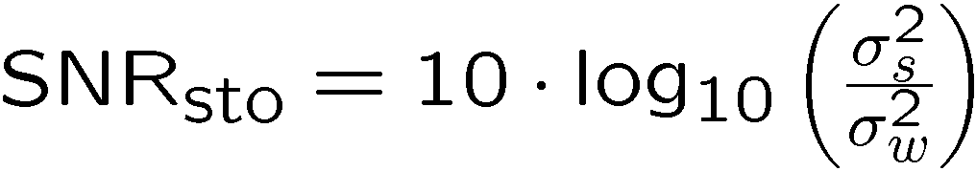
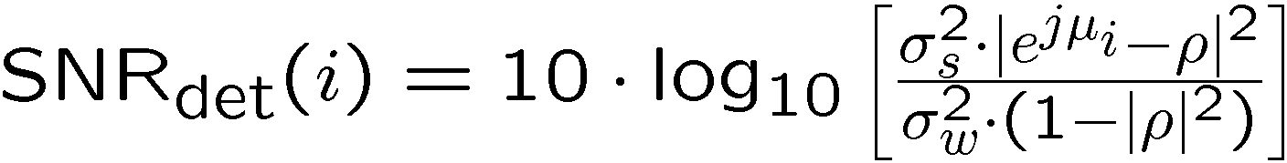
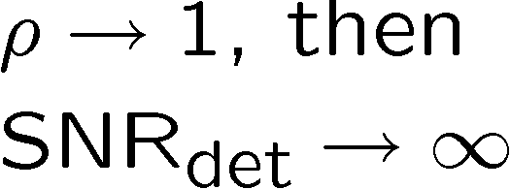
Power analysis
For the model assumed in [1], we have the following noise powers
while the SNRs are given by
The deterministic prewhitening
satisfies the shift invariance equation;
the prewhitened noise is white;
the greater the noise correlation, the smaller the noise power.

Slide 17
Outline
Data Model
Stochastic Prewhitening
Deterministic Prewhitening
Correlation Coefficient Estimation
Simulations
Conclusions

Slide 18
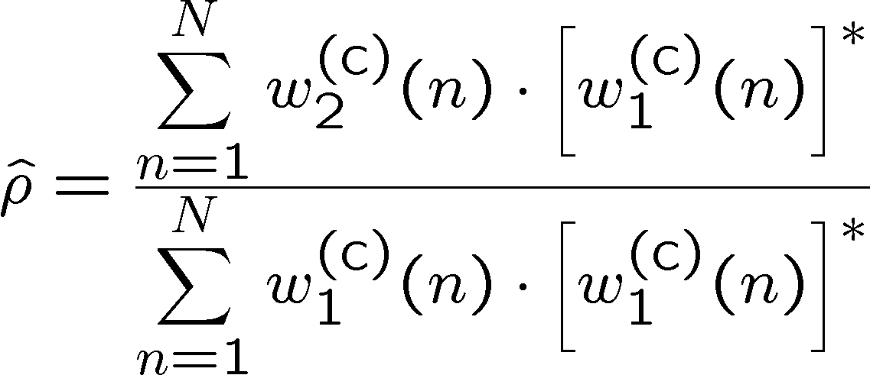

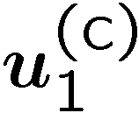
Correlation coefficient estimation
Sample estimate based approach
ESPRIT based approach for phase estimation

Slide 19
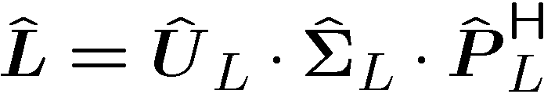
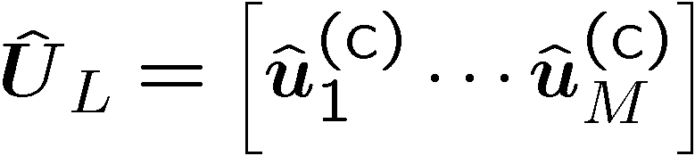

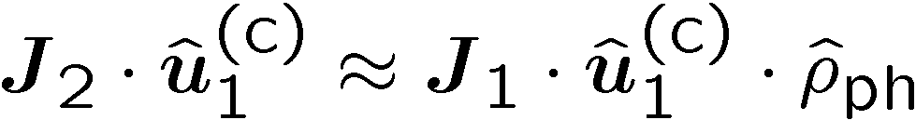
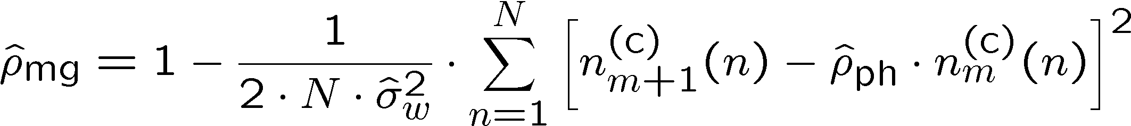
Correlation coefficient estimation
In practice,
Due to the structure of , the shift invariance is valid.
Magnitude estimation approach (assume phase is known)

Slide 20
Outline
Data Model
Stochastic Prewhitening
Deterministic Prewhitening
Correlation Coefficient Estimation
Simulations
Conclusions

Slide 21
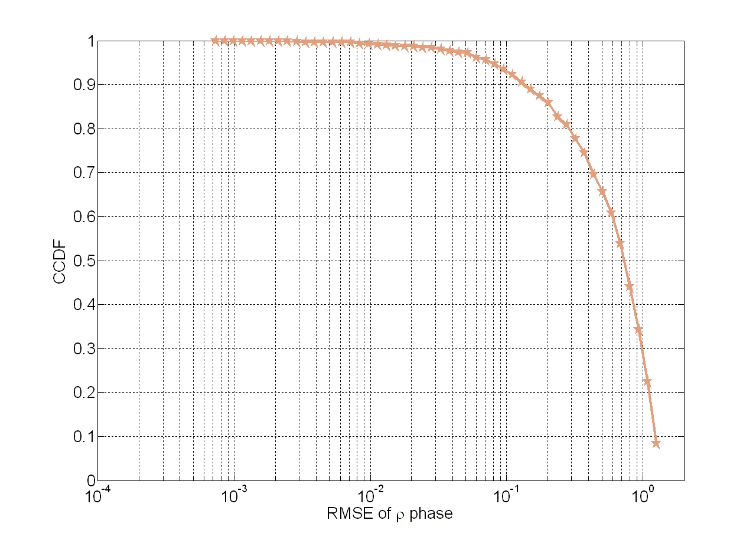

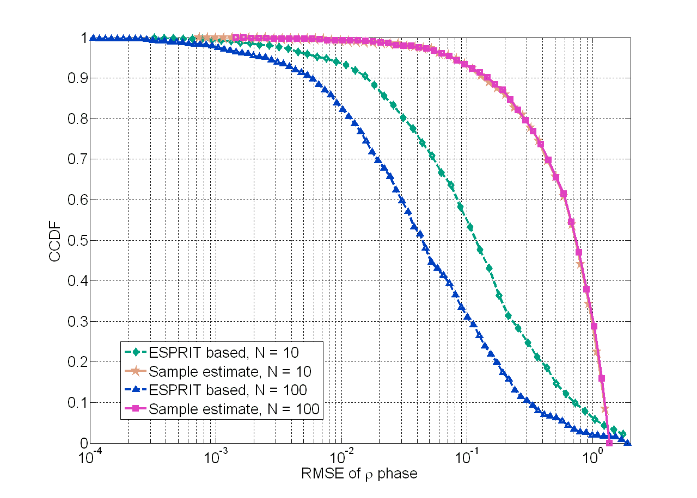

Simulations
Phase estimation of the correlation coefficient
Random phase and
magnitude for the
noise correlation.

Slide 22
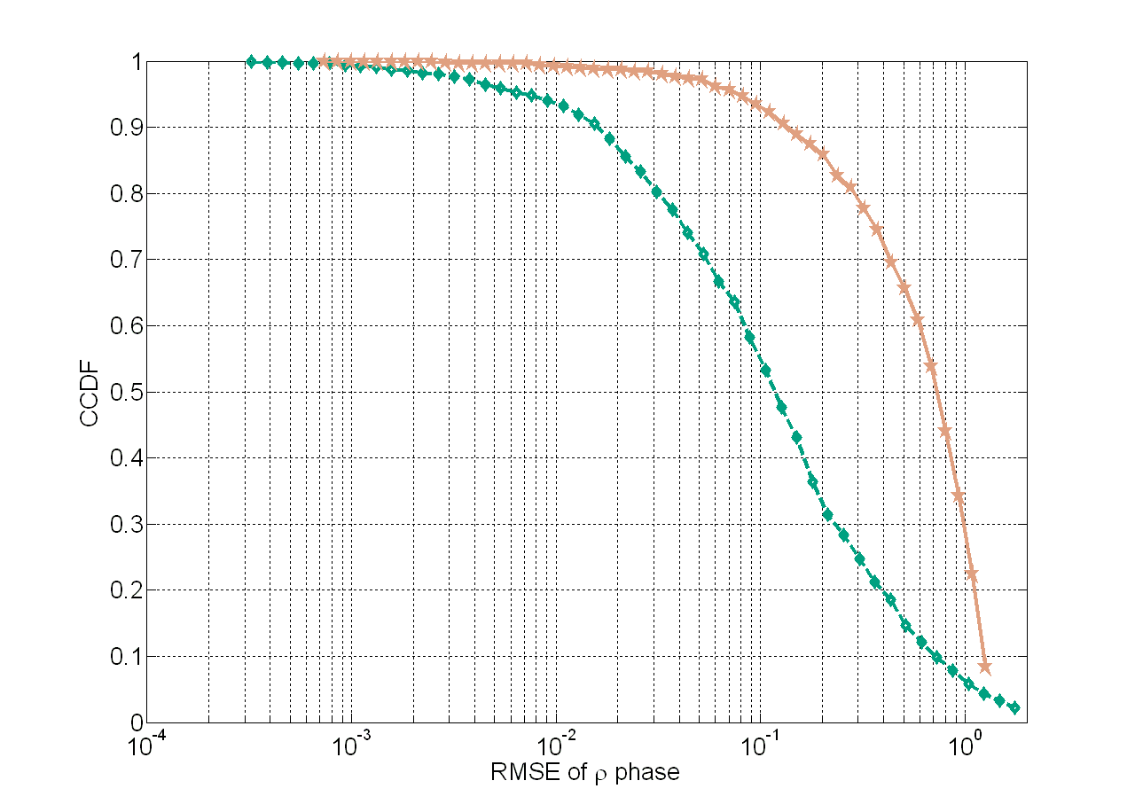
Simulations
Phase estimation of the correlation coefficient
Random phase and
magnitude for the
noise correlation.

Slide 23
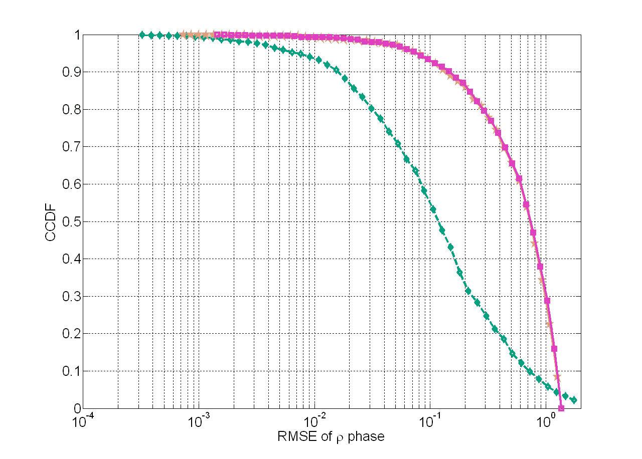

Simulations
Phase estimation of the correlation coefficient
Random phase and
magnitude for the
noise correlation.

Slide 24
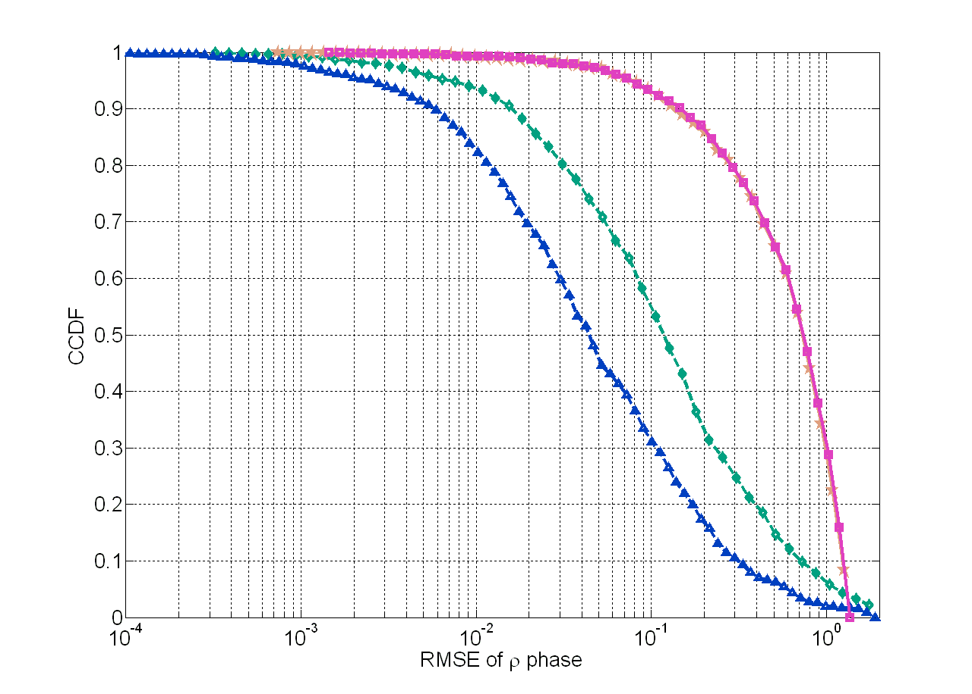
Simulations
Phase estimation of the correlation coefficient
Random phase and
magnitude for the
noise correlation.

Slide 25
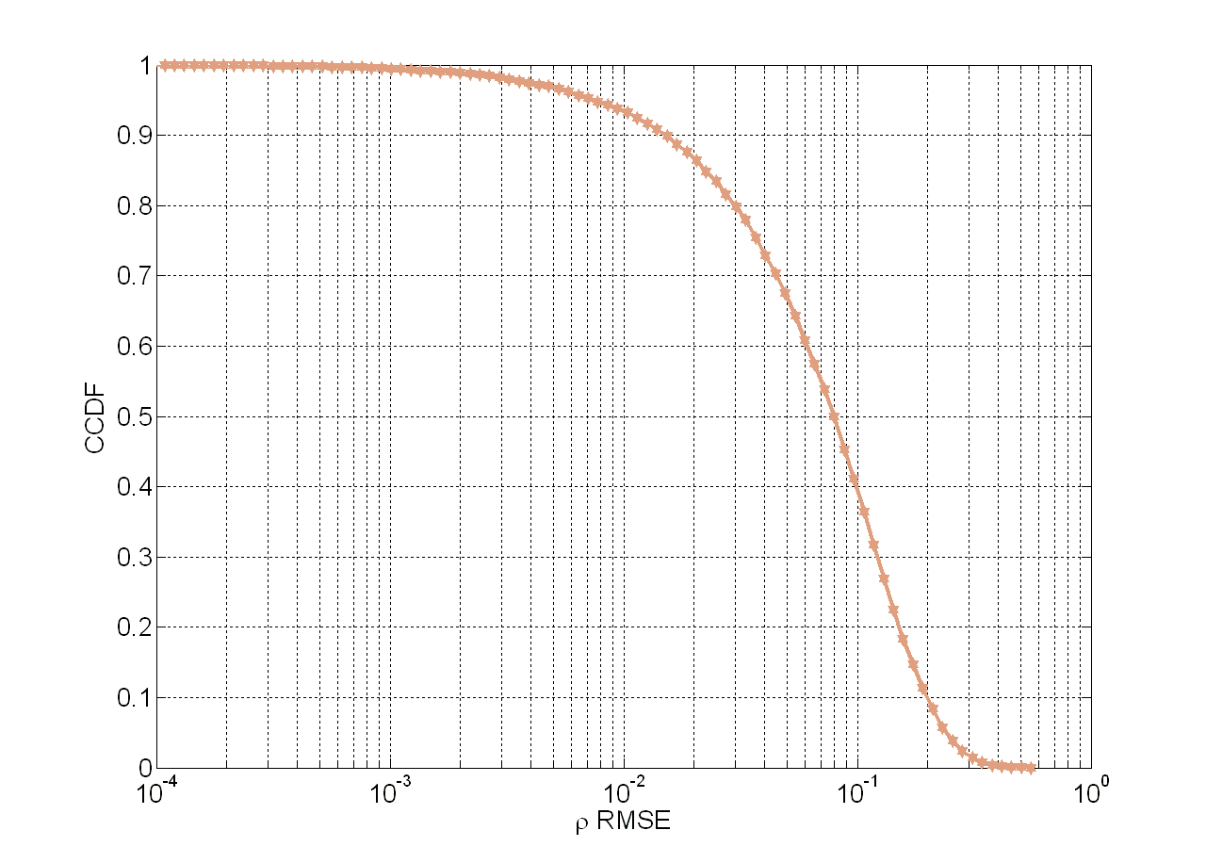
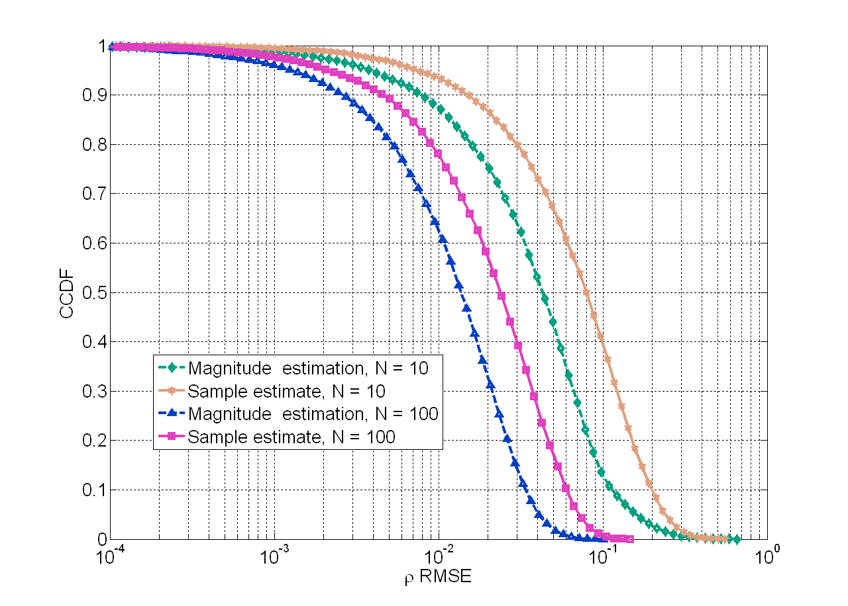
Simulations
Magnitude estimation of the correlation coefficient
Random phase and
magnitude for the
noise correlation.

Slide 26
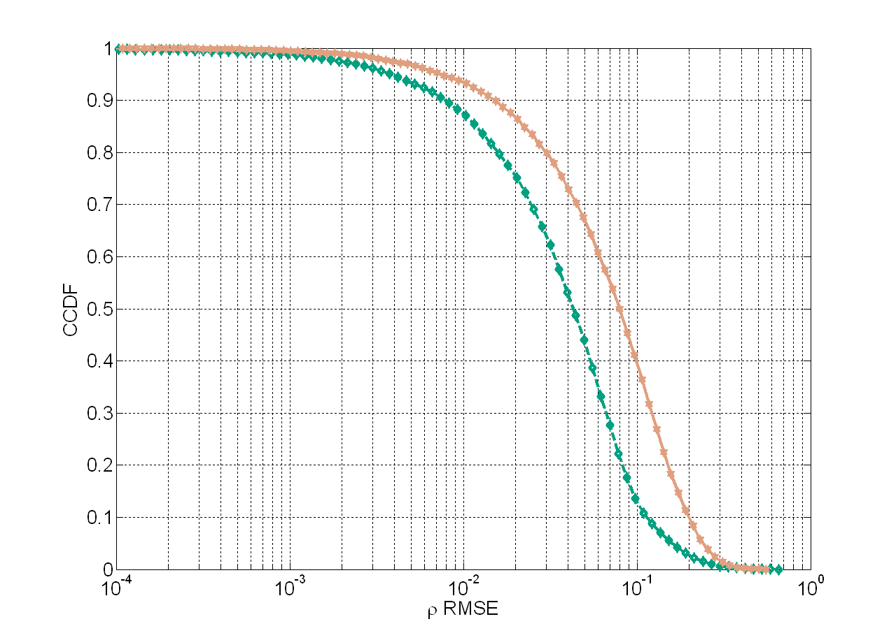
Simulations
Magnitude estimation of the correlation coefficient
Random phase and
magnitude for the
noise correlation.

Slide 27
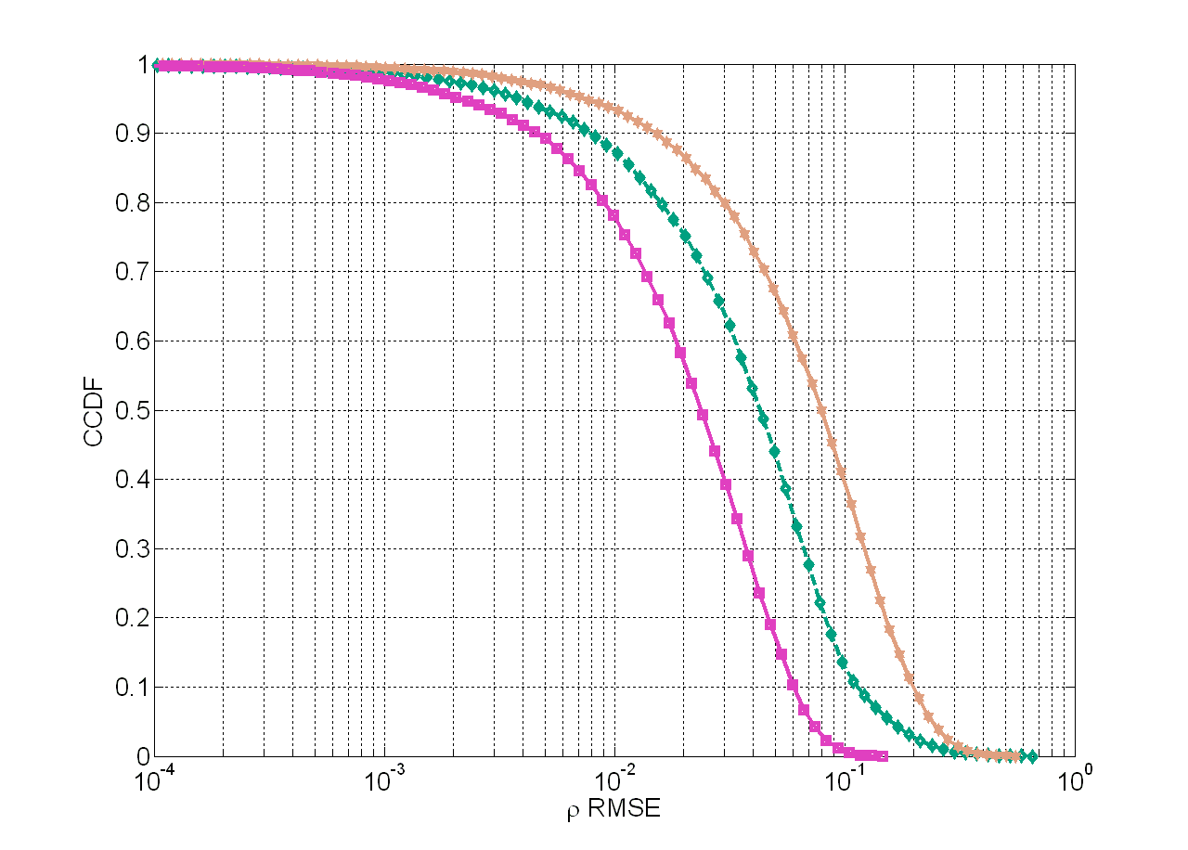
Simulations
Magnitude estimation of the correlation coefficient
Random phase and
magnitude for the
noise correlation.

Slide 28
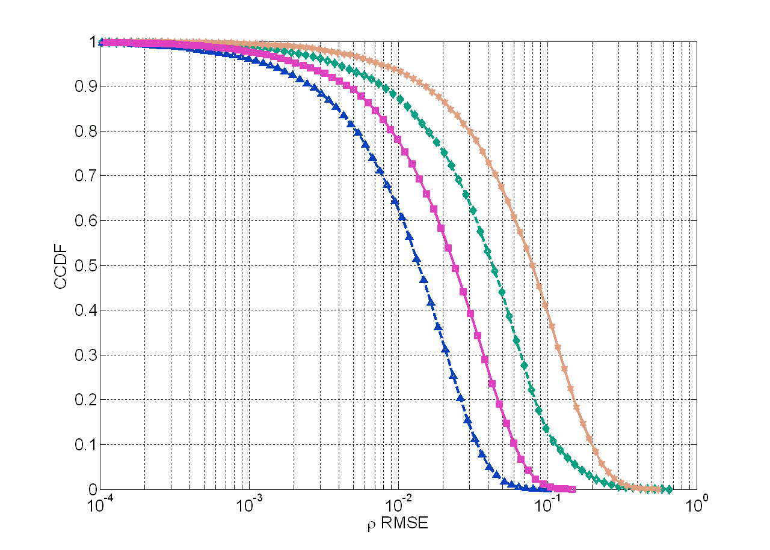
Simulations
Magnitude estimation of the correlation coefficient
Random phase and
magnitude for the
noise correlation.

Slide 29
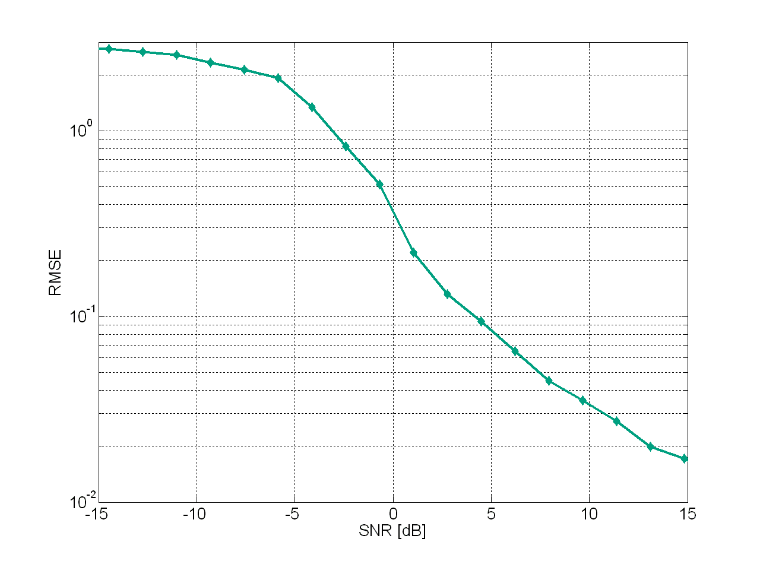
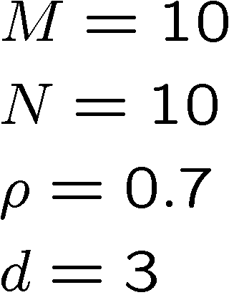
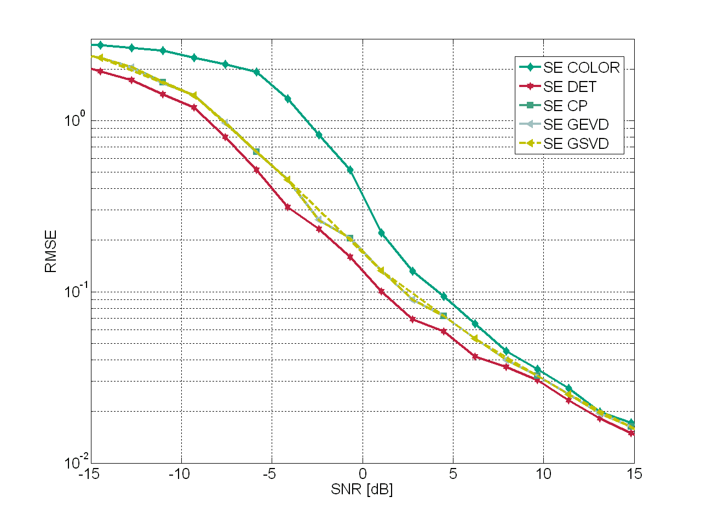
Simulations
Comparing the prewhitening schemes
The noise correlation is known.

Slide 30
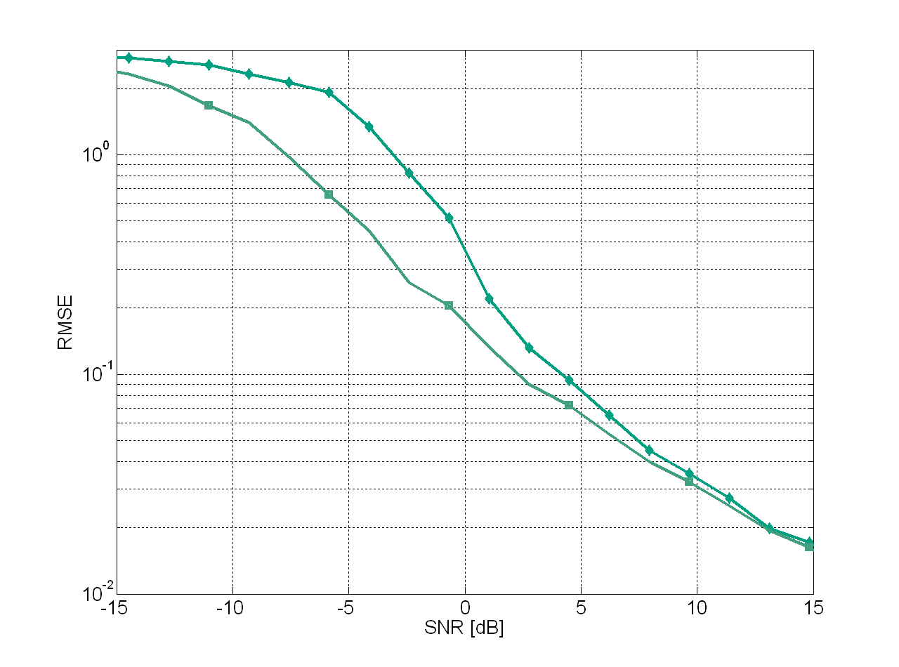
Simulations
Comparing the prewhitening schemes
The noise correlation is known.

Slide 31
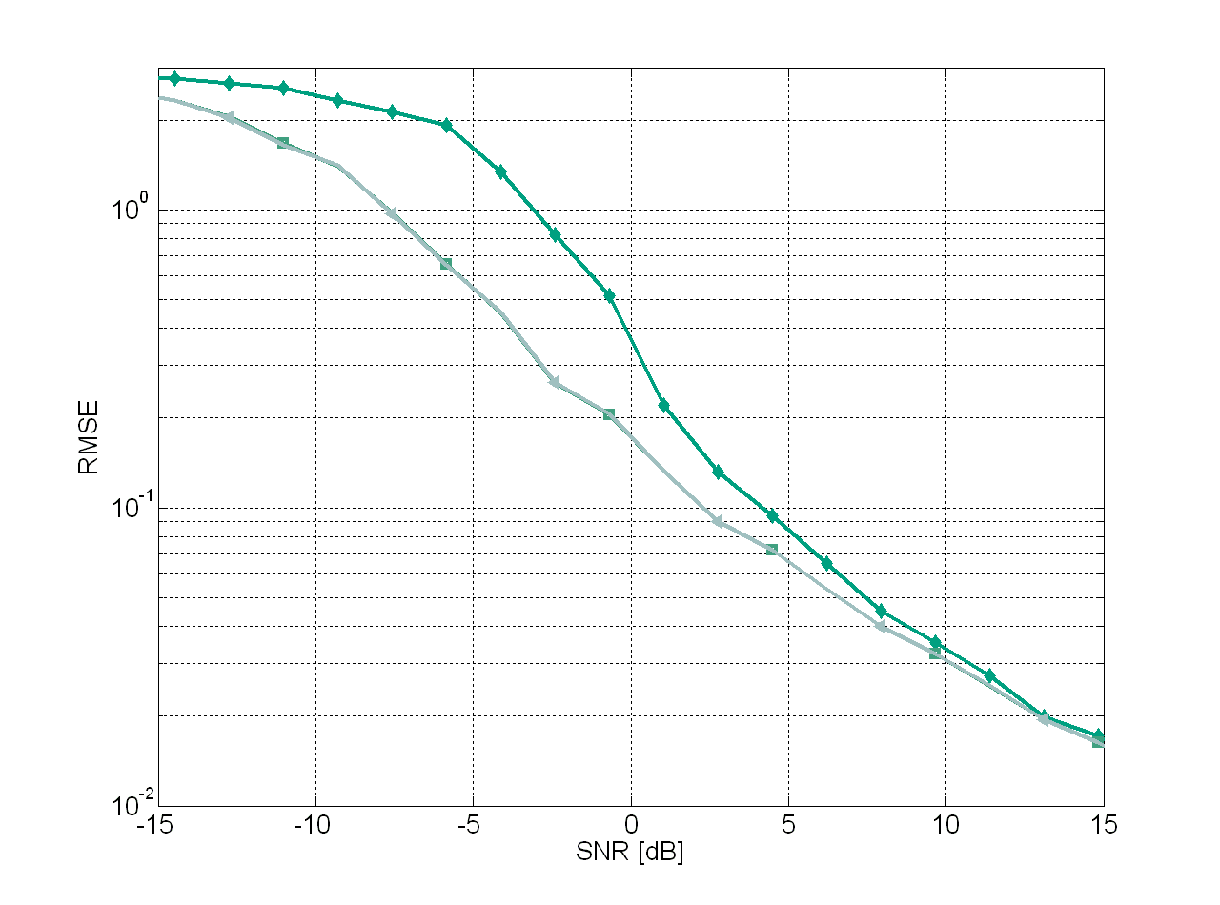
Simulations
Comparing the prewhitening schemes
The noise correlation is known.

Slide 32
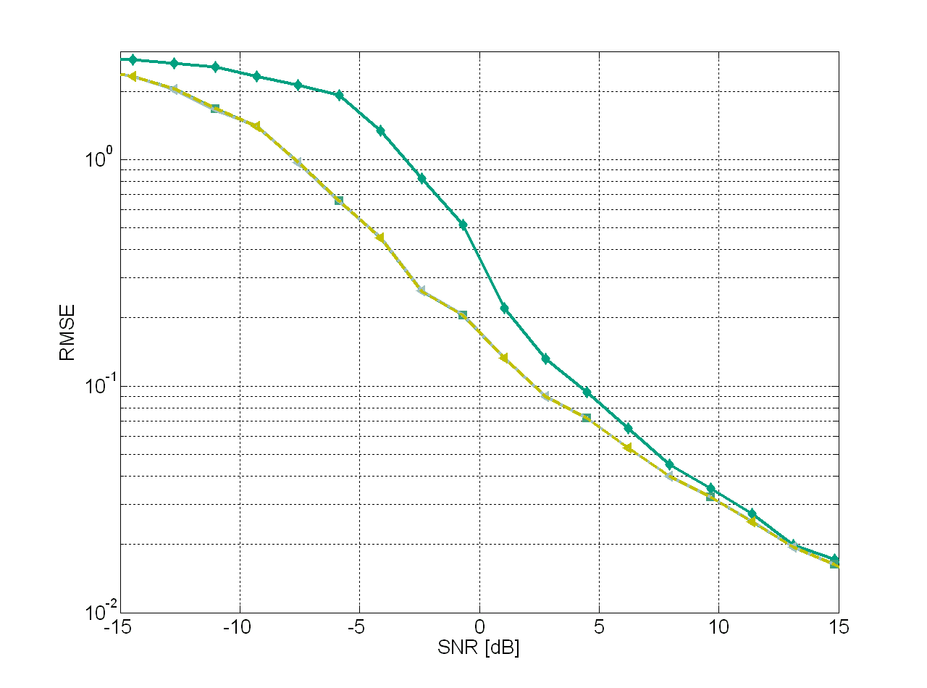
Simulations
Comparing the prewhitening schemes
The noise correlation is known.

Slide 33
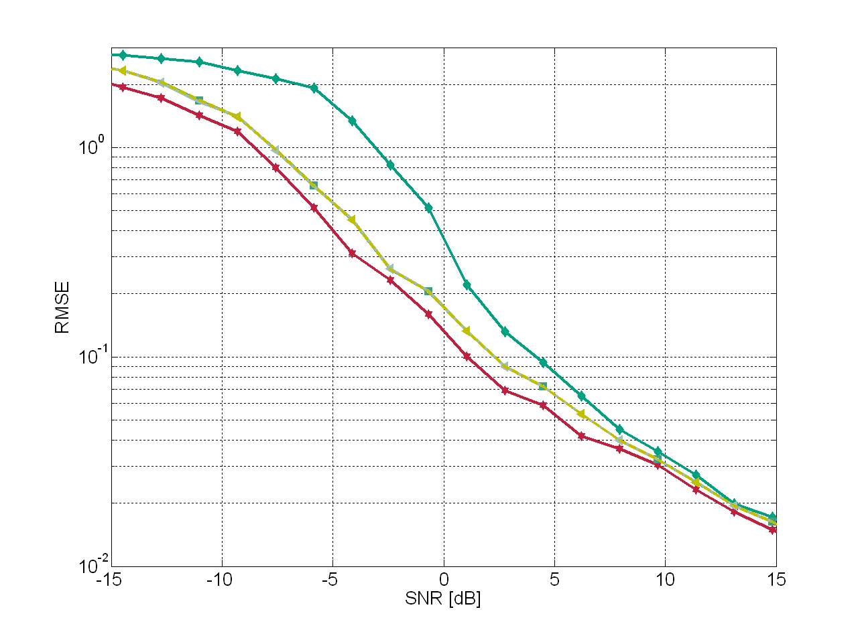
Simulations
Comparing the prewhitening schemes
The noise correlation is known.

Slide 34
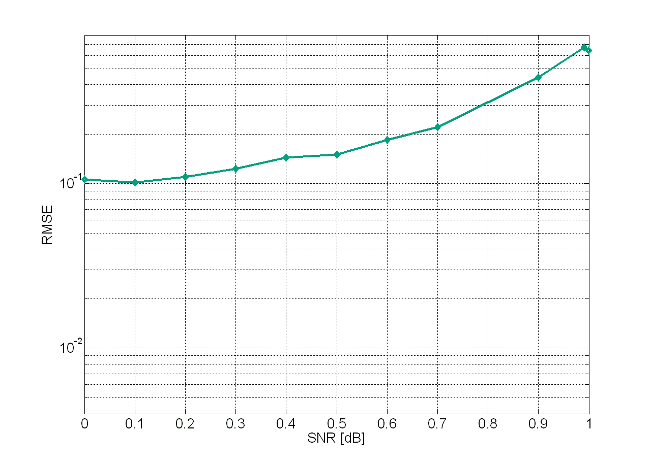


Simulations
Comparing the prewhitening schemes
The noise correlation is known.

Slide 35

Simulations
Comparing the prewhitening schemes
The noise correlation is known.

Slide 36

Simulations
Comparing the prewhitening schemes
The noise correlation is known.

Slide 37

Simulations
Comparing the prewhitening schemes
The noise correlation is known.

Slide 38

Simulations
Comparing the prewhitening schemes
The noise correlation is known.

Slide 39
Outline
Data Model
Stochastic Prewhitening
Deterministic Prewhitening
Correlation Coefficient Estimation
Simulations
Conclusions

Slide 40
Conclusions
Our deterministic prewhitening scheme, which assumes a certain structure and depends on only one parameter, outperforms significantly stochastic prewhitening schemes for high noise correlation scenarios.
Since the correlation coefficient can be estimated, we can separate three cases:
  Low noise correlation: no prewhitening scheme;
  Intermediate noise correlation: stochastic prewhitening approaches;
  High noise correlation: deterministic prewhitening scheme.
Additionaly, we have proposed schemes to estimate the phase and the magnitude of the correlation coefficient taking into account the noise structure.

Slide 41
Thank you for your attention!
Vielen Dank für Ihre Aufmerksamkeit!
Ilmenau University of Technology
Communications Research Laboratory
P.O. Box 10 05 65
D-98684 Ilmenau, Germany
E-Mail: haardt@ieee.org

Slide 42

Deterministic Prewhitening
Given the noise model in [1], the noise correlation matrix is given by

