Slide 1
Robot Run Café in LA
Market analysis of Los Angeles based eateries by type, whether a chain, location, and size.

Slide 2
Conclusions & Recommendations
The dataset contains 9,391 eateries in Los Angeles
75% of eateries are dubbed “Restaurants”
37% of eateries are chains
Most eateries have less than 50 seats, and within those, the average eatery has about 20
27% of eateries are located on one of the top 10 streets

Slide 3
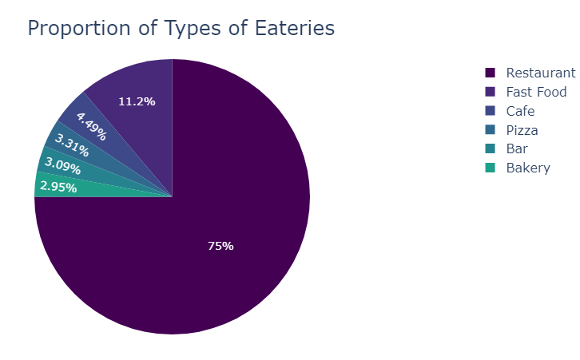
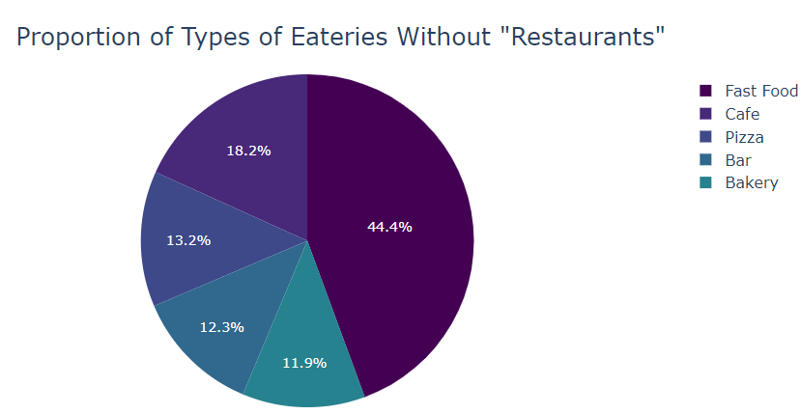
Most eateries are “Restaurants”
While most eateries are dubbed “Restaurants”, I am concerned this is a catch-all category as the term is not defined
Without “Restaurants”, “Fast Food” followed by “Café” are the largest eatery types
The difference between the sizes of the remaining 3 categories (“Pizza”, “Bar”, and “Bakery”) lacks significance

Slide 4
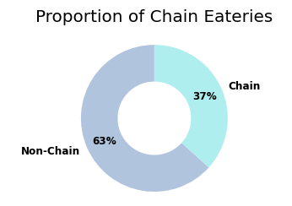
Most eateries are not part of a chain
61% of eateries are not a part of a chain, while 39% are.

Slide 5
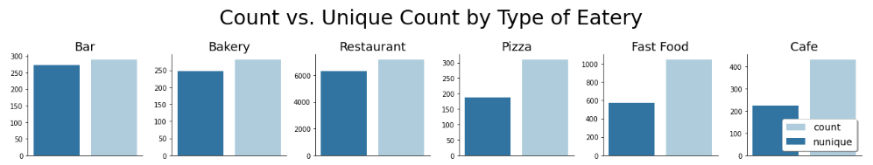
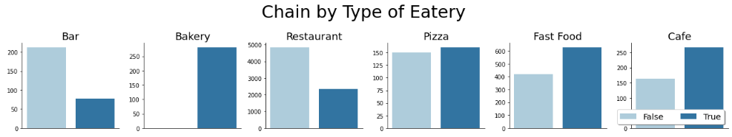
Fast Food venues, Cafes, and Pizza shops have a higher percentage of chains, or multiple locations than the remaining three
In the first graph, the size of the gap the bars demonstrates the amount of eateries with multiple locations for each type, i.e., potentially a chain. Fast Food, Cafes, and Pizza eateries had wider gaps which intuitively makes sense as they are more likely to be chains than Bakeries, Bars, and Restaurants
However, the breakdown in the second graph indicates that Bakeries are all chains and Pizza shops have few (which I addressed in my recommendations to the engineers)

Slide 6
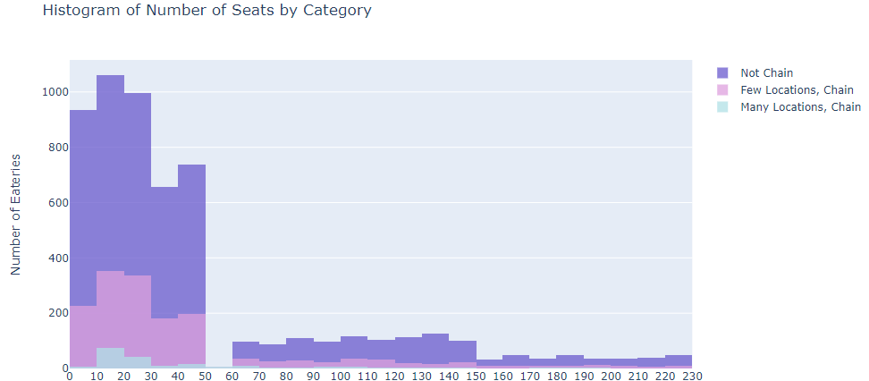
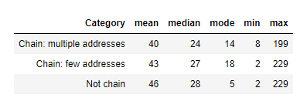
Chain/Number of locations did not affect the average number of seats for an eatery
The graphs demonstrate that the spread across the categories is very similar.
Each category has more eateries with <50 seats with a peak from 10 to 20 seats, few with between 20 and 30 seats, and a small increase between 40 and 50.

Slide 7
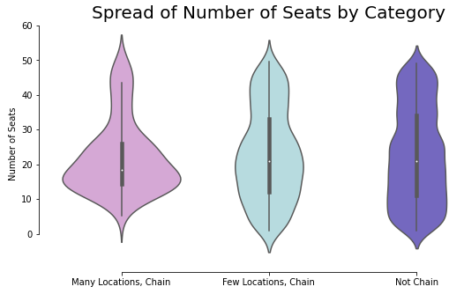
Chains with many locations tend to have fewer seats than chains with few location and non-chains.
The “Many Locations, Chain” category is bottom heavy meaning that it tends towards few seats within the eateries that have <=50 seats.
The 2 categories with fewer locations seem to follow a more similar, more evenly spread pattern with regard to seats.
However, the "Few Locations, Chain" category is more similar to the "Many Locations, Chain" than "Not Chain" is to the "Many Locations, Chain" category. It looks like the violin is being squeezed meaning that the weight towards the bottom becomes less and less as the category moves farther away from being a chain.

Slide 8
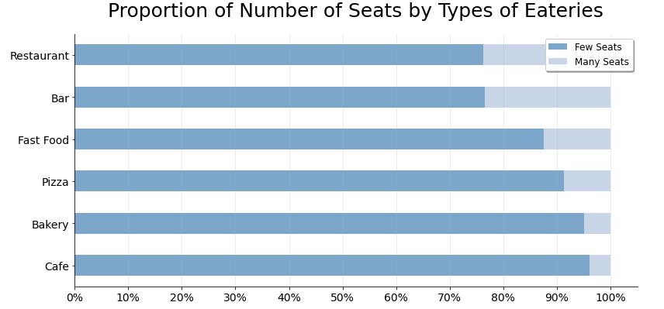
Restaurants and Bars are most likely to have more than 50 seats
Restaurants and bars are most likely to have more than 50 seats
Less than 90% of pizza shops, bakeries, and cafes have fewer than or equal to 50 seats, with fast food hovering around 88%.

Slide 9
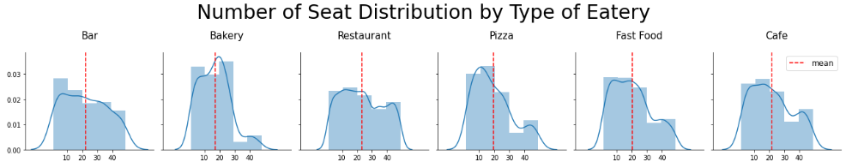
Within eateries with <=50 seats, type may be correlated with number of seats
When only considering eateries with 50 seats or less, all types average around 20 seats
The number of seats distribution for Restaurants doesn't really depict a pattern which supports my earlier concern that it's a catch all category
Bakeries, then pizza shops most heavily trend towards fewer seats
Fast food, bars, and cafes have more of an even spread, but maintain a right skew, i.e., trend towards fewer seats
Up to 20 seats seems to be most popular

Slide 10
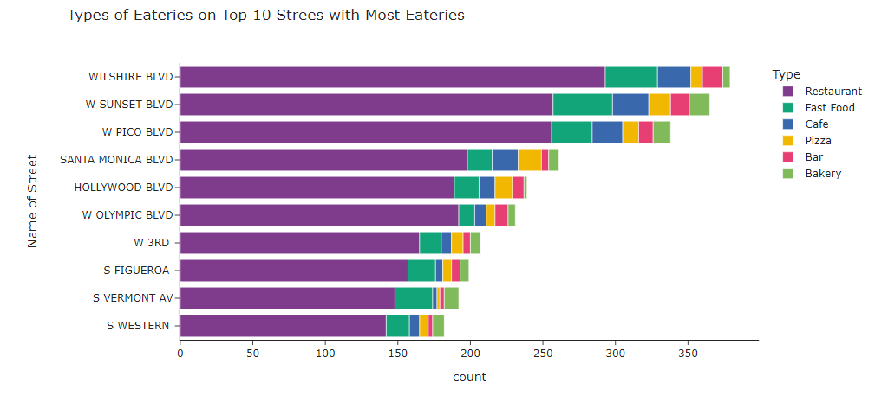
While the top 10 streets account for only 1% of the total streets, 27 % of eateries are located on one of them.

Slide 11
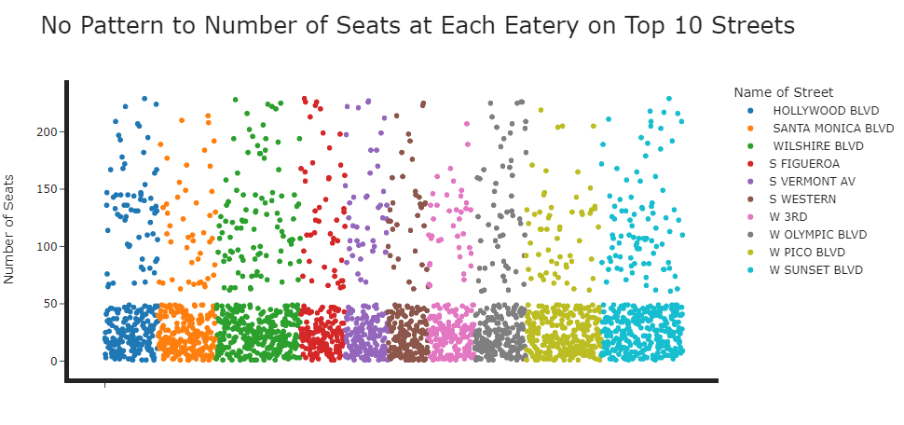
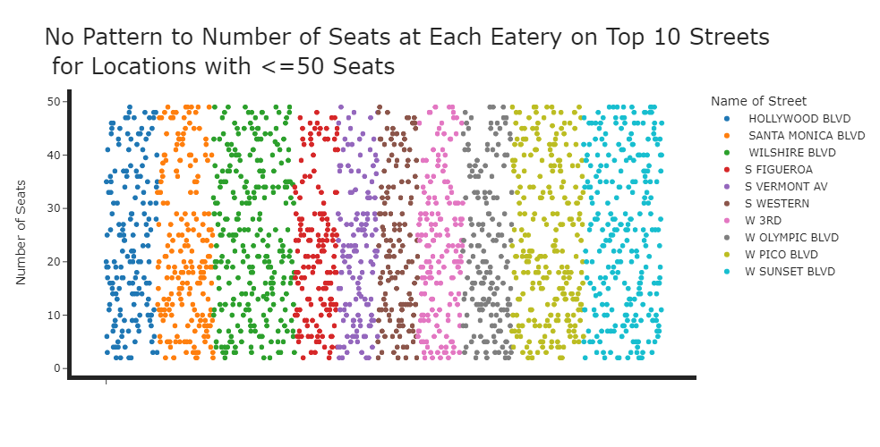
No relationship between location and size of eatery
2,022 or 78% of eateries have <=50 seats
When broken down further by individual street, all streets hover around this number (min=71%, max=86%).
This is not different then the whole population which hovers around 79% with few seats.
There are no meaningful differences in number of seats per eatery by street

