Slide 1

Deep learning for biologists:
From Classification to Segmentation
Thierry Pécot
Research Associate
Translational Science Lab
Chan Zuckerberg Initiative Imaging Scientist

Slide 2
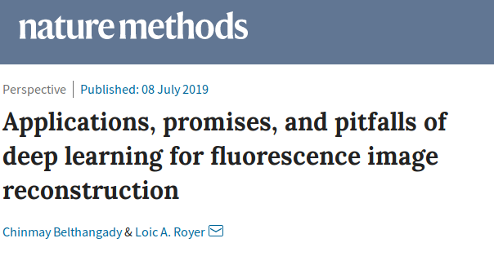
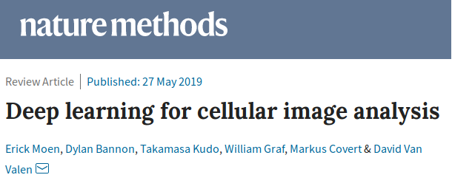
Deep Learning Applications in Microscopy

Slide 3
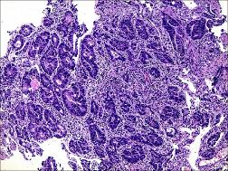
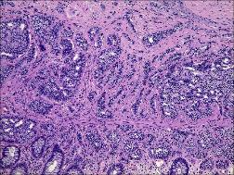
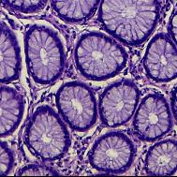
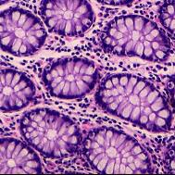
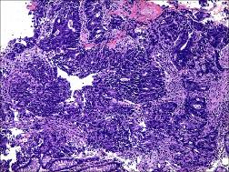
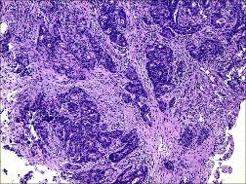
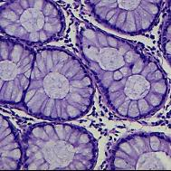
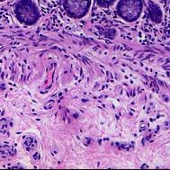
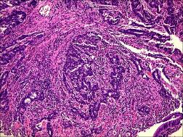
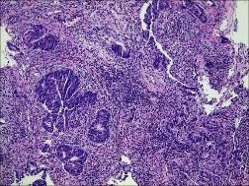
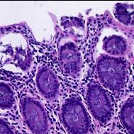
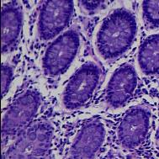
Image Classification
Adenocarcinoma
vs normal

Slide 4
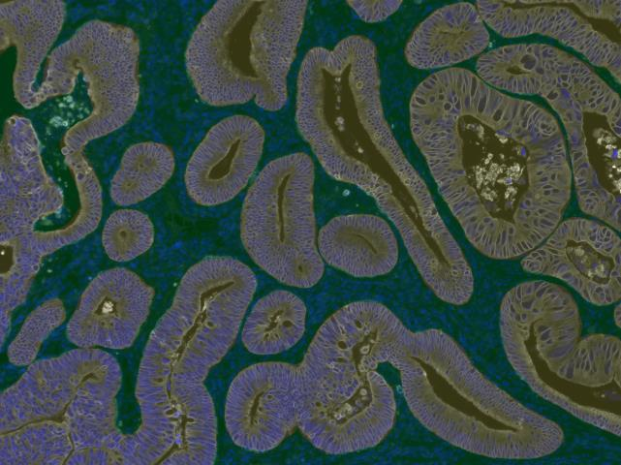
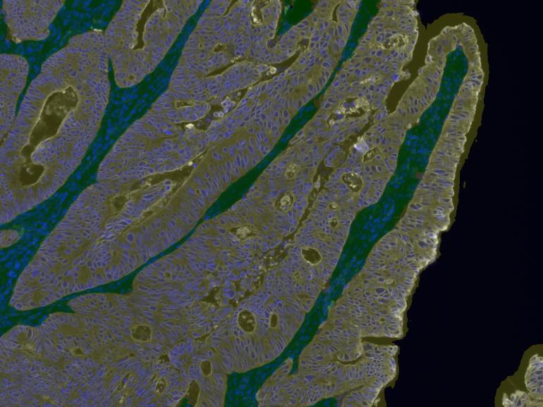
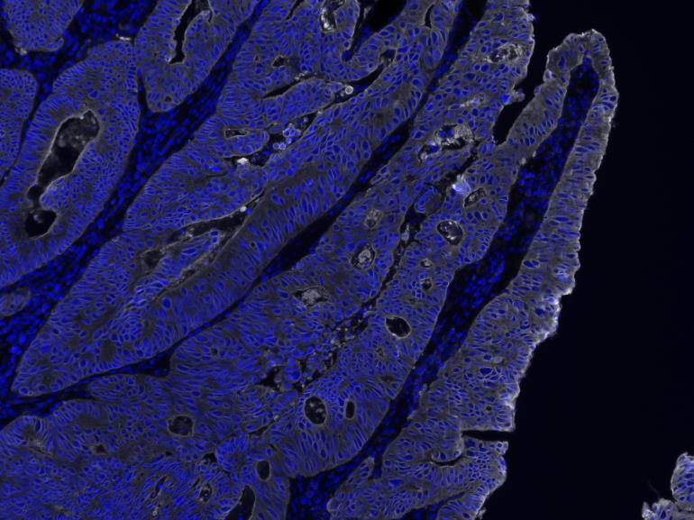
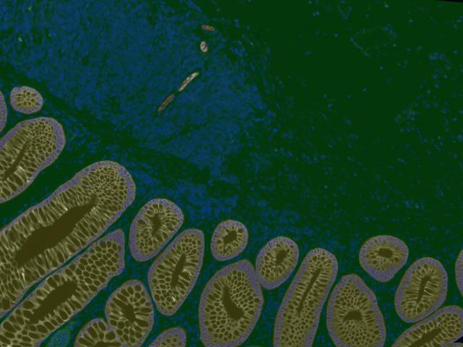
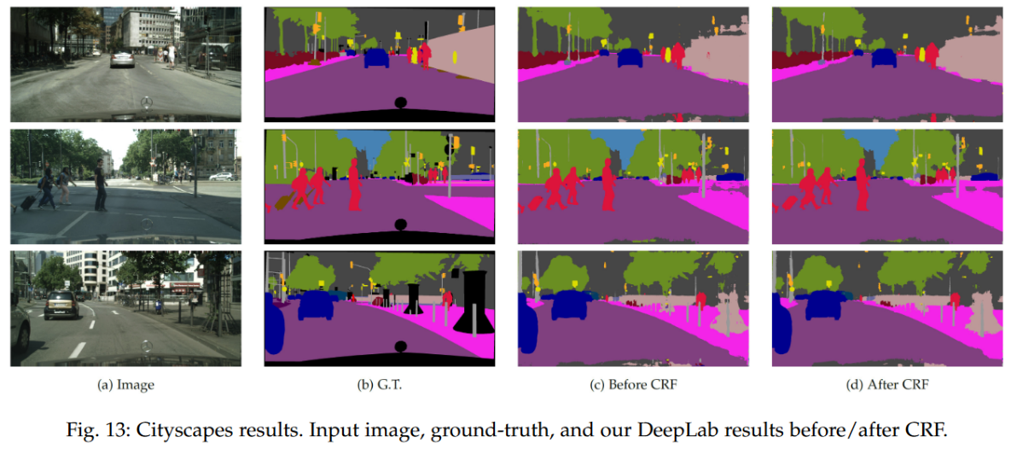
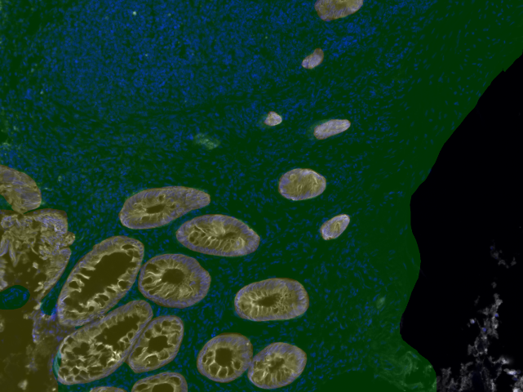
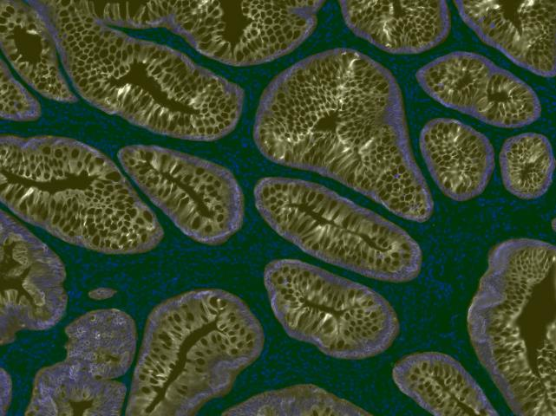
Tissue segmentation
Training dataset
Chen et al., DeepLab. IEEE transactions on pattern analysis and machine intelligence, 2017.

Slide 5
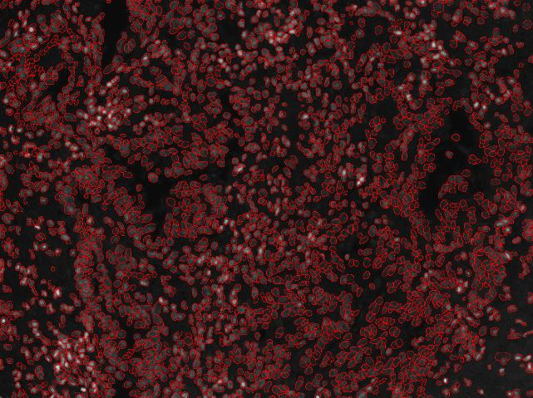
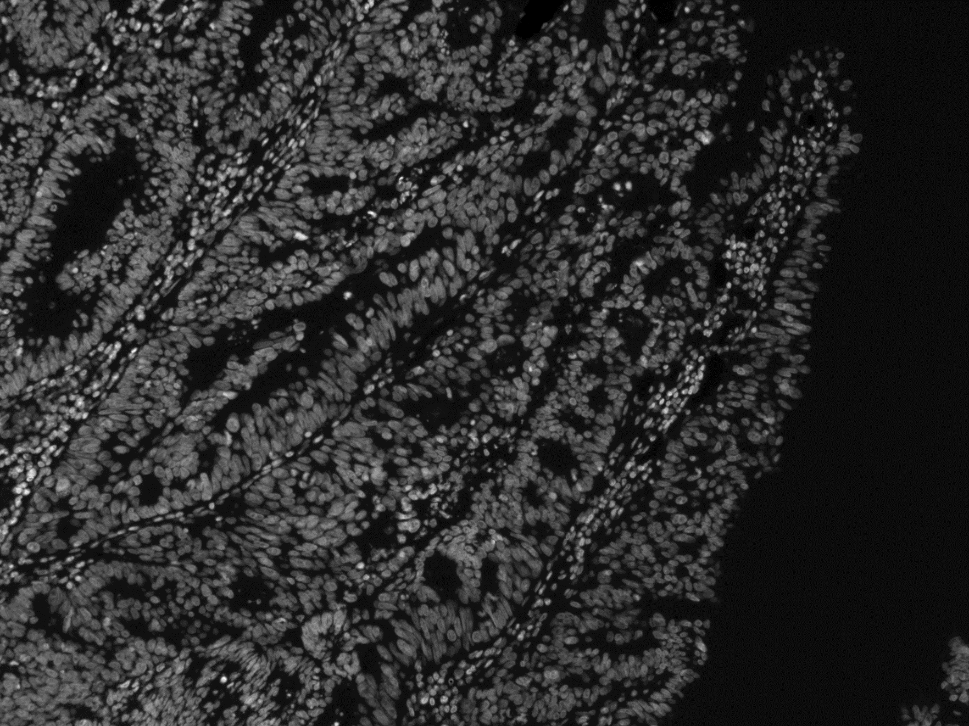
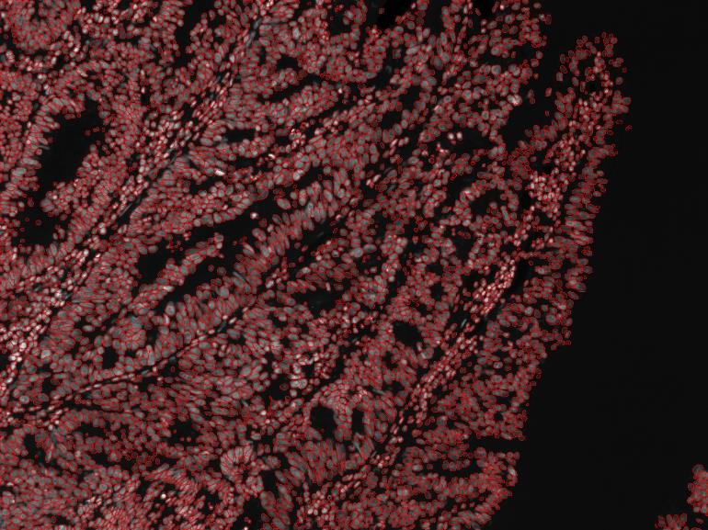
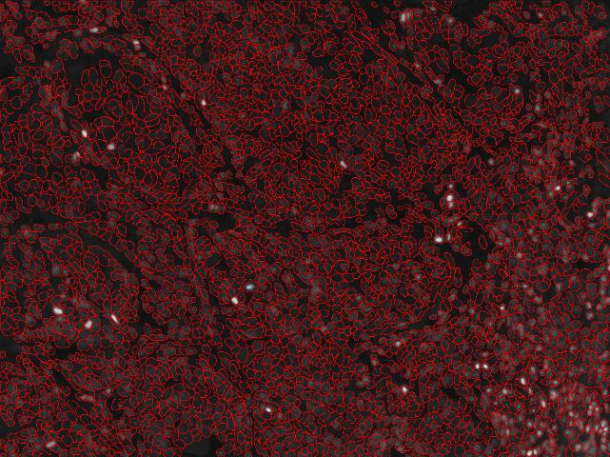
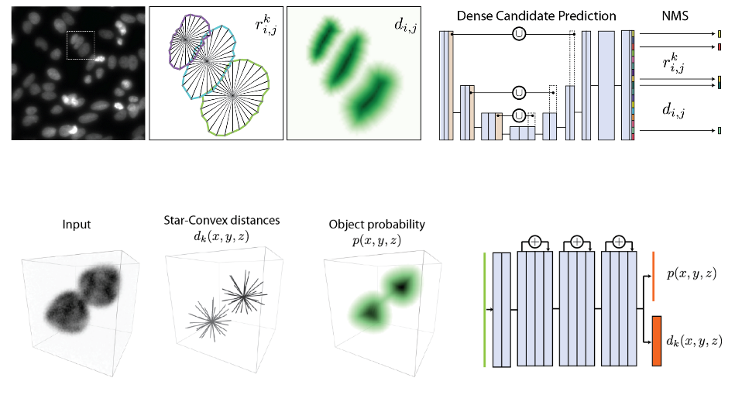
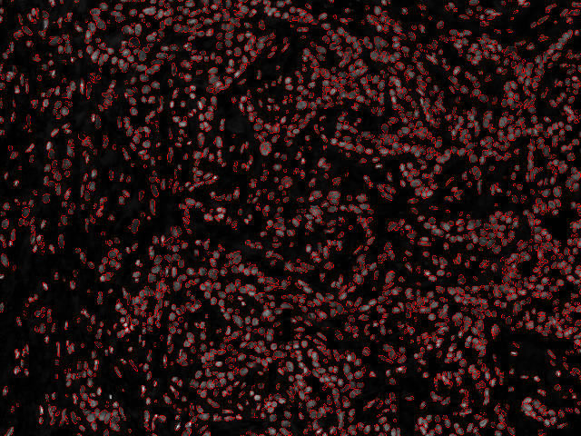
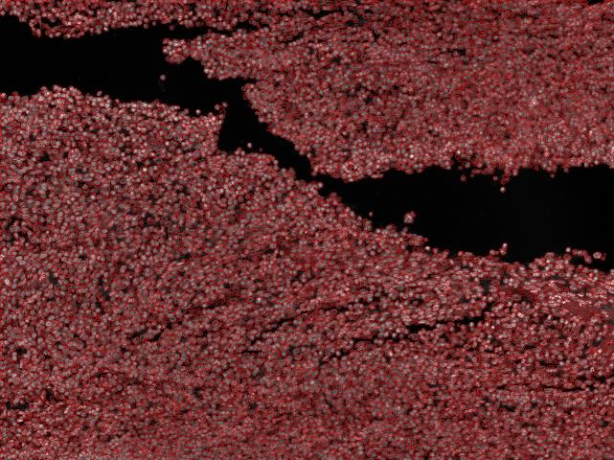
Nuclei Segmentation – 2D/3D
Training dataset
Schmidt et al. Cell detection with Star-Convex Polygons. MICCAI, 2018.
Weigert et al. Star-Convex Polyhedra for 3D Object Detection and Segmentation in Microscopy. WACV, 2020.

Slide 6
Program
Introduction to deep learning
Software installation (Python, cuda and required Python packages)
Image classification with MNIST
Image classification and transfer learning with MobileNetV2
Presentation and installation of ImageJ plugin Annotater
Annotation of epithelium and stroma with Annotater
Training and processing U-Net for epithelium/stroma segmentation
Training and processing U-Net for 2D nuclei segmentation
Training and processing Stardist for 2D nuclei segmentation
Combining results from U-Net and Stardist for 2D nuclei segmentation
Using simulated data to define training dataset
Training and processing Stardist for 3D nuclei segmentation

