Slide 1
Nx AI Manager — Stress Dashboard
Post-Processor
Capacity planning & stress testing for the NX AI Manager · Nx Meta and Nx Witness
Live CPU / RAM / GPU / NPU load · total & per-channel inference FPS · exportable reports
Network Optix

Slide 2
Overview
What it is and why it exists
A custom NX AI Manager post-processor that answers the question every integrator faces: “For this model and this many cameras, what frame rate do I actually get, and how hard is the hardware working?”
It runs as a transparent pass-through — measuring throughput without altering inference results — and pairs that with whole-machine resource load.
What it solves
• Capacity planning — how many channels can a box sustain before FPS drops?
• Bottleneck ID — which resource saturates first: CPU, GPU or NPU?
• Benchmarking — repeatable, shareable reports per model + camera-count + hardware.

Slide 3
How it works
Two cooperating components
Post-processor
Counts inference frames per camera channel (by DeviceID) and forwards per-second counts to the web app. Never modifies the inference results.
Web app
Samples whole-machine CPU/RAM/GPU/NPU once per second, turns frame counts into FPS, serves the live dashboard, records named runs, and exports reports.
Data path
NX AI Manager → (Unix socket) → Post-processor → (HTTP) → Web app → SQLite → Dashboard / Report

Slide 4
What it measures
…and where the numbers come from
Capabilities
• Live resource load — CPU, RAM, GPU, NPU (whole machine)
• Total throughput — concurrent inference FPS, all channels
• Per-channel FPS — by DeviceID, renamable
• Stress report — named run → HTML (charts + avg/peak/min/p95) + CSV
• Portable — auto-detects Nx Meta & Witness; sources degrade gracefully
Metric sources (Linux)
• CPU / RAM — psutil
• Intel NPU — intel_vpu sysfs busy-time (no root)
• Intel iGPU — xe / i915 DRM fdinfo (root) · freq fallback
• NVIDIA — NVML: util, mem, power, temp

Slide 5
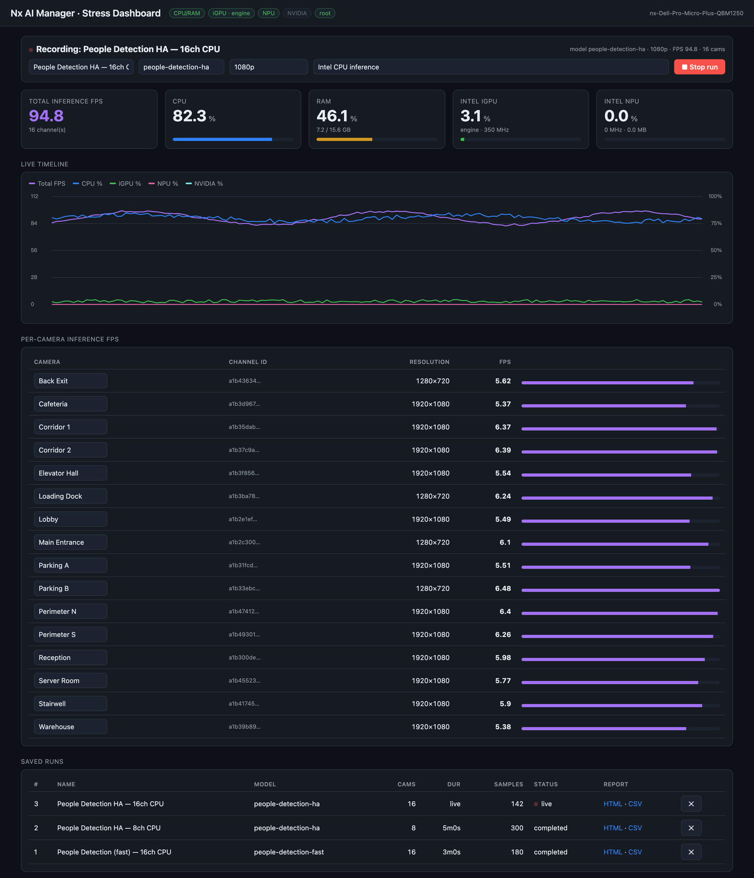
Live Dashboard — simulated
16 cameras · People Detection (high accuracy) · Intel CPU inference
Reading the example
• Throughput — ~94.8 FPS across 16 channels (~5.9 FPS/camera).
• Where the load is — CPU is the bottleneck at ~82%; iGPU (~3%) and NPU (~0%) sit idle — expected when inference is pinned to the CPU.
• Takeaway — offloading to the NPU or iGPU would free CPU headroom and raise the achievable channel count.

Slide 6
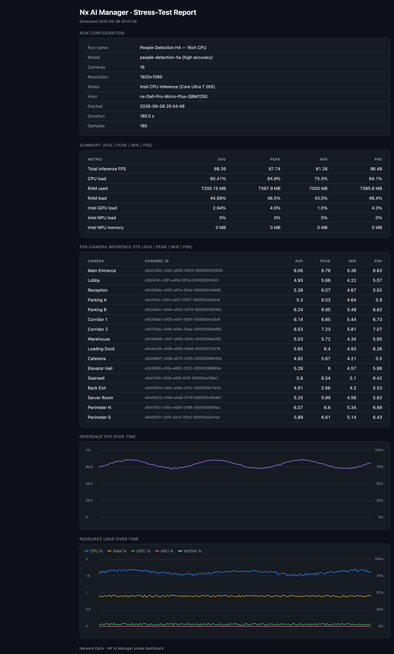
Stress-Test Report
Self-contained HTML + CSV export per run
Summary — avg / peak / min / p95
• Total inference FPS: 89.41 / 98.15 / 81.39 / 96.48
• CPU load: 80.47% / 84.8% / 75.5% / 84%
• RAM used: 7206.54 MB / 7399.8 MB / 7000.2 MB / 7380.6 MB
• Intel iGPU load: 3.13% / 4.5% / 1.5% / 4.4%
• Intel NPU load: 0% / 0% / 0% / 0%
Run: People Detection HA · 16 cameras · 1920×1080 · 180 s · DELL Core Ultra 7 265.
Also embeds per-camera FPS and time-series charts (FPS + resource load); opens offline.

Slide 7
Deployment
One command
Auto-detects Meta vs Witness, installs deps, registers the post-processor without clobbering others, and starts the web app:
./deploy.sh <server_ip> <ssh_user> <ssh_password> 8120 --start
Then open http://<server>:8120, enable “Stress Dashboard” on the cameras under test, and run the model.
Run the web app as root for true Intel iGPU engine utilisation; CPU, RAM and NPU work without root. GPU/NPU load reads ~0 until inference actually runs on that device.
Network Optix · NX AI Manager — Stress Dashboard post-processor

