Slide 1
Minimizing Simple and Cumulative Regret in MCTS
T. Pepels, T. Cazenave,
M.H.M. Winands, M. Lanctot

Slide 2
Content
Regret
In Multi-Armed Bandits
In Monte-Carlo Tree Search
Sequential Halving Applied to Trees
Hybrid MCTS
Experiments and Results
Conclusion

Slide 3
Multi-Armed Bandits (MAB)
Decision-making problem
Exploration vs. Exploitation
Two Contexts (Bubeck et al., 2010)
Cumulative regret
Simple regret

Slide 4
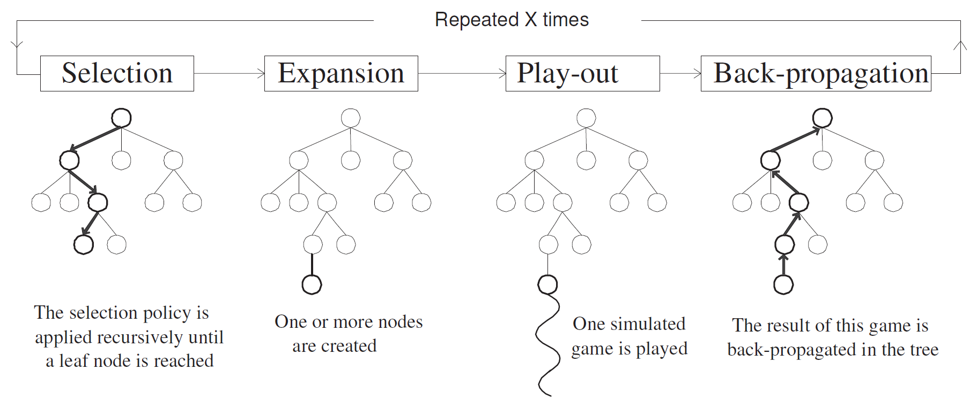
Monte-Carlo Tree Search (MCTS)
(Chaslot et al., 2008)

Slide 5
Regret
Cumulative regret (CR)
Every sample has a ‘cost’
Aim for lowest overall ‘cost’
Slot machine example
Simple regret (SR)
Sampling is ‘free’
Realistic simulated environment
Aim for best recommendation

Slide 6
Regret Minimization in MCTS
Regret minimization on every ply
Upper Confidence Bounds for Trees (UCT)
Minimizes Cumulative Regret
O(ln n) bounds on sub-optimal selections
Converges to greedy selection

Slide 7
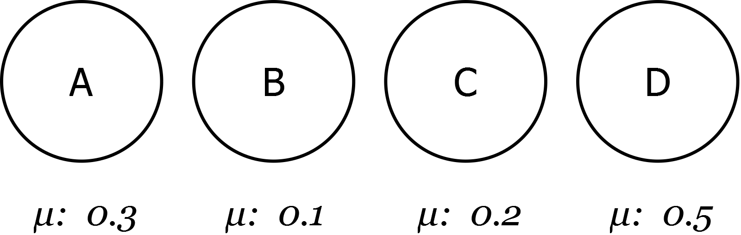
Multi-Armed Bandits (MAB)

Slide 8
Multi-Armed Bandits (MAB)
s₁ = 0.05
s₂ = 0.2
s₃ = 0.3
s₄ = 0.2
m_{A} = 0.19
s₅ = 0.1
s₆ = 0.2
s₇ = 0.05
s₈ = 0.01
m_{B} = 0.09
s₉ = 0.1
s₁₀ = 0.2
s₁₁ = 0.2
s₁₂ = 0.1
m_{C} = 0.15
s₁₃ = 0.4
s₁₄ = 0.2
s₁₅ = 0.1
s₁₆ = 0.4
m_{D} = 0.28

Slide 9
Multi-Armed Bandits (MAB)
s₁ = 0.05
s₂ = 0.2
s₃ = 0.3
s₄ = 0.2
m_{A} = 0.19
s₅ = 0.1
s₆ = 0.2
s₇ = 0.05
s₈ = 0.01
m_{B} = 0.09
s₉ = 0.1
s₁₀ = 0.2
s₁₁ = 0.2
s₁₂ = 0.1
m_{C} = 0.15
s₁₃ = 0.4
s₁₄ = 0.2
s₁₅ = 0.1
s₁₆ = 0.4
m_{D} = 0.28

Slide 10
Multi-Armed Bandits (MAB)
m_{A} = 0.19
m_{B} = 0.09
m_{C} = 0.15
m_{D} = 0.28

Slide 11
Multi-Armed Bandits (MAB)
m_{A} = 0.19
m_{B} = 0.09
m_{C} = 0.15
m_{D} = 0.28
Cummulative regret: R_{n}= 3.6
Simple regret r_{n} = 0

Slide 12
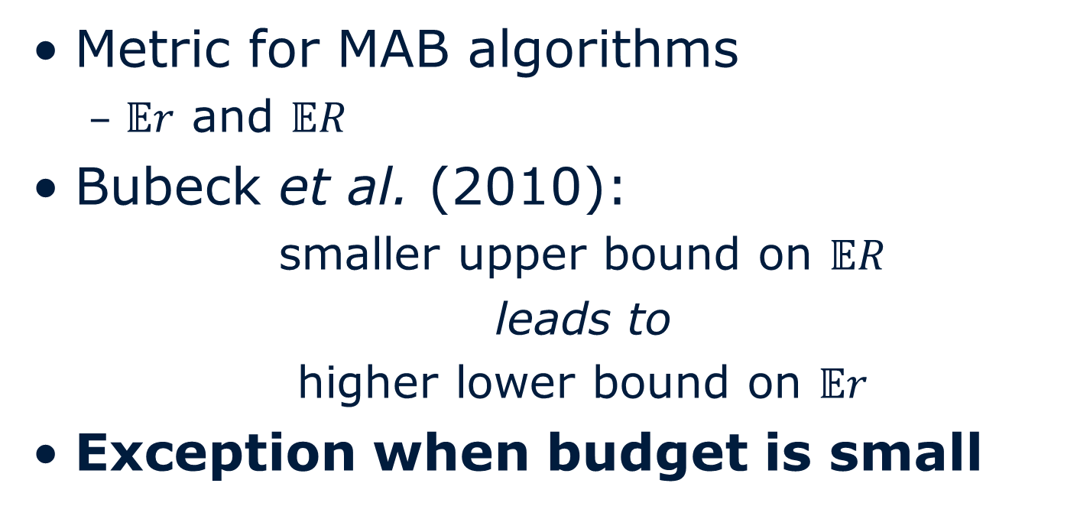
More on Regret
Metric for MAB algorithms
$𝔼r$ and $𝔼R$
Bubeck et al. (2010):
smaller upper bound on $𝔼R$
leads to
higher lower bound on $𝔼r$
Exception when budget is small

Slide 13
More on Regret
Bubeck et al. (2010)
Smaller upper bounds on the expected cumulative regret lead to higher lower bounds on the expected simple regret
No single method can provide optimal bounds on both simple and cumulative regret
When overall budget is small UCB empirically provides improved simple regret over other methods

Slide 14
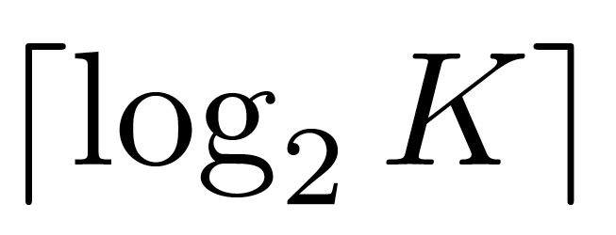
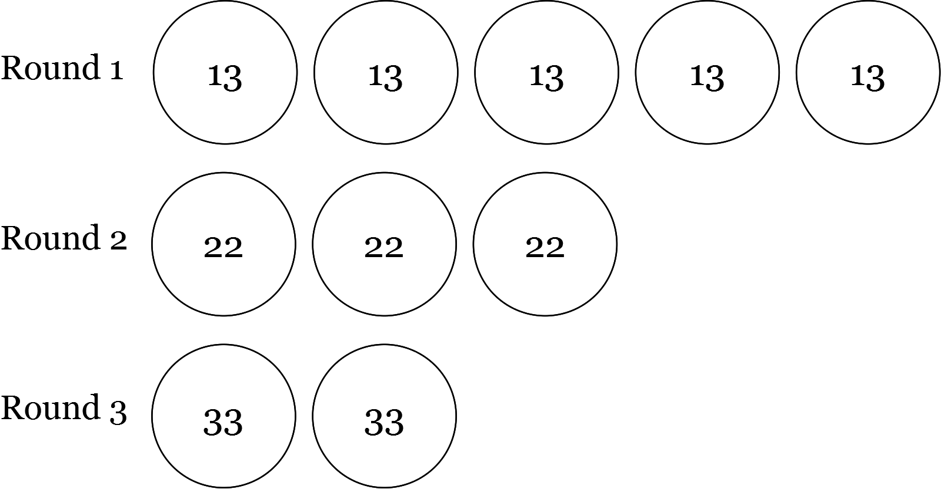
Minimizing Simple Regret
Sequential Halving (Karnin et al., 2013)
rounds
Remove worst ½ arms after each round
Recommend single remaining arm

Slide 15
Regret and MCTS
All samples are ‘free’
Costs only in terms of efficiency
Behaviour of agent in domain
Based only on recommendation
Why not minimize simple regret?

Slide 16
Regret and MCTS
Why UCT?
Spend minimal time on sub-optimal nodes
Find traps by searching deeper
Converges to game-theoretic value over time

Slide 17
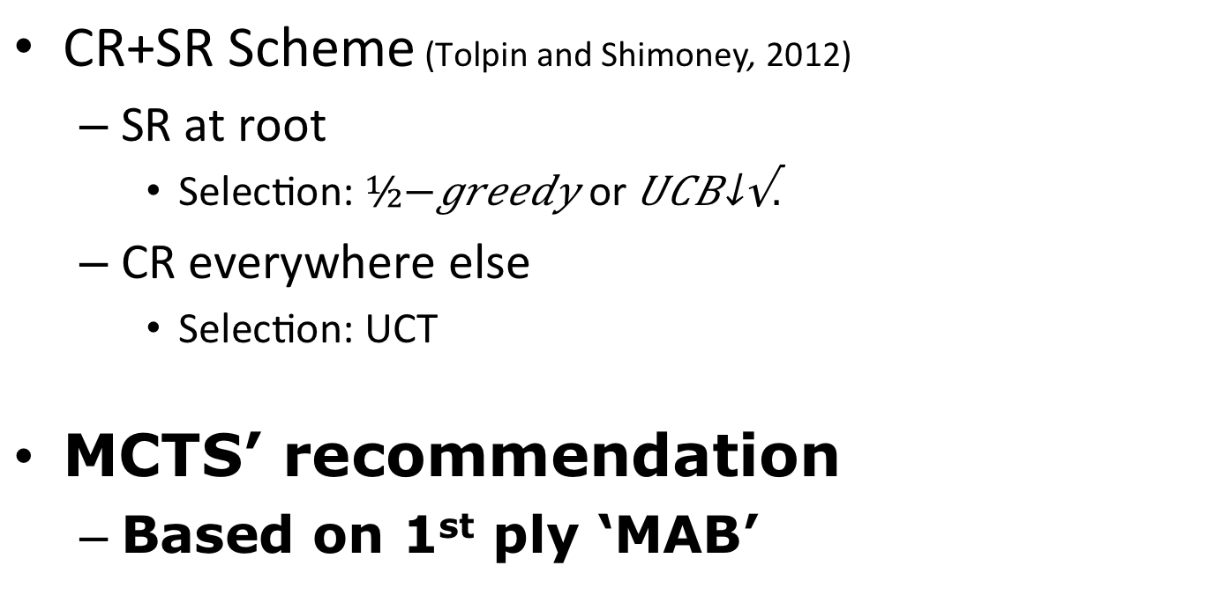
Simple Regret and MCTS
CR+SR Scheme (Tolpin and Shimoney, 2012)
SR at root
Selection: $½−greedy$ or ${UCB}_{\sqrt{.}}$
CR everywhere else
Selection: UCT
MCTS’ recommendation
Based on 1st ply ‘MAB’

Slide 18
Simple Regret and MCTS
Sequential Halving Applied to Trees (SHOT) (Cazenave 2014)
Faster than UCT
Recursive Seq. Halving
Minimize SR of best-reply
Not any-time
Requires knowledge of simulation budget
Outperforms UCT in NoGo (time-based)

Slide 19
Simple Regret and MCTS
Sequential Halving / SHOT
+ (SH) Best rate simple regret reduction
Back-propagation
CR+SR Scheme
+ Combined technique
- Inefficient selection in games

Slide 20
Hybrid MCTS
SR minimization near root
SHOT
CR minimization when budget is small
UCT
Switching point between SR and CR
Based on available budget

Slide 21
Hybrid MCTS
Switching point using budget limit B
h-mcts(node n, budget)
if (!isRoot(n) and budget < B)
do UCT(n) budget times
else
SHOT(n, budget)

Slide 22
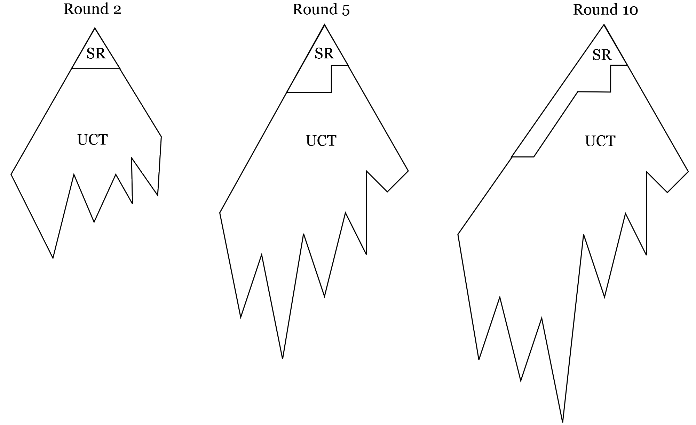
Hybrid MCTS

Slide 23
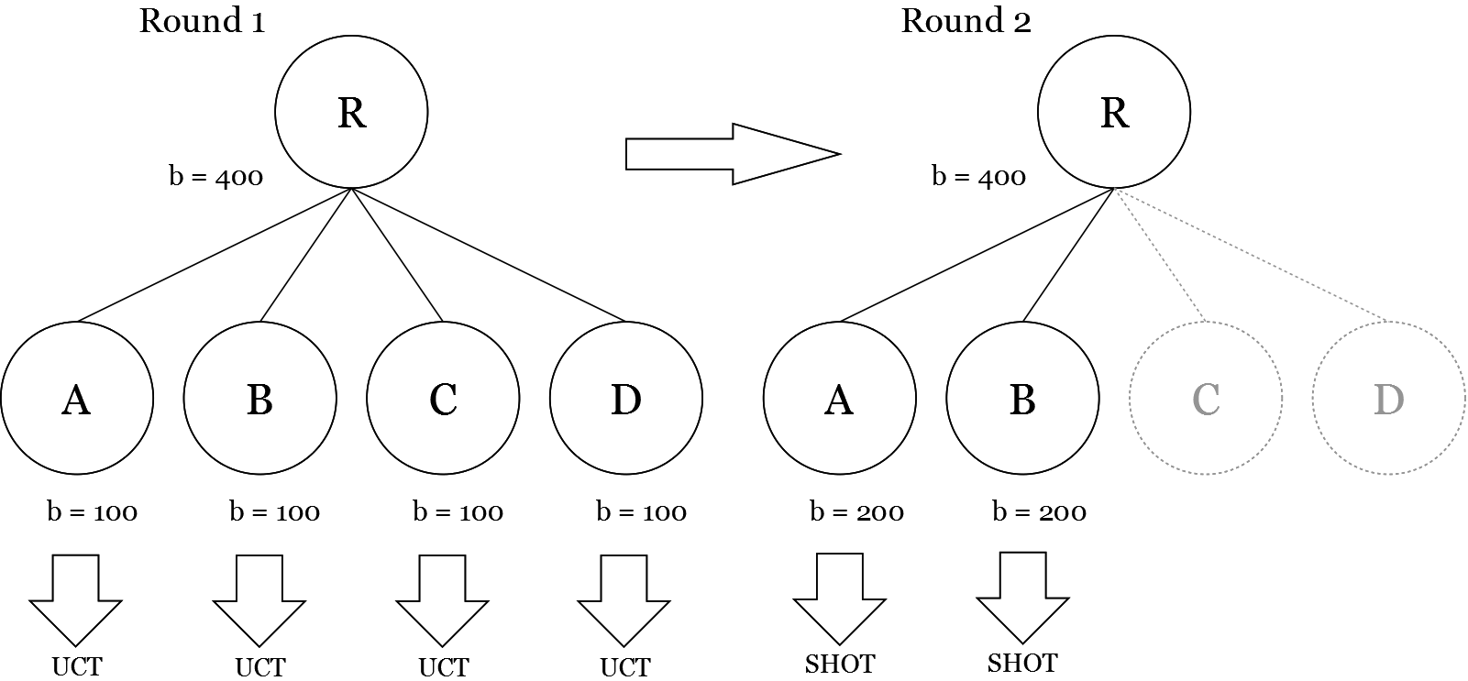
Hybrid MCTS
B = 150
Notes:
B = 150

Slide 24
Hybrid MCTS
B = 150
Notes:
B = 150

Slide 25
Hybrid MCTS
UCT’s any-time property
Low expected SR on recommendation
Low CR in tree
Use of UCT’s beneficial properties
Dynamic switching point B
Tuneable per game

Slide 26
Experiments
Java framework
Amazons (8x8)
Breakthrough (8x8)
NoGo (9x9)
Pentalath
C++ framework
AtariGo (9x9)
Ataxx (7x7)

Slide 27
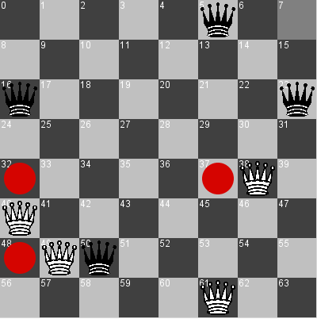
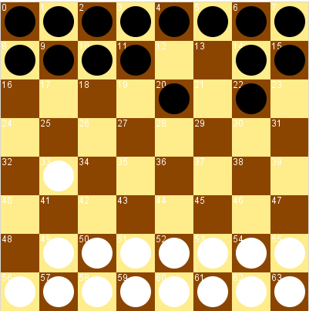
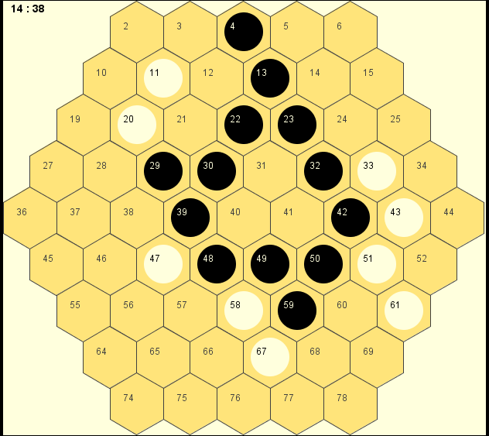
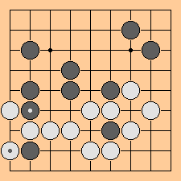
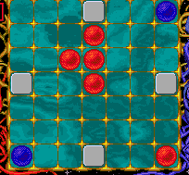
Experiments (domains)

Slide 28
Experiments
Fixed values for all C constants
Fixed budget, no timing
50% swapped seats
95% c.i.

Slide 29
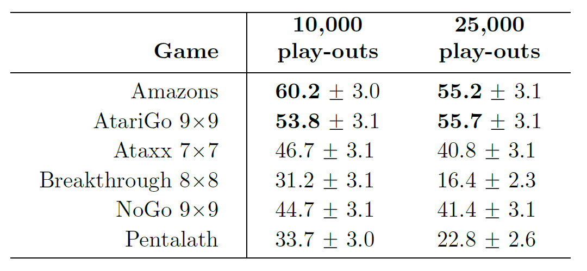
SHOT vs UCT

Slide 30
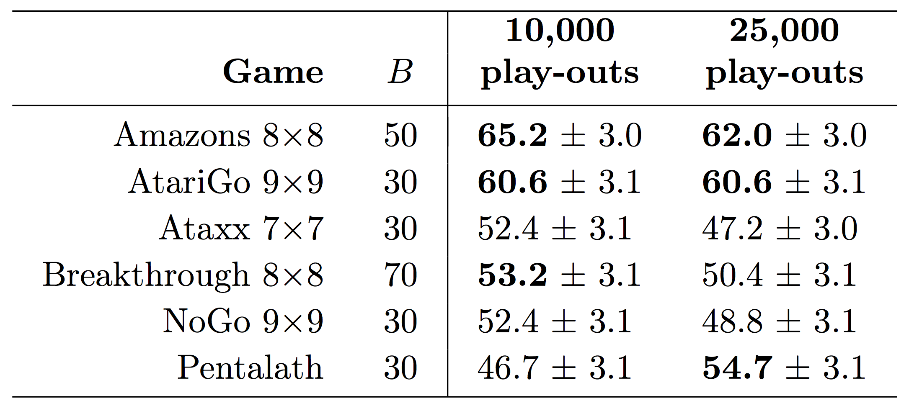
H-MCTS vs UCT
Notes:
Pentalath using 50.000 play-outs: 55.0% +- 3.1

Slide 31
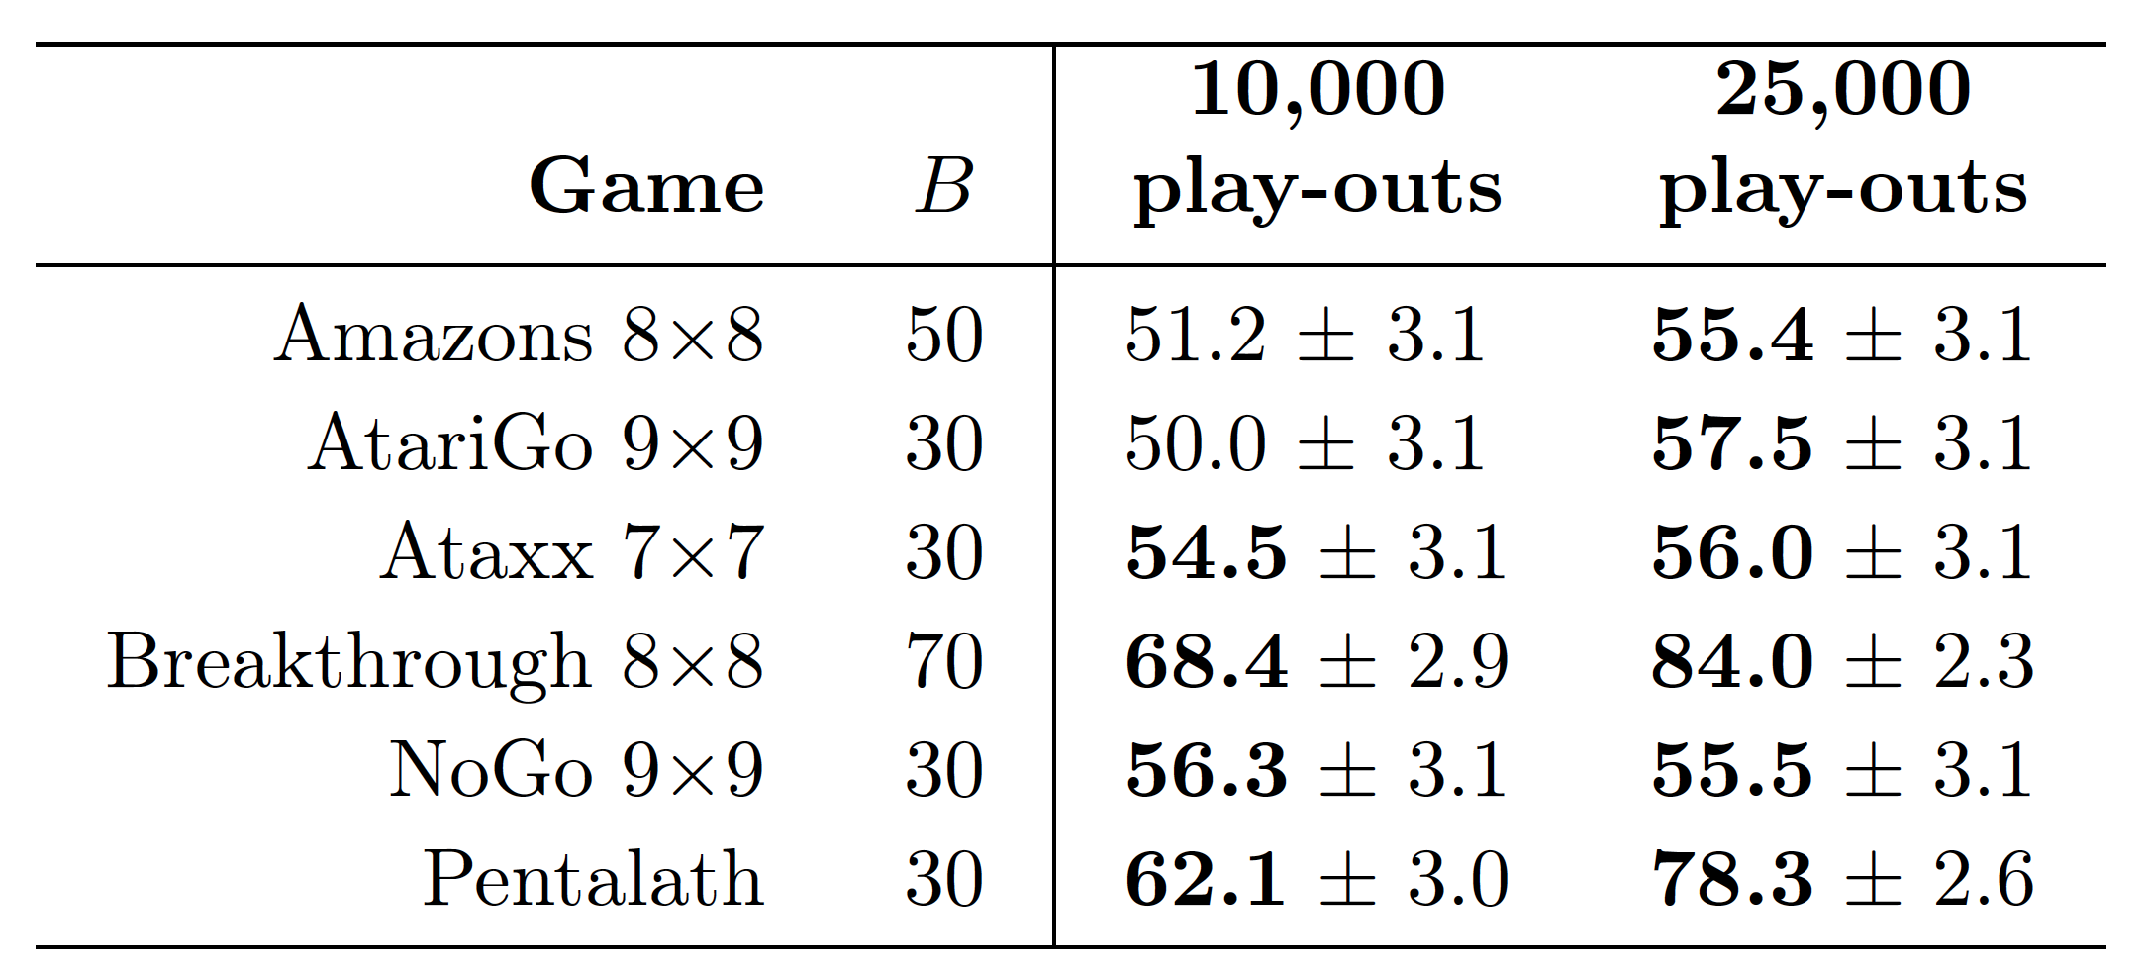
H-MCTS vs SHOT

Slide 32
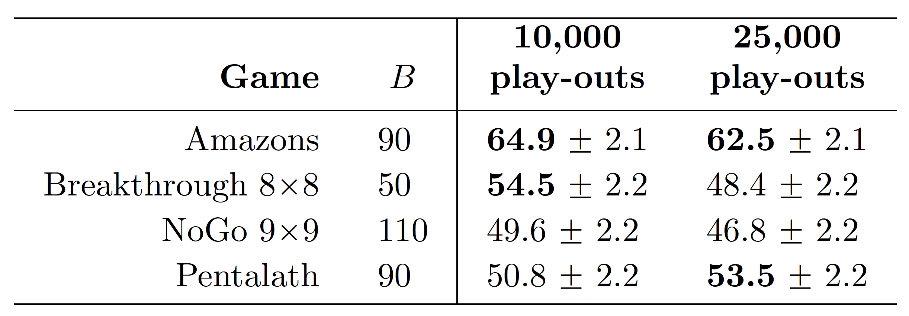
H-MCTS Solver

Slide 33
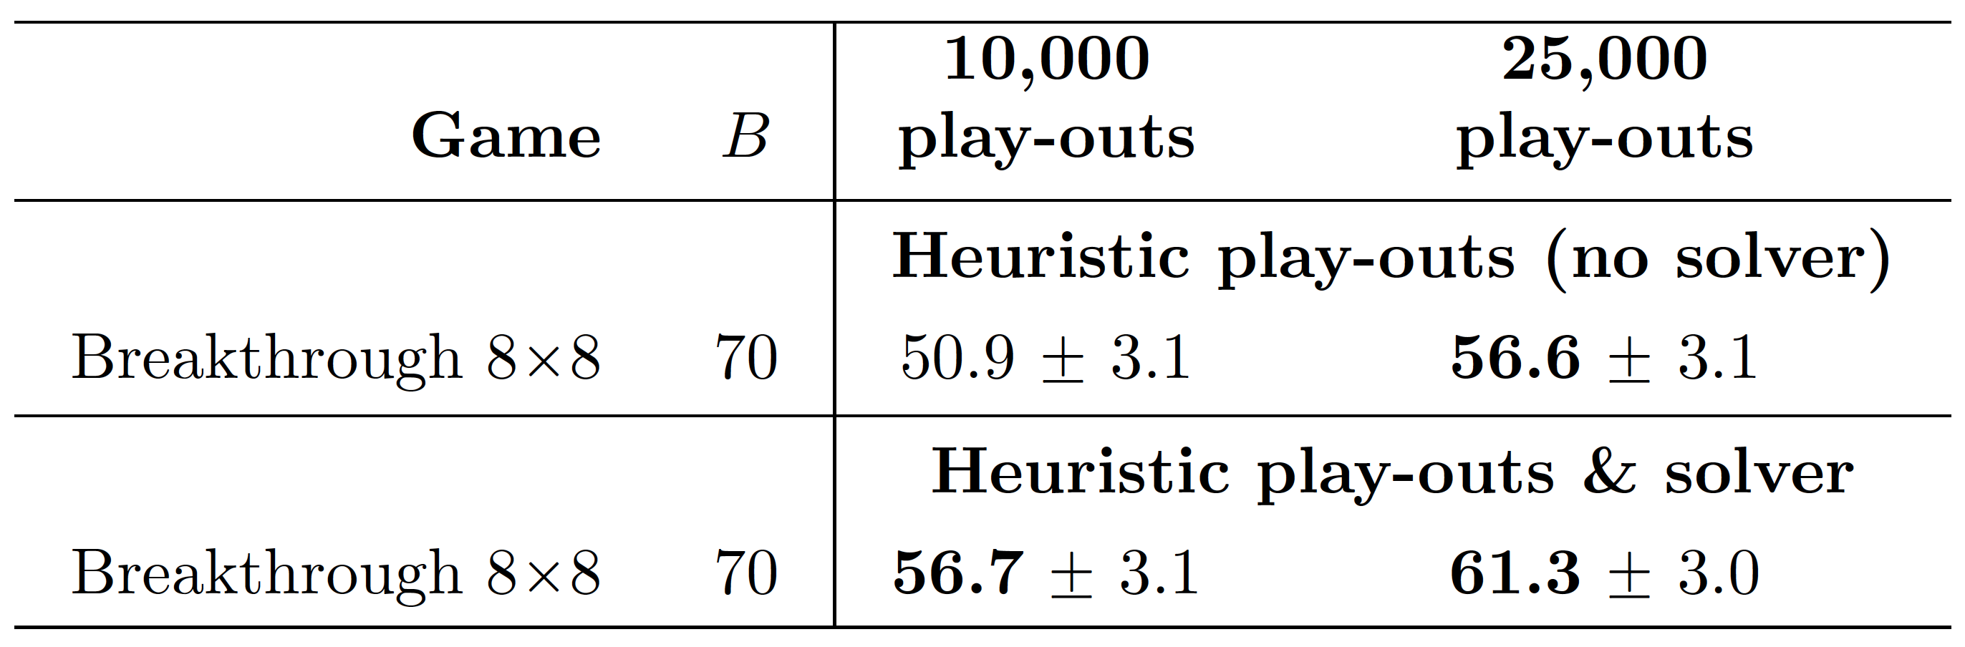
H-MCTS Solver

Slide 34
Conclusion
Conflict between CR and SR
Use separate selection policies
SHOT + UCT
Bubeck et al. (2010): When overall budget is small, UCB gives empirically lower SR
Switch to UCT when budget is small

Slide 35
Future Research
Compare SR of SHOT, UCT and H-MCT
H-MCTS’ effect on branching factor
Relation between B and UCT’s C
Different SR selection policies (e.g. successive rejects)
Parallelization of H-MCTS/SHOT
Back-propagation
Different methods for switching between CR/SR
Suboptimal values for C

