Slide 1
Quality-based Rewards for Monte-Carlo Tree Search Simulations
T. Pepels, M.J.W. Tak,
M. Lanctot, M.H.M Winands
ECAI 2014

Slide 2
Content
Background
Monte-Carlo Tree Search (MCTS)
MCTS simulations
Simulation Quality
Quality-Based Simulation Rewards
Control Variates
Relative and Qualitative Bonus
Conclusion

Slide 3
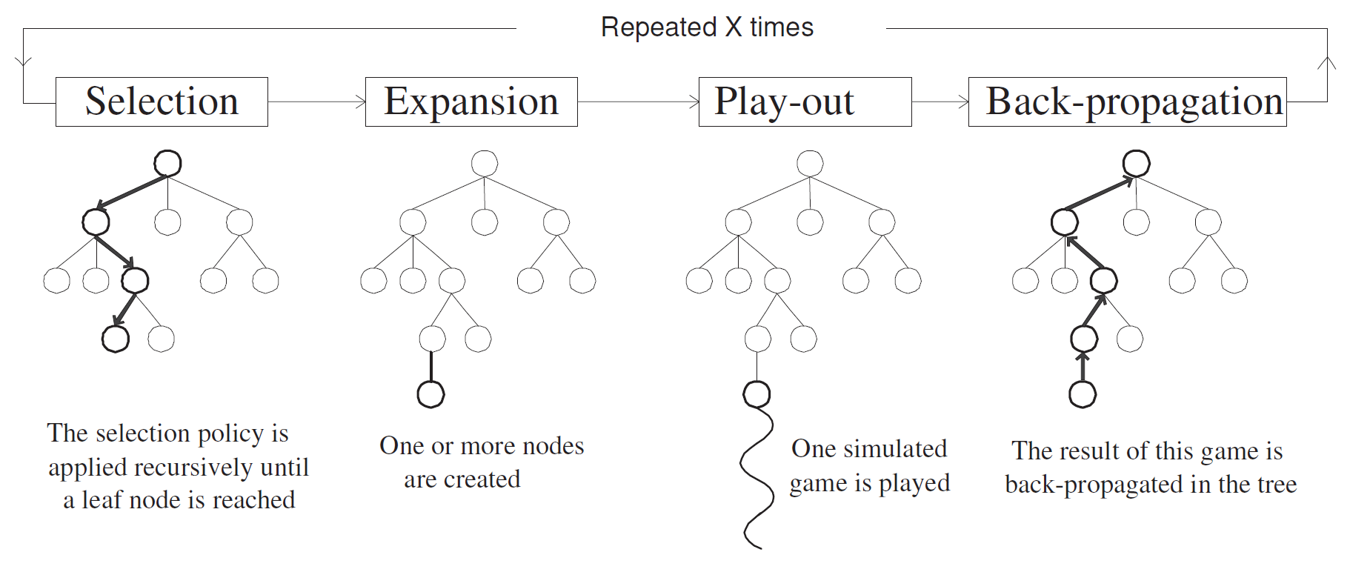
Monte-Carlo Tree Search (MCTS)
(Chaslot et al., 2008)

Slide 4
Monte-Carlo Tree Search (MCTS)
Traverse tree based on selection policy
UCT (Kocsis and Szepesvari, 2006)
Sample domain by simulation
UCT and simulated play-out
Play-out results back-propagated
Generally {-1, 0, 1} (loss, draw, win)
Results are averaged at selected nodes

Slide 5
Simulation Quality (motivation)
In MCTS in games, rewards are based on:
Loss/draw/win terminal state
Evaluation function of non-terminal state
Other information about the simulated play-out is generally ignored
How realistic was the play-out?
How accurate is its result?

Slide 6
Simulation Quality
Simulation Length (d):
Play-out policy balances quality of move selection and computational effort
Longer play-out → less certain about accuracy of its result
Domain independent measurement

Slide 7
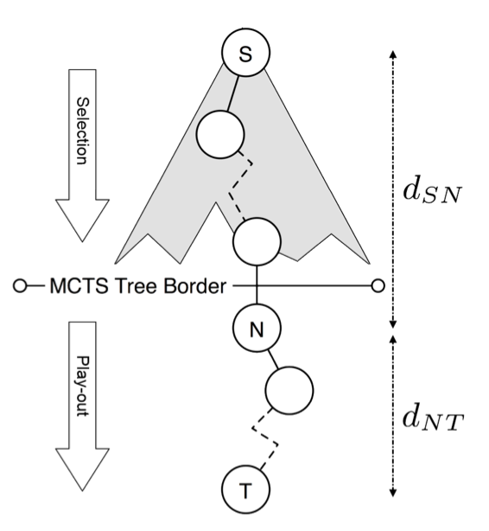
Simulation Quality
(Finnsson, 2012)

Slide 8
Simulation Quality
Terminal state quality (q):
Reliability of terminal state
Did I win or lose with a large advantage?
e.g., material difference (checkers/breakthrough)
Different measure for each domain

Slide 9
Simulation Quality
Play-out function now returns:
Result r ∈ {-1, 0, 1}
Simulation length d ∈ (0, ?)
Terminal state quality q ∈ (0, 1)
Winning player τ

Slide 10
Simulation Quality
How can we use the quality measurements of simulations to enhance rewards?
Without introducing bias!
Trying to play the shortest game
Trying to maintain the most material

Slide 11
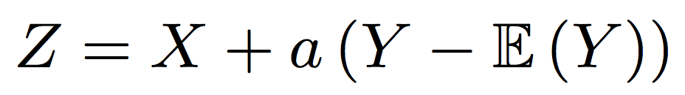
Quality-Based Rewards
Control Variates
Reduce variance by combining correlated samples
If Corr(X,Y) != 0 then random variable Z has lower variance than X
Optimal value for a can be determined analytically
Value added relative to its expectation
Control Variate

Slide 12
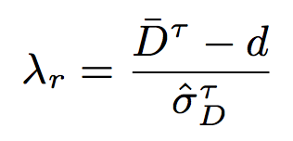
Relative and Qualitative Bonus
Relative bonus (RB)
Using simulation length d
Maintain mean and std. dev. of simulation lengths
Normalized value for d:
Qualitative bonus (QB)
Same as RB, using terminal state quality q

Slide 13
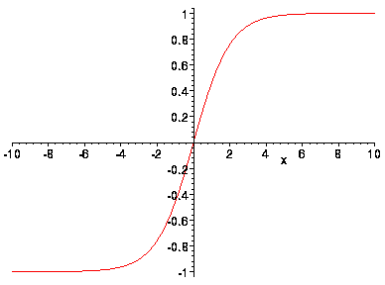

Relative and Qualitative Bonus
Normalized value has unbounded range
Use sigmoid to fix range b(x)
Parameter k determines slope
Alter the reward:
Use r_{b} or r_{q} to update values in tree
Control Variate

Slide 14
Experiments
Relative and Qualitative bonus in:
Amazons
Breakthrough
Cannon
Checkers
Chinese Checkers
Pentalath
Relative bonus in 14 GGP domains

Slide 15
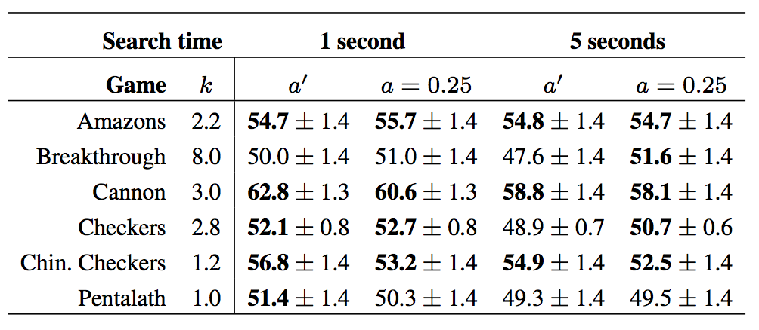
Results - Relative Bonus

Slide 16
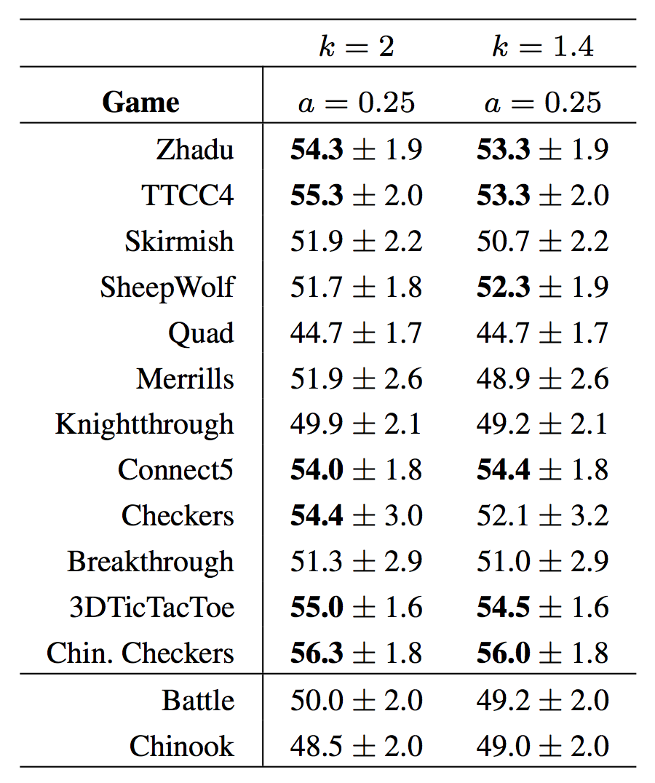
Results - Relative Bonus

Slide 17
Results – Qualitative Bonus
Amazons: Move-freedom of winning player
Breakthrough and Cannon: piece difference
Checkers: remaining pieces for winning player
Chin. Checkers: inverse number of losing player’s pieces in home-base
Pentalath: inverse of opponents longest row

Slide 18
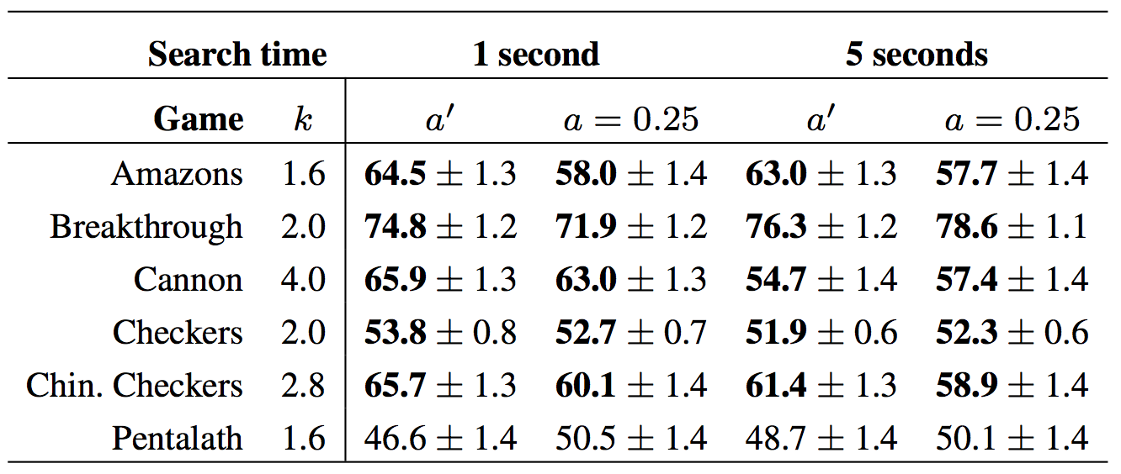
Results – Qualitative Bonus

Slide 19
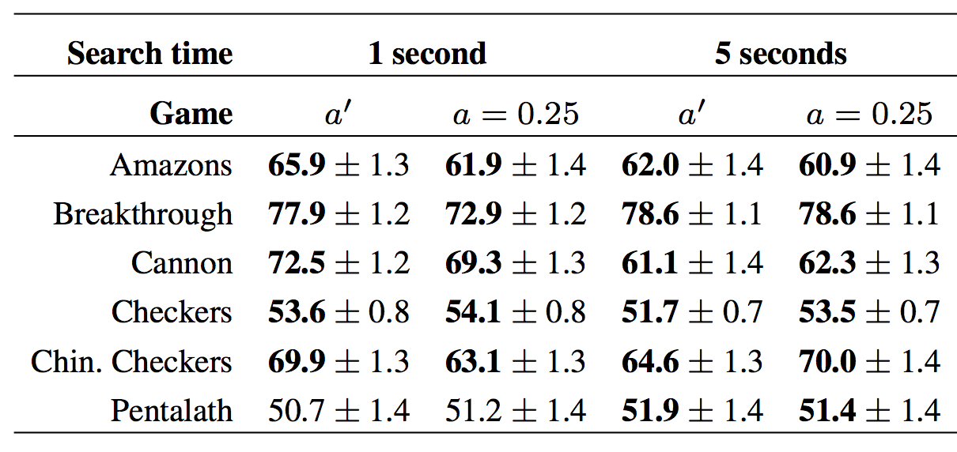
Results – RB & QB

Slide 20
Conclusion
Quality measures increase performance
Simple terminal state quality measure are sufficient to improve performance
Domain independent improvements in GGP
Approximate value for a is sufficient

Slide 21
Future Work
Combine with early and static cut-offs
Combine with online learning (PAST, N-Gram)
Improve value for a when combining QB & RB
Determine whether variance in simulation rewards is actually reduced

Slide 22
^{Quality-based Rewards for}
Monte-Carlo Tree Search Simulations
Tom Pepels and Mandy J .W. Tak and Marc Lanctot and Mark H. M. Winands
Thank you!
Tom Pepels
Maastricht University

