Slide 1

ONLINE BOOK STORE
By
Felipe Rojas
Sherik Lehal
Thomas Perale
Maximillien

Slide 2
About
Collection of ebooks that can be purchased by the users
Ebook has various attributes- Publisher, Author, Category, Rating etc.
User can be an admin or normal user
Each ebook is rated by the users who purchased it

Slide 3
Ontology rules
1. If the book belongs to a category and that category is also a subcategory to another category, it implies that the book belongs to both the main category and it's subcategory. Example- If a book belongs to "war" category and the "war" category belongs to "action" category, it is implied that the book belongs to both "war" and "action" categories.

Slide 4
Ontology rules
2. If a user makes a purchase and an ebook is part of the purchase, then we can imply that the user “HasPurchased” an ebook.
3. If a user has rated an ebook, it implies that the user purchased the ebook as the users can't rate a book without purchasing it.
4. If a user has the role "admin", they can manage the ebooks database on the system.

Slide 5
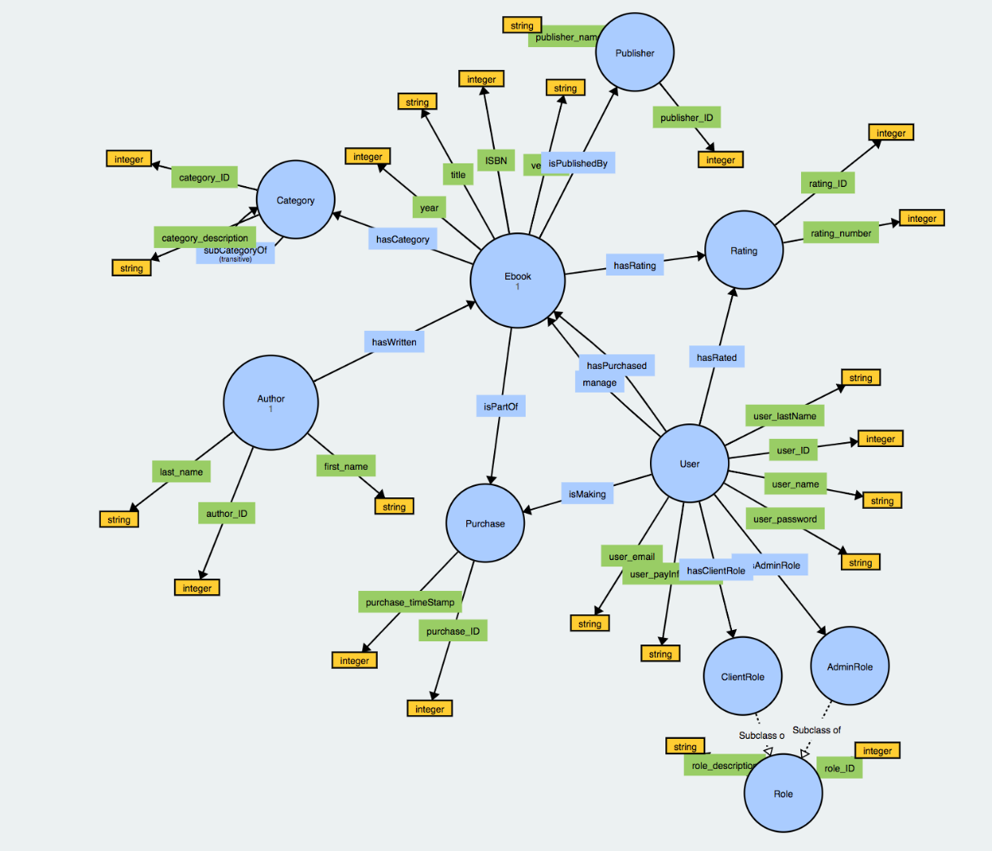

Slide 6
Server
d2rq

Slide 7
D2rq commands for the mapping
Generating a default mapping file ./generate-mapping -u root -o mydb.ttl jdbc:mysql:///mydb
This generates a mapping file mydb.ttl for your database.
Dumping the database ./dump-rdf -m mydb.ttl -o dump.nt
This creates dump.nt, a dump containing the mapped RDF in N-Triples format.
Mapping is important before we run the server

