Slide 1


Slide 2
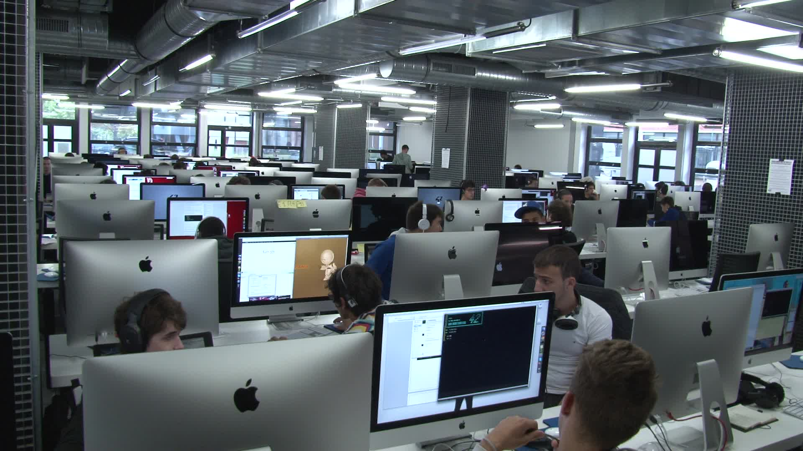
The school

Slide 3
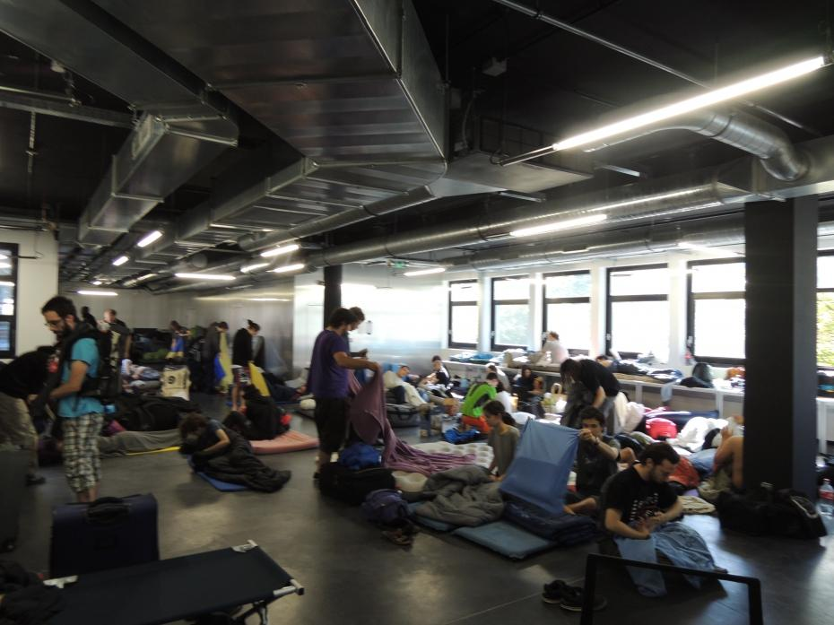
The swimmingpool

Slide 4

The program

Slide 5
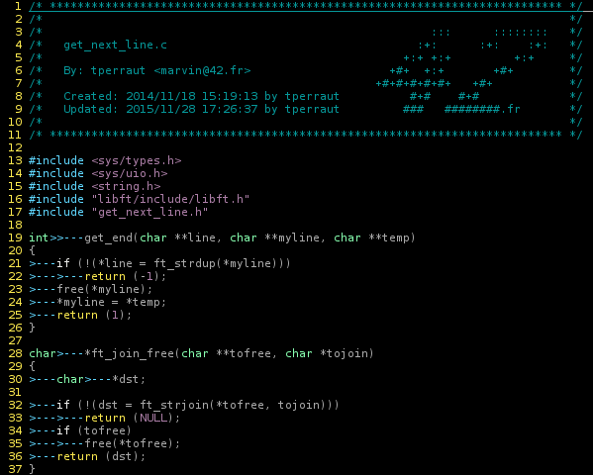
Standards

Slide 6
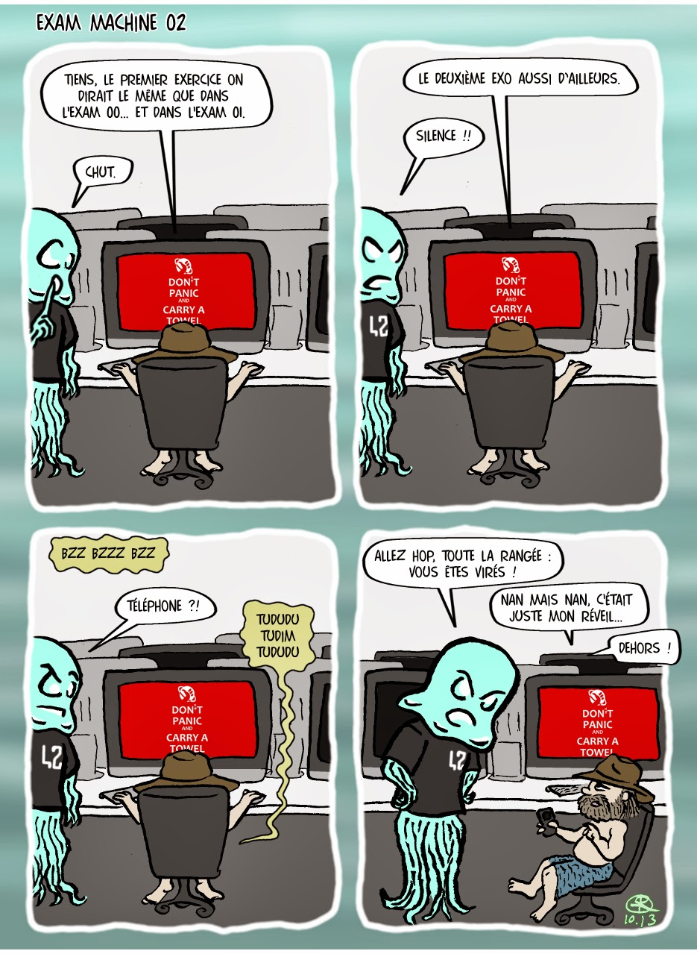
Exams

Slide 7

Conclusion

