Slide 1
The Cliff tops
"When you agree to collaborate, you agree to jump off a cliff holding hands with everyone, hoping the resourcefulness of each will insure that you all land on your feet." ~ Frank Gehry

Slide 2
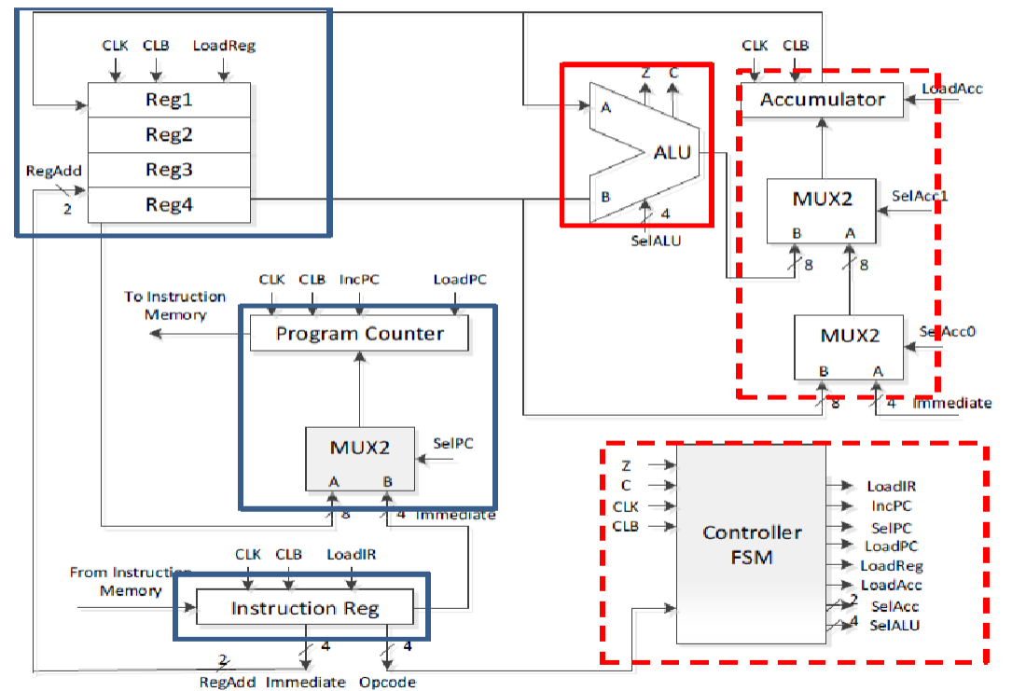
Project Module Diagram
"Hills tell old stories. Cliffs are poets with harps." ~ George MacKay
The 16-Register group module
The Program Counter group module
The Instruction Register group module
The Controller-FSM group module
The Accumulator group module
ALU group Module

Slide 3
The 16-Register group module
"It's too late to change your mind after you've jumped off the cliff." ~ Robert Jordan
Contains 16, 8 bit registers to store data for the whole system
INPUTS
Clock, Clock bar
Load Register
Register Add
From ACC
OUTPUTS
To Program Counter
To ALU and ACC

Slide 4
The Program Counter group module
"Dive today from the cliff of what you know into what you can't know." ~ Rumi
Contains the systems Program Counter and keeps track of when that Program Counter Changes
INPUTS
Clock, Clock bar
A, B inputs from Registers
Select PC
Increment PC
Load PC
OUTPUTS
Immediate

Slide 5
The Instruction Register group module
"Love meant jumping off a cliff and trusting that a certain person would be there to catch you at the bottom." ~ Jodi Picoult
Contains the next instruction to be executed by the system
INPUTS
Clock, Clock bar
Load Instruction Register
From Instruction Memory
OUTPUTS
Opcode
Register Add or Immediate

Slide 6
The Controller-FSM group module
"For happiness one needs security, but joy can spring like a flower even from the cliffs of despair." ~ Anne Morrow Lindbergh
Controls the system through input and output flags that detail where system data should be flowing at a given time
INPUTS
Clock, Clock bar
Z, C zero and carry flags
Opcode
OUTPUTS
Load Instruction Register
Increment Program Counter
Select Program Counter
Load Program Counter
Load Register
Load Accumulator
Select Accumulator
Select ALU

Slide 7
The Accumulator group module
"Science-fiction balances you on the cliff. Fantasy shoves you off." ~ Ray Bradbury
Contains the accumulator register that holds the value from the ALU/Register/ or Imiddiate
INPUTS
Clock, Clock bar
Load Accumulator
Select Accumulator
Data in from Registers
Immediate
ALU Out
OUTPUTS
Accumulator Out

Slide 8
ALU group Module
"You can stand on the cliff of my heart and shout nothing but ‘ugly’ through me. I promise all I will echo back is ‘Beauty, beauty, you have always been beauty" ~ Andrea Gibson
Contains the component to do arithmetic operations for the system
INPUTS
A, B operant inputs for calculations
ALU Select
OUTPUTS
ALU Output
Carry Out
Zero Flag

Slide 9
QUESTIONS/dEMINSTRATION?
"I've succeeded as far as I'm concerned - I don't feel that I have any cliffs I could fall over anytime soon." ~ Shania Twain

