Slide 1
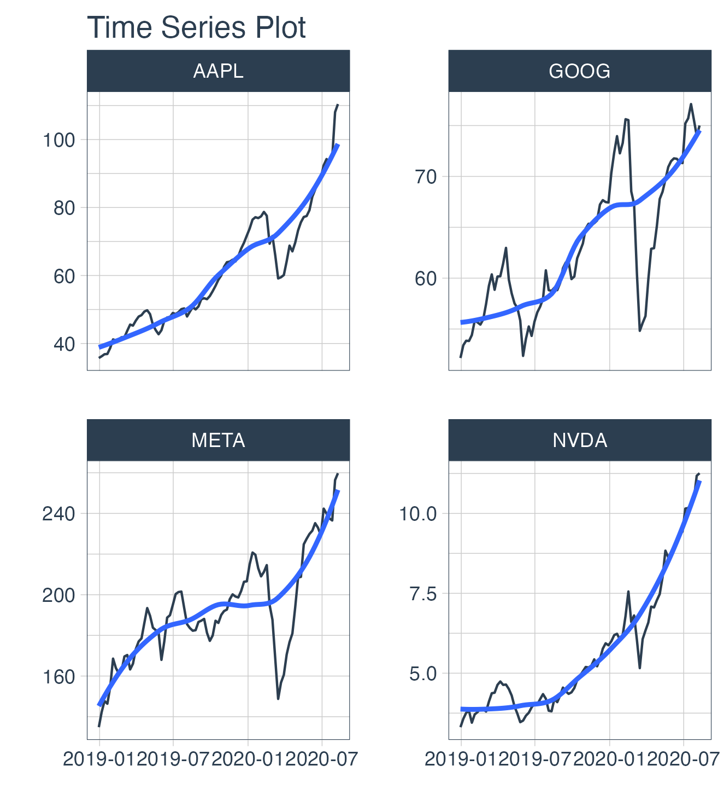
Stock Report
Symbol | Week | Month | Quarter | Year | All
AAPL | 1.06% | 23.2% | 73.53% | 171% | 197%
GOOG | 0.51% | 0.8% | 24.58% | 32% | 44%
META | -1.52% | 8.7% | 49.90% | 54% | 93%
NVDA | 2.02% | 17.5% | 73.35% | 211% | 241%

