Slide 1
Syntax Matters:
Writing abstract computations in F#
Tomas Petricek
University of Cambridge
Don Syme
Microsoft Research

Slide 2
Non-standard computations in various languages and F#

Slide 3




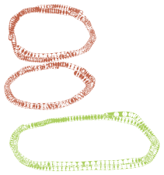
Haskell do-notation
getCategoryName :: string → Maybe string
getCategoryName name = do
product ← productByName name
category ← categoryByID (getProductID product)
return $ categoryName category
getCategoryName : string → Option<string>
let getCategoryName name = maybe {
let! product = productByName name
let! category = categoryByID (getProductID product)
return categoryName category }

Slide 4





Python generators
def duplicate(inputs):
for number in inputs:
yield number
yield number * 10
duplicate : seq<int> → seq<int>
let duplicate inputs = seq {
for number in inputs do
yield number
yield number * 10 }
Notes:
Cannot be done using Haskell comprehensions – could be done using MonadPlus with some do notation, but looks ugly.

Slide 5





C# 5.0 asynchronous methods
async Task<string> GetLength(string url) {
var html = await DownloadAsync(url);
return html.Length;
}
getLength : string → Async<int>
let getLength url = async {
let! html = downloadAsync url
return html.Length }

Slide 6
Unifying single-purpose extensions with F# computation expressions

Slide 7
Computation expressions in F#
Unify single-purpose extensions
  Code with custom or limited binding
  Code yielding multiple results
  Combinations of both!
Computation expression principles
  Mirror standard F# syntax
  Allow non-standard interpretation of constructs
  Add several additional constructs

Slide 8
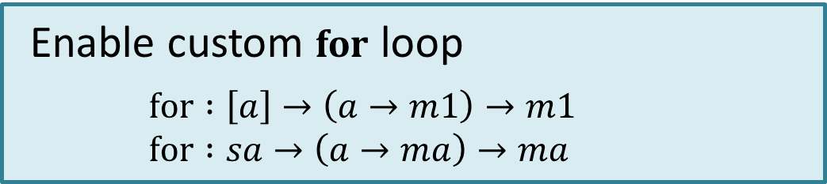
What types of computations?
Not restricted to a fixed set
  Adding operations enables more constructs
  Types of operations are flexible
Paper identifies common abstractions
  And proposes good syntax for them!

Slide 9
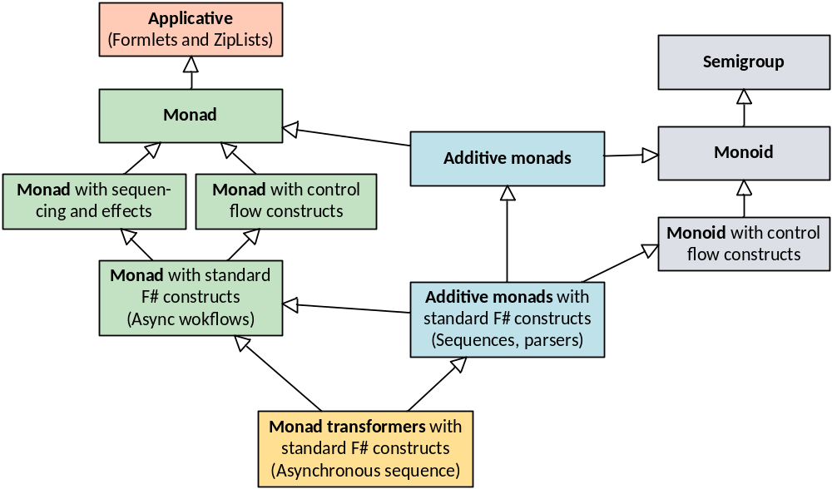
What can we express?

Slide 10
Defining interesting computations and choosing the best syntax

Slide 11
What can we express?

Slide 12
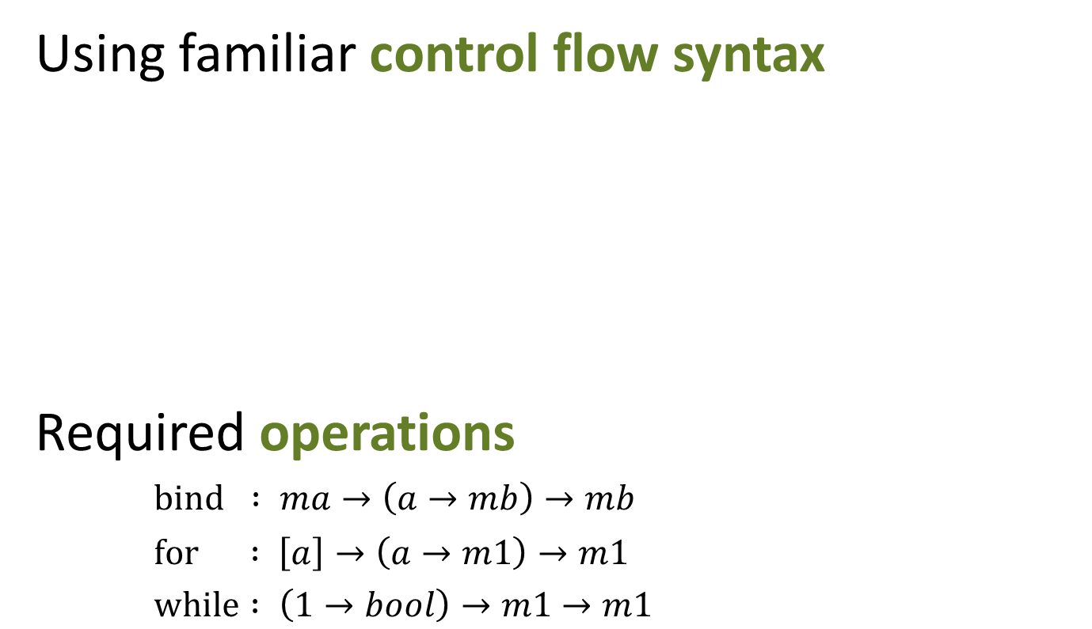

Monadic async workflows
async {
while true do
for color in [green; orange; red] do
do! Async.Sleep(1000)
displayLight color }

Slide 13
What can we express?

Slide 14
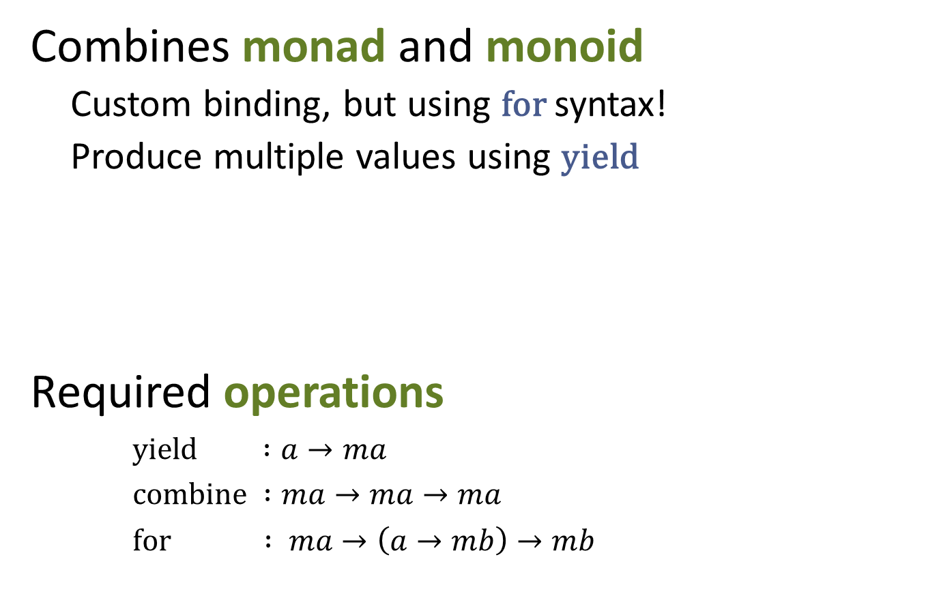
Monadic sequence expressions
seq { yield! Directory.GetFiles(dir)
for subdir in Directory.GetDirectories(dir) do
yield! listFiles subdir }

Slide 15
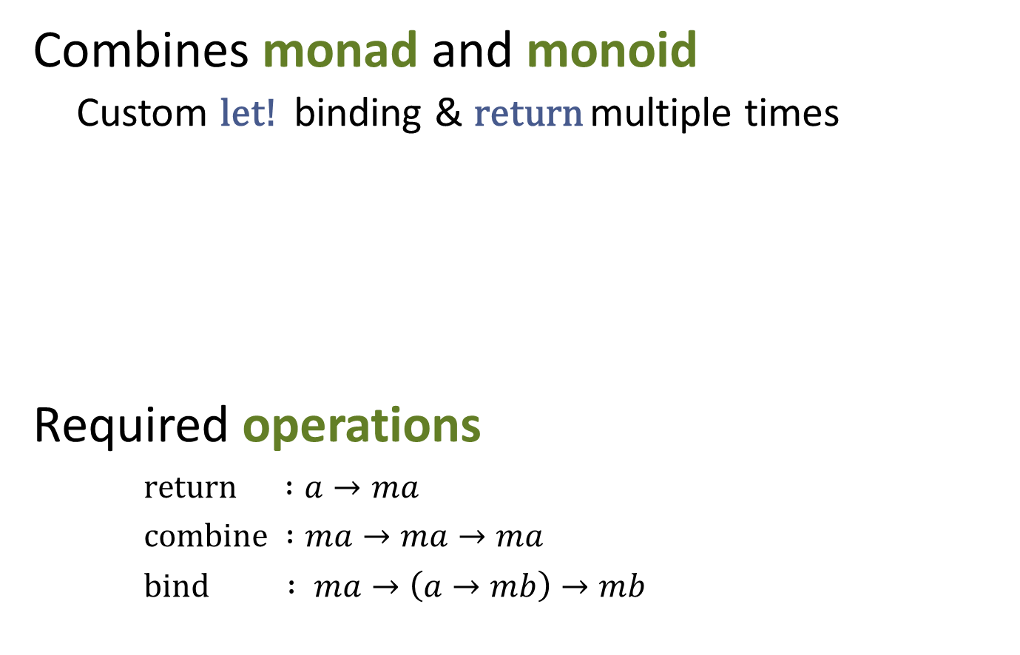
Monadic parser combinators
let rec some p = parse {
let! x = p
let! xs = many p
return x::xs }
and many p = parse {
return! some p
return [] }

Slide 16
What can we express?

Slide 17
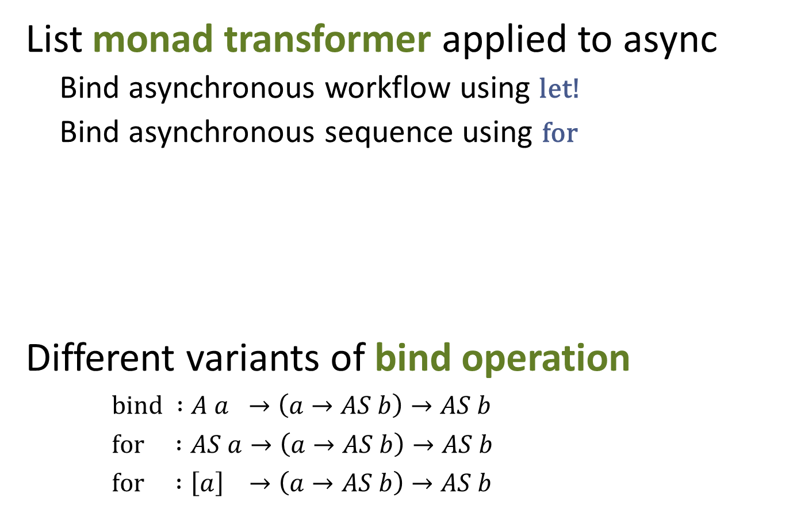
Combining Async and Sequences
let pages = asyncSeq {
for url in addressStream do
let! html = wc.AsyncDownloadString(Uri(url))
yield url, html }

Slide 18
What can we express?

Slide 19
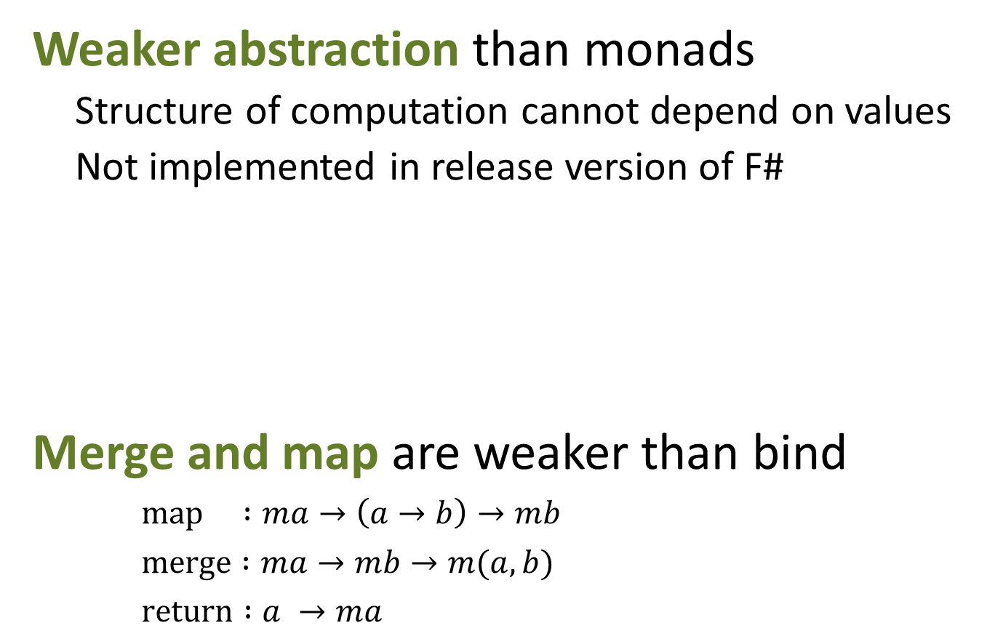
Applicative Formlets
let userFormlet = formlet {
let! name = Formlet.textBox
and gender = Formlet.dropDown ["Male"; "Female"]
return name + " " + gender }

Slide 20
Summary
Syntax matters!
  Custom interpretation of standard syntax
  Better intuition than combinators
Flexibility is useful!
  Wide range of practical computations
  Choose the right syntax for a computation
  Encourage experiments with computations

