Slide 1
Syntax Matters: Writing abstract computations in F#
Tomas Petricek
University of Cambridge
Don Syme
Microsoft Research

Slide 2
Non-standard computations in various languages and F#

Slide 3
Haskell do-notation
getCategoryName :: string → Maybe string
getCategoryName name = do
product ← productByName name
category ← categoryByID (getProductID product)
return $ categoryName category
getCategoryName : string → Option<string>
let getCategoryName name = maybe {
let! product = productByName name
let! category = categoryByID (getProductID product)
return categoryName category }

Slide 4
Python generators
def duplicate(inputs):
for number in inputs:
yield number
yield number * 10
duplicate : seq<int> → seq<int>
let duplicate inputs = seq {
for number in inputs do
yield number
yield number * 10 }
Notes:
Cannot be done using Haskell comprehensions – could be done using MonadPlus with some do notation, but looks ugly.

Slide 5
C# 5.0 asynchronous methods
async Task<string> GetLength(string url) {
var html = await DownloadAsync(url);
return html.Length;
}
getLength : string → Async<int>
let getLength url = async {
let! html = downloadAsync url
return html.Length }

Slide 6
Unifying single-purpose extensions with F# computation expressions

Slide 7
Computation expressions in F#
Unify single-purpose extensions
Code with custom or limited binding
Code yielding multiple results
Combinations of both!
Computation expression principles
Mirror standard F# syntax
Allow non-standard interpretation of constructs
Add several additional constructs

Slide 8
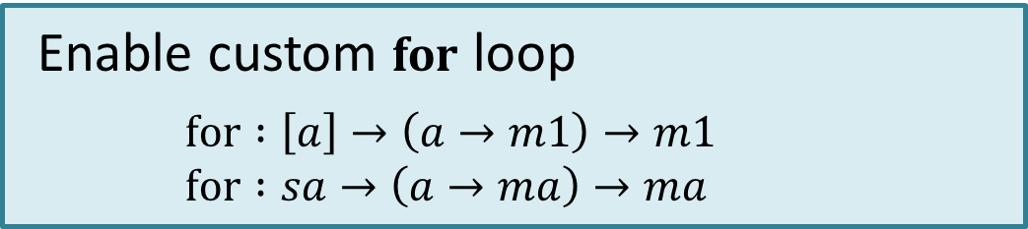
What types of computations?
Not restricted to a fixed set
Adding operations enables more constructs
Types of operations are flexible
Paper identifies common abstractions
And proposes good syntax for them!
Enable custom for loop
$for :\left[a\right]→\left(a→m1\right)→m1$ $for :sa→\left(a→ma\right)→ma$

Slide 9
What can we express?
TODO: Update image (wokflows)

Slide 10
Defining interesting computations and choosing the best syntax

Slide 11
What can we express?

Slide 12

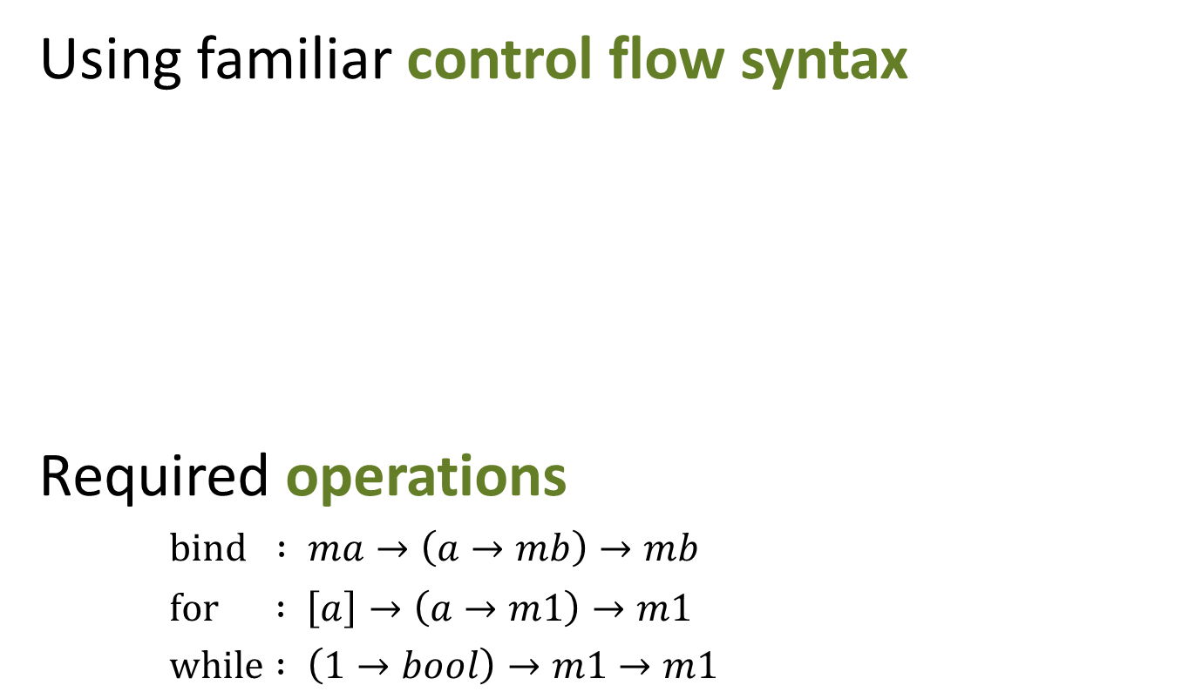
Monadic async workflows
Using familiar control flow syntax
Required operations
$bind : ma→\left(a→mb\right)→mb$
$for : \left[a\right]→\left(a→m1\right)→m1$
$while : \left(1→bool\right)→m1→m1$
async {
while true do
for color in [green; orange; red] do
do! Async.Sleep(1000)
displayLight color }

Slide 13
What can we express?

Slide 14
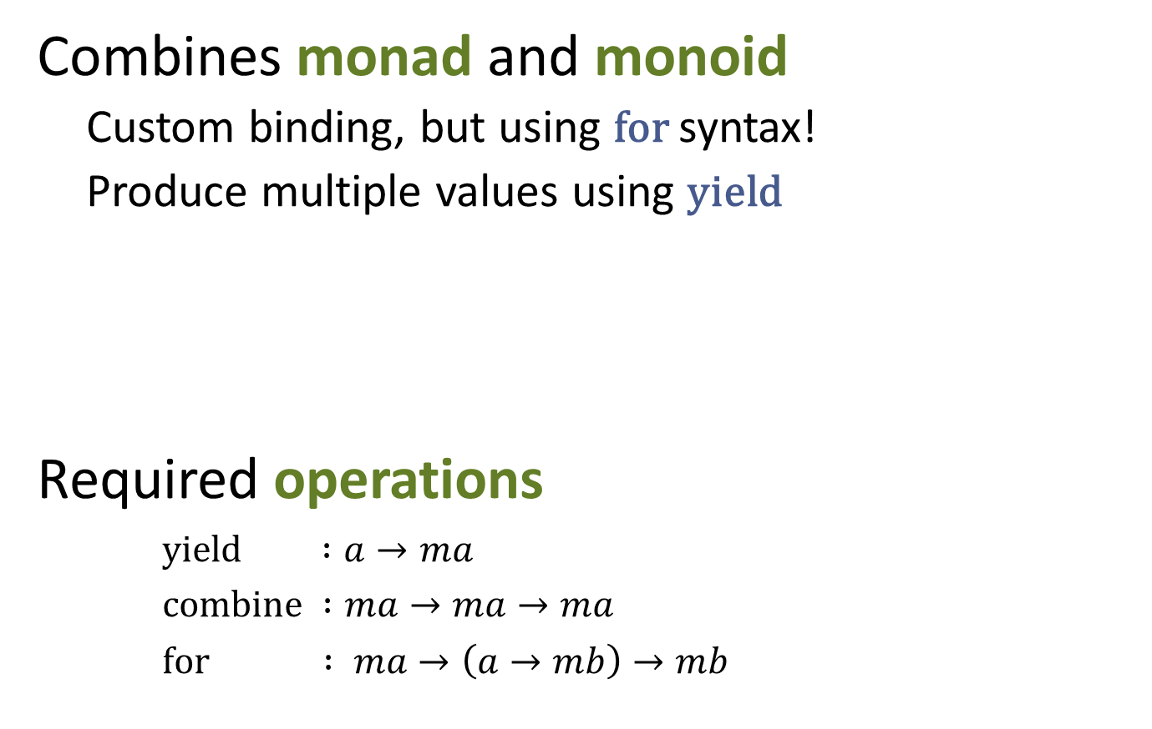
Monadic sequence expressions
Combines monad and monoid
Custom binding, but using for syntax!
Produce multiple values using yield
Required operations
$yield :a→ma$
$combine :ma→ma→ma$
$for : ma→\left(a→mb\right)→mb$
seq { yield! Directory.GetFiles(dir)
for subdir in Directory.GetDirectories(dir) do
yield! listFiles subdir }

Slide 15
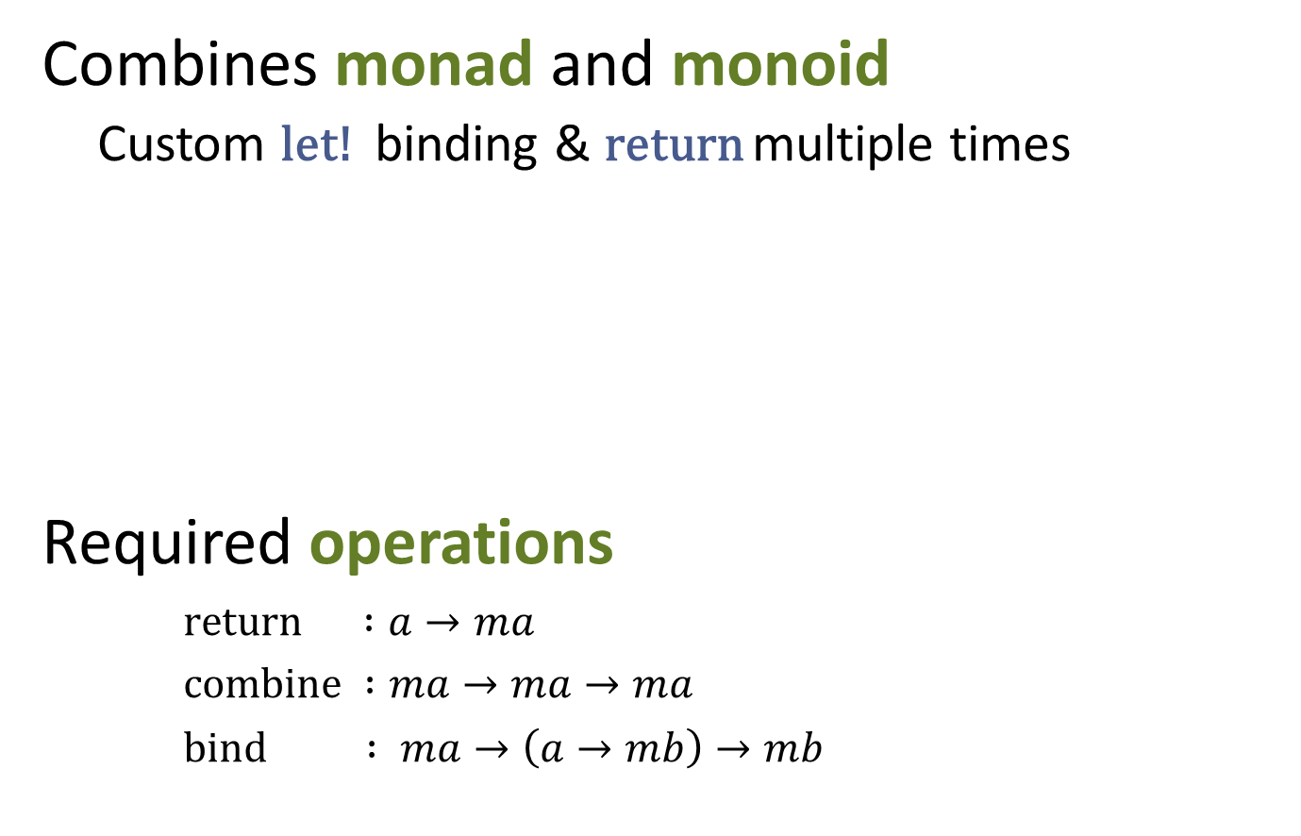
Monadic parser combinators
Combines monad and monoid
Custom let! binding & return multiple times
Required operations
$return :a→ma$
$combine :ma→ma→ma$
$bind : ma→\left(a→mb\right)→mb$
let rec some p = parse {
let! x = p
let! xs = many p
return x::xs }
and many p = parse {
return! some p
return [] }

Slide 16
What can we express?

Slide 17
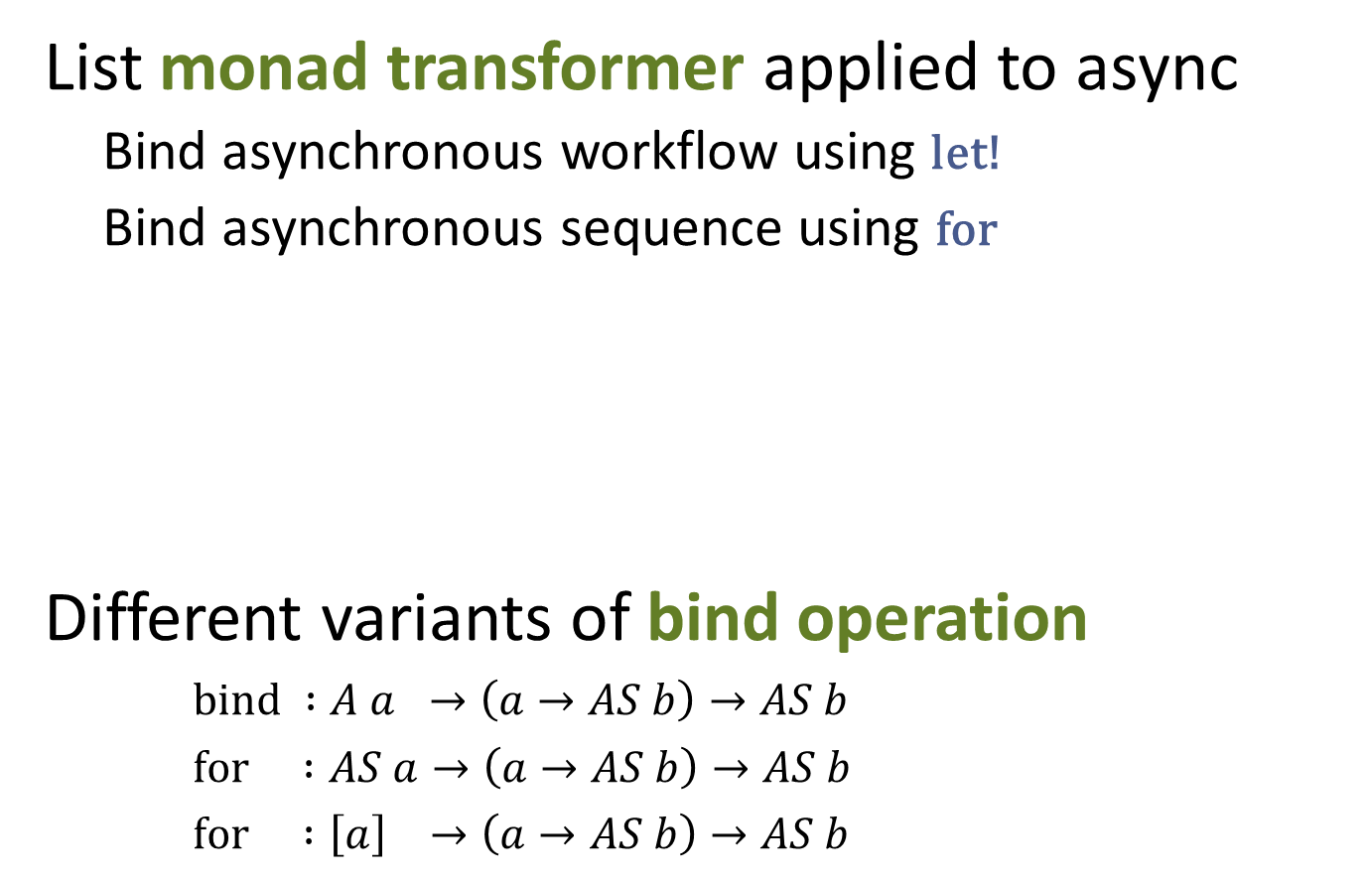
Combining Async and Sequences
List monad transformer applied to async
Bind asynchronous workflow using let!
Bind asynchronous sequence using for
Different variants of bind operation
$bind :A a →\left(a→AS b\right)→AS b$
$for :AS a→\left(a→AS b\right)→AS b$
$for :\left[a\right] →\left(a→AS b\right)→AS b$
let pages = asyncSeq {
for url in addressStream do
let! html = wc.AsyncDownloadString(Uri(url))
yield url, html }

Slide 18
What can we express?

Slide 19
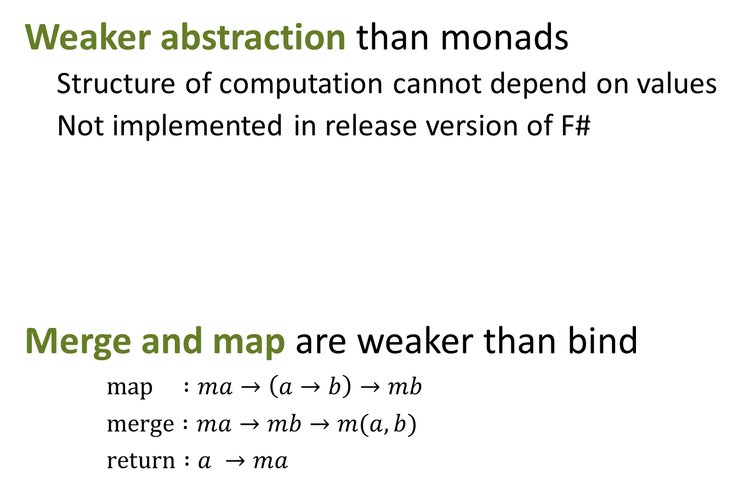
Applicative Formlets
Weaker abstraction than monads
Structure of computation cannot depend on values
Not implemented in release version of F#
Merge and map are weaker than bind
$map :ma→\left(a→b\right)→mb$
$merge :ma→mb→m(a,b)$
$return :a →ma$
let userFormlet = formlet {
let! name = Formlet.textBox
and gender = Formlet.dropDown ["Male"; "Female"]
return name + " " + gender }

Slide 20
Summary
Syntax matters!
Custom interpretation of standard syntax
Better intuition than combinators
Flexibility is useful!
Wide range of practical computations
Choose the right syntax for a computation
Encourage experiments with computations

