Slide 1



Denicek
add
Denicek
add
edit
edit
wrap
wrap
add
add

Slide 2
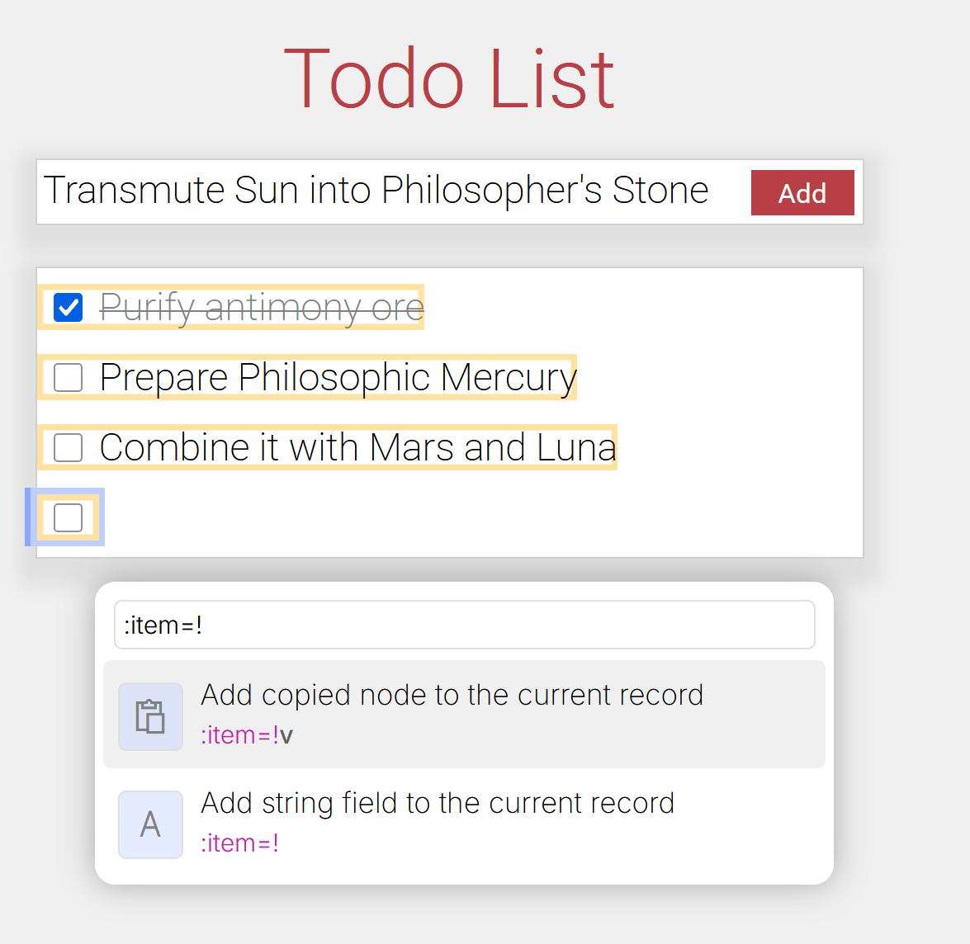
Webnicek
Denicek
add
edit
wrap
add
Design: Six formative examples in a simple web-based environment

Slide 3
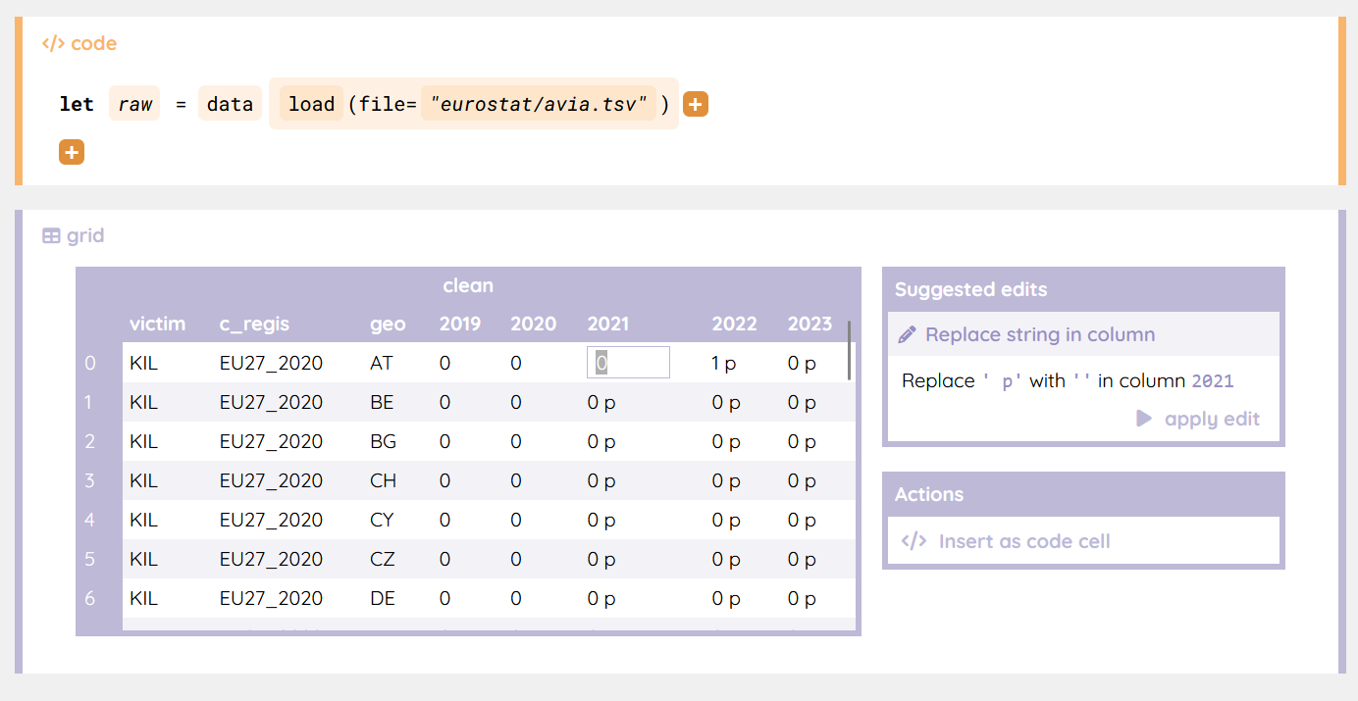
Webnicek
Datnicek
Denicek
add
edit
wrap
add
Design: Six formative examples in a simple web-based environment
Evaluation: Innovative data science notebook system

Slide 4
Denicek
Webnicek
add
edit
wrap
add
Datnicek

Slide 5
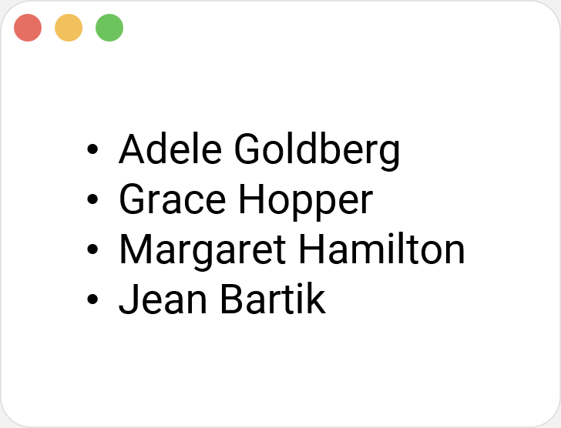
Local-first Collaborative Editing
Adele Goldberg
Grace Hopper
Margaret Hamilton
Jean Bartik

Slide 6
Local-first Collaborative Editing
Name | Surname
Adele | Goldberg
Name | Surname
Adele | Goldberg
Grace | Hopper
Margaret | Hamilton
Jean | Bartik
Adele Goldberg

Slide 7
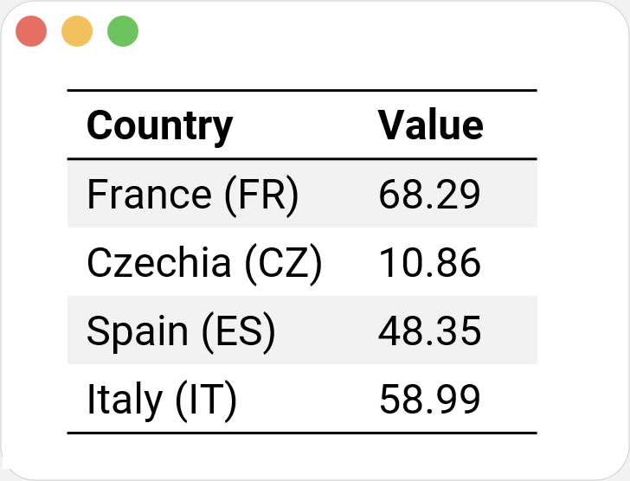
Programming by Demonstration
Country | Value
France (FR) | 68.29
Czechia (CZ) | 10.86
Spain (ES) | 48.35
Italy (IT) | 58.99

Slide 8
Programming by Demonstration
Country | Value
FranFR | 68.29
Czechia (CZ) | 10.86
Spain (ES) | 48.35
Italy (IT) | 58.99
Country | Value
FrFR | 68.29
Czechia (CZ) | 10.86
Spain (ES) | 48.35
Italy (IT) | 58.99
Country | Value
FFR | 68.29
Czechia (CZ) | 10.86
Spain (ES) | 48.35
Italy (IT) | 58.99
Country | Value
FR | 68.29
Czechia (CZ) | 10.86
Spain (ES) | 48.35
Italy (IT) | 58.99
Country | Value
FR | 68.29
Czechia (CZ) | 10.86
Spain (ES) | 48.35
Italy (IT) | 58.99
Country | Value
FrancFR | 68.29
Czechia (CZ) | 10.86
Spain (ES) | 48.35
Italy (IT) | 58.99
Country | Value
France (FR) | 68.29
Czechia (CZ) | 10.86
Spain (ES) | 48.35
Italy (IT) | 58.99
Country | Value
France (FR | 68.29
Czechia (CZ) | 10.86
Spain (ES) | 48.35
Italy (IT) | 58.99
Country | Value
France FR | 68.29
Czechia (CZ) | 10.86
Spain (ES) | 48.35
Italy (IT) | 58.99
Country | Value
FranceFR | 68.29
Czechia (CZ) | 10.86
Spain (ES) | 48.35
Italy (IT) | 58.99
Country | Value
FranceFR | 68.29
Czechia (CZ) | 10.86
Spain (ES) | 48.35
Italy (IT) | 58.99
Country | Value
FR | 68.29
CZ | 10.86
ES | 48.35
IT | 58.99

Slide 9
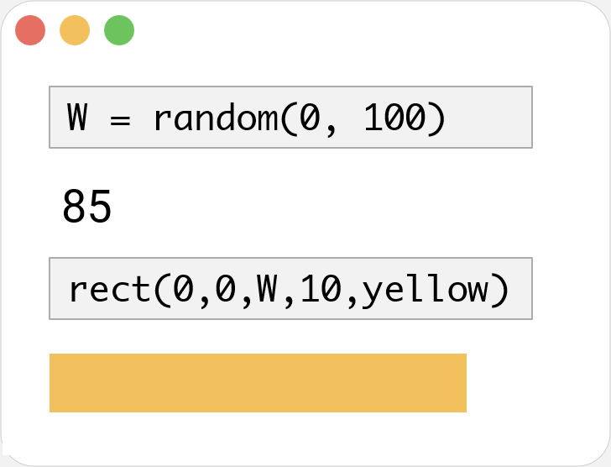

Incremental Recomputation
W = random(0, 100)
85
rect(0,0,W,10,red)
rect(0,0,W,10,yellow)
rect(0,0,W,10,yello)
rect(0,0,W,10,yell)
rect(0,0,W,10,yel)
rect(0,0,W,10,ye)
rect(0,0,W,10,)
rect(0,0,W,10,r)
rect(0,0,W,10,re)
rect(0,0,W,10,y)

Slide 10
Incremental Recomputation
W = random(0, 10)
W = random(0, 100)
W = random(0, 5)
W = random(0, 50)
W = random(0, )
W = random(0, 1)
85
rect(0,0,W,10,red)

Slide 11
Incremental Recomputation
W = random(0, 50)
42
rect(0,0,W,10,red)

Slide 12
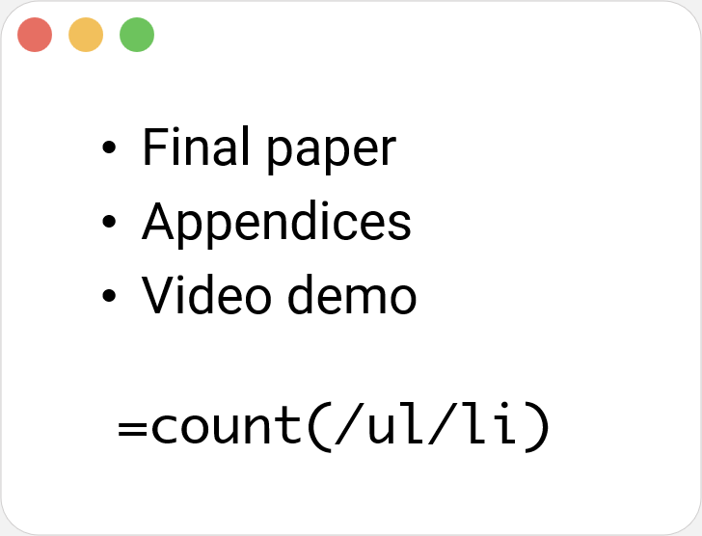
Schema Change Control
Final paper
Appendices
Video demo
=count(/ul/li)

Slide 13
Schema Change Control
Final paper
Appendices
Video demo
=count(/table/li)

Slide 14
Schema Change Control
Task | Done
Final paper
Appendices
Video demo
=count(/table/tbody/li)

Slide 15
Schema Change Control
Task | Done
Final paper | ✓
Appendices | ✓
Video demo
=count(/table/tbody/tr)

Slide 16
The Denicek Computational Substrate

Slide 17
Denicek: Edit History and Documents
add
edit
wrap
add

Slide 18
Denicek: Merging Edit Histories
wrap
add

Slide 19
Denicek: Merging Edit Histories
wrap
add
edit
edit
wrap
add

Slide 20
Denicek: Merging Edit Histories
add
edit
wrap
edit
wrap
add

Slide 21

Denicek: Edit Conflict Resolution
add
Reconcile compatible edits
add*
edit
Report conflicting edits
edit*
wrap
edit
wrap
add

Slide 22
Unreasonable Effectiveness of Merging
Merge edits during collaborative editing
add*
edit*
Replay edits recorded during programming by demonstration
wrap
Invalidate conflicting edits produced by formula evaluation
edit
wrap
Keep formulas in sync with the document structure
add

Slide 23
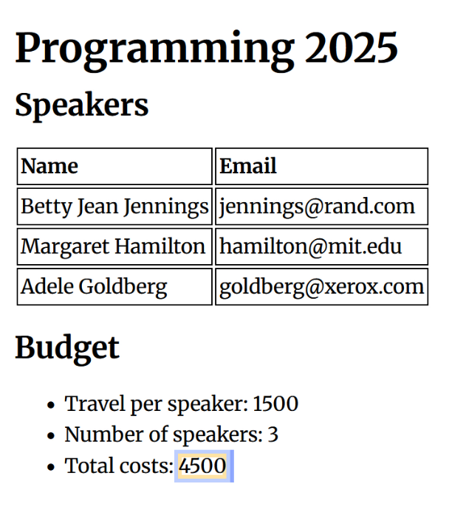
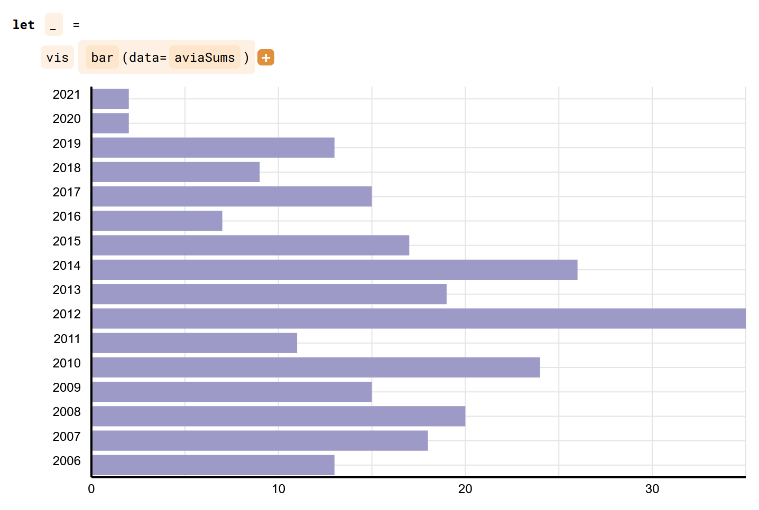
Denicek: Design and Evaluation
Webnicek Editor: Formative Prototype
Datnicek Notebook: Case Study

Slide 24
Denicek: Design and Evaluation
Webnicek Editor: Formative Prototype
Datnicek Notebook: Case Study

Slide 25

Formative Example: Counter App
Evelyn

Slide 26

Formative Example: Conference Organizer
Alfred
Juliana

Slide 27
Denicek: Design and Evaluation
Webnicek Editor: Formative Prototype
Datnicek Notebook: Case Study

Slide 28
Case Study: Datnicek Notebook
Juliana
Alfred

Slide 29
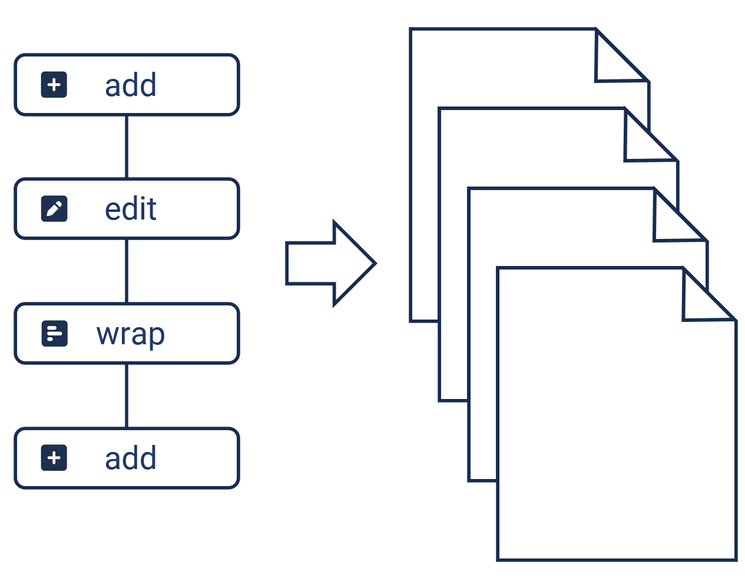
Denicek
Computational Substrate for Document-Oriented End-User Programming
Collaborative Local-first Editing
Programming by
Demonstration
Incremental Recomputation
Schema Change Control

