Slide 1
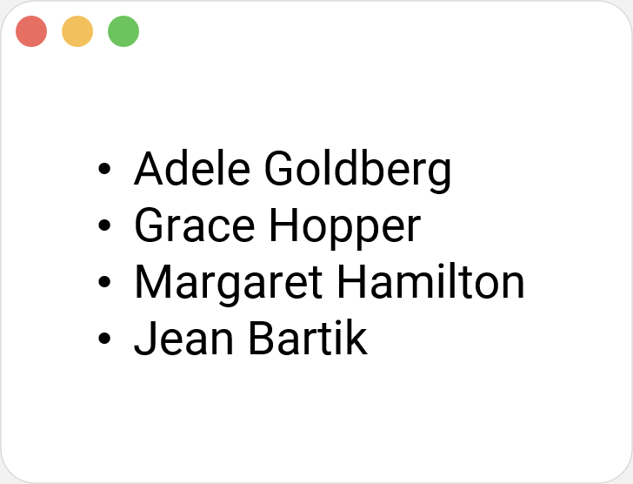
Local-first Collaborative Editing
Adele Goldberg
Grace Hopper
Margaret Hamilton
Jean Bartik

Slide 2
Local-first Collaborative Editing
Name | Surname
Adele | Goldberg
Name | Surname
Adele | Goldberg
Grace | Hopper
Margaret | Hamilton
Jean | Bartik
Adele Goldberg

Slide 3
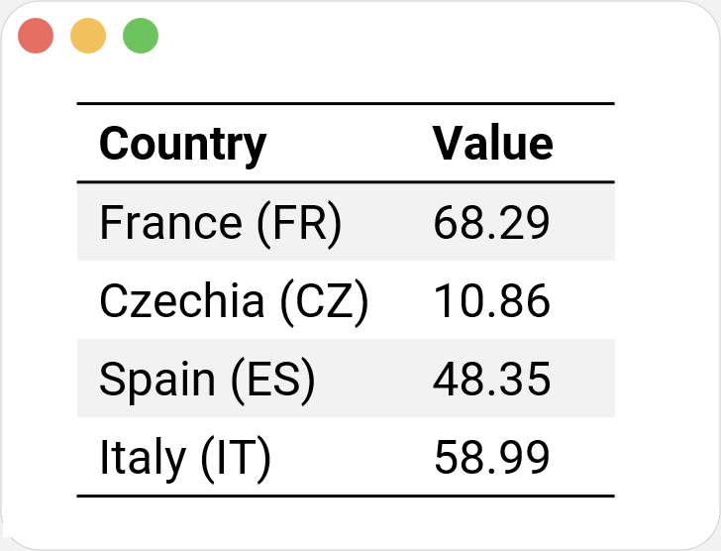
Programming by Demonstration
Country | Value
France (FR) | 68.29
Czechia (CZ) | 10.86
Spain (ES) | 48.35
Italy (IT) | 58.99

Slide 4
Programming by Demonstration
Country | Value
FranFR | 68.29
Czechia (CZ) | 10.86
Spain (ES) | 48.35
Italy (IT) | 58.99
Country | Value
FrFR | 68.29
Czechia (CZ) | 10.86
Spain (ES) | 48.35
Italy (IT) | 58.99
Country | Value
FFR | 68.29
Czechia (CZ) | 10.86
Spain (ES) | 48.35
Italy (IT) | 58.99
Country | Value
FR | 68.29
Czechia (CZ) | 10.86
Spain (ES) | 48.35
Italy (IT) | 58.99
Country | Value
FR | 68.29
Czechia (CZ) | 10.86
Spain (ES) | 48.35
Italy (IT) | 58.99
Country | Value
FrancFR | 68.29
Czechia (CZ) | 10.86
Spain (ES) | 48.35
Italy (IT) | 58.99
Country | Value
France (FR) | 68.29
Czechia (CZ) | 10.86
Spain (ES) | 48.35
Italy (IT) | 58.99
Country | Value
France (FR | 68.29
Czechia (CZ) | 10.86
Spain (ES) | 48.35
Italy (IT) | 58.99
Country | Value
France FR | 68.29
Czechia (CZ) | 10.86
Spain (ES) | 48.35
Italy (IT) | 58.99
Country | Value
FranceFR | 68.29
Czechia (CZ) | 10.86
Spain (ES) | 48.35
Italy (IT) | 58.99
Country | Value
FranceFR | 68.29
Czechia (CZ) | 10.86
Spain (ES) | 48.35
Italy (IT) | 58.99
Country | Value
FR | 68.29
CZ | 10.86
ES | 48.35
IT | 58.99

Slide 5
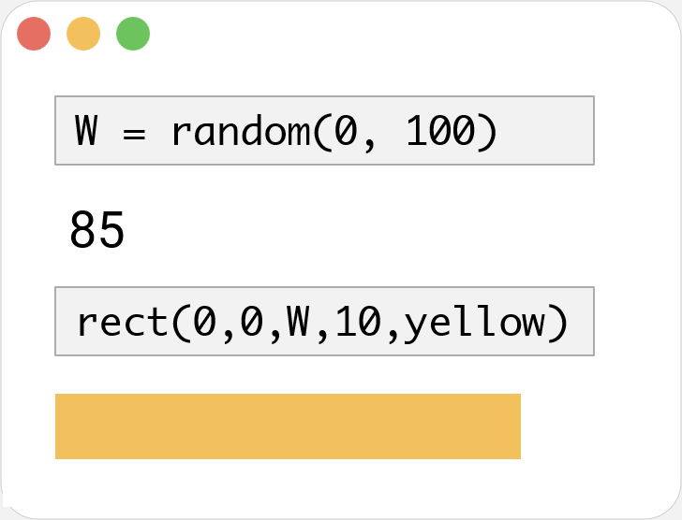

Incremental Recomputation
W = random(0, 100)
85
rect(0,0,W,10,red)
rect(0,0,W,10,yellow)
rect(0,0,W,10,yello)
rect(0,0,W,10,yell)
rect(0,0,W,10,yel)
rect(0,0,W,10,ye)
rect(0,0,W,10,)
rect(0,0,W,10,r)
rect(0,0,W,10,re)
rect(0,0,W,10,y)

Slide 6
Incremental Recomputation
W = random(0, 10)
W = random(0, 100)
W = random(0, 5)
W = random(0, 50)
W = random(0, )
W = random(0, 1)
85
rect(0,0,W,10,red)

Slide 7
Incremental Recomputation
W = random(0, 50)
42
rect(0,0,W,10,red)

Slide 8
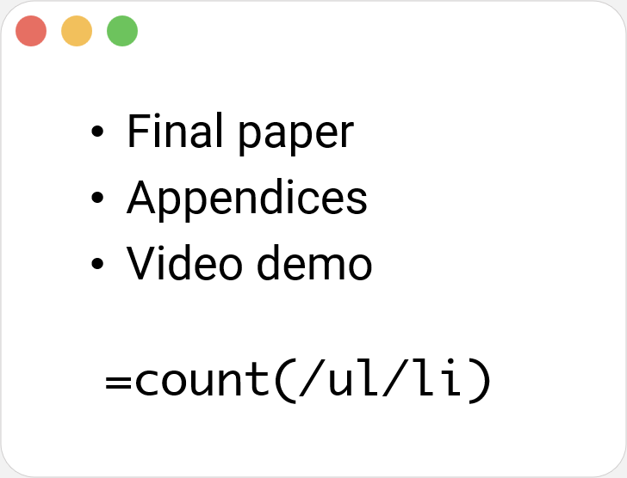
Schema Change Control
Final paper
Appendices
Video demo
=count(/ul/li)

Slide 9
Schema Change Control
Final paper
Appendices
Video demo
=count(/table/li)

Slide 10
Schema Change Control
Task | Done
Final paper
Appendices
Video demo
=count(/table/tbody/li)

Slide 11
Schema Change Control
Task | Done
Final paper | ✓
Appendices | ✓
Video demo
=count(/table/tbody/tr)

Slide 12
The Denicek Computational Substrate

Slide 13



Denicek: Edit History and Documents
add
edit
wrap
add

Slide 14
Denicek: Merging Edit Histories
wrap
add

Slide 15
Denicek: Merging Edit Histories
wrap
add
edit
edit
wrap
add

Slide 16
Denicek: Merging Edit Histories
add
edit
wrap
edit
wrap
add

Slide 17

Denicek: Edit Conflict Resolution
add
Reconcile compatible edits
add*
edit
Report conflicting edits
edit*
wrap
edit
wrap
add

Slide 18
Unreasonable Effectiveness of Merging
Merge edits during collaborative editing
add*
edit*
Replay edits recorded during programming by demonstration
wrap
Invalidate conflicting edits produced by formula evaluation
edit
wrap
Keep formulas in sync with the document structure
add

Slide 19
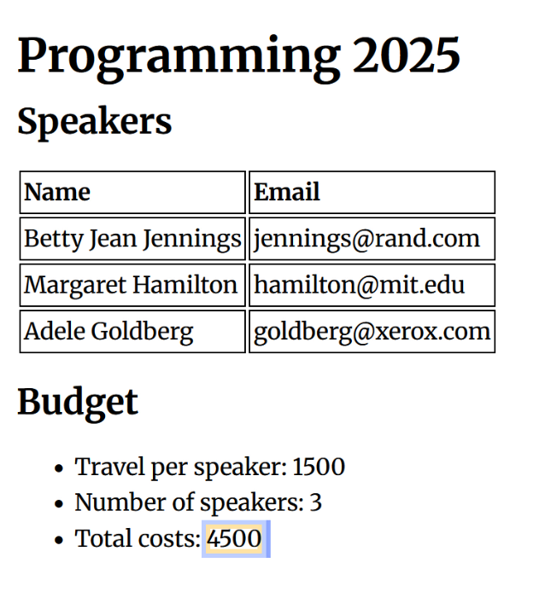
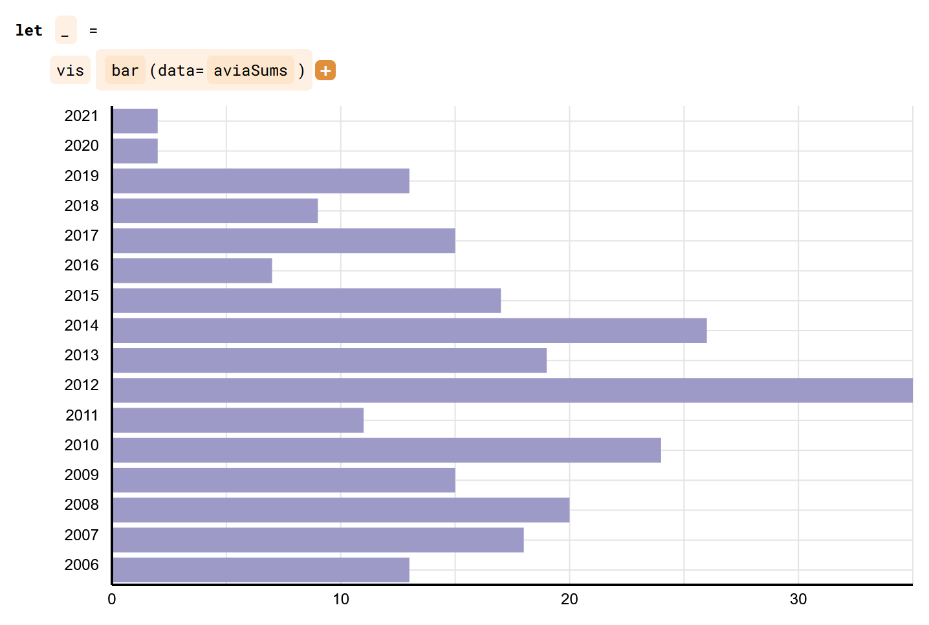
Denicek: Design and Evaluation
Webnicek Editor: Formative Prototype
Datnicek Notebook: Case Study

Slide 20
Denicek: Design and Evaluation
Webnicek Editor: Formative Prototype
Datnicek Notebook: Case Study

Slide 21

Formative Example: Counter App
Evelyn

Slide 22

Formative Example: Conference Organizer
Alfred
Juliana

Slide 23
Denicek: Design and Evaluation
Webnicek Editor: Formative Prototype
Datnicek Notebook: Case Study

Slide 24
Case Study: Datnicek Notebook
Juliana
Alfred

Slide 25
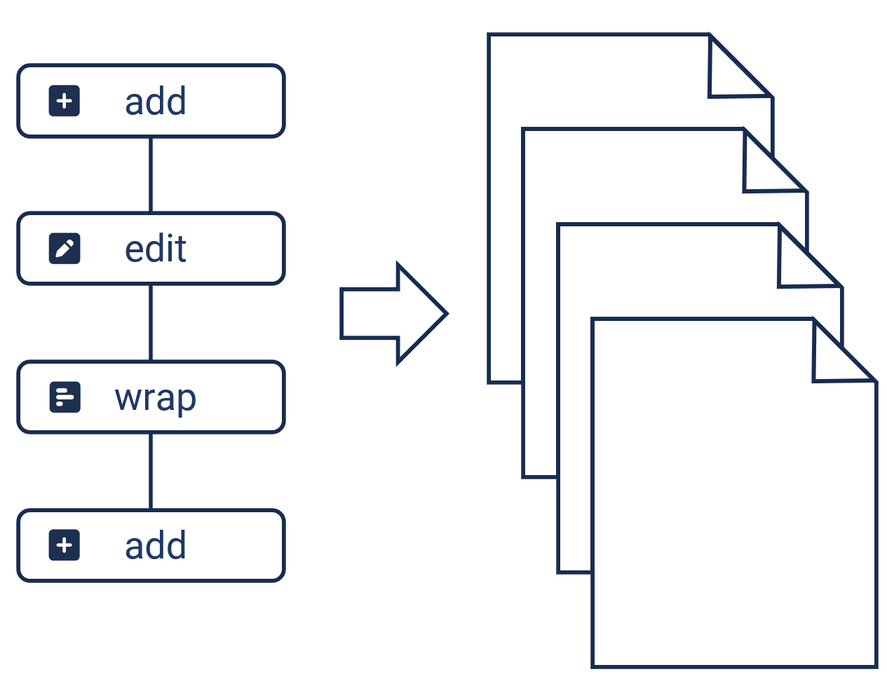
Denicek
Computational Substrate for Document-Oriented End-User Programming
Collaborative Local-first Editing
Programming by
Demonstration
Incremental Recomputation
Schema Change Control

