Slide 1
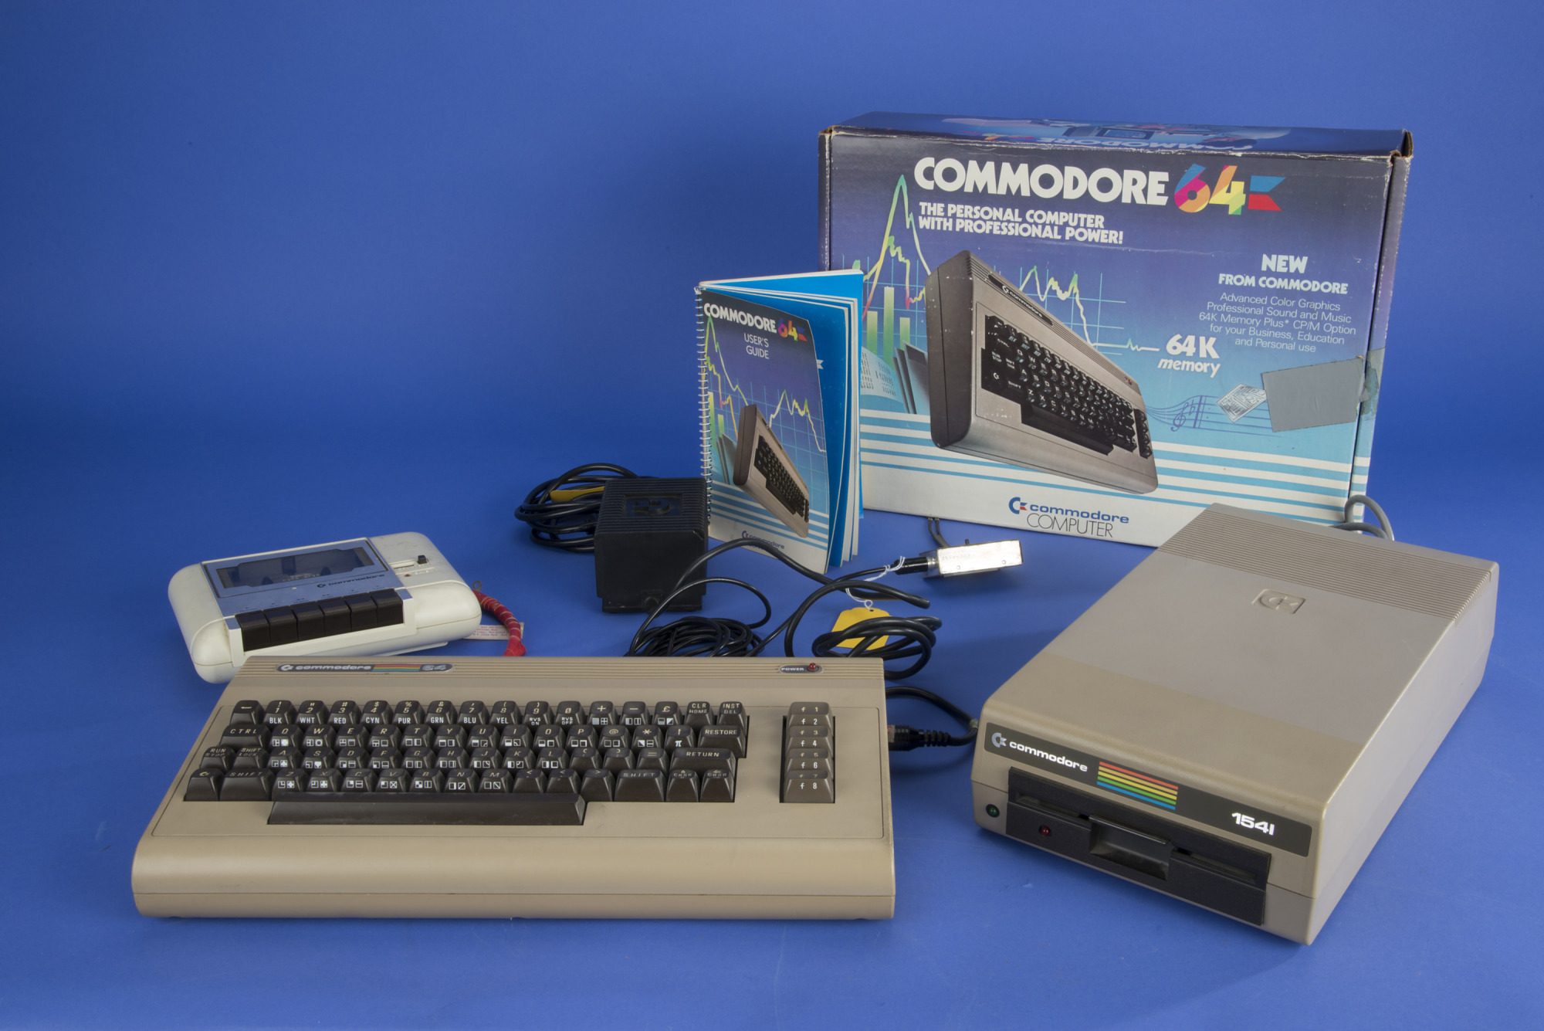
Complementary science of interactive programming systems
Tomas Petricek and Joel Jakubovic tomas@tomasp.net | jdj9@kent.ac.uk University of Kent

Slide 2
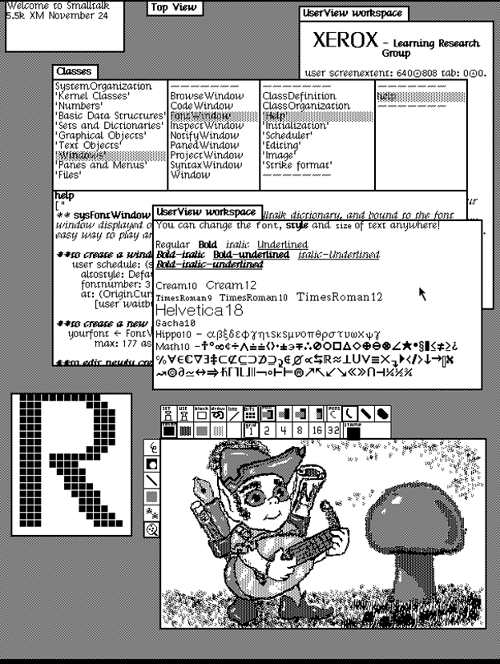
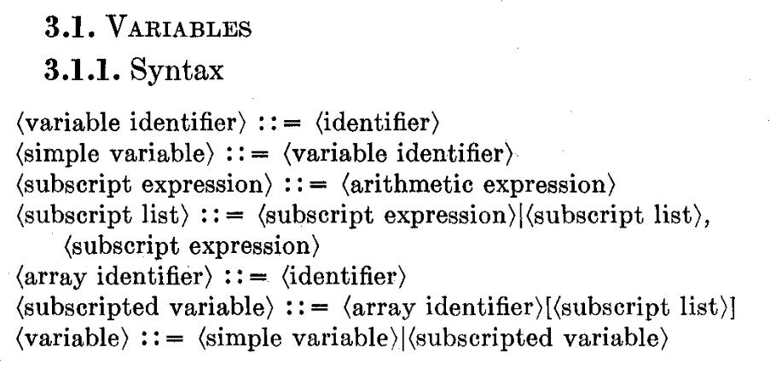
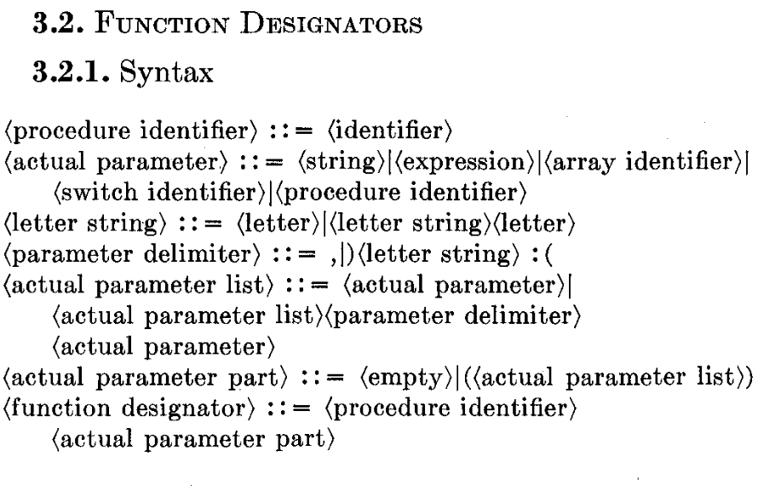
Paradigm shift in computer programming
Programming languages
Programming systems

Slide 3
Paradigm shift in computer programming
Programming languages
Algol, Java, Haskell
Code in a formal language
Program as text
Can be analyzed and run
Programming systems
Interlisp, Smalltalk, Hypercard
State includes code and data
Interesting user interfaces
Can be interacted with

Slide 4
Kuhn loss
What do we lose if we think about programming languages rather than programming systems?

Slide 5
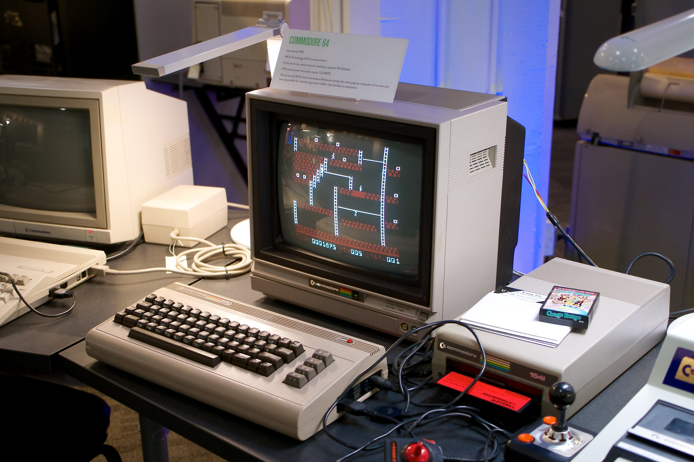
What is using past programming system like?
Harder to study than programming languages!
Do you need a real machine to experience the interaction?
What can we learn from past programming systems?

Slide 6
Complementary science of programming
Hasok Chang (2012)
Look at history to recover forgotten knowledge
Contribute alternative views to current science
Physics ideas abandoned due to experimental failures
Programming systems
Many innovative past systems worth exploring!
Abandoned not just for scientific reasons
Easier to recreate and further develop than in physics

Slide 7
Commodore 64 BASIC
Recreating the interactive experience of programming Commodore 64

Slide 8
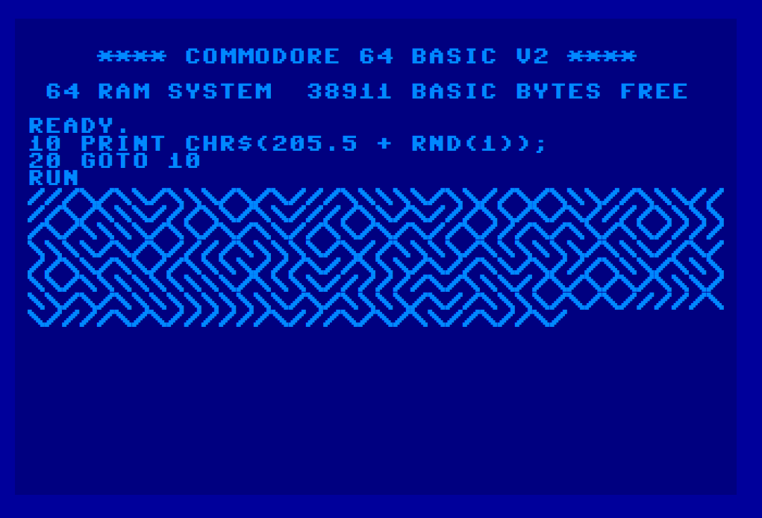
What makes C64 BASIC interesting?
Everything done through one kind of interaction
Encourages users to become programmers
Memory mapped I/O with POKE offers hacker flexibility

Slide 9
Complementary science of interactive programming systems
Many lost interesting ideas on programming systems!
Look at the past to get new ideas for the future
Simplistic partial reconstructions can be enough
Tomas Petricek and Joel Jakubovic, University of Kent tomas@tomasp.net | jdj9@kent.ac.uk

