Slide 1
Programvací jazyky F# a OCaml
Preface
Introduction to F# and functional programming

Slide 2
O této přednášce...
Vznikla minulý rok (Milan Straka)
Rozsáhlý přehled jazyků OCaml a F#
... včetně poměrně pokročilých vlastností
Tento rok trochu jiný obsah...
Spíše úvod do funkcionálního programování a F#
Jak FP souvisí s ostatními předměty na MFF?
… pokud bude čas tak i více ☺
Webové stránky: http://tomasp.net/mff

Slide 3
Za co bude zápočet?
Alternativní metody
Zajímavější cesta pro ty, které to zajímá :-)
Nějaká esej, článek nebo referát...
Nějaký projekt (něco zajímavého vymyslíme!)
Za x bodů z domácích úkolů...
Domácí úkoly budou na webových stránkách
Budou strašně těžké (viz. alternativní metody)

Slide 4
Functional Programming

Slide 5
Functional programming
1930s – Lambda calculus
Theoretical foundation of functional languages
Attempt to formalize all mathematics
1958 – LISP
First functional (computer) programming language
1978 – ML (meta-language)
Originally used in theorem proving systems
Useful as a general purpose language too!

Slide 6
OCaml and F#
1990 – Haskell
Strict and lazy language, many advanced features
1996 – OCaml (based on ML)
Combines functional and object-oriented features
2002 – F# (based on OCaml)
Microsoft Research functional language for .NET
Now official part of Visual Studio 2010

Slide 7
Why functional programming?
Functional abstractions hide how the code executes and specify what result we’re trying to get
Functional code is easier to understand, modify and reason about (assuming mathematical thinking)
Code is more easily composable and testable
Makes it easier to avoid repetitive patterns
Big topic today: Parallel and asynchronous code

Slide 8
Programvací jazyky F# a OCaml
Chapter 1.
Expression as a basic building block

Slide 9
Functional programming
Functional programming is a style of programming that emphasizes the evaluation of expressions, rather than execution of commands. The expressions in these languages are formed by using functions to combine basic values. [Hutton ed. 2002]
Evaluation of expressions
This is exactly how mathematics works!
For example:

Slide 10
Program as an expression
Writing equation as a single expression
Equations can get long and hard to read
How to break long equations into pieces?
Another idea from mathematics:
…called let binding in functional languages

Slide 11
Expressions at a small scale…
Calculating: 2x² – 5x + 3 for x = 2:
Using let binding to declare value x:
“;;” specifies the end of the input
> 2*(2*2) - 5*2 + 3;;
val it : int = 1
F# interactive prints the result
> let x = 2;;
val x : int = 2
> 2*(x*x) - 5*x + 3;;
val it : int = 1
Declared symbol with its value
We can re-use the symbol

Slide 12
Expressions at a larger scale…
Writing real programs as expressions
Example: describing drawings and animations
Declares two circle drawings
let greenCircle = circle Brushes.OliveDrab 100.0f
let blueCircle = circle Brushes.SteelBlue 100.0f
let drawing =
compose (translate -35.0f 35.0f greenCircle)
(translate 35.0f -35.0f blueCircle)
af.Animation <- forever drawing;;
Composes complex drawing from circles
Animation that doesn’t move
Exception: Modifies state of some object

Slide 13
Expressions at a larger scale…
Example continued: composing animations
Declare “animated” solar system objects
let sun = circle (forever Brushes.Goldenrod) 100.0f.forever
let earth = circle (forever Brushes.SteelBlue) 50.0f.forever
let mars = circle (forever Brushes.Chocolate) 40.0f.forever
let moon = circle (forever Brushes.DimGray) 10.0f.forever
let planets =
sun -- (rotate 160.0f 1.0f
(earth -- (rotate 40.0f 12.0f moon)))
-- (rotate 250.0f 0.7f mars)
Compose solar system from objects

Slide 14
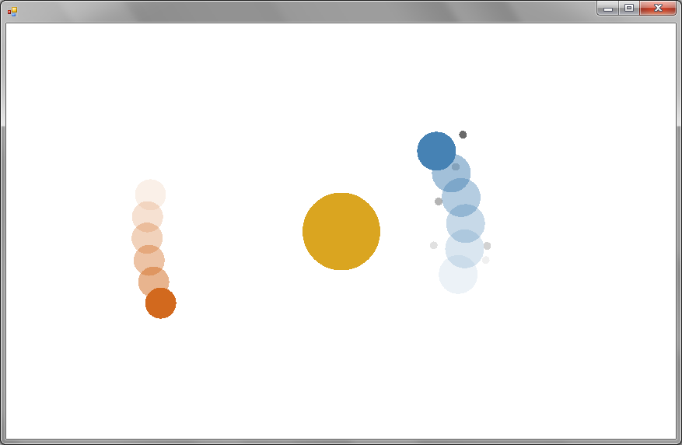
Solar system animation

Slide 15
Program as an expression
The examples so far were single expressions!
Declarative programming
The program describes the results we want to get
…not steps that should be performed to get it
Composability
Build complex programs from simpler pieces
…without unexpected interactions
Easy to reason about
Calculating the result of an expression is easy

Slide 16
Calculating with expressions

Slide 17
Calculating with numbers
Unary and binary operators:
– unary “–”, binary “+”
– standard precedence
– specifying precedence
Calculating with floating point numbers:
– works as expected
– oops! what happened?
> -5 + 10;;
val it : int = 5
> -5 + 10 * 2;;
val it : int = 15
> (-5 + 10) * 2;;
val it : int = 10
> 1.5 * (12.2 + 7.8);;
val it : float = 30.0
> 1.5 * (12 + 8);;
error FS0001: The type 'int'
does not match the type 'float'

Slide 18
Expressions have a type…
Each expression has a type
Compiler forbids expressions with wrong types
Type of binary numeric operators
// The most important types
> 42;;
val it : int = 42
> 42.0;;
val it : float = 42.0
> 42.0f;;
val it : float32 = 42.0f
// Other interesting types
> 42uy;;
val it : byte = 42uy
> 42.0UL;;
val it : uint64 = 42UL
> 42I;;
val it : BigInteger = 42I
// Overloaded
val (+) : int -> int -> int
val (+) : float -> float -> float

Slide 19
Converting numeric values
No conversions happen automatically
Conversion functions are overloaded too:
Actually, it is generic – works with any type
Any type that satisfies some conditions…
> int 10.0;;
val it : int = 10
> int 10.0f;;
val it : int = 10
> float 10;;
val it : float = 10.0
Calling a function
Different type of the parameter
val int : float -> int
val int : float32 -> int
val int : 'T -> int // Where 'T supports conversion to int

Slide 20
Calling operators and functions
Reading the type of a function
Why we always use the “->” symbol?
Calculating square roots of: 2x² – 5x + 3
val pown : float -> int -> float
result
first parameter
second parameter
> (-(-5.0) + sqrt ((pown -5.0 2) - 4.0*2.0*3.0)) / 2.0*2.0;;
val it : float = 6.0
> (-(-5.0) - sqrt ((pown -5.0 2) - 4.0*2.0*3.0)) / 2.0*2.0;;
val it : float = 4.0

Slide 21
Value bindings
Calculating square roots – again!
Even better – using discriminant:
let a, b, c = 2.0, -5.0, 3.0
(-b + sqrt ((pown b 2) - 4.0*a*c)) / 2.0*a
(-b - sqrt ((pown b 2) - 4.0*a*c)) / 2.0*a
let a, b, c = 2.0, -5.0, 3.0
let d = (pown b 2) - 4.0*a*c
(-b + sqrt d) / 2.0*a
(-b - sqrt d) / 2.0*a

Slide 22
Value binding as an expression
Value binding is also an expression
If we use line-break in F#, we don’t need “in”
> let n = 2 * 3 in 100*n + n;;
val it : int = 606
> 10 + (let n = 2 * 3 in 100*n + n) + 20;;
val it : int = 636
White-space sensitive
>
10 + (let n = 2 * 3
100 * n + n) + 20;;
val it : int = 636
We can still do the same thing!

Slide 23
Printing to console & unit type

Slide 24
Printing to the console
This doesn’t look like an expression:
Side-effect: Evaluation of an expression modifies the state of the world (e.g. global variables or console)
Avoided where possible, but sometimes needed…
…but, how can this be an expression?
Introducing the “unit” type…
printfn "Hello world!"
> printfn "Hello world!";;
val it : unit = ()

Slide 25
Introducing the “unit” type
Unit type represents no information
It has exactly one value written as “()”
Functions without result return unit value
> let unitValue = ();;
val unitValue : unit = ()
> let unitValue = printfn "Hello world!";;
Hello world!
val unitValue : unit = ()

Slide 26
Calculating with unit values
Sequencing expressions using semicolon:
In F# we can use new-line instead of “;”
Ignored value should be unit
> let n = (printfn "calculating"; 10 + 4);;
calculating
val n : int = 14
let n = (printfn "calculating"
10 + 4);;
> let n = (10 + 2; 10 + 4);;
warning FS0020: This expression should have type 'unit', but has type 'int'.
val n : int = 14

Slide 27
Ignoring values
Generic function ignore:
Ignores any value and returns unit instead
The example from the previous slide:
Useful especially when working with .NET
val ignore : 'T -> unit
> let n = (ignore (10 + 2); 10 + 4);;
val n : int = 14

Slide 28
Conditions and Booleans

Slide 29
Calculating with Booleans
Another useful type – values true and false
Operators have short-circuiting behavior
> let b1, b2 = true, false;;
> b1 && b2;;
val it : bool = false
> b1 || b2;;
val it : bool = true
> true || (printfn "test"; true);;
val it : bool = true
> true && (printfn "test"; true);;
test
val it : bool = true
Second argument not evaluated
Needs second argument too!

Slide 30
Writing conditions using “if”
This is also an expression!
The “else” branch may be missing
if d = 0.0 then printfn "one solution"
elif d < 0.0 then printfn "no solutions"
else printfn "two solutions"
> let n = (if d=0.0 then 1 elif d<0.0 then 0 else 2)
val n : int = 2
Returns “unit” in any case
> if d < 0.0 then printfn "yay!";;
val it : unit = ()
> let n = (if (d = 0.0) then 1)
error FS0001: This expression was expected to have type ‘unit’ but here has type ‘int’
What can this return?

Slide 31
Conditions using “match”
Test value against multiple cases (patterns)
We’ll talk about patterns in detail later
Patterns decompose complex data types
match d with
| 0.0 ->
printfn "one solution"
| discr when discr < 0.0 ->
printfn "no solutions"
| _ ->
printfn "two solutions"
Constant pattern
Binding with condition
“match-all” pattern

Slide 32
Evaluating expressions

Slide 33
Evaluation is a reduction
Example:
We can follow one of the two rules:
Rule 1: Evaluate value of symbols first:
Rule 2: Replace symbols with expression
let d = (pown -5.0 2) - 4.0*2.0*3.0 in
(5.0 + sqrt d) / 2.0*2.0
⤳ let d = 1.0 in (5.0 + sqrt d) / 2.0*2.0
⤳ (5.0 + sqrt 1.0) / 2.0*2.0
⤳ ... ⤳ 6.0
⤳ (5.0 + sqrt ((pown -5.0 2) - 4.0*2.0*3.0)) / 2.0*2.0
⤳ ... ⤳ 6.0

Slide 34
Example
Analyze the evaluation tree of an expression:
Step-by-step application of the two rules
What is the shortest path?
Which path will the F# compiler follow?
let num = (let ten = 5 + 1 in ten + ten + 1) in
num * 2

Slide 35
Homework #1
Find an expression where evaluating the value of symbols first is better and another expression where replacing symbols with expressions is better .
Better means smaller number of reduction steps (no unnecessary calculations).

Slide 36
Homework #2
Write expression that prints “yes” if the value of n is less than 10 and “no” otherwise. Without using if and match construct.

