Slide 1

The F# language
Tomáš Petříček
Microsoft C# MVP
http://www.tomasp.net

Slide 2
What is this F# thing?
Full-blown .NET language
  It is possible to use any .NET library from F#
  It is possible to use F# library from other .NET languages
Combines two important programming paradigms
  Object oriented programming
  Functional programming
  Also very useful for interactive scripting

Slide 3
Why is F# interesting?
Functional programming is general principle
  You can use some idioms in other languages as well
What languages will we use in a few years?
  Some F# features may appear in future languages
Developed at Microsoft Research
  License allows using F# in commercial applications!
  F# is well tested, optimized and has growing community
Thanks to .NET you can use it in part of larger project
  Which can be good idea for some kind of tasks

Slide 4
Why inventing another language?
Programs today are hard to parallelize
  Using threads leads to nondeterministic behavior
Some ideas are difficult to express
  Declarative programming is easier to understand
In OOP you can easily write reusable type
  But writing reusable function/algorithm isn’t that simple
Sometimes you need to target multiple “runtimes”
  For example CLR, SQL and JavaScript hosted in browser
  In F# it is possible to “compile” F# code to other languages

Slide 5
Agenda
Functional programming in F#
Some useful functional idioms
Interactive scripting
Interoperability between F# and other .NET languages
F# as a language for ASP.NET
Meta-programming in F#

Slide 6
Type system
Strict type safety (similar to C#)
  Usually you don’t have to specify type explicitly
  Types are inferred from the context
  Uses type parameters when possible (generics in .NET 2.0)
// Integer number value (int)
let n = 42
// Value of string type (string)
let str = "Hello world!"
// Function (int -> int)
let add10(n) =
n + 10
// Function that returns parameter ('a -> 'a)
let id(sth) = sth

Slide 7

Type system
Function is type as any other
  Can be passed as a parameter or returned from function
  Can be created anywhere in code
// Function (int -> int)
let add10_a(n) =
n + 10
// Function written using longer syntax (int -> int)
let add10_b =
fun n -> n + 10
// Function that accepts function as a parameter
// Type: (int -> int -> int) -> int
let volani(func) =
1 + func 2 3
// Passing ‘anonymous’ function as a parameter
volani(fun a b -> a + b)

Slide 8
Type system
Discriminated union
The OOP way of expressing this is following:
// Can contain one of the following variants
type simple_expr =
| Num of int
| Add of simple_expr * simple_expr
| Sub of simple_expr * simple_expr
simple_expr
simple_expr.Num
simple_expr.Add
simple_expr.Sub
value : int
value1 : simple_expr
Value2 : simple_expr
value1 : simple_expr
Value2 : simple_expr

Slide 9
DEMO
Type system in F#
Type safety and functions
Discriminated union & pattern matching
Notes:
Srovnani quicksortu v F# a C#
Web crawler

Slide 10
Type system
Tuple – combination several different types
List – collection of elements with same type
  F# allows you to work with .NET arrays too!
// Tuple (int * string)
let tup = (1, “Hello world!”)
// Function working with tuple
let func tup =
let (n, s) = tup
// ...
// List of numbers (int list)
let list = [1; 2; 3; 4; 5]
// Internal representation of list
type int_list =
| Nil
| Cons of int * int_list

Slide 11
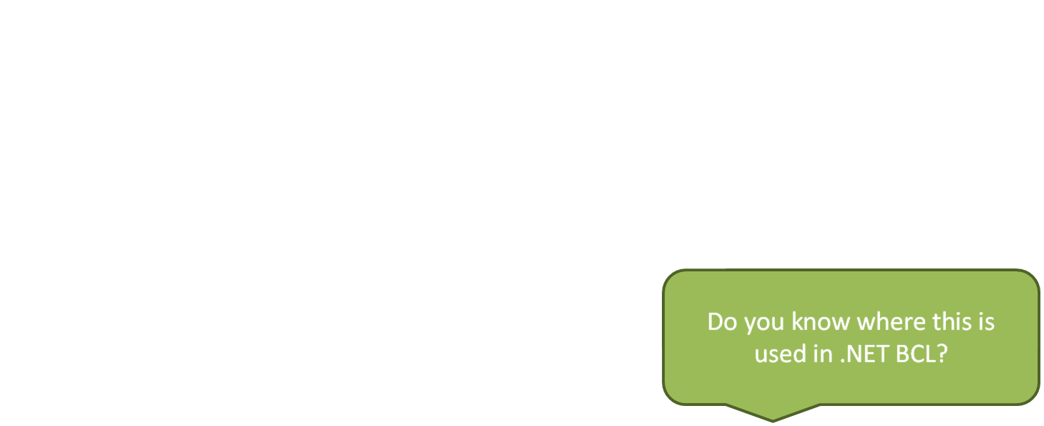
Functional vs. imperative approach
Imperative approach
  Assignment is the most important operation
Functional approach
  Based on recursion
  Value of „variables“ doesn’t change (immutable values)
  Pure functional functions doesn’t have side effects
    Easier to test and debug
    Can be executed in parallel
Notes:
NOTE: The answer to the question is .NET string type.

Slide 12
Functional vs. imperative approach
In F# you can combine both approaches
  Imperative approach is good for .NET interoperability
Functional
Imperative
// Factorial (functional approach)
let rec fac_f n =
if (n = 0) then 1 else n * fac_f(n – 1)
// Factorial (imperative approach)
let fac_i n =
let ret = ref 1
for i = 1 to n do
ret := !ret * i
done
!ret

Slide 13
DEMO
Functional approach
The QuickSort algorithm (F# vs. C#)
Web crawler (written by the F# team)
Notes:
Srovnani quicksortu v F# a C#
Web crawler

Slide 14
Agenda
Functional programming in F#
Some useful functional idioms
Interactive scripting
Interoperability between F# and other .NET languages
F# as a language for ASP.NET
Meta-programming in F#

Slide 15
A few interesting FP idioms
Functions map (Select), filter (Where) a foldl
let list = [0; 1; 2; 3; 4; 5; 6; 7; 8; 9]
// Filter and map
// result = [0; 9; 36; 81]
let result = list
|> List.filter ( fun n -> n%3 = 0)
|> List.map ( fun n -> n*n )
// Foldl
// sum = 126
let sum = result |> List.fold_left
( fun acc v -> acc + v ) 0

Slide 16
A few interesting FP idioms
Function parameters are replaced with delegates
(implementation of Iter and Map is similar)
public delegate T Func<A0, T>(A0 arg0);
public delegate T Func<A0, A1, T>(A0 arg0, A1 arg1);
// Vybere prvky pro které ‘filterFunc’ vrací true
public IEnumerable<T> Filter<T>
(IEnumerable<T> e, Func<T, bool> filterFunc) {
foreach(T el in e)
if (filterFunc(el)) yield return el;
}
// Postupně akumuluje výsledek pomocí ‘accFunc’
public R FoldLeft<T, R>(IEnumerable<T> en,
Func<R,T,R> accFunc, R init) {
R ret = init;
foreach(T el in en) ret = accFunc(ret, el);
return ret;
}

Slide 17
DEMO
A few interesting FP idioms
Map, Filter and FoldLeft in C#

Slide 18
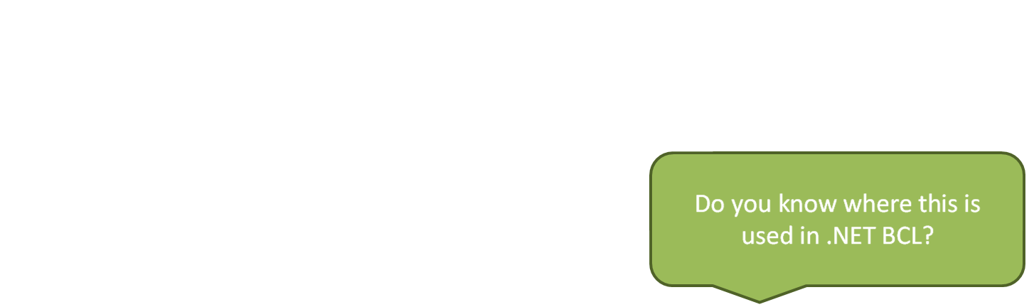
A few interesting FP idioms
Lazy evaluation
  Delays the calculation until the result is really needed
let a = Lazy.lazy_from_func ( fun () -> (* calc. *) 42 )
let b = Lazy.lazy_from_func ( fun () -> (* calc. *) 84 )
let func (x:Lazy<int>) (y:Lazy<int>) =
// calculation...
if (use_x_value) then
Lazy.force x
else
Lazy.force y
// Calling the ‘func’ function
func a b
Notes:
NOTE: The answer is IEnumerable (but you can probably find other correct answers, like loading something from cache etc…)

Slide 19
DEMO
A few interesting FP idioms
Lazy evaluation – class Lazy<T>

Slide 20
Agenda
Functional programming in F#
Some useful functional idioms
Interactive scripting
Interoperability between F# and other .NET languages
F# as a language for ASP.NET
Meta-programming in F#

Slide 21
Interactive scripting
Used by administrators or in mathematical applications
  Cmd, Bash, PowerShell, Mathematica
User enters commands one by one
  Typical scripting languages are interpreted
  F# is, of course, compiled
What are requirements for successful scripting language?
  The code must be as simple as possible
  In F# you get basic verification thanks to type checking!

Slide 22
DEMO
Interactive scripting in F#
Famous mathematical simulation in DirectX (by James Margetson)

Slide 23
Agenda
Functional programming in F#
Some useful functional idioms
Interactive scripting
Interoperability between F# and other .NET languages
F# as a language for ASP.NET
Meta-programming in F#

Slide 24
Using of .NET classes
In F# you can use any .NET object
  Use operator “<-” for assigning values to properties
  Use operator “.” for calling methods, accessing properties
// import .NET namespaces
open System
open System.Windows.Forms
// .NET atributes
[<STAThread>]
let main() =
// Create new Form and set the values
let form = new Form()
form.Width <- 400
form.Height <- 300
form.Text <- "Hello World Form“
Application.Run(form)
do main()

Slide 25
Exporting F# functions
Functions are exported as static methods
  You can use modules to set the class name
Usage may be difficult with some F# types
  See the next demonstration for details
namespace MyFSharp.Export
module Math = begin
let rec factorial n =
if (n = 0) then 1 else n * (factorial (n-1))
end

Slide 26
Writing classes in F#
F# has standard OOP compatible with other .NET languages
  Visibility is currently determined by the “FSI” header file
type Customer = class
val name:String
val mutable income:int
new(n,a) = { name = n; income=10000 }
override this.ToString() =
String.Format("(Name={0}, Income={2})",
this.name, this.income);
member this.Income
with get() = this.income
and set(v) = this.income <- v
member this.Name
with get() = this.name
end

Slide 27
DEMO
Interoperability between F# and other .NET languages
Windows Forms application in F#
Using F# functions and classes from C#

Slide 28
Agenda
Functional programming in F#
Some useful functional idioms
Interactive scripting
Interoperability between F# and other .NET languages
F# as a language for ASP.NET
Meta-programming in F#

Slide 29
F# as a language for ASP.NET
Two possibilities
  Writing only code-behind classes in F# (ASP.NET 1.1)
  Writing the whole website in F# (only ASP.NET 2.0)
Thanks to the ASP.NET extensibility
  It is possible to add support for any (OO) language
Uses CodeDomProvider
  For generating code from ASPX/ASCX files
  For compilation of generated sources

Slide 30
DEMO
ASP.NET web written in the F# language
Demo web applications

Slide 31
Agenda
Functional programming in F#
Some useful functional idioms
Interactive scripting
Interoperability between F# and other .NET languages
F# as a language for ASP.NET
Meta-programming in F#

Slide 32
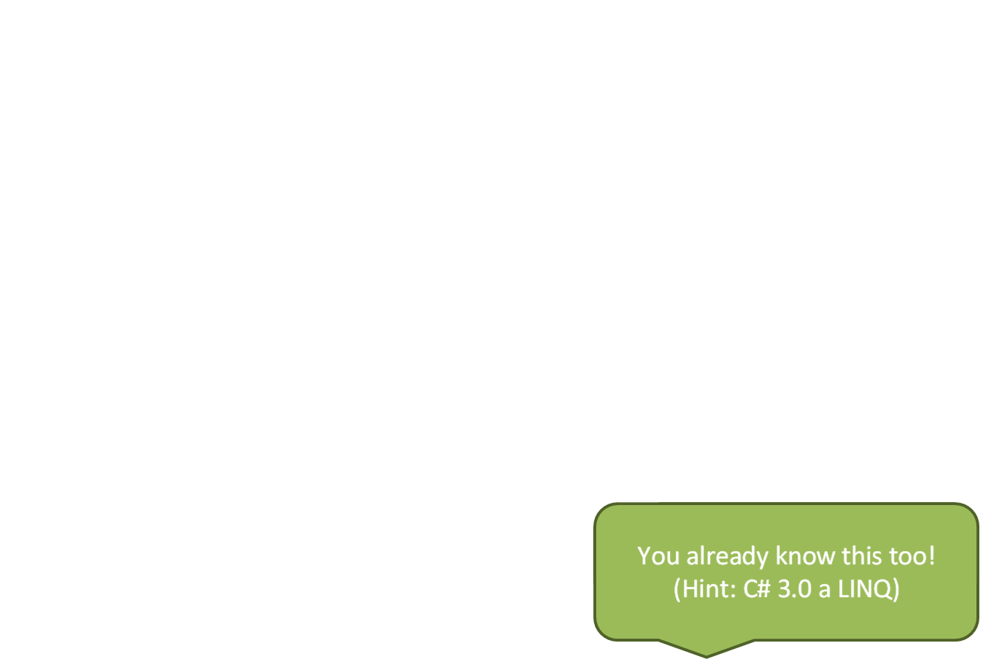
Meta-programming in F#
Writing of programs that generate or manipulate with other programs (or themselves) as their data
What does this mean?
  You can access to part of the program as data
  Returned data structure represents correct F# program
What is it good for?
  Code can be analyzed
  Code can be translated to another language
Notes:
NOTE: the answer is lambda expressions in C# 3.0

Slide 33
Meta-programming in F#
Program is represented as tree structure
>> <@ 1 + 2 * 4 @>
> val it : expr = <@
> Microsoft.FSharp.MLLib.Pervasives.op_Addition (Int32 1)
> Microsoft.FSharp.MLLib.Pervasives.op_Multiply (Int32 2) (Int32 4))
> @>
op_Addition
(Int32 1)
op_Multiply
(Int32 2)
(Int32 4)
Notes:
This diagram isn’t exactly correct, because the representation is a bit different in functional languages, but it is easier to explain…

Slide 34
F# and the LINQ project
Code written in F# can be translated to another language
  For example to the SQL!
  Expressions used for filtering, projection etc. are translated
  Note.: Operator “|>” represents chaining – the result of the first operation is passed as a parameter to the next
// Northwind is generated by tools from LINQ project
let db = new nwind.Northwind
("Database=Northwind;Server=.;Integrated Security=SSPI")
// Database query in F#
let query = db.Customers
|> where <@ fun c -> c.Country="USA" @>
|> select <@ fun c -> (c.CompanyName, c.City, c.Country) @>

Slide 35
DEMO
Meta-programming
Simple example
FLINQ and working with database in F#

Slide 36
Who is using F#?
In Microsoft
  Driver verification (code analysis)
In Microsoft Research
  Automated machine proving
  Analysis of multithreaded applications
  Experiments in the game development team
Others...
  Analysis of financial data

Slide 37
References and sources
Official F# homepage
http://research.microsoft.com/projects/fsharp/
F# community web site
http://cs.hubfs.net/
Don Syme’s blog
http://blogs.msdn.com/dsyme
Functional programming explained (for Java programmers):
http://www.defmacro.org/ramblings/fp.html

