Slide 1
Wrattler: Making notebooks reproducible, polyglot and live
Tomas Petricek The Alan Turing Institute
tomas@tomasp.net | @tomaspetricek

Slide 2
Data science is…
Iterative and exploratory
Maze of corner cases
Ad hoc tools & languages

Slide 3
Data science needs…
Reproducible workflows
“Human in the loop“ AI advice
Immediate feedback
Mix and match tools

Slide 4
Wrattler
Platform for AI-assisted data science

Slide 5

Wrattler Platform for AI-assisted data science
Common notebook issues
Limited reproducibility
No rollback of state
Limited interaction model
One language per kernel
Wrattler architecture
Reproducibility and versioning
Interactive development
Platform for AI assistants
Polyglot programming
KERNEL CLIENT
PROVIDERS CLIENT
Notes:
[NOT IN THE SLIDE] Notebooks are rightly popular for a number of good reasons:
They allow you to iterate on your code quickly via REPL environment
They provide rich output with embedded charts and tables
They are lightweight portable interface for a cloud server
[IN THE SLIDE] But the way most current notebooks systems are implemented leads to a number of issues:
Reproducibility – If you run cells out of order and tweak parameters, you can get into a state without knowing how
No rollback – There is no way to go to the previous model if it worked better; more generally, version control support is also poor
Limited interaction – You can just run cells and get results, but more complex interactions – like previews or notebook refactoring are not part of the “protocol”
One language – This can be done via “magics” but it’s hard because state is associated with one primary kernel, so magics has to mirror it in a hackish way
[ARCHITERCTURE DIAGRAM] Our key idea is to (logically) move the state from a single kernel on the server to the client. The client can evaluate some things on its own and for other things, calls one of several providers. The client owns the state logically, but data is in a durable data store that keeps versions and allows easy sharing of state with providers. Client only needs “references” to the state, so it never actually loads all “big data” into the browser.
[IN THE SLIDE] This alternative architecture allows us to address the main issues with notebooks:
Reproducibility – In our architecture, client always evaluates current state of code (with caching to make this work), so what you see is what everyone will see
Versioning – The datastore keeps the history of changes, so you can go back to the previous state of a notebook
Interactivity – We can build a lot more intelligence into the client and provide more rapid feedback – e.g. by giving live previews and showing outliers or typical rows (this is handled by datastore and client, so the language-specific provider stays simple)
Polyglot programming – The client can call multiple providers to mix multiple languages or AI assistants in order to do the job

Slide 6
TheGamma
Automatic suggestions and live feedback

Slide 7
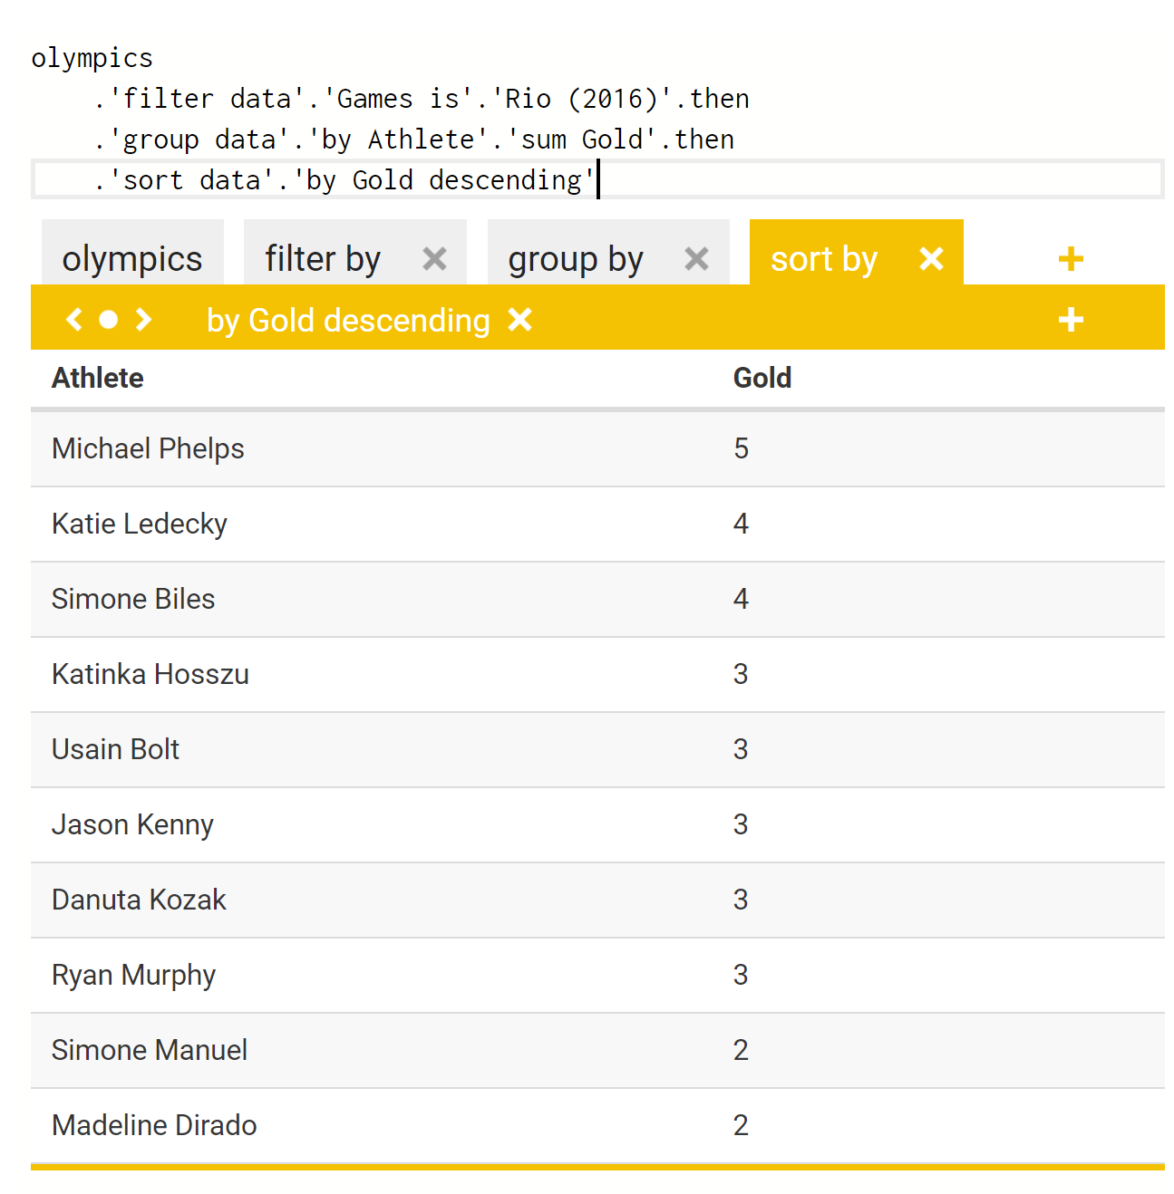
TheGamma Simple language for data exploration
Live programming
Runs in the browser
Recalculate on the fly
Dependency graph
Direct manipulation
Edit data, not code!
End-user programming
Keep reproducibility

Slide 8
Datadiff
AI assistants for data wrangling

Slide 9
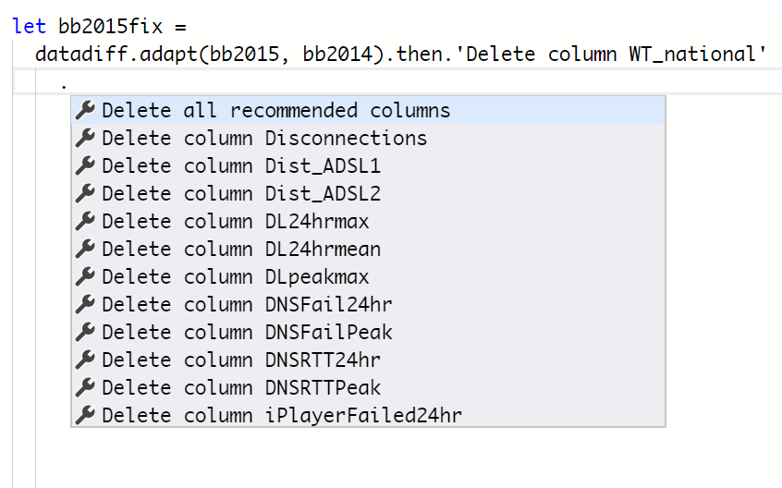
Datadiff AI assistants for data wrangling
AI assistants
No black box magic
Generate instructions
Domain specific languages
Datadiff
R and Python package
List of patches
Delete, shift, scale, etc.

Slide 10
Polyglot
R for statistics, JavaScript for visualization

Slide 11
Wrattler Platform for AI-assisted data science
DATA STORE
(with provenance)
CLIENT
(browser)
AI AGENTS
LANGUAGE RUNTIMES
Notes:
[NOT IN THE SLIDE] Notebooks are rightly popular for a number of good reasons:
They allow you to iterate on your code quickly via REPL environment
They provide rich output with embedded charts and tables
They are lightweight portable interface for a cloud server
[IN THE SLIDE] But the way most current notebooks systems are implemented leads to a number of issues:
Reproducibility – If you run cells out of order and tweak parameters, you can get into a state without knowing how
No rollback – There is no way to go to the previous model if it worked better; more generally, version control support is also poor
Limited interaction – You can just run cells and get results, but more complex interactions – like previews or notebook refactoring are not part of the “protocol”
One language – This can be done via “magics” but it’s hard because state is associated with one primary kernel, so magics has to mirror it in a hackish way
[ARCHITERCTURE DIAGRAM] Our key idea is to (logically) move the state from a single kernel on the server to the client. The client can evaluate some things on its own and for other things, calls one of several providers. The client owns the state logically, but data is in a durable data store that keeps versions and allows easy sharing of state with providers. Client only needs “references” to the state, so it never actually loads all “big data” into the browser.
[IN THE SLIDE] This alternative architecture allows us to address the main issues with notebooks:
Reproducibility – In our architecture, client always evaluates current state of code (with caching to make this work), so what you see is what everyone will see
Versioning – The datastore keeps the history of changes, so you can go back to the previous state of a notebook
Interactivity – We can build a lot more intelligence into the client and provide more rapid feedback – e.g. by giving live previews and showing outliers or typical rows (this is handled by datastore and client, so the language-specific provider stays simple)
Polyglot programming – The client can call multiple providers to mix multiple languages or AI assistants in order to do the job

Slide 12
Architecture details…
Runtimes are stateless
Communicate via data store
Dependency graph on client

Slide 13
Architecture enables…
Polyglot programming
Live programming
AI assistant integration
Reproducibility and versioning

Slide 14
Thanks & Discussion
Tomas Petricek, The Alan Turing Institute
tomas@tomasp.net | @tomaspetricek

