Slide 1
Game development za Windows Phone
Toni Petrina (Microsoft MVP for C#)
Ekobit
@to_pe
http://tonicodes.net/blog/

Slide 2
Demo time

Slide 3
Engines and Frameworks
Unity (FREE)
GameMaker (99$ + 199$)
http://www.yoyogames.com/studio
MonoGame
Open source XNA implementation

Slide 4


...and if I want to create engine?
C++
DirectX 3D
There is no 2D ☹
DirectX Tool Kit (XNA-like)
C#
SharpDX (thin wrapper)
MonoGame
XNA – limited to WP7

Slide 5
Demo time
Unity

Slide 6
OK, I’ll bite...MonoGame?
Yeah, MonoGame
Hey, it’s C#!
Open source (http://monogame.net/)
Just copy/paste XNA code and it will work
No MonoGame namespaces, they are still Microsoft.Xna
More platforms
Android, iPhone, Mac, Vita, Ouya...

Slide 7
Demo time
MonoGame

Slide 8
Physics
Farseer engine
http://farseerphysics.codeplex.com/
Open source
Portable (based on Box2D)
BEPUphysics
3D
Free

Slide 9
Demo time
Farseer

Slide 10
Specs
The essential stuff

Slide 11
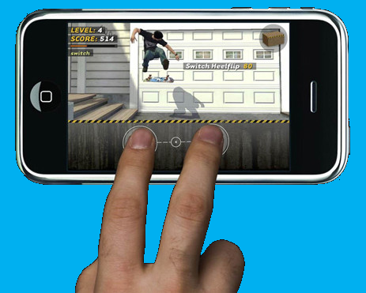
Input
Touch the screen maybe?
4-point multi-touch
Sensors
Accelerometer, Motion API
Camera
Or two...

Slide 12

Sound & Video
XNA
(SoundEffect).Play(), MusicPlayer
VideoPlayer
Windows Phone 8
XAudio2, WASAPI
MediaFoundation
It may be hard...

Slide 13
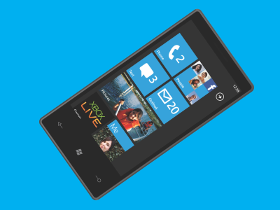
What kind of hardware? WP7
480x800
4-point multi-touch
DirectX9
256MB of RAM (or higher)
Accelerometer, ambient light sensor, proximity sensor and Assisted GPS
Maybe front-facing camera, compass and gyroscope

Slide 14
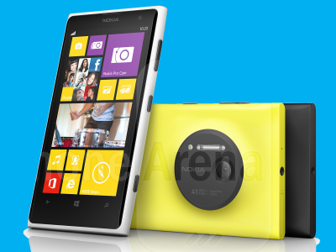
What kind of hardware? WP8
480x800, 720x1280, 768x1280
4-point multi-touch
DirectX 11 (limited)
512MB of RAM (or higher)
Dual-core
Accelerometer, proximity and ambient light sensors, as well as vibration motor (magnetometer and gyroscope are optional)

Slide 15
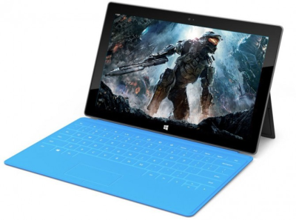
Windows 8?
Why would I care?
Ahem...money?
Is it easy?
Kinda...
Lots of code sharing
Lots of differences

Slide 16
Summary
XNA
WP8 possible (reflection, IAP), but there are problems ☹
With MonoGame – multiplatform approach
DirectX
Hard, C++, thin wrapper possible with SharpDX
Portable to Windows Store
Unity/other engines
Multiplatform approach, pipeline, support
Price ☹

Slide 17
Messages for takeaway
Make games, not engines
Be creative
Be mindful of constraints
Have fun

