Slide 1




A Systematic Study of the Mobile App Ecosystem
Thanasis Petsas, Antonis Papadogiannakis, Evangelos P. Markatos
Michalis Polychronakis
Thomas Karagiannis
Notes:
Good Afternoon! My name is Thanasis Petsas!
I am going to present you our work Rise of the Planet of the apps,
a systematic study of the mobile app ecosystem
It is a joint work and was done in collaboration with …

Slide 2
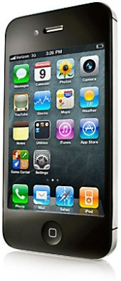


Smartphone Adoption Explodes
Smartphone adoption:
10x faster than 80s PC revolution
2x faster than 90s Internet Boom
3x faster than social networks
1.4 B smartphones will be in use by 2013!
Source:
Notes:
The rate of iOS and Android device adoption has surpassed that of any
consumer technology in history. Compared to recent technologies, smart
device adoption is being adopted:
10X faster than that of the PC revolution,
2X faster than that of Internet Boom and
3X faster than that of recent social network adoption
According to ABI research there will be about one and a half billion smartphones in active use by the end of this year, with Android keeping its lead
in handsets and iOS continuing to dominate in tablets.
http://blog.flurry.com/bid/88867/iOS-and-Android-Adoption-Explodes-Internationally
http://techcrunch.com/2013/01/31/a-race-of-two-horses-and-two-ponies-1-4b-smartphones-in-use-by-2013-only-45m-windows-phone-20m-bb10-devices-with-android-ios-dominating/
http://www.brighthand.com/default.asp?newsID=20028&news=Smartphone_sales_overtake_feature_phone_sales_Q1_201

Slide 3



Mobile Apps are Getting Popular
50B+
downloads
1M+
apps
50B+
downloads
900K+
apps
2B+
downloads
100K+
apps
Windows Store
Notes:
* This evolution in smartphones also enhances the popularity of mobile applications.
Google Play, that is the official Android marketpace recently reached the milestone of
1 million apps and 50 billion downloads. Second comes the Apple store with almost the same number of apps and downloads and third the windows market
--- with over 100 thousands of apps and 2 billion of downloads.
Appstores are the platforms that host and distribute these apps to the end users.

Slide 4















A Plethora of Marketplaces
In addition to the ofﬁcial marketplaces...
Many alternative markets
Notes:
Apart from the official marketplaces, there is a big number of alternative ones that boost app popularity and streamline the process of publishing apps from
developers, and also help users to search, download and install apps.
But why a developer to choose such an appstore, instead of Google Play
which can give it much more visibility?
3rd party appstores may provide extra benefits to developers, e.g. SlideMe
does not charge transaction fees to developers
Can be found pre-installed in many devices
-------------------------------------------
There are many reasons,
For example, he can put his app to many other appstores in order to gain more popularity, and to increase his income
Moreover, Google Play supports only specific locations for merchants, so some developers to no supported locations will choose a local marketplace instead

Slide 5
Motivation
App popularity
How does app popularity distribution look like?
Is it similar with other domains?
WWW, P2P, UGC
Can we model app popularity?
App pricing
How does price affect app popularity?
What is the developers’ income?
Which are the common pricing strategies?
Notes:
* Despite this rapid evolution of this mobile app ecosystem, there is no any large scale study analyzing its main properties.
In this study we are focusing on app popularity. We compare it with other fields like web, p2p and video sharing systems and try to identify
the parameters that may affect it. Then, based on these parameters we construct a model for it.
Moreover, we are also interested in app pricing.
We try to explore how the cost affects app popularity and developers income and what are their common revenue strategies.

Slide 6

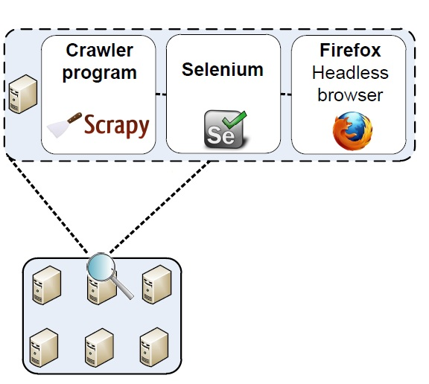
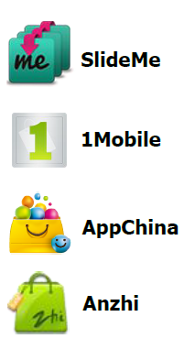
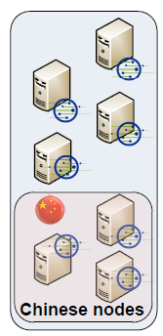
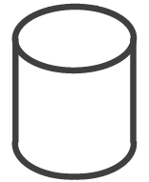
Data Collection
App stats APKs
App stats APKs
App stats APKs
App stats APKs
PlanetLab Proxies
Marketplaces
Crawler Hosts
Database
Notes:
For our data collection, we used a set of local machines (as you can see in the bottom) where each one is hosting multiple crawler instances.
We implemented our cralwers using the Scrapy framework in Python.
In order to deal with Javascript generated content, we proxy our requests through the Selenium browser automation tool.
We crawled 4 popular alternative Android marketplaces on a daily basis
(SlideMe, 1Mobile and the Chinese ones: AppChina and Anzhi).
We didn’t crawl Google Play because terms of service do not allow to access
the site through any type automated means. Moreover, Google Play does
not provide precise number of app downloads, but ranges, which would
harden our analysis.
In order to avoid our crawler hosts to be blacklisted we used a set of Planetlab nodes as proxies.
Moreover, the Chinese appstores apply rate limiting to hosts away from China, so we used a set of PlanetLab nodes located in China.
Finally the collected information is stored in a local database (MySQL).

Slide 7
Datasets
Appstore | Crawling period | Total apps* | New apps / day | Total downloads* | Daily downloads
SlideMe (free) | 5 months | 16,578 | 28.0 | 96 M | 215.7 K
SlideMe (paid) | 5 months | 5,606 | 6.5 | 914 K | 5.2 K
1Mobile | 4.5 months | 156,221 | 210.4 | 453 M | 651.5 K
AppChina | 2 months | 55,357 | 336.0 | 2,623 M | 24.1 M
Anzhi | 2 months | 60,196 | 29.6 | 2,816 M | 23.7 M
Paid apps:
less downloads
fewer uploads
* Last Day
~ 300K apps
Notes:
Here are the collected data from our crawling process of our 4 monitored appstores which has a duration from 2 – 5 months.
The total apps we collected from all the marketplaces are around 300 thousand applications, which was roughly half of the apps hosted on Google Play at the same time. This implies that
our dataset comprises a significant part of the mobile app ecosystem.
We see that a higher number of new apps are added every day to AppChina and
1Mobile as oppose to the other appstores. This is probably due to the increasing popularity of the AppChina marketplace, while 1Mobile hosts the largest number of apps among these appstores.
We see that the Chinese markets receive an extremely higher number of downloads per day
than the rest as they are used by a larger share of users in China.
We also observe that paid apps receive significantly/notably less downloads
than free apps, and fewer paid apps are added to SlideMe appstore per day.

Slide 8
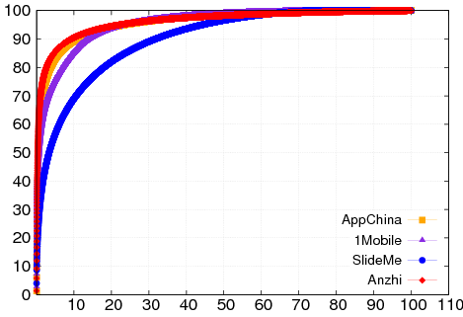
App Popularity Is There a Pareto Effect?
10% of the apps account for
90% of the downloads
Downloads (%) CDF
Normalized App Ranking (%)
Notes:
In this figure we can see the CDF of the percentage of app downloads
as a function of the app ranking (ranked from the most popular to the
least popular) for the different appstores.
As we can see, a small percentage of apps receives a large percentage of downolads.
For example:
In the Chinese appstores, about 10% of the apps receives the 90% of total downloads.
This evidence for the existence of the Pareto effect is significant for the design of efficient
caching mechanisms for application delivery to end users, as we will see later on, in this presentation.
Next, we will explore whether the app downloads follow a power law distribution much like
web downloads do.

Slide 9
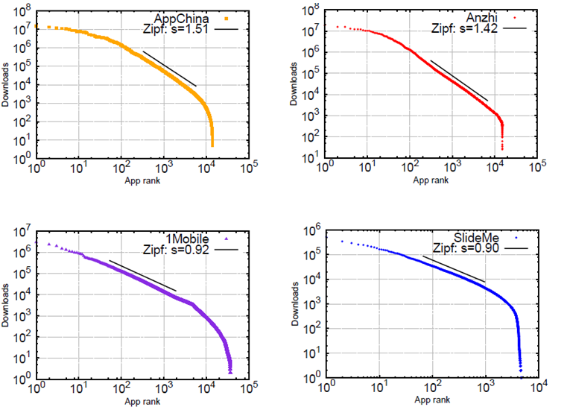
App Popularity Is There a Power-law Behavior?
Let’s focus on one appstore
Notes:
In these 4 plots we can see the popularity distribution among the 4 different monitored appstores.
In the y-axis is the number of downloads for each app, where in the x-axis is the app ranking.
As we can see, all monitored share a similar pattern: that is the main “trunk” in each plot has a
linear slope indicating a Zipf distribution.
But, lets focus on one appstore to see what are the differences from a pure Zipf behavior.

Slide 10
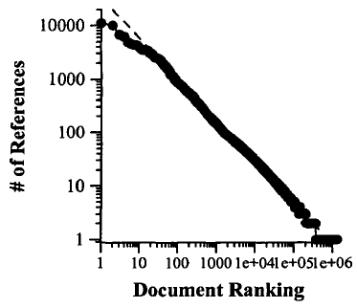
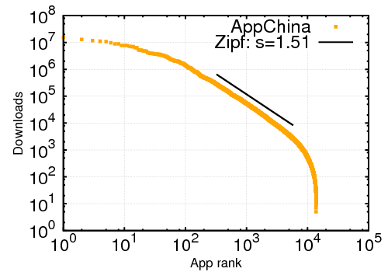
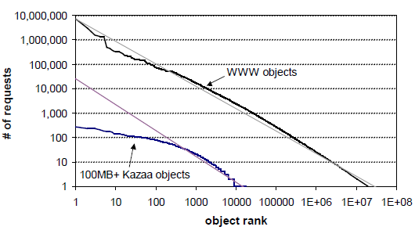
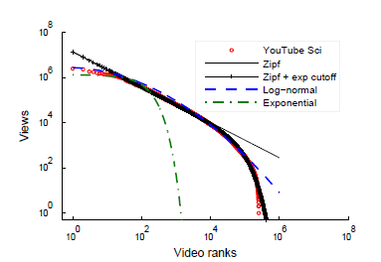
App Popularity Deviations from ZIPF
WWW
INFOCOM‘99
P2P
SOSP’03
UGC
IMC’07
Notes:
Here we can see the app popularity distribution in AppChina appstore.
There have been many similar studies that try to explain the popularity distribution in different areas.
For example, in the Web. On the right side we see the popularity distribution in the web documents. As we see they follow a clear Zipf distribution. In contrast,
AppChina’s app popularity distribution appears to deviate from the pure Zipf at both ends: for small and large x values.
Such behavior has been also observed in P2P systems as for example in Kazaa, and in UGC systems, as for example in the video downloads in YouTube.
Lets see now where these works attribute these deviations.

Slide 11
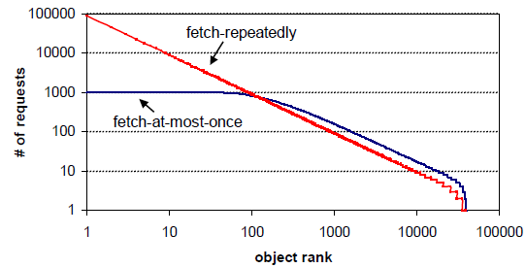
Truncation for small x values: Fetch-at-most-once
P2P
SOSP’03
Also observed in P2P workloads
Users appear to download an application at most once
simulations
Notes:
As we can see, the truncation in small x values, also been observed in the P2P systems too has been already attributed in the fetch-at-most-once behavior of the users in such systems (in the right), where they download each object only once.
In the right bottom there are the simulations results of two models the: famo behavior of the users and
Fetch-repeatedly. It is demonstrated/validated that the famo behavior seems to deviate from the pure zipf for the
most popular objects.
This outcome also applies to appstores workloads too, where a user downloads an app only once and then use
this app which is locally stored in their phone.
(the popularity distributions of object requests made by a set of simulated users, based on two models)

Slide 12
Truncation for large x values: clustering effect
UGC
IMC’07
Other studies attribute this truncation to information filtering
Our suggestion: the clustering effect
Notes:
The deviation that is observed for the least popular apps (large x values), has also been observed in video sharing systems too, as we can see on the
Right for the videos in Youtube
On the right hand, we see the same behavior in the distribution of video downloads
In Youtube.
This study has attributed this deviation to search engines and recommendation systems
that apply information filtering and propel/promote the already popular objects and thus they are becoming even more popular.
We believe that this is an instance of a more general phenomenon which is driven by users interests and we call it clustering effect. According to this, users tend to download apps from same clusters e.g. from the same categories.
In order to validate this
effect we first have to show that apps are categorized into clusters (A).

Slide 13












App Clustering
Apps are grouped into clusters
App clusters can be formed by
App categories
Recommendation systems
User communities
Other grouping forces
Games
Reader
Social
Tool
Notes:
This is easy to show..
Most appstores already group apps into clusters/categories based on the app’s content,
For example, there exists a cluster of games, one of tools etc.
Moreover clusters can be formed by other grouping forces, such as
By recommendation systems based on users interests
By user communities as a result of positive comments or ratings

Slide 14

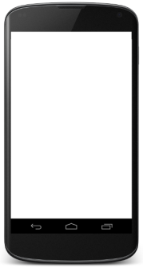
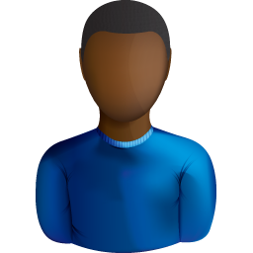






Clustering Hypothesis
Users tend to download apps from the same clusters
I like Games!
I like Social apps!
Notes:
Having shown that apps are divided into clusters we should validate our hypothesis: that is
(B) once users have downloaded an app from one cluster, it is more likely to
download another app from the same cluster, rather than switching to another one
To validate the clustering hypothesis we tried to study the download patterns of
individual users and see if they tend to focus on a few clusters.
-----
concentrate around a few clusters.

Slide 15
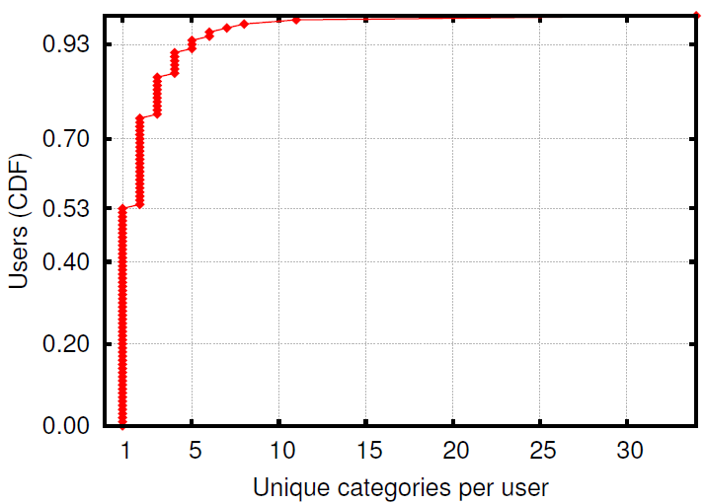
Validating Clustering Effect in User Downloads
Dataset: 361,282 user comment streams, 60,196 apps in 34 categories
94% of users commented on apps from up to 5 categories
53% of users commented on apps from a single category
Notes:
To validate the clustering hypothesis bwe tried to study the download patterns of
individual users and see if they tend to concentrate around a few clusters.
In order to do this, we chose the Anzhi appstore because it was the only one
that gives precise time information.
We used the comments of users accompanied by ratings, which is a strong indication
of actual downloads and we gathered the comment streams of each user.
We recorded over 300 thousand user comment streams to over 60 thousand apps in
34 categories.
Here we see the CDF of unique categories commented per user. As we see almost half of the users
commented on apps from a single category. Moreover, most of them commented to up to 5 categories.
So users seem to download apps from a single or very few categories, which partially validates our clustering
Hypothesis, but we tried to study the user download patterns through time in order to better validate our hypothesis.
--------------------
Den eixame ta actual downloads. Melethsame ta comments.
5b
Kai meta 8elame na doume pws sumperiferetai me to xrono enas
Xrhsths me ta downloads.
Opote orisame to temporal affinity

Slide 16
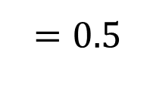
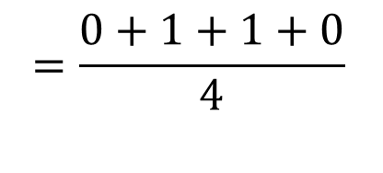
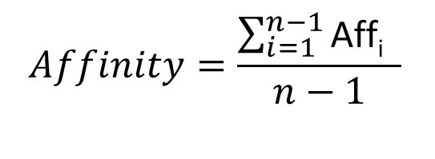
User Temporal Affinity
x
✔
✔
x
User downloads sequence
a1, a2, a3, a4, a5
a1
a2
a3
a4
a5
Aff1 = 0
Aff2 = 1
Aff3 = 1
Aff4 = 0
Pair 1
Pair 2
Pair 3
Pair 4
$$Affinity=\frac{\sum_{i=1}^{n−1}{\text{Aff}\text{i} }}{n−1}$$
$$=\frac{0+1+1+0}{4}$$
$$=0.5$$
Notes:
To do so, we used the user temporal affinity metric to app categories.
We’ll now try to define this metric.
Let’s say that we have the app downloads of a user in chronological order,
Let’s also assume that we know the category for these apps as shown
in different colors, For example, a1 is of red category, a2 to a4 is of blue and a5 is of purple
category.
The user temporal affinity measures the tendency of a user to download apps from the same
categories or not and is equal to the percentage of apps that are in the same category with the
previous downloaded ones.
In order to calculate it, we divide the downloads sequence into consecutive pairs and we find the percentage of pairs containing identical categories
So here this percentage is 0.5
if affinity approaches the highest value (i.e., one),
then users tend to repeatedly download apps from the same category
On the contrary, if the affinity is low,
then users tend to switch from one category to another.

Slide 17
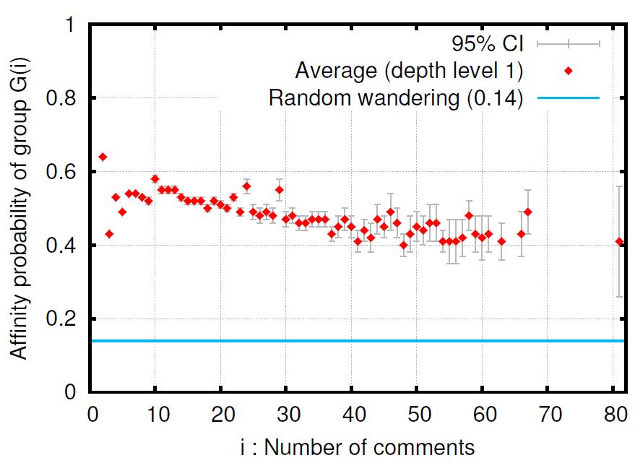
Users Exhibit a Strong Temporal Affinity to Categories
0.55
3.9 x
0.14
Notes:
We measured this metric on the Anzhi dataset for all the users.
We grouped together the users that made the same number of comments and
we plot the affinity for each group.
Also we plot the affinity of the base case, which is a random wandering
where a user randomly wanders from one category to another (taking into
account the uneven distribution of apps among the different categories).
The results show that the affinity (0.55) is about 4 times
higher than the one of the base case. This implies that Anzhi users are
4 times more likely to stay in the same category compared to the base case.
The results show that there is a strong temporal affinity of users’ comments to
app categories,( which is a strong indication that users tend to download successive
apps from the same categories). These observations validate our hypothesis
about the existence of clustering in user downloads.

Slide 18

















Modeling Appstore Workloads
3
Top
1
2.2
If downloaded apps < user downloads
→ go to 2.
2.1
2
1-p
App populatiry
p
. . .
bottom
Games
Reader
Social
Productivity
APP-CLUSTERING model
1. Download the 1st app – overall app ranking
2. Download another app
2.1 with prob. p from a previous app cluster c – cluster app ranking
2.2 with prob. 1-p – overall app ranking
3. If user’s downloads < d go to 2.
Notes:
In order to validate that clustering in user downloads has an effect in app popularity distribution we constructed a model.
Our model is based on simulation of appstore users.
In our model each user downloads a number of apps randomly but with two constraints:
Fetch-at-most-once: the same user cannot download the same app more than once
Clustering effect: user downloads a percentage of apps based on previous selections
On the left side is a user and on the right side is the appstore with its apps devided in a number of clusters/categories. The first column in red is the
category of games, the second in green is the category of readers and follows the social and productivity clusters.
In the top is the most popular apps and in the bottom the unpopular ones.
The APP-CLUSTERING MODEL suggets that a user behaves as follows:
First, he downloads an app according to the overall ranking of apps, that is through a Zipf distribution applied in all apps regardless clustering/grouping
When a user downloads the first app, this download is drawn from a Zipf-like distribution
Once a user has downloaded at least one app, his next downloads will be from the same category of a previous download with probability p,
and from a different category with probability 1−p.
2) So, then, he will download another app
2.1) with prob. p from a randomly chosen category of a previous app(selection), for example a games app, as his first download was a game app. Also, here the downloads are drawn from a Zipf-like distribution applied only to the apps of the same category.
Or
2.2) with prob. 1-p from through a Zipf-like distribution on the whole apps in the appstore as in step 1
3) Then, this process continues from the second step until user finish all of his downloads.

Slide 19
Model Parameters
Symbol | Parameter Description
A | Number of apps
D | Total downloads
d | Downloads per user (average)
C | Number of clusters
U | Number of users
zr | Zipf exponent for overall app ranking
ZG | Overall Zipf distribution of all apps
P | Percentage of downloads based on clustering effect
zc | Zipf exponent for cluster’s app ranking
Zc | Zipf distribution of apps in cluster c
D(I,j) | Predicted downloads for app with total rank i and rank j in its cluster
Number of downloads of the most popular app
Notes:
We have the information of Number of apps, Number of downloads and average downloads per user from our collected data.
We set the number of clusters equal to the number of categories in each appstore.
We tuned the rest parameters (Zipf exponents and the percentage of downloads based on
the clustering effect, and number of users) to produce the best data fit to the actual data through simulations.
We found through simulations that the number of users that gives
(the minimum distance from the measured data) the best data fit
is equal to the number of downloads of the most popular app for each appstore,
So we set the #users to this value for the rest of our experiments.
--------------------------
, by running
simulations with all parameter combinations, and measuring the distance
from actual data.

Slide 20
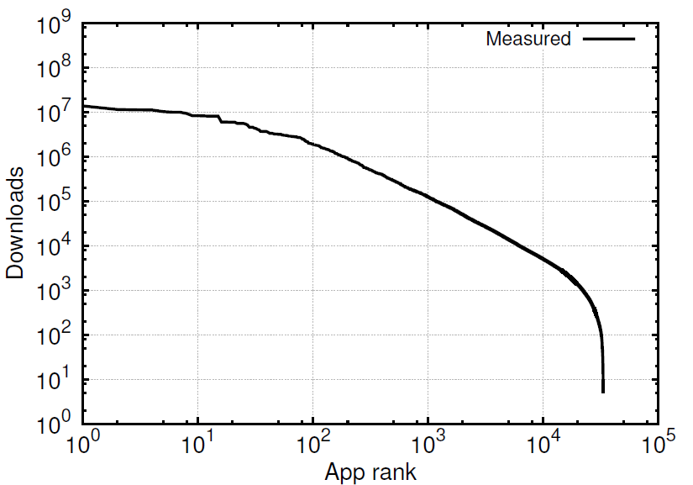
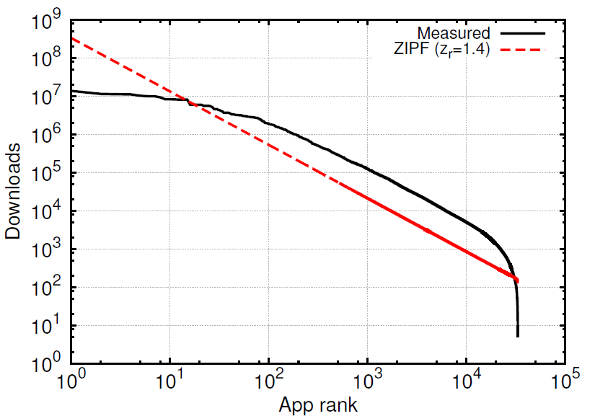
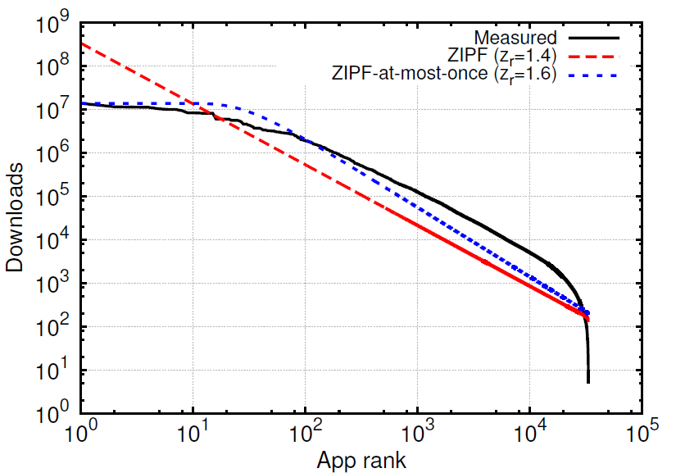
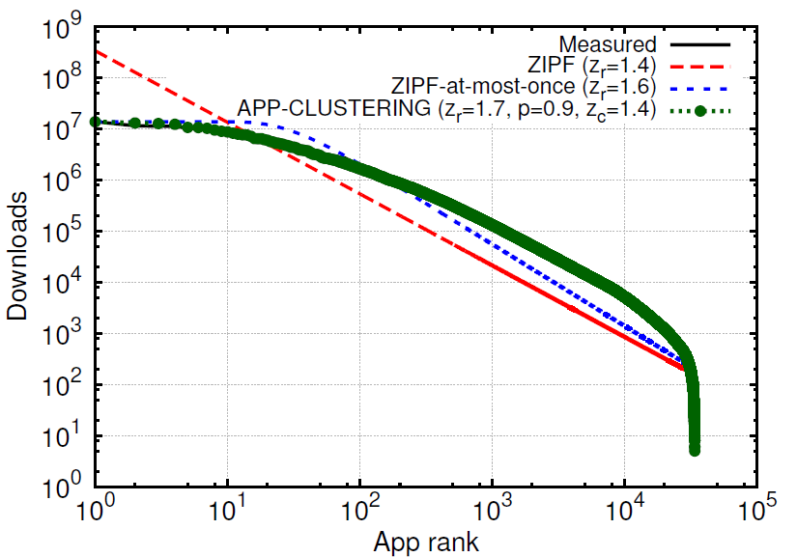
Results
Model Distance from
measured data
ZIPF 0.77
ZIPF-at-most-once 0.71
APP-CLUSTERING 0.15
AppChina
Notes:
Here we will see the results of our model. We can see the measured distribution
of app popularity in appchina appstore. We plot in red the results of the zipf user behavior model which deviates from the actual data. Then
We plot in blue the results of fetch-at-most-once model which fits the data
better than the pure zipf but deviate for large x values. And finally we plot in green the results of our app-clustering model which fits the measured data very closely.
Actually we measured the distance of the simulated results from the actual data and found that app-clustering exceeds the minimum distance. This is true for the other appstores too.
This outcome provides strong evidence that clustering affects app downloads distribution and is responsible for the observed tail behavior.

Slide 21
App Pricing
Main Questions:
Which are the differences between paid & free apps?
What is the developers’ income range?
Which are the common developer strategies
How do they affect revenue?
Notes:
The main questions that drive our analysis regarding app pricing and
developers’ income are the following:
(Q1) Which are the main differences between paid and free apps?
(Q2) What is the income of the average developer?
(Q3) Which are the revenue strategies of developers?
we explore these questions in more detail using the dataset of the SlideMe
appstore, which is the only of our monitored appstores that hosts both free
and paid apps.

Slide 22
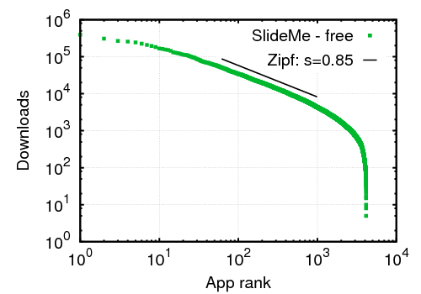
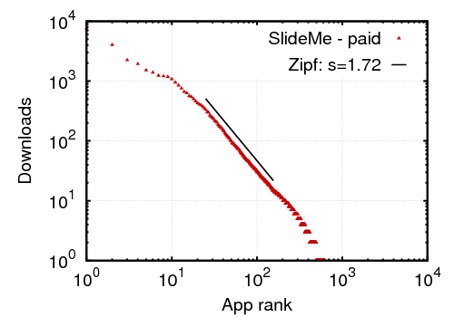
The influence of cost
Free
Paid
Clear
power-law
Users are more selective when downloading paid apps
Notes:
Here we can see the influence of the cost in app popularity.
Free apps (on the right) follow a similar distribution as the one we saw in the whole app population.
But, paid apps clearly follow a pure Zipf distribution with no significant deviations.
This is probably due to the fact that users are more selective when downloading paid apps. They are less influenced by recommendation systems and more considerate about
Cost.
-------------------------
Thus, less popular apps are deprived from any casual downloads.
Less popular free apps get a decent number of downloads

Slide 23
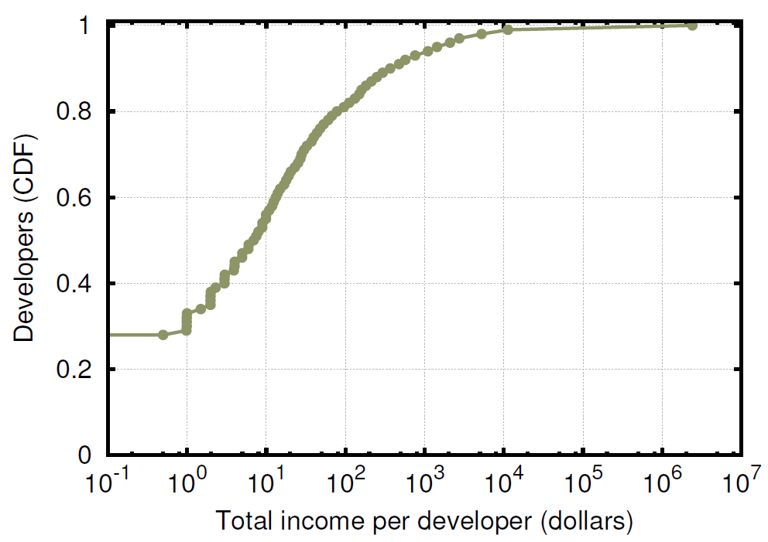
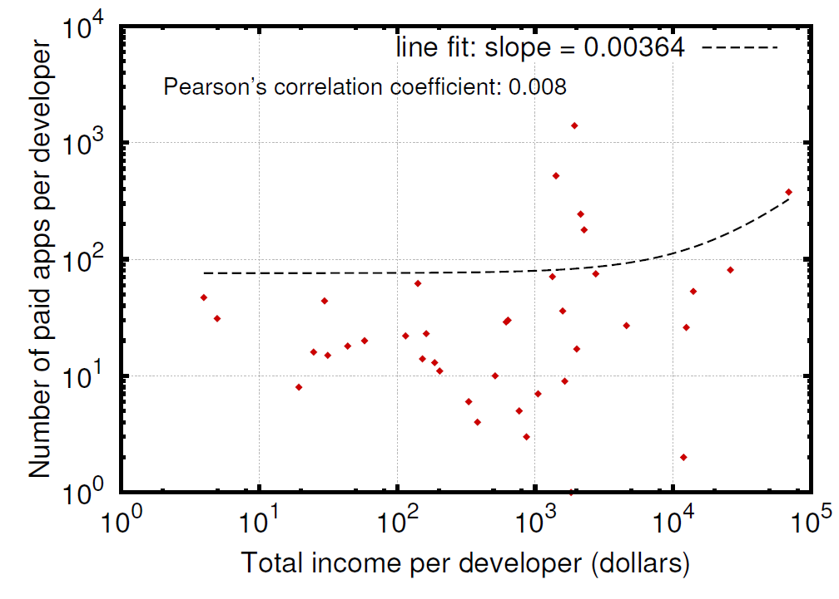
Developers’ Income
95% < 1500 $
80% < 100 $
Median: < 10 $
Quality is more important than quantity
(USD)
Notes:
the CDF of total income per developer.
…
However, we observe that there is a small percentage of developers, roughly
around 1%, with income higher than 2 million dollars from very
popular applications.
Overall, it is clear that the majority of developers
in the SlideMe appstore had a negligible income by selling
paid apps, while only a very small percentage of them made a significant
income.
We then tried to find if this income is correlated with the number of apps made by developers.
An interesting question that comes up is whether the total income
So we plot he number of paid apps per developer versus their average
total income (binned by the number of paid apps)
There is no correlation, so a developer cannot earn more
By creating more apps →
This is very interesting, because it shows that quality is more important
than quantity for the developers’ income.
-----------------------
In other words, can a developer earn more by offering
more applications?

Slide 24
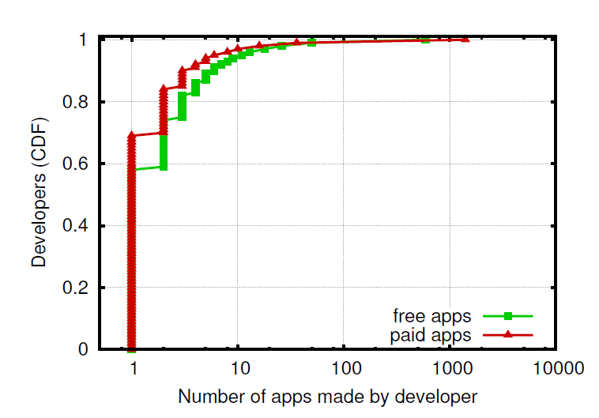
Developers Create a Few Apps
95% of developers
create < 10 apps
10% of developers offer free & paid apps
A large portion of developers create only 1 app
Notes:
Here is the CDF of number of apps made by developers.
…
We also found that only
10% of developers offer both free & paid apps:
This outcome implies that most developers choose a single pricing strategy:
either they offer their apps as free, aiming at income from advertisements or in-app billing,
or they choose to sell their apps at a pre-defined price.

Slide 25
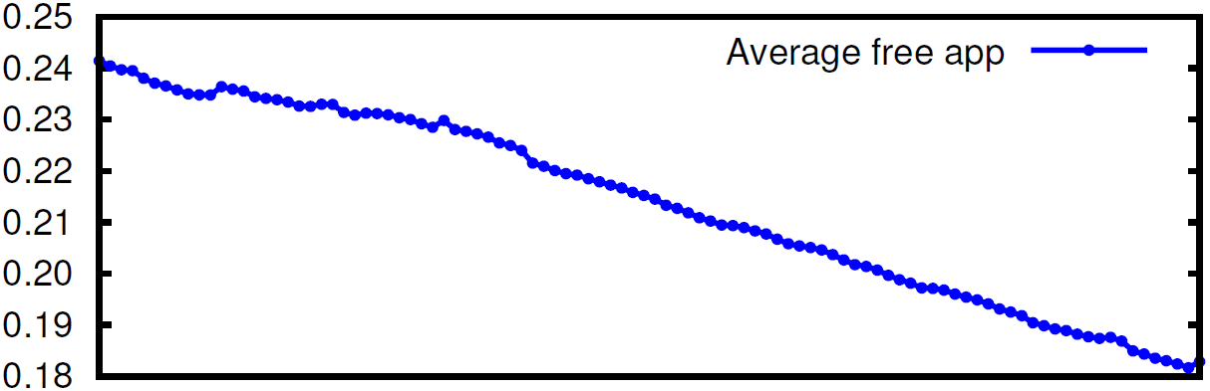
Can Free Apps Generate Higher Income Than Paid Apps?
Average: 0.21 $
Necessary ad income (USD)
Day
An average free app needs about
0.21 $/download to match the income of a paid app
Notes:
We tried to answer the question: Whether free apps can make
higher income than paid apps.
We didn’t have app usage information like Ad clicks and
impressions in order to compute the ad income of free apps.
Instead we estimated the necessary ad income per download of a free app in order to match the income of a paid app.
We found that this value is 21 cents on average.
We see that the ad income is dropping over time, and this happens because
downloads of free apps increase much faster than those in paid apps.
So an ad-based revenue strategy seems more promising than offering an app at a predefined price, but it depends on the app usage.

Slide 26
Conclusions
App popularity: Zipf with truncated ends
Fetch-at-most-once
Clustering effect
Practical implications
New replacement policies for app caching
Effective prefetching
Better recommendation systems
Increase income
Notes:
We did a systematic study in 4 third-party Android marketplaces for a period of
2 – 5 months.
We studied the app popularity distribution and we found that it is affected by the
Fetch-at-most-once behavior of the users and the app clustering in appstores.
We validate it through a model.
So here we describe why our results can be useful
Imiplications
------------------------
The existence of locality in user downloads as we shown with the Pareto Effect (or as manifested by) can help appstore operators to design efficient caching mechanisms for improving the app delivery to end users, e.g. by caching the most popular apps in fast memory or in local network caches.
Understanding the strong users temporal affinity to app categories can help the design of more efficient prefetching methods. Most popular apps from a user’s preferred category, that
have not been downloaded from the user yet, can be prefetched to a local place for better user
experience and delivery performance.
The understanding of user download patterns as drawn from the clustering effect, can help appstore improve the current state of recommendation systems through a richer set of cluster based suggestions.
Understanding the parameters that affect app popularity is of high interest
for developers who want to maximize the popularity of their apps.
Moreover, understanding which pricing models result in higher revenue can help developers to choose the appropriate pricing policies for increasing their apps popularity and, eventually, their income.
A typical recommendation system follows a collaborative filtering
method [18]. The main idea of this method is to find groups of
users who share similar interests. These users can be determined
based on their similar app downloads. If an app is downloaded by
most users in a group, then it is likely to be of interest for another
user in the same group that has not yet downloaded it. Thus, this is
a possible suggestion from the recommendation system.
The clustering effect, however, can also suggest apps that have
not necessarily been downloaded by users who share similar interests.
For example, a user who downloaded an app from a given
category may be interested in other popular apps of the same category.
Thus, the clustering effect provides a richer set of choices
than the limited choices of current recommendation systems, which
are mainly based on the common apps downloaded by a set of
users.
------------------------
We observed the existence of high locality in user downloads where 10% of the
apps account for 70-90% of the total downloads
We show that the popularity of apps follows a Zipf-like distribution with truncated tails, which is different than the one observed in Web and P2P systems from other studies, but similar with user generated content services like ‘Youtube’
We attributed the observed distribution to a new download pattern, we refer to as
“clustering effect”, which implies that users will download the next apps from the same categories as their previous downloads. We validated it with a user behavior study which
Shows a strong temporal affinity of users to app categories.
Then we introduced a model for app downloads based on the clustering effect and we validated with simulations that it approximates very close the actual user downloads. Our model is able to approximate very well the downloads distributions of all appstores, which implies that the proposed clustering effect is a more general phenomenon rather than a random property of a singe appstore.
We also studies the effect of cost on app popularity. We observed that paid apps follow a clear
Power law distribution. We measured how revenue of paid apps are distributed to developers.
The results show that the large majority of them have very low income, while a small percentage of them make a significantly higher income. We also found that the number of developer’s apps do
Not increase developer’s income. Finally, we found that free apps with ads need to make just 0.21$
Per download to match the income of paid apps, which seems a more promising strategy especially for
Popular apps.

Slide 27
Thank you!

Slide 28
Backup Slides

Slide 29
Modeling Appstore Workloads
Each user downloads d apps randomly
Fetch-at-most-once: a user downloads an app only once
Clustering effect: user downloads a percentage of the apps based on previous selections
Each app has two rankings
an overall ranking
a ranking in its cluster
Notes:
Our model is based on simulation of appstore users. In our model each user downloads a number of apps randomly but with two constraints:
Fetch-at-most-once: the same user cannot download the same app more than once
Clustering effect: user downloads a percentage of apps based on previous selections
We assume that all apps are categorized in C clusters so that each app
belongs to exactly one cluster.
Therefore, each app has two rankings:
Its overall ranking i, taking values between 1 and the number of the total apps in the appstore,
and its ranking j within its category, taking values between 1 and the number of apps
in that category
Now we’re going to see our modeling algorithm through an example

Slide 30
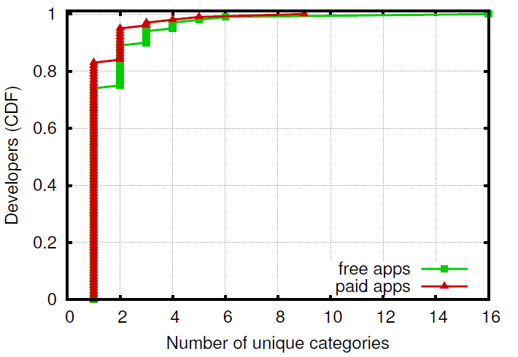
Developers Focus on Few Categories
~99% of developers
focus on 1-5 categories
80% of developers
focus on 1 category
Notes:
CDF of the number of unique categories
for which each developer create apps. We see that developers usually
focus on one or just few categories: 75% of the free app developers
and 85% of the paid app developers create apps belonging to
a single category, while 99% of the developers in both cases focus
on 1 up to 5 categories. This outcome shows that most developers
are also interested in specific app categories.

Slide 31
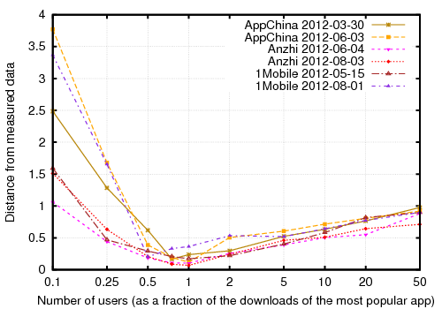
Choosing the Right Number of Users
Minimum distance
Notes:
Given that different appstores have a different actual number of
users, we express the number of users as a function of the total
number of downloads of the most popular app.
of users U and setting the rest of the simulation parameters
to the values that produce the minimum distance from the actual
Data.
our simulation results while varying the number
The x-axis is the number of the simulated users, as a ratio
of the total number of downloads of the most popular app, and the
y-axis reports the distance between the simulation results and the
measured downloads.
in all cases the minimum distance from the measured data is achieved when
the number of users is very close to the downloads of the most popular app.
Downloads of the most popular app are a good esti-
mate of the number of users

Slide 32
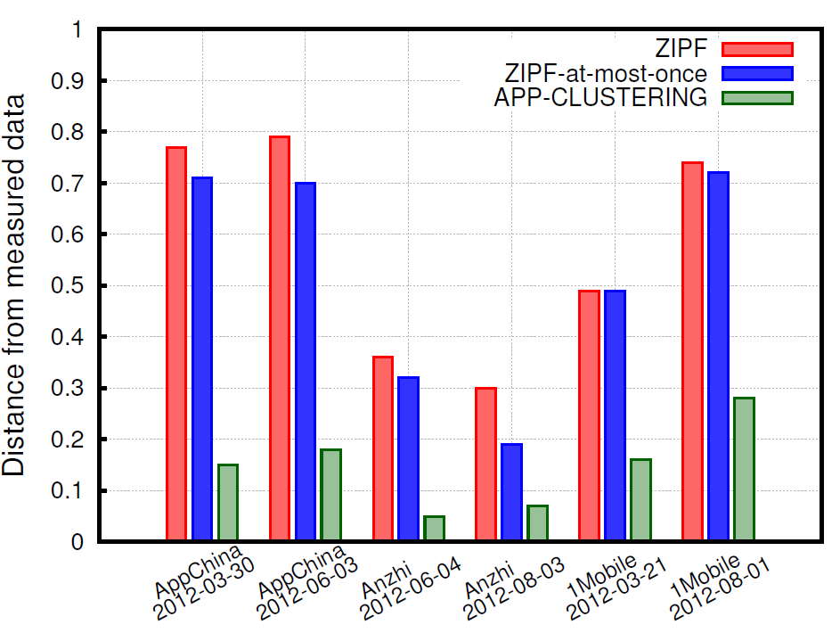
Distance From Actual Data
APP-CLUSTERING:
up to 7.2 times closer than ZIPF
up to 6.4 times closer than ZIPF-at-most-once
Notes:
APP-CLUSTERING has the smallest distance from
measured data
APP-CLUSTERING approximates the actual
downloads up to 7.2 times closer than ZIPF and up to 6.4 times
closer than ZIPF-at-most-once

Slide 33
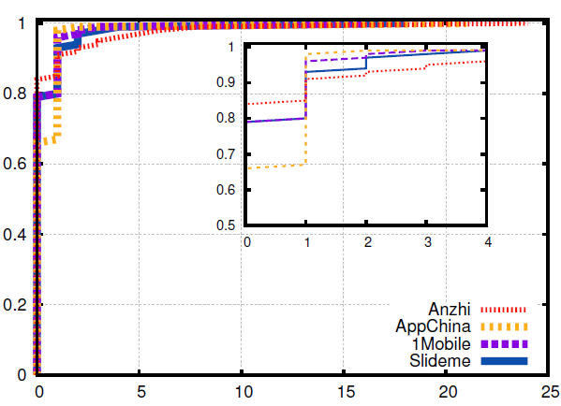
Apps Are Not Updated Often
Apps (CDF)
Number of Updated

Slide 34
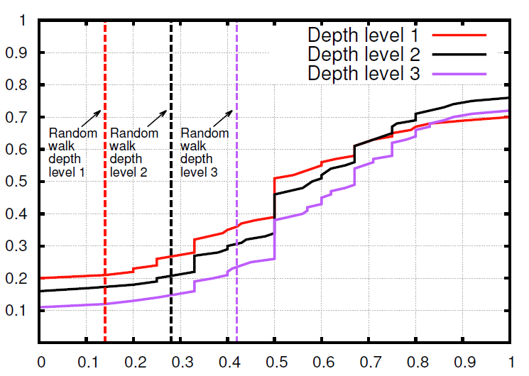
Temporal Affinity for Different Depth Levels
Apps (CDF)
Number of Updated

Slide 35
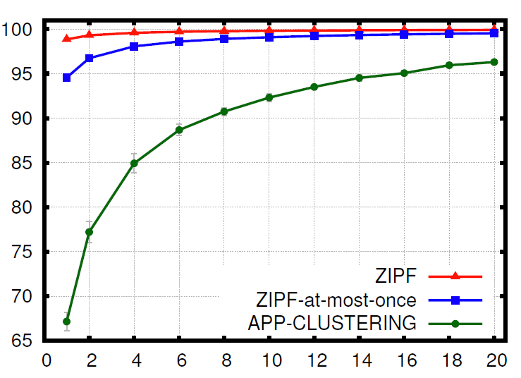
Clustering-based User Behavior Affects LRU Cache Performance Negatively
Cache Hit Ratio (%)
Cache Size (% of total apps)

Slide 36
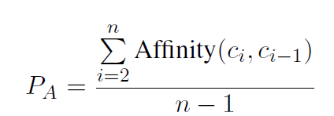
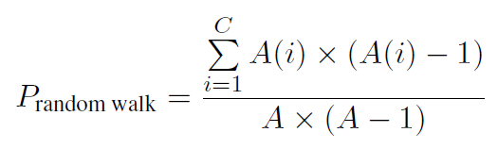
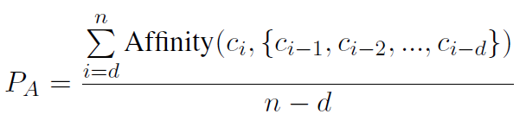
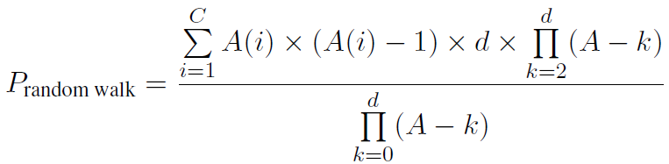
User affinity to app categories - Equations
Depth 1:
Depth d:

Slide 37





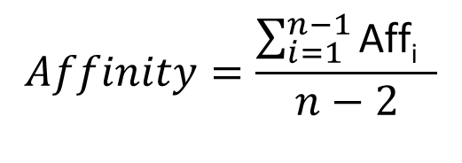

User Temporal Affinity
✔
✔
✔
x
x
x
Depth = 2
a1
a2
a1
a2
a1
Aff1 = 1
Aff2 = 1
Aff3 = 1
$$Affinity=\frac{\sum_{i=1}^{n−1}{\text{Aff}\text{i} }}{n−2}$$
$$1+$$
$$1$$
$$1+$$
$$\frac{ }{3}$$
$$=1$$
$$=$$
Notes:
To do so, we used the user temporal affinity metric to app categories.
We’ll now try to define this metric.
Let’s say that we have the app downloads of a user in chronological order,
Let’s also assume that we know the category for these apps as shown
in different colors, For example, a1 is of red category, a2 to a4 is of blue and a5 is of purple
category.
The user temporal affinity measures the tendency of a user to download apps from the same
categories or not and is equal to the percentage of apps that are in the same category with the
previous downloaded ones.
In order to calculate it, we divide the downloads sequence into consecutive pairs and we find the percentage of pairs containing identical categories
So here this percentage is 0.5
if affinity approaches the highest value (i.e., one),
then users tend to repeatedly download apps from the same category
On the contrary, if the affinity is low,
then users tend to switch from one category to another.

