Slide 1

A systematic characterization of IM threats using honeypots
Spiros Antonatos, Iasonas Polakis, Thanasis Petsas and Evangelos Markatos
polakis@ics.forth.gr
Network & Distributed System Security
March 2010

Slide 2


Instant messaging (IM)
One of the most popular Internet activities
240 million MSN users (2008)
  7 billion exchanged messages per day
Users trust content received from people in their friend-list
Iasonas Polakis

Slide 3
Unsolicited Activities in IM networks
IM phishing
  Stealing credentials through various techniques
Malware infection
  Attackers send URLs that point to executables, or send executables through direct file transfer
Advertisements for money
  Messages contain URLs that promote porn or dating sites with subscription
SMS based subscriptions
  Sites offer prizes to users that subscribe to services through SMS
Iasonas Polakis

Slide 4

HoneyBuddy
An active honeypot infrastructure that acquires information from IM attacks
Uses decoy MSN accounts and logs unsolicited incoming messages
Three main components
  Harvesting module
  Engine that handles the MSN messenger clients
  Inspection module
Iasonas Polakis

Slide 5
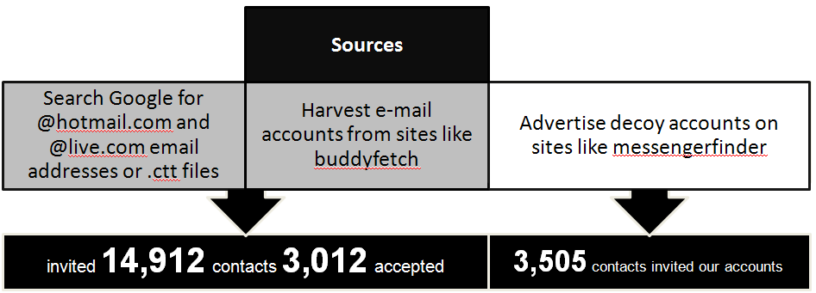
Harvesting module
Gather accounts that will later be added to the decoy accounts
Harvested accounts are inserted in CTT files (MSN contact files)
Iasonas Polakis

Slide 6

Client-handling engine
Use of AutoIt to handle all client windows
  Check for new incoming messages and log them
  Respond with random greeting
  Accept all file transfers
  Deny video or audio conversations
Iasonas Polakis

Slide 7

Inspection module
Extracts URLs from logs
Fetch emails from inbox of decoy accounts
  Extract URLs and attachments
Store URLs in database
  Query URL status every one hour for uptime check
Iasonas Polakis

Slide 8
Collecting URLs
Initially, fetched URLs with wget
Attackers use Javascript for Dynamic pages
  Block all invalid requests
  If 3 invalid requests sent, block IP for 24 hours
Solution: Pages fetched through Crowbar
  Web scraping environment
  Runs inside xulrunner
Iasonas Polakis

Slide 9
URL Classifier
Simple classifier
  Matches certain text segments or keywords
6 categories
  MSN Phishing, Porn, Dating, Adware, Malware, Unknown
Focus on phishing and malware
Classification process may have FP/FN for certain categories
Iasonas Polakis

Slide 10
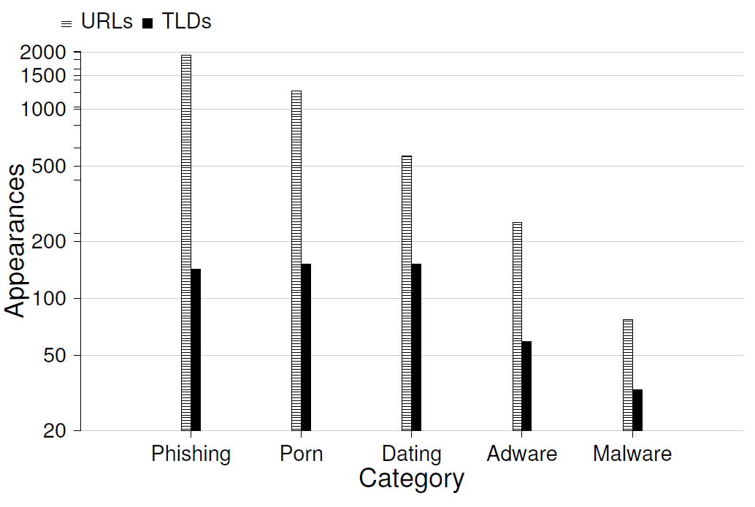
URL classification
Collection period: 02/27/2009 -> 09/16/2009
Collected 6,966 unique URLs that belong to 742 unique top-level domains (TLDs)
Iasonas Polakis

Slide 11
MSN PHISHING
ANALYSIS
Iasonas Polakis

Slide 12
MSN phishing
Attackers harvest MSN credentials by tricking users into entering MSN e-mail and password in a bogus site
Lure victims by advertising false services
We created several MSN victim accounts and entered credentials in phishing sites
Each victim account had a honeypot account in its friend list that ultimately received URLs leading to the site
Iasonas Polakis

Slide 13
Comparison to other blacklists
HoneyBuddy detected phishing sites hosted on 142 unique TLDs
Only 11 (7%) were listed by Google blacklist (used by Firefox as anti-phishing measure)
  Average delay between our detection and Google including the site was around two weeks
SURBL detected only 1 out of the 142 domains
None of the phishing sites were listed by URLblacklist.com
Iasonas Polakis

Slide 14
Comparison to email spam
Spam Archive: 458,615 emails
  Extracted 467,211 URLs - 52,000 TLDs
  URL comparison: 1 common benign site
  TLD comparison: 21 common domains
    9 benign sites
    No MSN phishing sites
Scams in IM networks are different to those in spam emails
Iasonas Polakis

Slide 15
Comparison to anti-phishing product
Selected Norton Safe Web by Symantec
Submitted 2,010 phishing and malware URLs
  After the collection period
Norton Safe Web flagged only 13% of the submitted URLs as dangerous or suspicious
  246 phishing, 10 malware
Iasonas Polakis

Slide 16
Hosting analysis
TLDs translate to small number of IP addresses
During July and August of 2009, we periodically collected IP addresses of TLD
10 of the phishing TLDs belonged to fast-flux networks
98% of TLDs translated to 1 IP address, the others to 2
Iasonas Polakis
Notes:
1 of the malware-distributing TLD belonged to fast-flux
One IP address that hosted 3 malware-distributing domains also hosted one of the phishing domains (US)

Slide 17

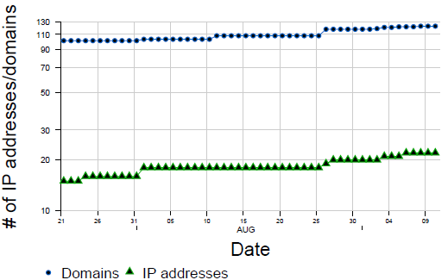
Hosting of phishing domains
Iasonas Polakis

Slide 18
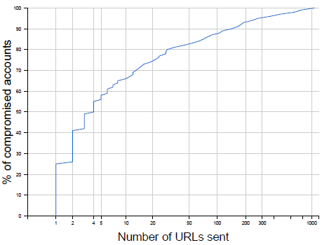
Attacker profile
“cautious” strategy
  25% of the attackers sent only one URL
Iasonas Polakis

Slide 19
Attacker profile
“cautious” strategy
  25% of the attackers sent only one URL
  75% sent less than 20
  Attacker avoids to trigger intrusion detection systems
Iasonas Polakis

Slide 20
Attacker profile
“cautious” strategy
  25% of the attackers sent only one URL
  75% sent less than 20
  Attacker avoids to trigger intrusion detection systems
“aggressive” strategy
  12% of the attackers sent between 100 and 1000 URLs
  Amongst the top ten accounts we found all the victim accounts whose credentials we had entered in phishing sites
Iasonas Polakis

Slide 21
Benign campaign
We launched our own benign campaign
  Localize message?
  Conversation?
Sent the following message to 231 online contacts
  “Hey! Check this out: http://mygallery.webhop.net/gallery1/photo1.jpg”
URL pointed to our web server, redirected to a (benign) executable
Executable was a harmless program that just requested another URL, again from our own web server
27 (13%) unique users visited the URL
9 (4%) executed the file
Iasonas Polakis

Slide 22
MALWARE ANALYSIS
Iasonas Polakis

Slide 23
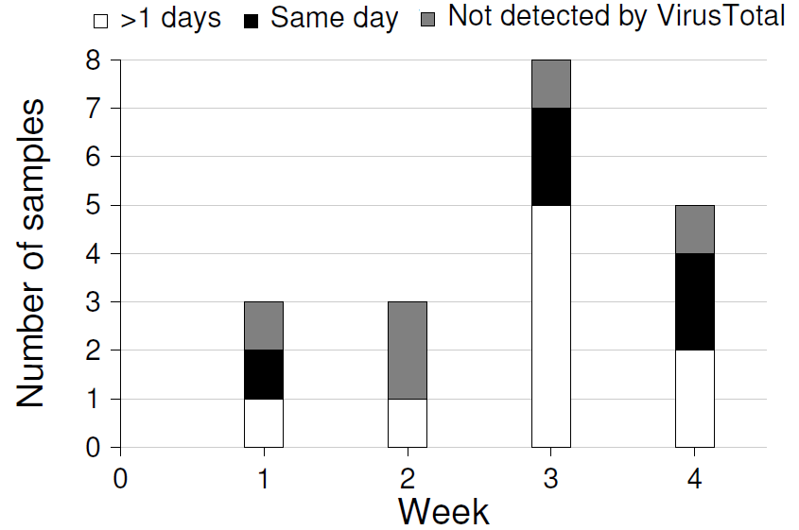
Malware analysis
Analysis of the malware collected during March 2009
19 unique malware samples collected
Submitted all samples to VirusTotal
26% of our samples were previously-unseen malware instances
26% were collected the same day they entered the VirusTotal database
Iasonas Polakis

Slide 24
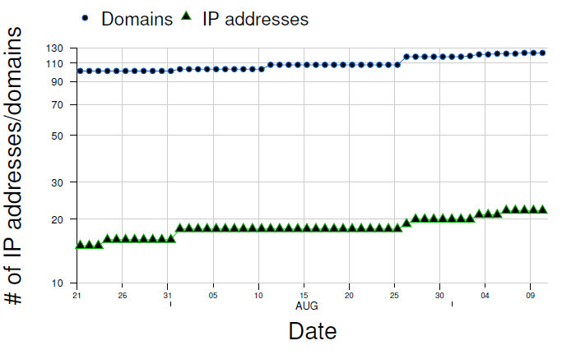
Hosting of malware-distributing domains
Each TLD translated to different IP address
Only one to three domains overlap
Iasonas Polakis

Slide 25
MAILBOX ANALYSIS
Iasonas Polakis

Slide 26
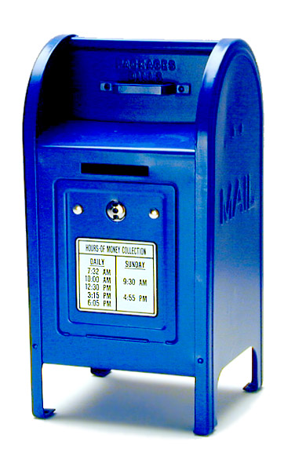
Mailbox Analysis
Our decoy accounts also received 4,209 emails in their inboxes
403 emails had 1,136 attachments
Emails contained 5,581 URLs
  26 pointed to phishing domains
  7 redirected to malware
Majority of attachments were pictures, docs
Iasonas Polakis

Slide 27

Email attack
Hotmail drops executable attachments and scans all other
  Attackers find way to bypass defenses
Attachment was “.zip” files
  Extracted to a “.lnk” file
  The “.lnk” file was a command line script that connects to an FTP site and downloads and executes malicious software
Iasonas Polakis

Slide 28
myMSNhoneypot services
Iasonas Polakis

Slide 29
myMSNhoneypot
Detection service for MSN networks
http://www.honeyathome.org/imhoneypot/
Users register and add a honeypot to friend list
If user infected, will send messages to honeypot
Online report shows any messages received by user
  Messages are an indication of compromise
Iasonas Polakis

Slide 30
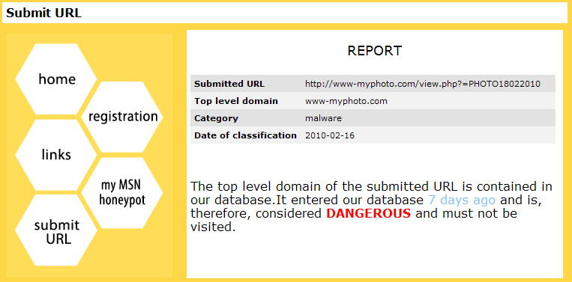
URL submission service
Users can submit URLs they receive in IM conversations
Checks if TLD of URL has been received by our honeypots
Iasonas Polakis

Slide 31
Summary
Use of decoy accounts as honeypots for IM networks
Implemented and deployed HoneyBuddy
93% of phishing URLs not in popular blacklists
87% of malicious URLs flagged as safe by commercial product
26% of malware not collected by other infrastructures
Prototype implementation of myMSNhoneypot services
Iasonas Polakis

Slide 32

Any questions?
Iasonas Polakis

Slide 33
Backup Slides
Iasonas Polakis

Slide 34
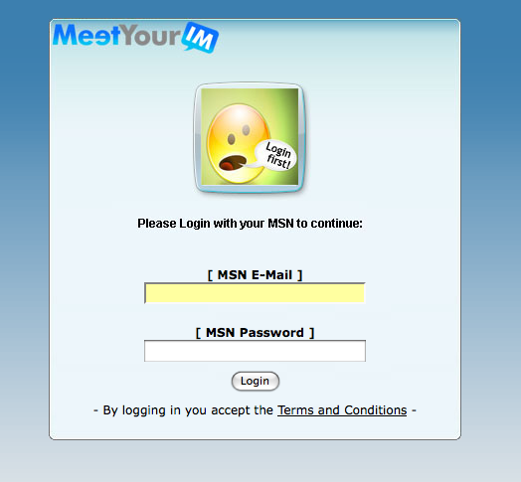
MSN phishing “templates”
All phishing sites we visited shared one of three different “looks”
The HTML code was identical amongst the pages of each look
  One site contained automatically translated text
Iasonas Polakis

Slide 35
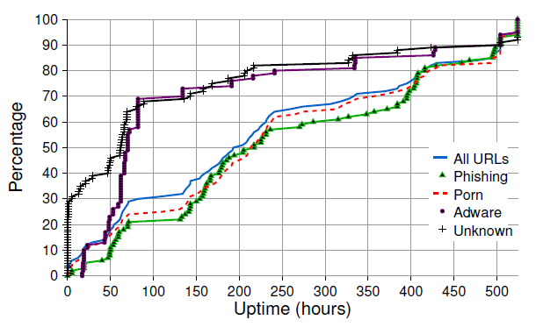
URL uptime
Porn and MSN phishing sites present higher uptime
Iasonas Polakis

Slide 36
Malware Analysis
Analysis of the malware collected during March
19 unique malware samples collected
Malware categories
  Direct malware
    Direct file transfers
    URLs that were redirected to executable files
  Indirect malware
    Install adobe flash plugin
    Install screen saver
Iasonas Polakis

Slide 37
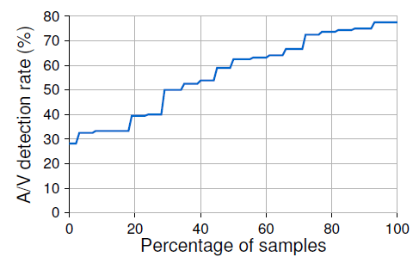
Malware detection by AV products
42% of the samples were detected by half the anti-virus engines used by VirusTotal
Reports after collection period
  Higher detection rate for AV engines
Iasonas Polakis

Slide 38
Motivation
Problem: Increase of phishing campaigns in Instant Messaging networks
Goal: Collect new campaigns upon release and analyze
Iasonas Polakis

