Slide 1


Rage Against The Virtual Machine: Hindering Dynamic Analysis of Android Malware
Thanasis Petsas, Giannis Voyatzis,
Elias Athanasopoulos, Sotiris Ioannidis,
Michalis Polychronakis

Slide 2
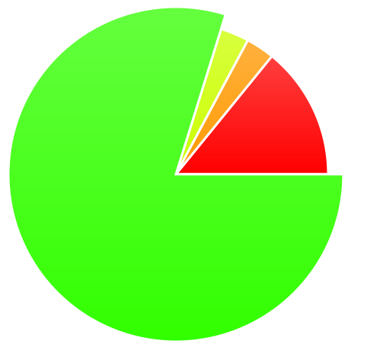

Android Dominates Market Share
Smartphones have overtaken client PCs
Android accounted for 79% of global smartphone market in 2013
Other 3.6%
Microsoft 3.3%
Q2 2013 Smartphone
Market Share
iOS
14.2%
Android
79.0%
Source:
Notes:
Surpass
Android climbed to 79 percent of smartphone market share in 2013, but its growth has slowed

Slide 3


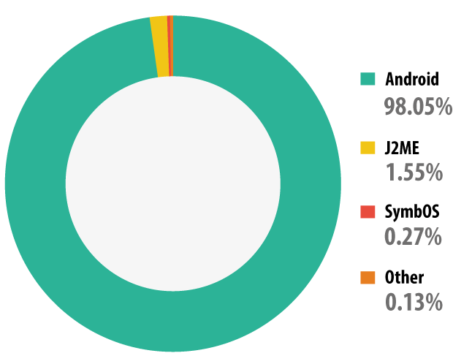
Android Malware
98% of all mobile threats target Android devices
Source:
Distribution of mobile malware
detected by platform – 2013
Notes:
+ Kaspersky histogram
- Mobile malware

Slide 4















Android specific anti-malware tools
Static analysis tools (AV apps)
Identify malware through signatures
Usually installed by users
Real time protection
How to evade static analysis?
Dynamic analysis services
Used by security companies
Run applications on an Emulator
Detect suspicious behavior
How to evade dynamic analysis?
DroidChameleon ASIA CCS’13
This work
Notes:
Mple kouti aeroplaniko pou na leei this work!
- signatures
Ti kanoun ta static kai ti ta dynamic analysis tools
How to evade static analysis →
How to evade dyn. Analysis this work!
- Security companies analyze apps in Emulators
Run sfw in emulator
Detect suspicious behavior
Real time protection of mobile users
Vulnerable to malware transformations
Identifier renaming
Data Encryption (payloads, exploits)
Call indirections
Indirect calls
Vulnerable to malware transformations
Identifier renaming
Data Encryption (payloads, exploits)
Call indirections

Slide 5
Our Study
A taxonomy of emulation evasion heuristics
Evaluation of our heuristics on popular dynamic analysis services for Android
Countermeasures
Objective: Can we effectively detect Android emulated analysis environment?
Notes:
Can we effectively detect an Android emulated analysis env. ?

Slide 6
VM Evasion Heuristics
Category | Type | Examples
Static | Pre-installed static information | IMEI has a fixed value
Dynamic | Dynamic information does not change | Sensors produce always the same value
Hypervisor | VM instruction emulation | Native code runs differently
Notes:
You can fingerprint the sensors easily
The same behavior of the sensors is constantly repeated
Code executes or is executed?

Slide 7
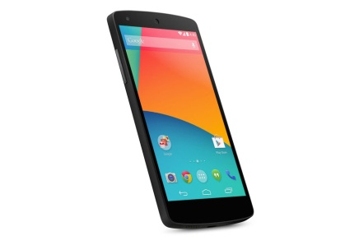
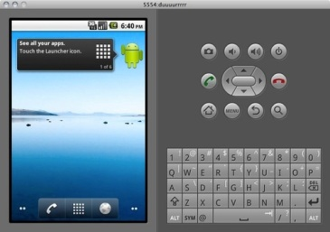
Static Heuristics
Device ID (IdH)
IMEI, IMSI
Current build (buildH)
Fields: PRODUCT, MODEL, HARDWARE
Routing table (netH)
virtual router address space: 10.0.2/24
Emulated network IP address: 10.0.2.15
Android Pincer malware family
IMEI
123456789012347
null
MODEL
Nexus 5
google_sdk
/proc/ net/tcp
Ordinary network
Emulated network
Notes:
Emulated network interface IP address: 10.0.2.15

Slide 8

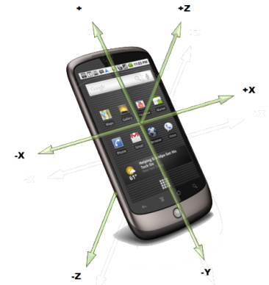

Dynamic Heuristics (1/3)
GPS
Sensors:
A key difference between mobile & conventional systems
new opportunities for mobile devices identification
Can emulators realistically simulate device sensors?
Partially: same value, equal time intervals
Accelerometer
Gyroscope
Gravity Sensor
Proximity Sensor
Rotation Vector
Magnetic Field
Notes:
Put icons of sensors here.
The existence of sensors is a key difference between
smartphones and conventional computing systems. The increasing
number of sensors on smartphones presents new opportunities for
the identification of actual mobile devices, and thus
for the differentiation
and detection of emulators

Slide 9
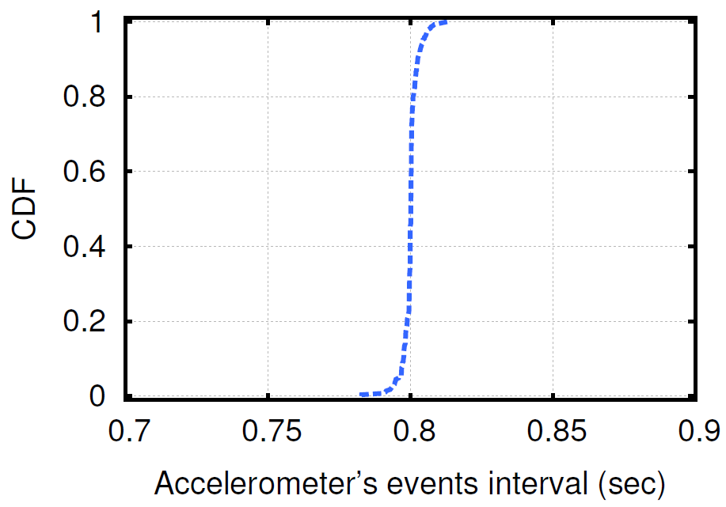
Dynamic Heuristics (2/3)
0.8 ± 0.003043
Generation of the same value at equal time intervals
Notes:
By default, the Android emulator cannot simulate device movements;
this can be achieved through additional sensor simulators [4].
Current builds of the Android Emulator also support partially or
not at all simulation of other types of sensors.
In our testing of the
available simulated sensors, we found that they generated the same
value at equal time intervals equal in average to 0.8 second with
negligible standard deviation (equals to 0.003043). The CDF of the
intervals between accelerometers’ events as observed in an Android
Emulator running for a couple of minutes is shown in Figure 1.
We found that the CDF for the rest of the sensors in Android Emulator
follows a similar pattern

Slide 10
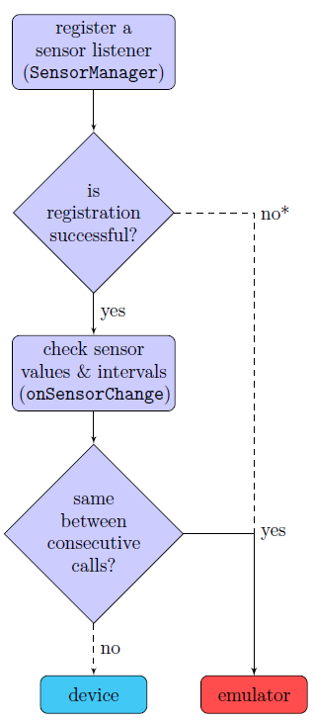

Dynamic Heuristics (3/3)
Sensor-based heuristics
Android Activity that monitors sensors’ output values
We implemented this algorithm for a variety of sensors
Accelerometer (accelH)
magnetic field (magnFH)
rotation vector (rotVecH),
proximity (proximH)
gyroscope (gyrosH)
Notes:
Afairw to star
Kai ena backup slide
Limitation

Slide 11
Hypervisor Heuristics
Try to identify the hosted virtual machine
Android Emulator is based on QEMU
Our heuristics
Based on QEMU’s incomplete emulation of the actual hardware
Identify QEMU scheduling
Identify QEMU execution using self-modifying code
Notes:
Try to identify the hosted virtual machine that performs the hardware virtualization.

Slide 12

Identify QEMU Scheduling (1/2)
Virtual PC in QEMU
is updated only after the execution of a basic block (branch)
OS scheduling does not occur during a basic block
QEMU Binary Translation (BT) Detection
Monitor scheduling addresses of a thread
Real Device: Various scheduling points
Emulator: A unique scheduling point
BTdetectH
Notes:
This heuristic is based on an optimization of QEMU.
As we know a physical CPU increases the PC after each instr. in order to keep it always up-to-date.
In a virtualized env. all the registers are emulated, so there is no need the vPC to be correct. It is (or is not necessary)
only needed to be correct when source code access it. QEMU handles these cases and otherwise
does not update the vPC after every instr., but only after branches.
This has as a result that QEMU OS scheduling does not occur during a basic block as vPC would be impossible to be reconstructed
→ So in this heuristic, that was first introduced by DEXLabs, we monitor the different scheduling points of a thread on
a real device and of an emulator.
As is evident, in a real device there are various scheduling points where in an emulator only a unique
scheduling point is observed.

Slide 13
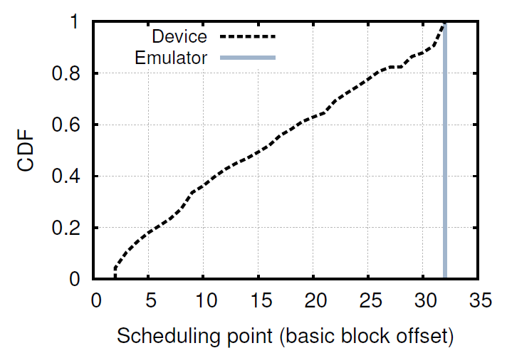
Identify QEMU Scheduling (2/2)
Emulator: A specific scheduling point
Notes:
Due to optimizations, QEMU does not update the virtual
PC on every instruction execution, and therefore many of the
scheduling events that can take place are not exhibited on an emulated
environment.
This is better shown in this figure. Here we can see the CDF of the scheduling points
for an emulator and for a device. As we can see, …

Slide 14
ARM Architecture
Memory
Memory
Caches are not coherent!
I-Cache
D-Cache
Cache
miss
Device
Emulator
Run the code
Android cacheflush:
Clean the D-Cache range
Invalidate the I-Cache
Invalidate the I-Cache
old code
Clean the D-Cache range
new code
Notes:
Before describe our second hypervisor heuristic let’s take a look at the ARM cache architecture.
The main difference between ARM and x86 architecture is the fact that ARM cache is split into
two separated parts: one for instruction accesses and one for data accesses.
CPU cannot access the main memory directly. It can only execute instructions from the I-Cache
and it can only read and write instructions in the D-Cache. So if we had a piece of code (in red circle)
and would like to replace it with a new piece of code (a common JIT compilers operation) through
self-modifying code for example, we would end up in sth like this, where our new code is shown in the
green circle.
Then, if we try to execute this new piece of code, the CPU will probably execute the old code from I-Cache
as caches are not synchronized.
In order to synchronize the two caches we have to move the new code to I-Cache.
As control arrows imply the new code must move first the main memory and then
to I-Cache.
To force this:
First, we have to clean the specific data cache range from main memory, and then
We have to invalidate the I-Cache
If we now attempt to run the code, the instruction fetch will miss in the I-cache and the
processor will have to get the new version from memory.

Slide 15
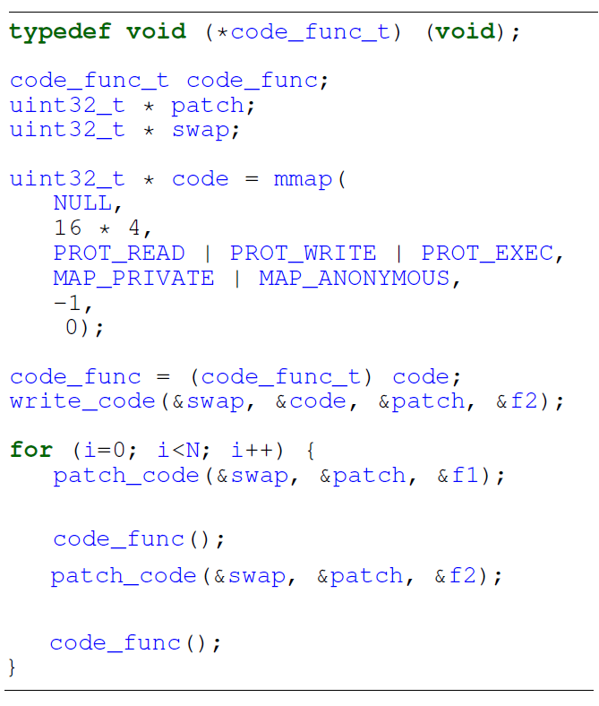




Identify QEMU execution – xFlowH
with cacheflush:
same behavior.
cacheflush();
without cacheflush:
different
behavior!
cacheflush();
Notes:
We implemented a piece of self-modifying code that overwrites a memory segment
with 2 different functions in a loop fashion and observes the different call sequences
on an emulator and on a device.
First, we allocate a memory segment with write + execute rights through mmap.
Then, we set a function pointer to point to this segment.
And then in a loop we patch the content of this segment with the one of the
functions f1 and f2 alternately. *f1 and f2 are simple functions that append in
a global string variable their name, so as the actual call sequence can be observed/inferred.
We ran this code on an emulator and a device synchronizing the caches through a
cacheflush call and we found out that the results were the same (a consistent call sequence as the loop determines)
We ran the code without the cacheflush call and we found that in the device the sequence were
random because of the cache (loss of ) coherence problem we described in the previous slide.
The behavior of the Emulator is unaffected.
Emulator behavior is the same, while in the device we observe a different behavior
due to the cache split.

Slide 16
Implementation
Use of Android SDK for static & dynamic heuristics
Use of Android NDK for hypervisor heuristics
Implementation of an Android app
runs the heuristics
send the results to an HTTP server
Repackaging of well known Android malware samples
Smali/Baksmali
Apktool
Patching the Smali Dalvik Bytecode
Notes:
, we used
the Java Native Interface (JNI) to invoke the native code that implements
the functionality of each heuristic. We developed a simple
Android game application that runs our heuristics in the background,
and for each one collects information about its effectiveness.
The collected data are sent to an HTTP server to be stored in
a local database.

Slide 17
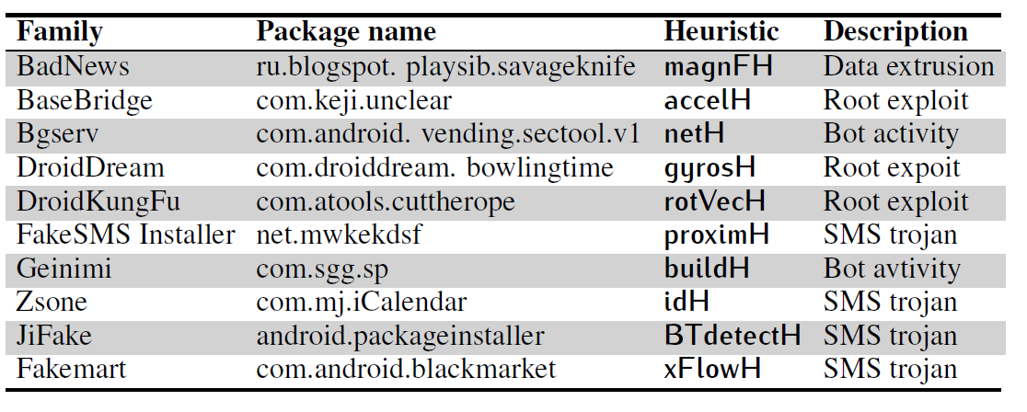

Evaluation: Malware Set
Source:
http://contagiominidump.blogspot.com/

Slide 18
Evaluation: Dynamic Analysis Services
Stand alone tools
DroidBox, DroidScope, TaintDroid
Online services
Andrubis, SandDroid, ApkScan, Visual Threat, TraceDroid, CopperDroid, APK Analyzer, ForeSafe, Mobile SandBox

Slide 19
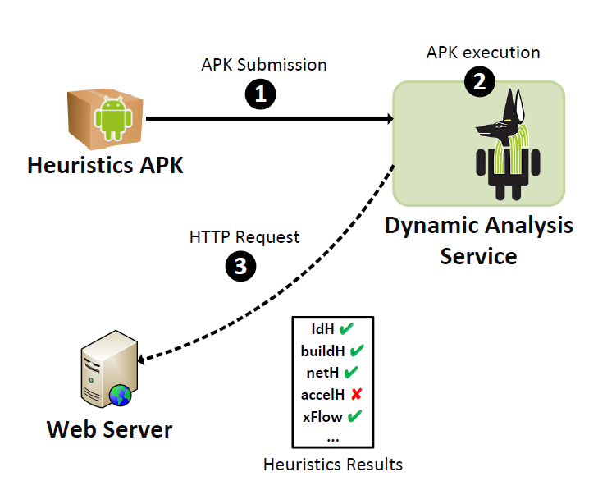
Methodology (1/2)

Slide 20
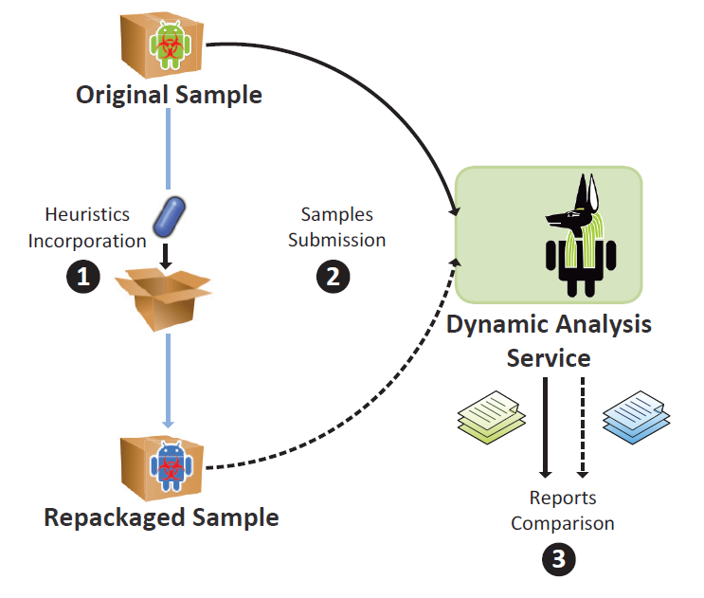
Methodology (2/2)

Slide 21
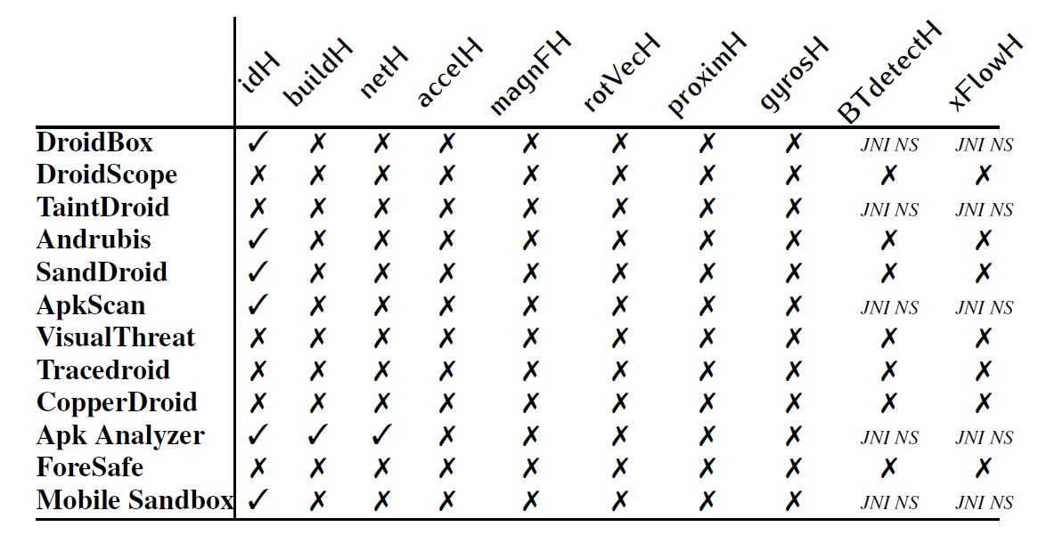
Resilience of dynamic analysis tools
Static
Dynamic
Hypervisor
Only 1 service provides information about VM evasion attempts
These tools failed to infer malicious behavior of the repackaged malware samples
All studied services are vulnerable to 5 or more heuristics

Slide 22
Countermeasures
Static heuristics
Emulator modifications
Dynamic heuristics
Realistic sensor event simulation
Hypervisor heuristics
Accurate binary translation
Hardware-assisted virtualization
Hybrid application execution
Notes:
Regarding our static heuristics, Android Emulator can be modified easily in order to be resistant to them, (or to cope with them)
as all of these heuristics are based on static information that is pre-configured on the Emulator.
In order to make all dynamic heuristics ineffective, more realistic sensor simulation is required. (This is a challenging task as it requires in-depth knowledge of specific hardware components.) For this, external software sensor simulators can be used in order to simulate sensors data at real time or record-and-replay approaches.
For our third category of our heuristics, there are a lot of options that can be used:
The binary translation process can become more accurate to the real execution used in a physical CPU, for example virtual PC has to be always updated after every instruction
Hardware-assisted virtualization can be used in order to avoid the issues that BT brings about and in order all the code to be executed by the hardware directly
Moreover, hybrid app exec would be the most secure and efficient solution: concerning this, app bytecode can run in a patched emulator shielded with the protection measures against the static and dynamic heuristics, as we described. When an app is about to load and run native code, then the execution can be forwarded and take place on a real device.
More Accurate bt in order issues like the one related with the virtual program counter to be fixed
HAV in order to avoid again the issues of BT and in order the code to run directly to the appropriate hardware
HAE where app bytcode can run on a patched emulator and when an app trys to load and run…

Slide 23
Summary
Evaluation of VM evasion to 12 Android dynamic analysis tools
Only half of the services detected our most trivial heuristics
No service was resilient to our dynamic and hypervisor heuristics
Majority of the services failed to detect repackaged malware
Only 1 service
generated VM evasion attempts
was resilient to all our static heuristics

Slide 24
Thank you!
Rage Against The Virtual Machine: Hindering Dynamic Analysis of Android Malware
Thanasis Petsas, Giannis Voyatzis, Elias Athanasopoulos, Sotiris Ioannidis,
{petsas, jvoyatz, elathan, sotiris}@ics.forth.gr
Michalis Polychronakis,
mikepo@cs.columbia.edu

