Slide 1
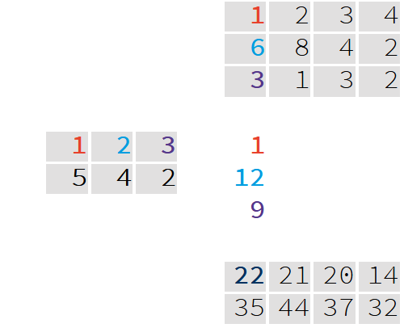
A <- matrix(c(1, 2, 3,
5, 4, 2), nrow = 2, byrow = TRUE)
B <- matrix(c(1, 2, 3, 4,
6, 8, 4, 2,
3, 1, 3, 2), nrow = 3, byrow = TRUE)
*
A %*% B
[,1] [,2] [,3] [,4]
[1,] 22 21 20 14
[2,] 35 44 37 32
+

