Slide 1
Mobile Applications (420-P84-AB)
John Abbott College
Mobile App Structure
Aakash Malhotra

Slide 2
Limited Resources
As there are some rules for memory management to follow for the best experience are: if no object is needed, release the object. Hold the ownership of an object that you didn’t create until you must release these objects too when they are not needed. Last, no need to release the objects that is not under your ownership
Android has a built-in system for memory management which is called “low memory killer”. When memory is insufficient for new applications then android terminates processes until sufficient memory is available.
The process to be terminated depend upon the predefined priority and memory consumption but this termination is sometime inconvenient for the user.

Slide 3
Limited Resources
Generally, applications running on android OS work smoothly but sometimes application crashes in the middle of its lifecycle. This happens due to the memory leaks in the system. As memory leaks are not easily identified

Slide 4
File Structure
app > java > com.example.myfirstapp > MainActivity
This is the main activity (the entry point for your app). When you build and run the app, the system launches an instance of this Activity and loads its layout.
app > res > layout > activity_main.xml
This XML file defines the layout for the activity's UI. It contains a TextView element with the text "Hello world!".

Slide 5
File Structure
app > manifests > AndroidManifest.xml
The manifest file describes the fundamental characteristics of the app and defines each of its components.
Gradle Scripts > build.gradle
You'll see two files with this name: one for the project and one for the "app" module. Each module has its own build.gradle file, but this project currently has just one module. You'll mostly work with the module's build.gradle file to configure how the Gradle tools compile and build your app.

Slide 6
Manifest File
Every app project must have an AndroidManifest.xml file (with precisely that name) at the root of the project source set. The manifest file describes essential information about your app to the Android build tools, the Android operating system, and Google Play.
Among many other things, the manifest file is required to declare the following:
The app's package name, which usually matches your code's namespace. The Android build tools use this to determine the location of code entities when building your project. When packaging the app, the build tools replace this value with the application ID from the Gradle build files, which is used as the unique app identifier on the system and on Google Play.

Slide 7
Manifest File
The components of the app, which include all activities, services, broadcast receivers, and content providers. Each component must define basic properties such as the name of its Kotlin or Java class. It can also declare capabilities such as which device configurations it can handle, and intent filters that describe how the component can be started.
The permissions that the app needs in order to access protected parts of the system or other apps. It also declares any permissions that other apps must have if they want to access content from this app.
The hardware and software features the app requires, which affects which devices can install the app from Google Play.

Slide 8
Manifest File
If you're using Android Studio to build your app, the manifest file is created for you, and most of the essential manifest elements are added as you build your app (especially when using code templates).
More at: https://developer.android.com/guide/topics/manifest/manifest-intro

Slide 9
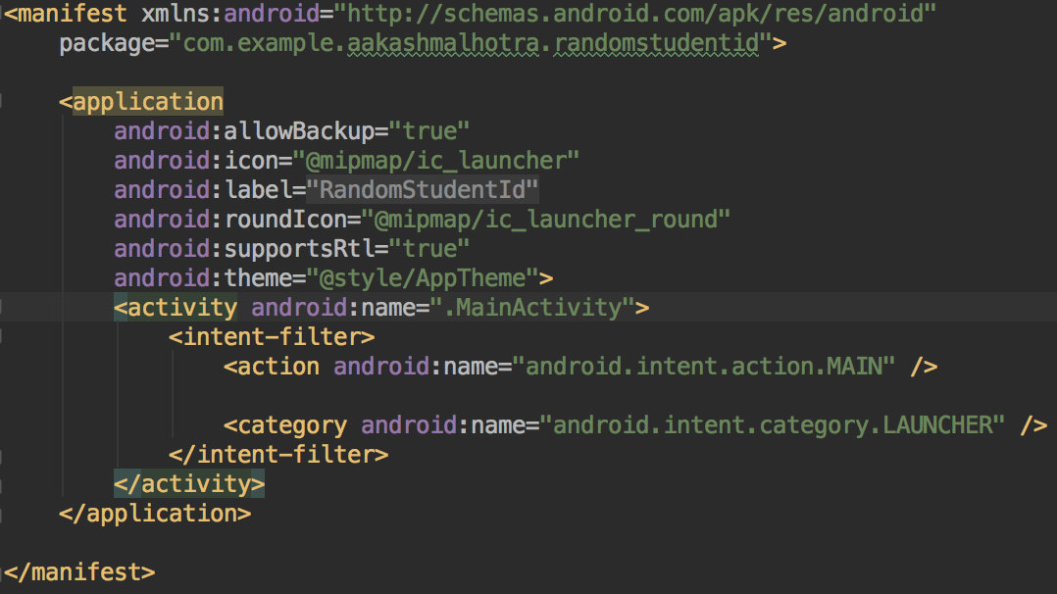
Manifest File

Slide 10
Manifest File
<manifest>
The root element of the AndroidManifest.xml file. It must contain an <application> element and specify xmlns:android and package attributes.
attributes:
xmlns:android
Defines the Android namespace. This attribute should always be set to "http://schemas.android.com/apk/res/android".

Slide 11
Manifest File
package
A full Java-language-style package name for the Android app. The name may contain uppercase or lowercase letters ('A' through 'Z'), numbers, and underscores ('_'). While building your app into the an application package (APK), the build system uses the package attribute for two things:
It applies this name as the namespace for your app's generated R.java class (used to access your app resources).
For example, if package is set to "com.example.myapp", the R class is created at com.example.myapp.R.
It uses this name to resolve any relative class names that are declared in the manifest file.
For example, if package is set to "com.example.myapp", an activity declared as <activity android:name=".MainActivity"> is resolved to be com.example.myapp.MainActivity.

Slide 12
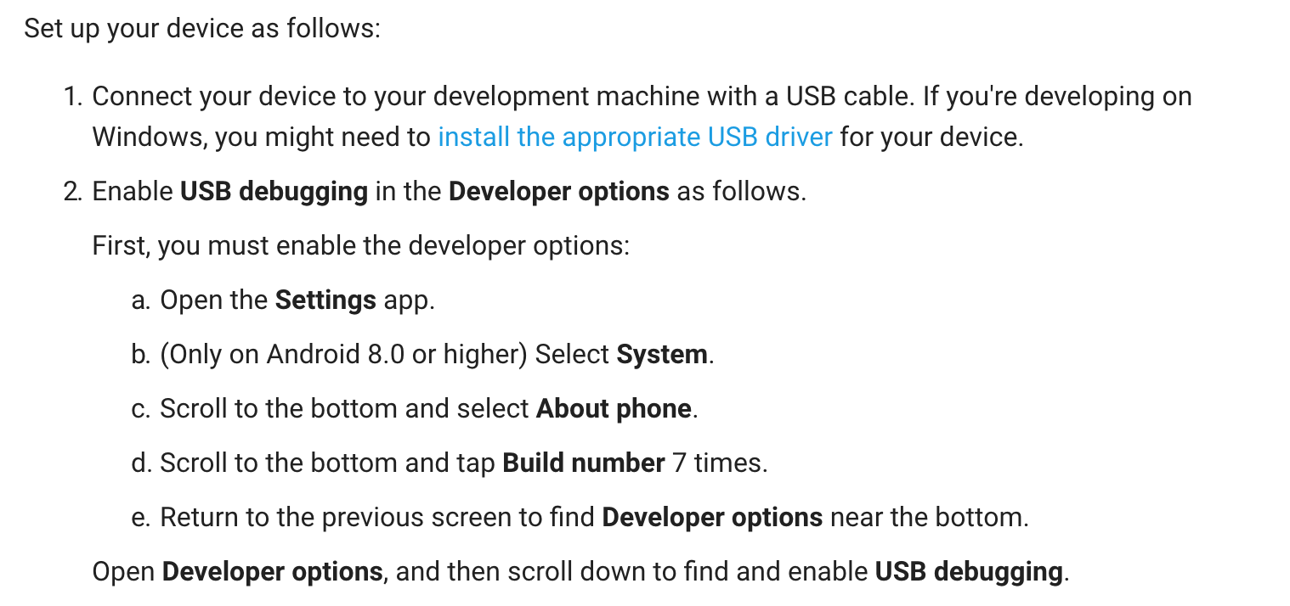
Run on a Real Device

Slide 13
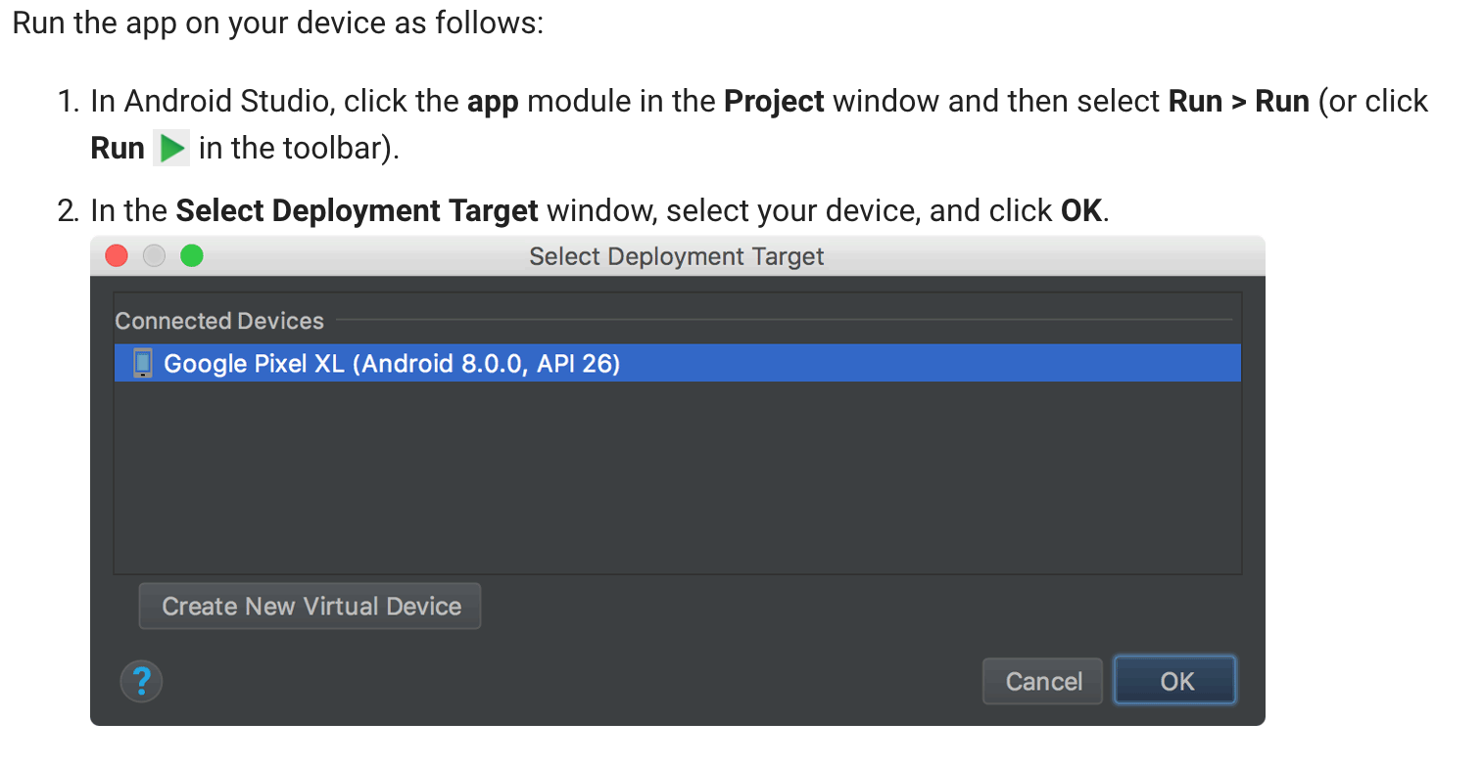
Run on a Real Device

Slide 14
Task 1:
Create a program in Java that selects and displays a random Student Id from a list of Student Ids

Slide 15
Task 1 Solution:
import java.util.Random;
public class random {
public static void main(String args[]) {
String studentId[] = { "1", "2", "3", "4", "5", "6", "7", "8", "9", "10", "11", "12", "13", "14", "15" , "16"};
Random r = new Random();
int j = r.nextInt(studentId.length); // Parameter is upper limit (excluding)
System.out.println(studentId[j]);
}
}

Slide 16
Task 2:
Create an application which displays a random Student Id from a provided list of student Ids
Extra Practice: Create an application that displays list of all student Ids

Slide 17
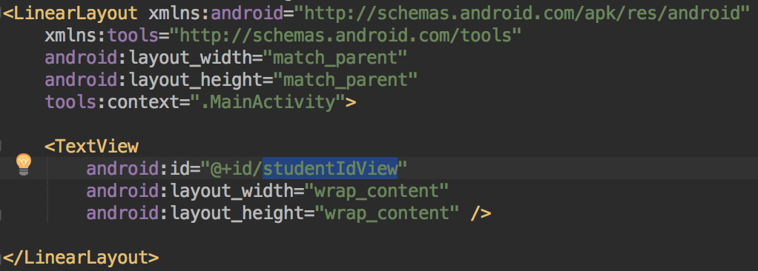
Task 2 Solution:

Slide 18
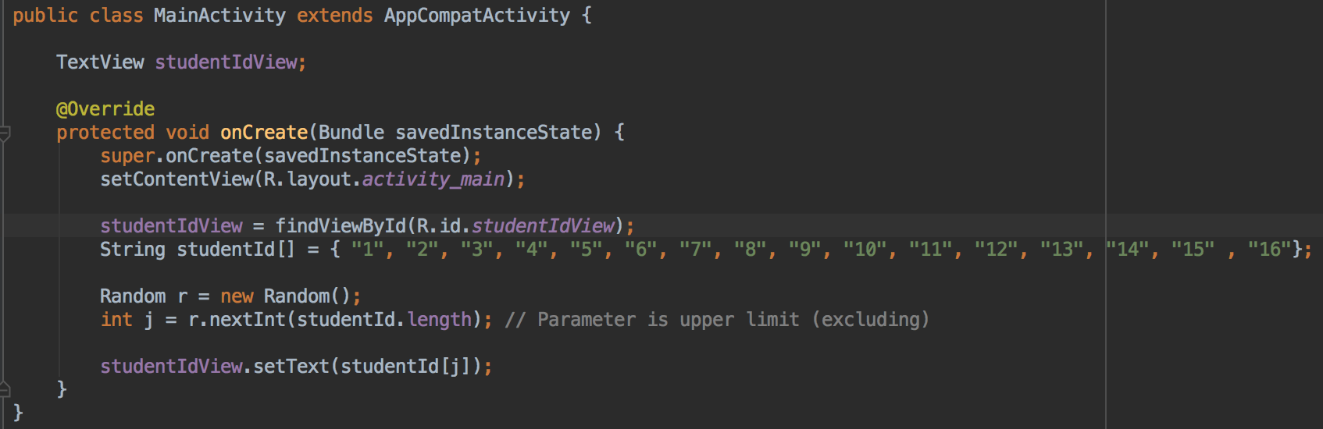
Task 2 Solution:

Slide 19
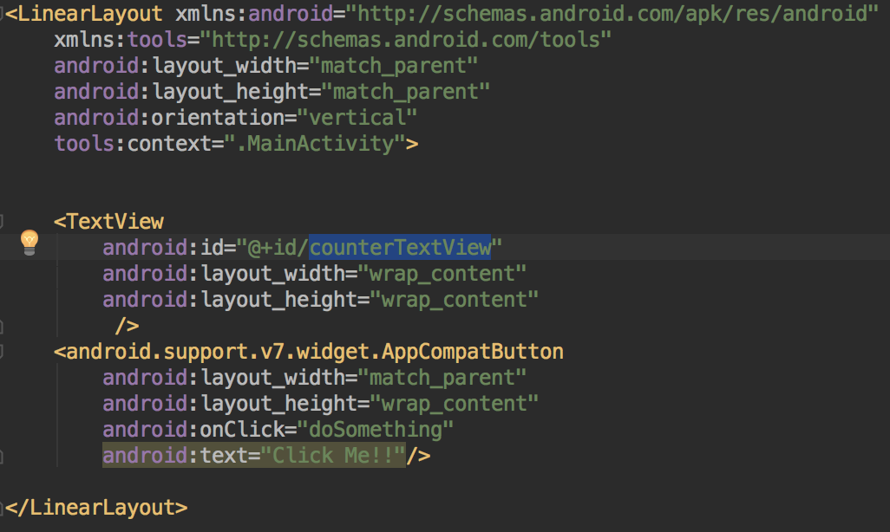
Add a Button

Slide 20
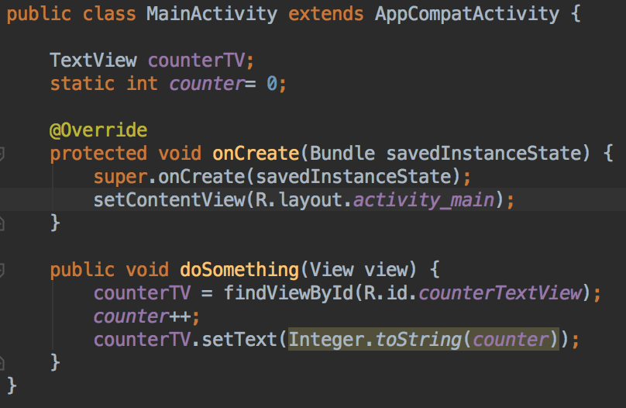
Add a Button

Slide 21
Task 3:
Create an application that displays a random Student Id from a list of student Ids when clicked on a button
Extra Practice: Also display name of the student

Slide 22
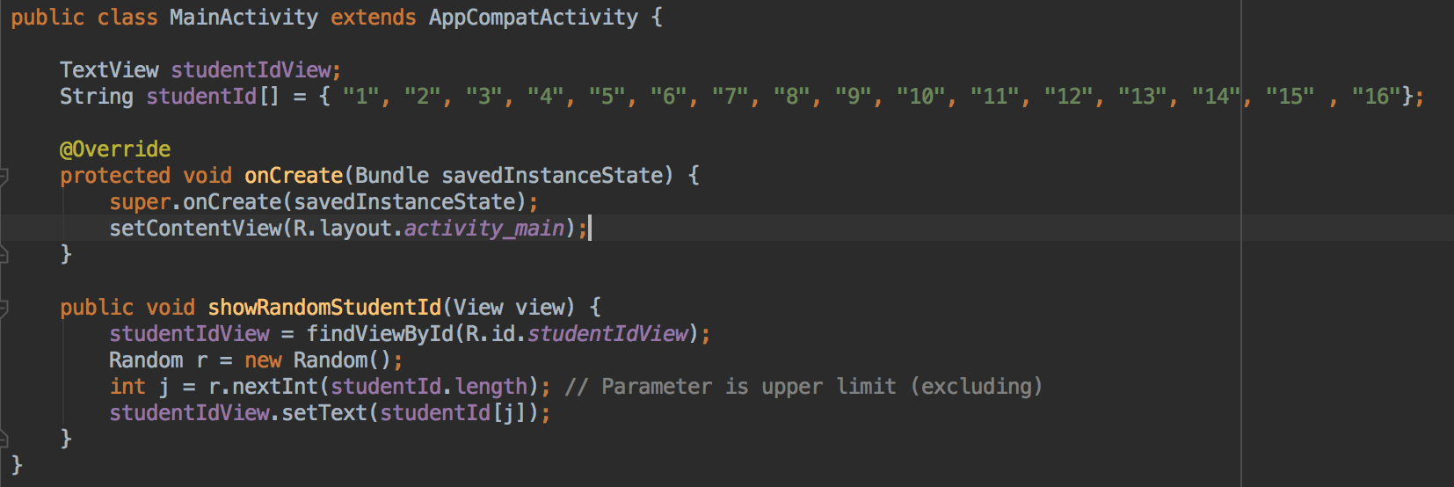
Task 3 Solution:

Slide 23
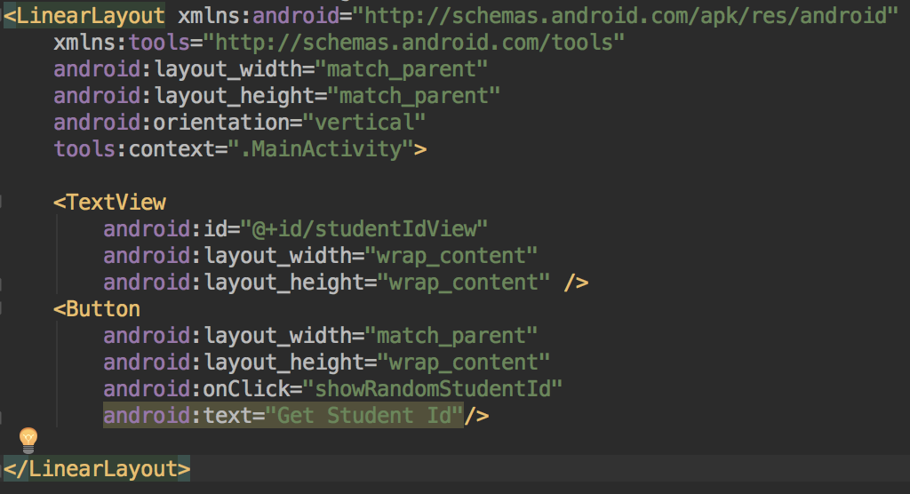
Task 3 Solution:

Slide 24
Margin and Padding
layout_margin:
layout_marginLeft
layout_marginRight
layout_marginTop
layout_marginBottom
padding
paddingLeft
paddingRight
paddingTop
paddingBottom

Slide 25
Design Units / Dimensions
A dimension value defined in XML. A dimension is specified with a number followed by a unit of measure. For example: 10px, 2in, 5sp. The following units of measure are supported by Android:
dp
Density-independent Pixels - An abstract unit that is based on the physical density of the screen. These units are relative to a 160 dpi (dots per inch) screen, on which 1dp is roughly equal to 1px. When running on a higher density screen, the number of pixels used to draw 1dp is scaled up by a factor appropriate for the screen's dpi. Likewise, when on a lower density screen, the number of pixels used for 1dp is scaled down. The ratio of dp-to-pixel will change with the screen density, but not necessarily in direct proportion. Using dp units (instead of px units) is a simple solution to making the view dimensions in your layout resize properly for different screen densities. In other words, it provides consistency for the real-world sizes of your UI elements across different devices.

Slide 26

Design Units / Dimensions

Slide 27
Design Units / Dimensions
sp
Scale-independent Pixels - This is like the dp unit, but it is also scaled by the user's font size preference. It is recommend you use this unit when specifying font sizes, so they will be adjusted for both the screen density and the user's preference.
pt
Points - 1/72 of an inch based on the physical size of the screen, assuming a 72dpi density screen.
px
Pixels - Corresponds to actual pixels on the screen. This unit of measure is not recommended because the actual representation can vary across devices; each devices may have a different number of pixels per inch and may have more or fewer total pixels available on the screen.

Slide 28
Design Units / Dimensions
mm
Millimeters - Based on the physical size of the screen.
in
Inches - Based on the physical size of the screen.

Slide 29
Task 4:
Beautify your App

Slide 30
String Resources
A string resource provides text strings for your application with optional text styling and formatting. There are three types of resources that can provide your application with strings:
String
XML resource that provides a single string.
String Array
XML resource that provides an array of strings.
Quantity Strings (Plurals)
XML resource that carries different strings for pluralization.

Slide 31
String
All strings are capable of applying some styling markup and formatting arguments. For information about styling and formatting strings, see the section about Formatting and Styling.
String
A single string that can be referenced from the application or from other resource files (such as an XML layout).
Note: A string is a simple resource that is referenced using the value provided in the name attribute (not the name of the XML file). So, you can combine string resources with other simple resources in the one XML file, under one <resources> element.

Slide 32
String
file location:
res/values/filename.xml
The filename is arbitrary. The <string> element's name is used as the resource ID.
compiled resource datatype:
Resource pointer to a String.
resource reference:
In Java: R.string.string_name
In XML:@string/string_name

Slide 33
String
syntax:
<resources>
<string
name="string_name"
>text_string</string>
</resources>

Slide 34
String
elements:
<resources>
Required. This must be the root node.
No attributes.
<string>
A string, which can include styling tags. Beware that you must escape apostrophes and quotation marks. For more information about how to properly style and format your strings see Formatting and Styling.

Slide 35
String
attributes:
name
String. A name for the string. This name is used as the resource ID.
example:
XML file saved at res/values/strings.xml:
<?xml version="1.0" encoding="utf-8"?>
<resources>
<string name="hello">Hello!</string>
</resources>

Slide 36
String
This layout XML applies a string to a View:
<TextView
android:layout_width="fill_parent"
android:layout_height="wrap_content"
android:text="@string/hello" />
Java:
String string = getString(R.string.hello);
You can use either getString(int) or getText(int) to retrieve a string. getText(int)retains any rich text styling applied to the string.

Slide 37
String Practice
Make changes in your current application to use string resources

Slide 38
String Array
An array of strings that can be referenced from the application.
Note: A string array is a simple resource that is referenced using the value provided in the name attribute (not the name of the XML file). As such, you can combine string array resources with other simple resources in the one XML file, under one <resources> element.
file location:
res/values/filename.xml
The filename is arbitrary. The <string-array> element's name is used as the resource ID.
compiled resource datatype:
Resource pointer to an array of Strings.

Slide 39
String Array
resource reference:
In Java: R.array.string_array_name
syntax:
<?xml version="1.0" encoding="utf-8"?>
<resources>
<string-array name="string_array_name">
<item>text_string</item>
</string-array>
</resources>

Slide 40
String Array
elements:
<resources>
Required. This must be the root node.
No attributes.
<string-array>
Defines an array of strings. Contains one or more <item> elements.
attributes:
name
String. A name for the array. This name is used as the resource ID to reference the array.

Slide 41
String Array
<item>
A string, which can include styling tags. The value can be a reference to another string resource. Must be a child of a <string-array> element. Beware that you must escape apostrophes and quotation marks. See Formatting and Styling, below, for information about to properly style and format your strings.
No attributes.
example:
<resources>
<string-array name="planets_array">
<item>Mercury</item>
<item>Venus</item>
<item>Earth</item>
<item>Mars</item>
</string-array>
</resources>

Slide 42
String Array
JAVA:
Resources res = getResources();
String[] planets = res.getStringArray(R.array.planets_array);

Slide 43
String Array Practice
Create a list of String array resource and display that list on the screen

Slide 44
Quantity Strings
Different languages have different rules for grammatical agreement with quantity. In English, for example, the quantity 1 is a special case. We write "1 book", but for any other quantity we'd write "nbooks". This distinction between singular and plural is very common, but other languages make finer distinctions. The full set supported by Android is zero, one, two, few, many, and other.
The rules for deciding which case to use for a given language and quantity can be very complex, so Android provides you with methods such as getQuantityString() to select the appropriate resource for you.
Although historically called "quantity strings" (and still called that in API), quantity strings should only be used for plurals. It would be a mistake to use quantity strings to implement something like Gmail's "Inbox" versus "Inbox (12)" when there are unread messages, for example. It might seem convenient to use quantity strings instead of an if statement, but it's important to note that some languages (such as Chinese) don't make these grammatical distinctions at all, so you'll always get the other string.

Slide 45
Quantity Strings
The selection of which string to use is made solely based on grammatical necessity. In English, a string for zero is ignored even if the quantity is 0, because 0 isn't grammatically different from 2, or any other number except 1 ("zero books", "one book", "two books", and so on). Conversely, in Korean only the other string is ever used.
Don't be misled either by the fact that, say, two sounds like it could only apply to the quantity 2: a language may require that 2, 12, 102 (and so on) are all treated like one another but differently to other quantities. Rely on your translator to know what distinctions their language actually insists upon.
It's often possible to avoid quantity strings by using quantity-neutral formulations such as "Books: 1". This makes your life and your translators' lives easier, if it's an acceptable style for your application.

Slide 46
Logging
API for sending log output.
Generally, you should use the Log.v(), Log.d(), Log.i(), Log.w(), and Log.e() methods to write logs. You can then view the logs in logcat.
The order in terms of verbosity, from least to most is ERROR, WARN, INFO, DEBUG, VERBOSE. Verbose should never be compiled into an application except during development. Debug logs are compiled in but stripped at runtime. Error, warning and info logs are always kept.
Tip: A good convention is to declare a TAG constant in your class:
private static final String TAG = "MyActivity";
and use that in subsequent calls to the log methods.

Slide 47
Logging
API for sending log output.
Generally, you should use the Log.v(), Log.d(), Log.i(), Log.w(), and Log.e() methods to write logs. You can then view the logs in logcat.
The order in terms of verbosity, from least to most is ERROR, WARN, INFO, DEBUG, VERBOSE. Verbose should never be compiled into an application except during development. Debug logs are compiled in but stripped at runtime. Error, warning and info logs are always kept.
Tip: A good convention is to declare a TAG constant in your class:
private static final String TAG = "MyActivity";
and use that in subsequent calls to the log methods.

Slide 48
Logging Practice
Log all the student ids in String Array

Slide 49
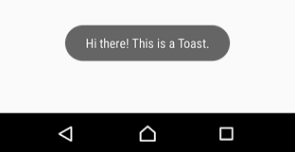
Let's make a Toast
Toast.makeText(MainActivity.this, "Hi there! This is a Toast", Toast.LENGTH_LONG).show();

Slide 50
References:
https://peerj.com/preprints/3344.pdf
https://developer.android.com/training/basics/firstapp/creating-project
https://developer.android.com/training/basics/firstapp/running-app
https://developer.android.com/guide/topics/manifest/manifest-intro
https://developer.android.com/guide/topics/manifest/manifest-element
https://developer.android.com/guide/topics/resources/string-resource
https://developer.android.com/reference/android/util/Log

