Slide 1
Mobile Applications (420-P84-AB)
John Abbott College
Introduction
Aakash Malhotra

Slide 2

Ice Breaker

Slide 3
Questions that may help
Background (Last job/profession, prior education)
Why this Program?
What perfect job would look like?
Favourite Superhero?
Favourite developer/influencer?
Favourite technology/framework?

Slide 4
A Little Bit About The Course
You will learn:
how to define and implement User Interface
basic components of a mobile application
how to communicate over the network
how to use app resources

Slide 5
A Little Bit About The Course
handle errors and debug a mobile app
mobile app development best practices.

Slide 6
Job Market
Average salary of a Mobile Application Developer in Canada is $61,164/year as per payscale.com
$79,250/year in Montreal as per Indeed.com

Slide 7
Grading Scheme
Quiz - 25%: On 14th August 2018. Both MCQs and Subjective.
Project - 35%: Due on 19th August 2018 at 11:55 pm. Demo on 20th August. Max team size of 2.
Final - 40%: On 22nd August 2018

Slide 8
Types of Mobile Applications
Native:
A native app is a smartphone application developed specifically for a mobile operating system.
IOS (Objective-C or Swift)
Android (Kotlin for Android)

Slide 9
Types of Mobile Applications
Cross-platform: A cross-platform app is a smartphone application that has the capability to run on multiple platforms.
Native Cross-platform
Appcelerator Titanium
Xamarin
React Native
Hybrid Cross-platform
Html5 + JS + CSS + Phonegap / Cordova
Ionic + Phonegap / Cordova

Slide 10
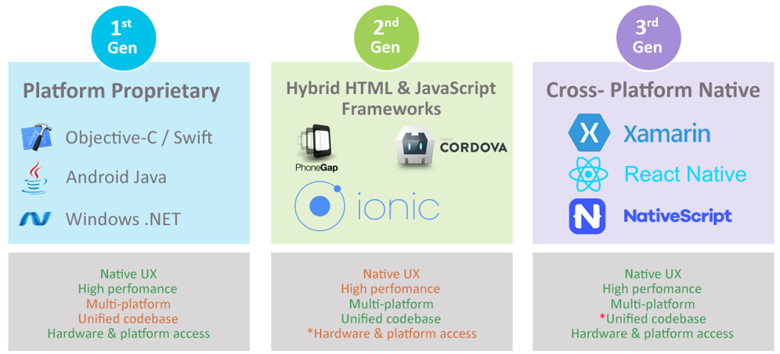
Types of Mobile Applications

Slide 11
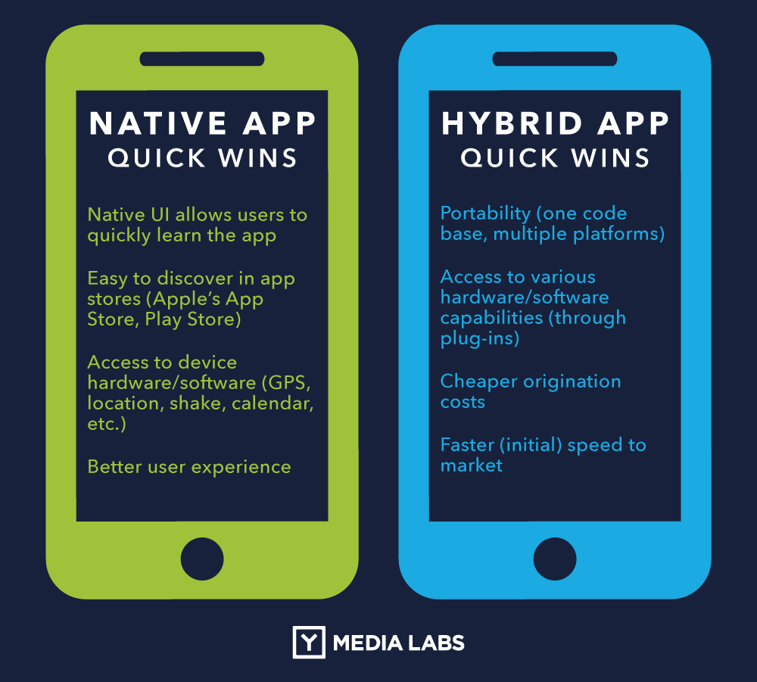
Native vs Hybrid Mobile Applications

Slide 12
Java Review
https://docs.oracle.com/javase/tutorial/

Slide 13
References:
https://www.payscale.com/research/CA/Job=Mobile_Applications_Developer/Salary
https://ca.indeed.com/salaries/Mobile-Developer-Salaries,-Montr%C3%A9al-QC?from=serpsalaryblock
https://www.conferencecalling.com/blog/wp-content/uploads/2013/05/conference-call-ice-breakers.jpg
https://ymedialabs.com/hybrid-vs-native-mobile-apps-the-answer-is-clear
https://devopedia.org/images/article/34/8729.1529045461.png

