Slide 4
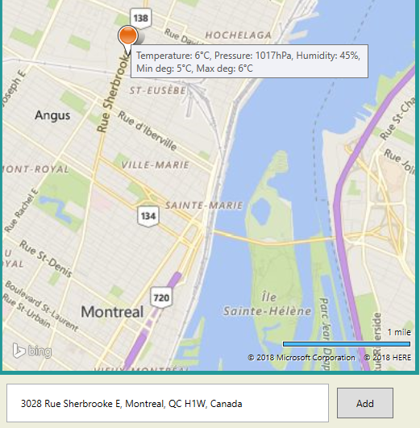
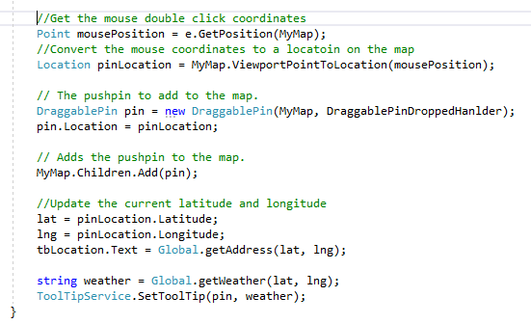
Pick a location

Slide 5
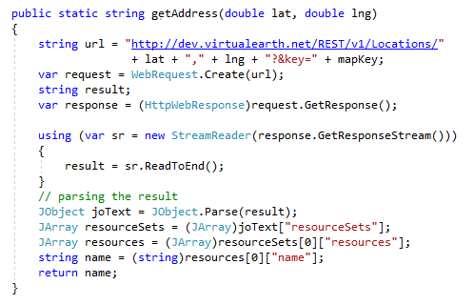
getAddress() method invoked from Global class

Slide 6
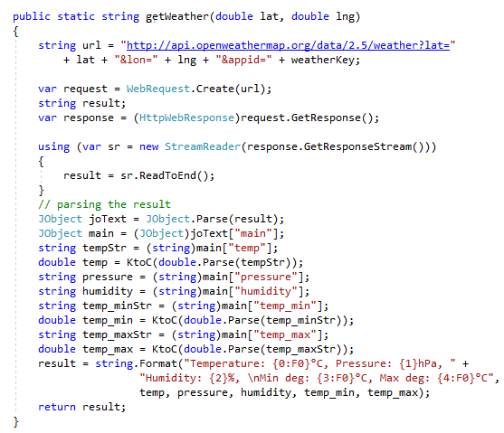
getWeather() method invoked from Global class.

Slide 7
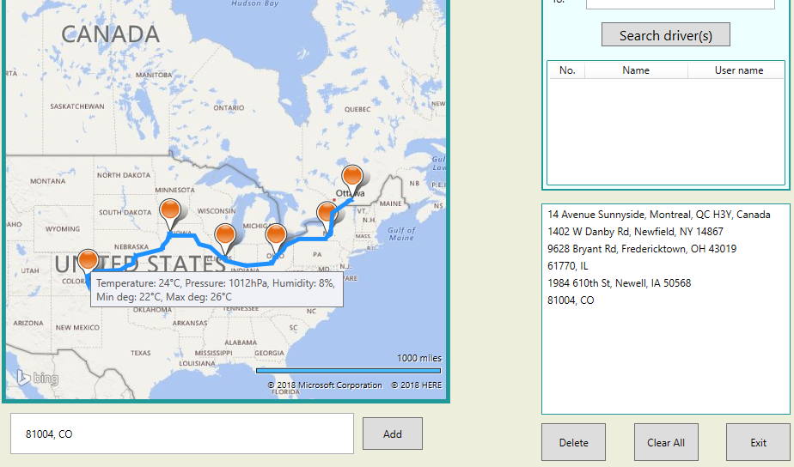

Slide 8


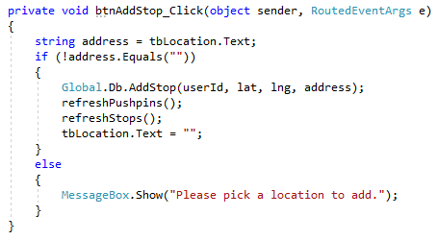
btnAddStop_Click() method in Code behind

Slide 9
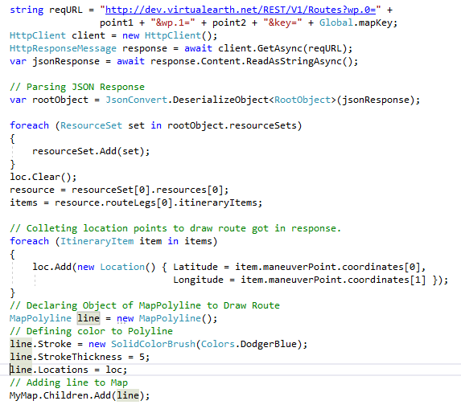

Slide 10
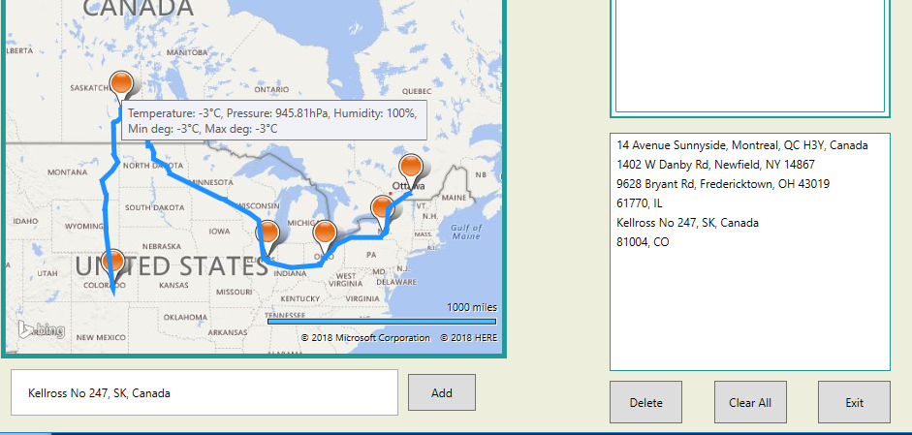
Dragging, dropping a pushpin

Slide 11
Summary
References:
https://msdn.microsoft.com/ja-jp/library/hh709044.aspx
https://msdn.microsoft.com/en-us/library/ff701710.aspx
https://openweathermap.org/current#current_JSON
https://rbrundritt.wordpress.com/2010/05/04/simple-infoboxes-in-bing-maps-silverlight/
https://rbrundritt.wordpress.com/2009/08/01/ve-silverlight-control-%E2%80%93-pushpins-infoboxes-and-best-map-view/
https://code.msdn.microsoft.com/windowsapps/Draw-Route-using-Bing-Maps-4a6ad1e7
https://jsonformatter.curiousconcept.com/
Special thanks to Mr. Prokopski.

