Slide 1
FluidGPT; Foundational Navier Stokes modelling
Deterministic VS Probabilistic PDE Modelling
MSc Grad. Tom Harmsen
supervised by Vlado Menkovski

Slide 2
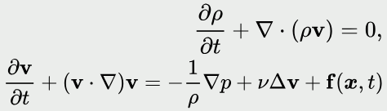
FluidGPT; Datasets
Traditional PDE solving very slow
~20TB raw data from 9 different Navier Stokes datasets
Only Velocity vectors passed to model
Compressible/Incompressible
Different initialisation methods
Different solvers/sources
Turbulent/Laminar flow and different simulation parameters (viscosity terms, pressure, density, etc.)
Different boundary conditions
With/without forcing term

Slide 3
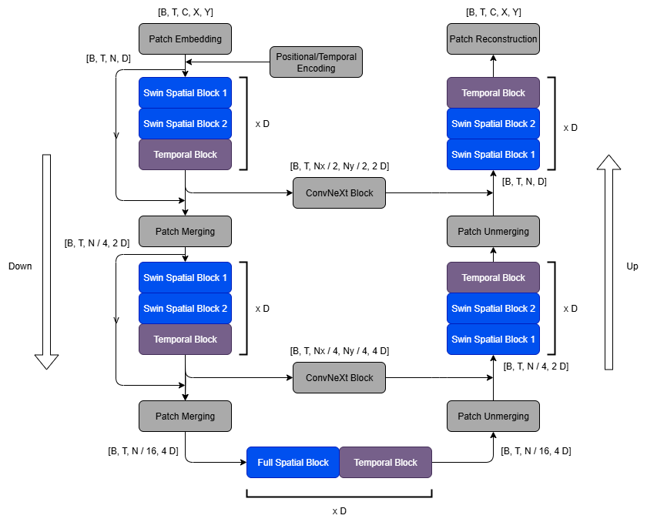
FluidGPT; Model
New auto-regressive transformer model (Swin + Unet)
Generalisability
Time-bundling for temporal stability

Slide 4
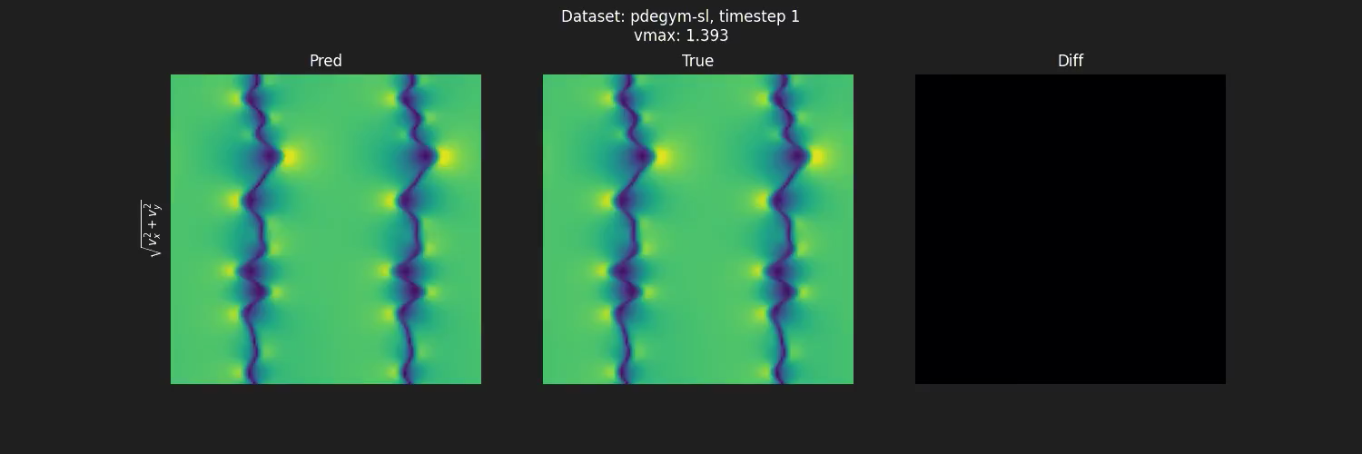
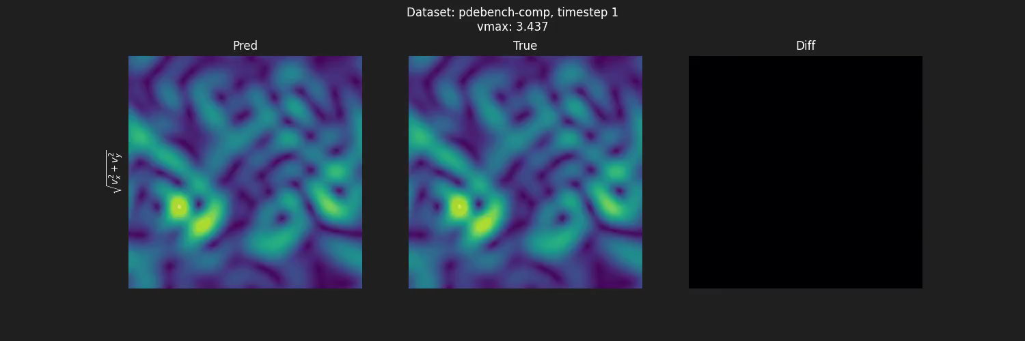
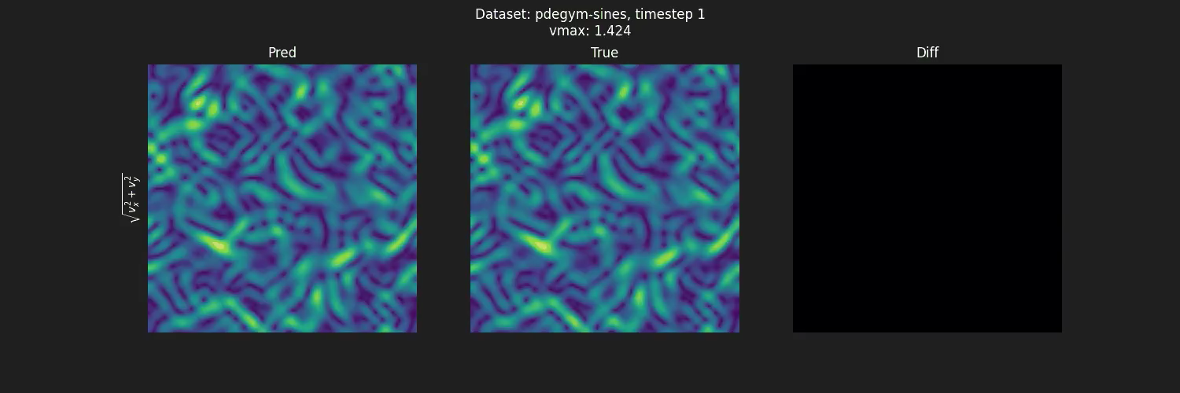
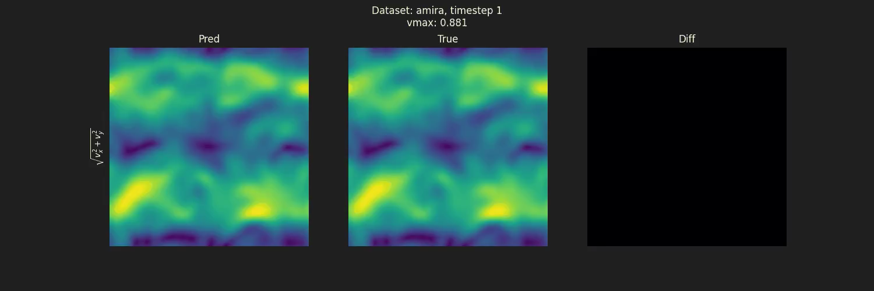

Slide 5
Probabilistic VS deterministic
Flow matching:
Learn velocity field from simple distribution to complex distribution and integrate as if ODE

Slide 6
Experience with Spike
High compute
Large VRAM (useful for attention-heavy tasks)
High disk read-out speeds (data on disk)
Large static memory (dataset storage)
Docker/kubernetes
RunAI GUI/CLI
Define W&B key
SSH containers port-forwarding
Not ideal for code development
Sometimes still buggy

