Slide 1



De l’autre côté du miroir La fabrique du software
ThomasPierrain
|
@tpierrain
Notes:
Image payée: https://www.istockphoto.com/fr/photo/miroir-deau-de-bordeaux-en-%C3%A9t%C3%A9-france-gm1152270059-312559548

Slide 2

Content(e)s de vos projets ?
Notes:
https://www.google.com/url?sa=i&url=https%3A%2F%2Fblog.neocamino.com%2Ftrouver-son-site%2F&psig=AOvVaw1VrpoH4O4B0ZlzXbdnIp_D&ust=1630441897943000&source=images&cd=vfe&ved=0CAkQjRxqFwoTCPDTp8XO2fICFQAAAAAdAAAAABAD

Slide 3

C’est Trop long P…
Notes:
https://www.google.com/url?sa=i&url=https%3A%2F%2Fstock.adobe.com%2Ffr%2Fsearch%3Fk%3Dblas%25C3%25A9&psig=AOvVaw1LJRkPkwsgWTLzHzDv1PTy&ust=1630443155636000&source=images&cd=vfe&ved=0CAkQjRxqFwoTCLjUiJ3Q2fICFQAAAAAdAAAAABAD

Slide 4

Trop tech-centric
Notes:
https://www.google.com/url?sa=i&url=https%3A%2F%2Fstephan.services%2Fpodcast-18-developpeur-informatique%2F&psig=AOvVaw2JNxcnP5tq7pti9YVbW8Ou&ust=1631437390810000&source=images&cd=vfe&ved=0CAkQjRxqFwoTCIi3gIjI9vICFQAAAAAdAAAAABAo

Slide 5

Given …
When …
Then …
Trop rigides
Notes:
https://www.google.com/url?sa=i&url=https%3A%2F%2Fwww.ionos.fr%2Fdigitalguide%2Fsites-internet%2Fdeveloppement-web%2Fquest-ce-que-le-behavior-driven-development%2F&psig=AOvVaw0-8YDaHbea7Z01BeTM8FmZ&ust=1631437801080000&source=images&cd=vfe&ved=0CAkQjRxqFwoTCLjvhM_J9vICFQAAAAAdAAAAABAD

Slide 6
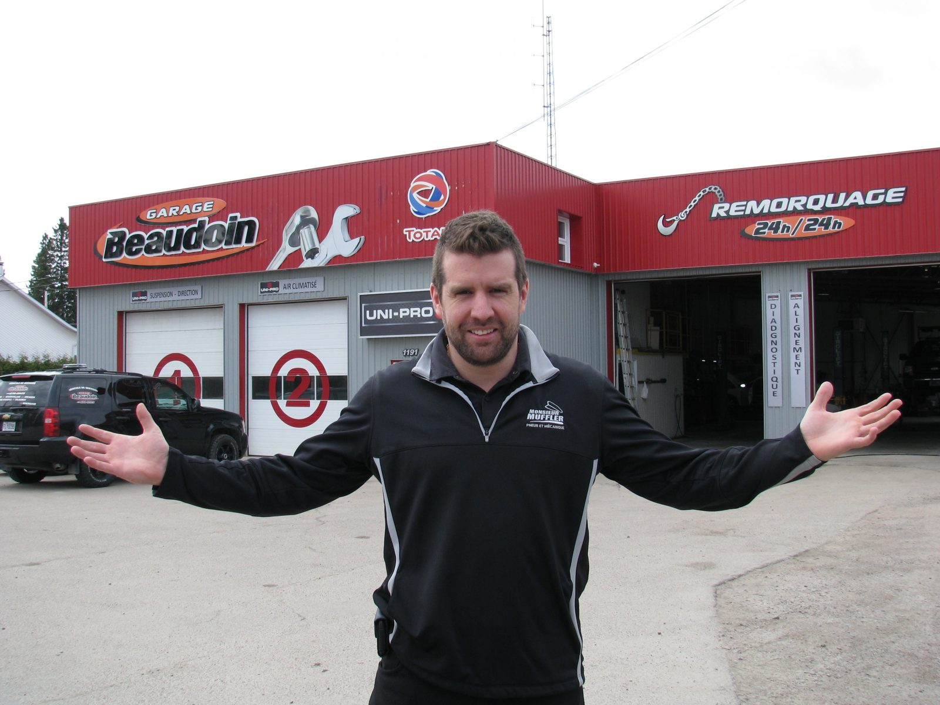
Les « Garagistes »
Notes:
https://www.google.com/url?sa=i&url=https%3A%2F%2Fwww.letoiledulac.com%2Feconomie%2Fmessieurs-les-garagistes%2F&psig=AOvVaw34Wo-gcIGb-PJP56gTnWSd&ust=1630442329164000&source=images&cd=vfe&ved=0CAkQjRxqFwoTCKDBqZ7N2fICFQAAAAAdAAAAABAE

Slide 7

Once Upon a time
Notes:
https://www.google.com/url?sa=i&url=https%3A%2F%2Fwww.meilleursbrokers.com%2Fblog%2F2018%2F05%2F14%2Fcomment-devenir-trader-%25C3%25A9tudes-et-dipl%25C3%25B4mes%2F&psig=AOvVaw2hSaifPFX-PPqCZ7bROabC&ust=1630442766372000&source=images&cd=vfe&ved=0CAkQjRxqFwoTCJCZ6OPO2fICFQAAAAAdAAAAABAD

Slide 8
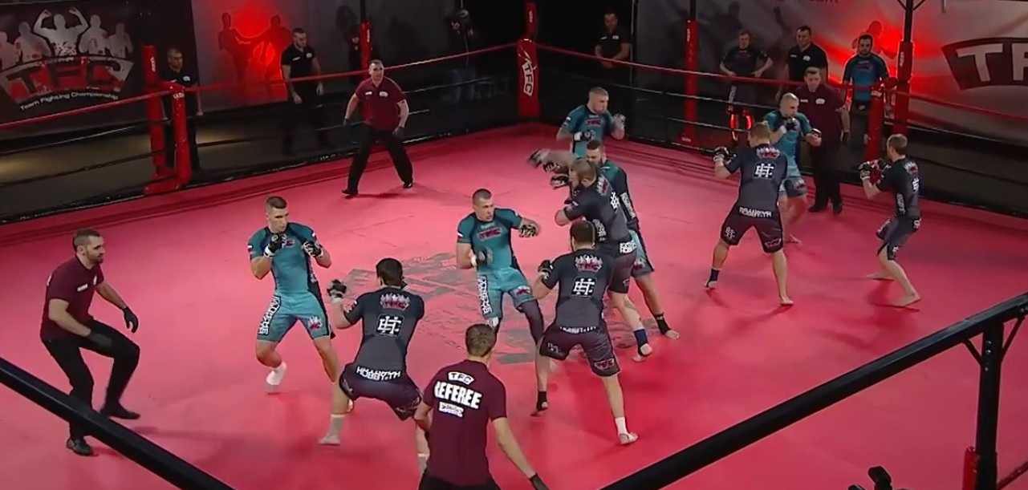
Relations entre équipes de dev
Notes:
https://www.google.com/url?sa=i&url=https%3A%2F%2Fwww.meilleursbrokers.com%2Fblog%2F2018%2F05%2F14%2Fcomment-devenir-trader-%25C3%25A9tudes-et-dipl%25C3%25B4mes%2F&psig=AOvVaw2hSaifPFX-PPqCZ7bROabC&ust=1630442766372000&source=images&cd=vfe&ved=0CAkQjRxqFwoTCJCZ6OPO2fICFQAAAAAdAAAAABAD

Slide 9

C’est Trop …
Notes:
https://www.google.com/url?sa=i&url=https%3A%2F%2Fstock.adobe.com%2Ffr%2Fsearch%3Fk%3Dblas%25C3%25A9&psig=AOvVaw1LJRkPkwsgWTLzHzDv1PTy&ust=1630443155636000&source=images&cd=vfe&ved=0CAkQjRxqFwoTCLjUiJ3Q2fICFQAAAAAdAAAAABAD

Slide 10

De l’autre côté
Notes:
https://www.google.com/url?sa=i&url=https%3A%2F%2Fwww.papergeek.fr%2Fmatrix-resurrections-voici-la-folle-bande-annonce-du-4e-film-de-la-saga-2454400&psig=AOvVaw1o7Y-Xsy0HiH_teeuKZfBk&ust=1631438660817000&source=images&cd=vfe&ved=0CAkQjRxqFwoTCKDG4eTM9vICFQAAAAAdAAAAABAJ

Slide 11

Basics
Notes:
https://images.app.goo.gl/eU9Jrtu8zn2qWMBo9

