Slide 1



De l’autre côté du miroir La fabrique du software
ThomasPierrain
|
@tpierrain
Notes:
Image payée: https://www.istockphoto.com/fr/photo/miroir-deau-de-bordeaux-en-%C3%A9t%C3%A9-france-gm1152270059-312559548

Slide 2

Content(e)s de vos projets ?
Notes:
https://www.google.com/url?sa=i&url=https%3A%2F%2Fblog.neocamino.com%2Ftrouver-son-site%2F&psig=AOvVaw1VrpoH4O4B0ZlzXbdnIp_D&ust=1630441897943000&source=images&cd=vfe&ved=0CAkQjRxqFwoTCPDTp8XO2fICFQAAAAAdAAAAABAD

Slide 3

Trop long…
Notes:
https://www.google.com/url?sa=i&url=https%3A%2F%2Fstock.adobe.com%2Ffr%2Fsearch%3Fk%3Dblas%25C3%25A9&psig=AOvVaw1LJRkPkwsgWTLzHzDv1PTy&ust=1630443155636000&source=images&cd=vfe&ved=0CAkQjRxqFwoTCLjUiJ3Q2fICFQAAAAAdAAAAABAD

Slide 4
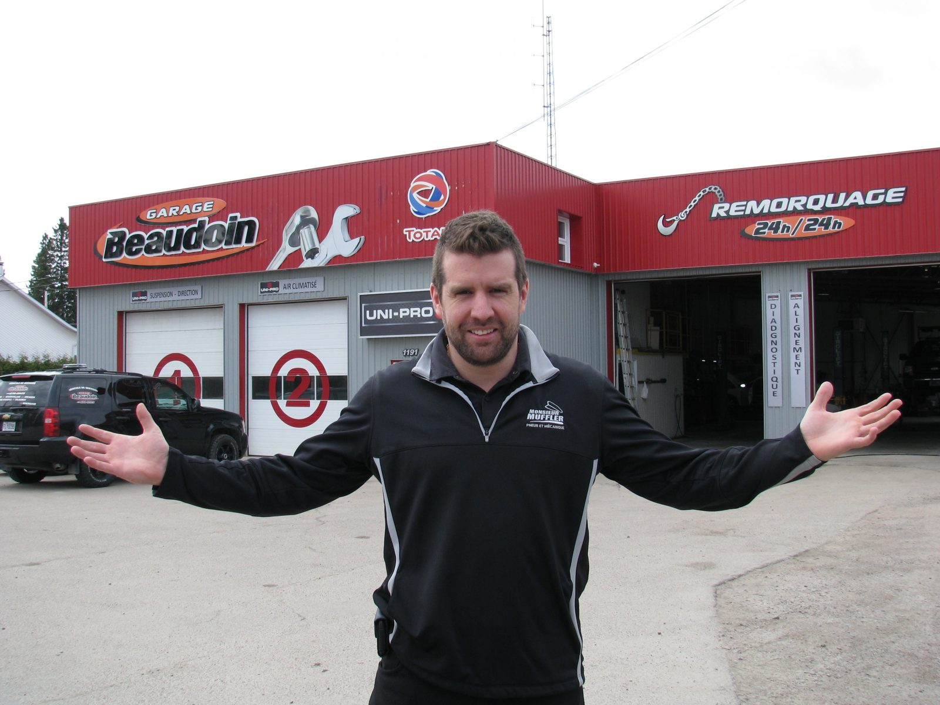
Les Garagistes
Notes:
https://www.google.com/url?sa=i&url=https%3A%2F%2Fwww.letoiledulac.com%2Feconomie%2Fmessieurs-les-garagistes%2F&psig=AOvVaw34Wo-gcIGb-PJP56gTnWSd&ust=1630442329164000&source=images&cd=vfe&ved=0CAkQjRxqFwoTCKDBqZ7N2fICFQAAAAAdAAAAABAE

Slide 5

Once Upon a time
Notes:
https://www.google.com/url?sa=i&url=https%3A%2F%2Fwww.meilleursbrokers.com%2Fblog%2F2018%2F05%2F14%2Fcomment-devenir-trader-%25C3%25A9tudes-et-dipl%25C3%25B4mes%2F&psig=AOvVaw2hSaifPFX-PPqCZ7bROabC&ust=1630442766372000&source=images&cd=vfe&ved=0CAkQjRxqFwoTCJCZ6OPO2fICFQAAAAAdAAAAABAD

Slide 6

Basics
Notes:
https://images.app.goo.gl/eU9Jrtu8zn2qWMBo9

