Slide 1
For Each Structure in Data File
For Each Family in Population
For Each Agent in Population
Create Adult by Family Type Vector
Assign Business
Assign Age
Create Rent Vector
Assign Infrastructure
If Child Assign Gender
Create Child Vector
Assign Tribe
Integrate Vectors to Create Families

Slide 2
For Each Agent in Population
Assign Employment
Assign
Physiology
Calculate Distance to Shops

Slide 3
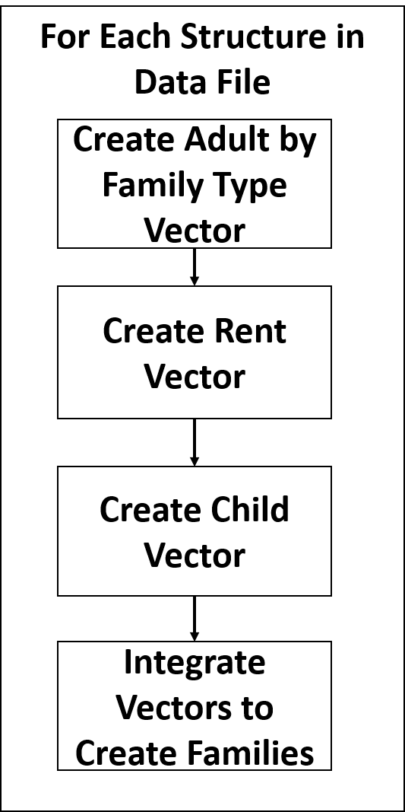
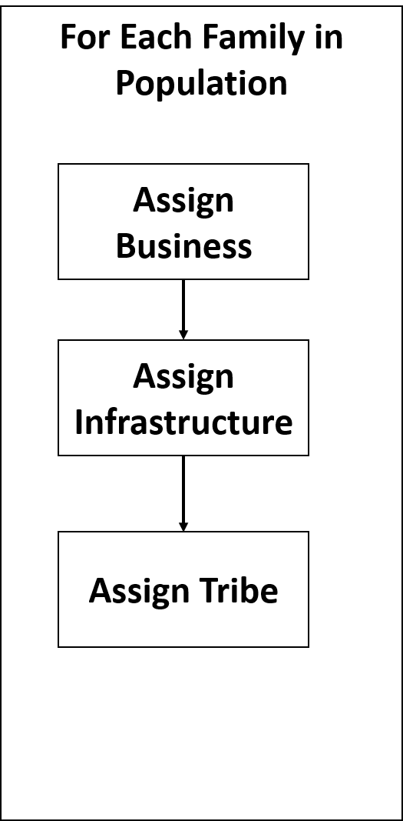
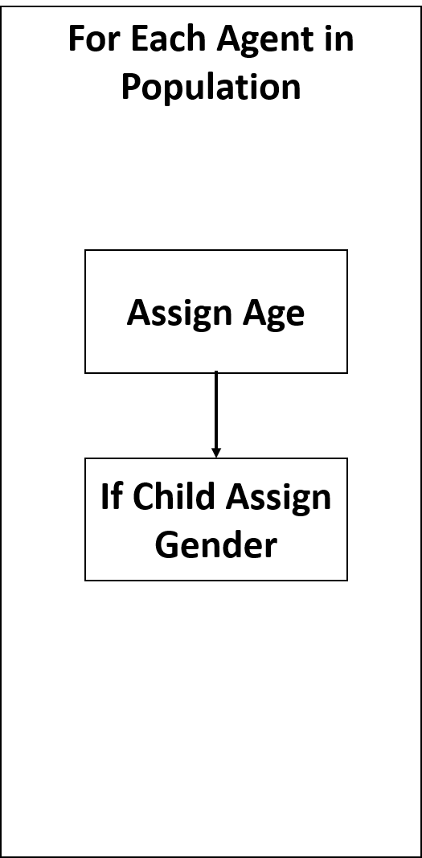
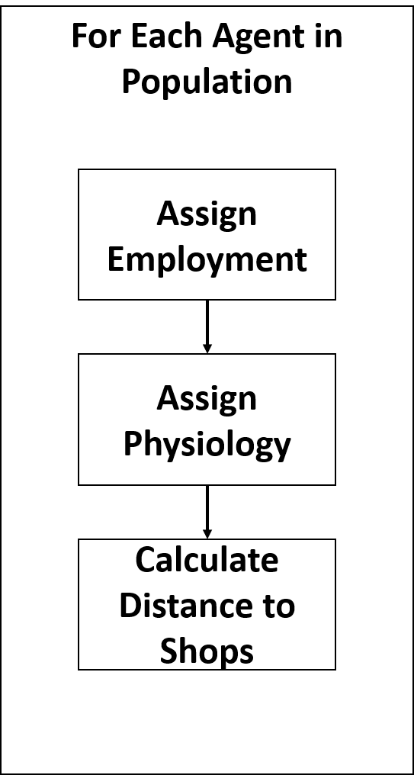
Phase I
Phase II
Phase III
Phase IV
Read data file
Population

