Slide 1
Model Predictive Control of a sewer system
Jacob Naundrup Pedersen, Thomas Holm Pilgaard

Slide 2
Agenda
Introduktion
Problemet
Flow
Koncentrat
Area of interest
Løsning

Slide 3
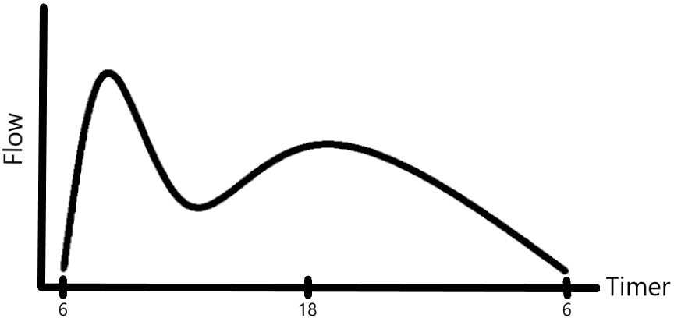
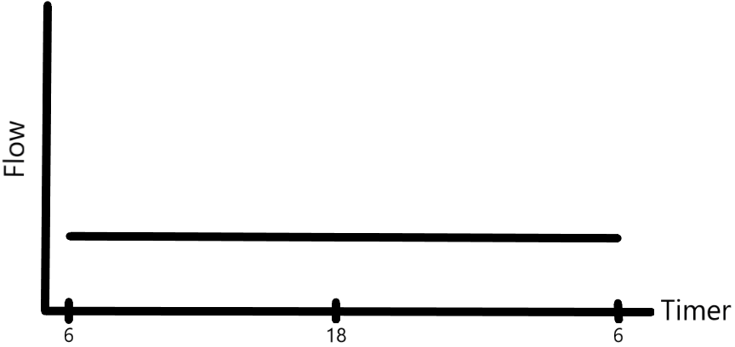
Problemstillinger
Flow / Koncentrat
Beboelse
Konsistent
Industri
Periodisk / Ukendt

Slide 4
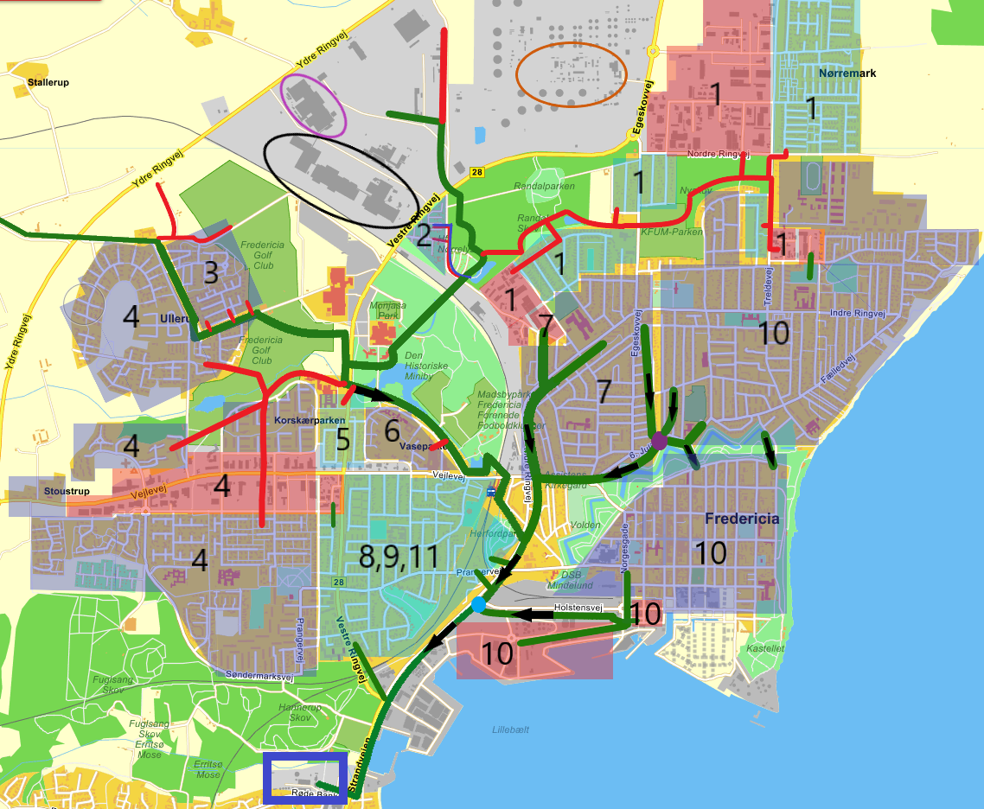
Area of interest

Slide 5
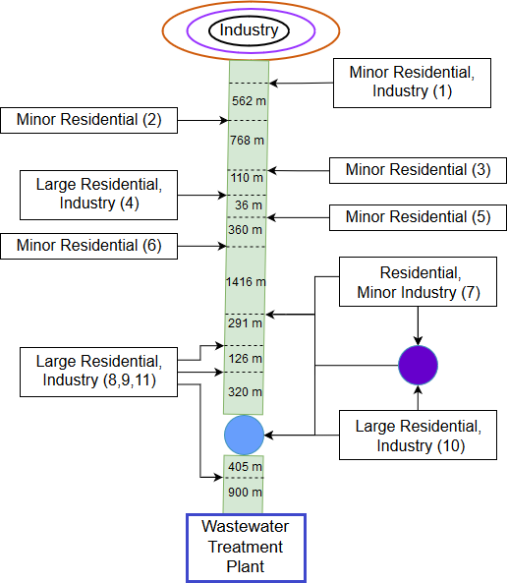

Slide 6
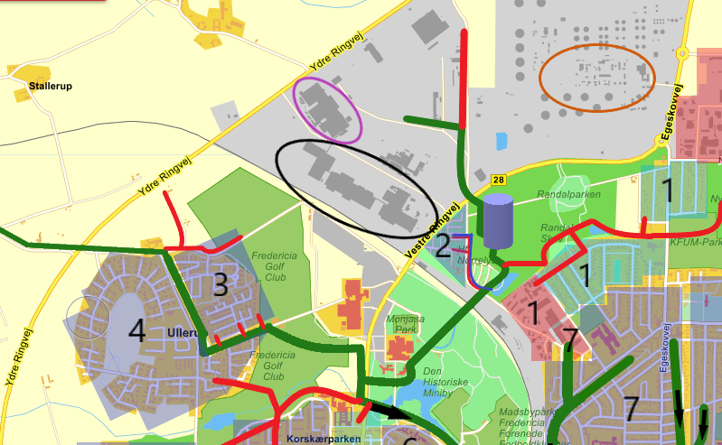
Løsnings forslag

