Slide 1
Tomas Pilvelis
Application for Developer Team Lead

Slide 2
My Story
Consistency, Determination
Notes:
My story at Glasswall is of consistency and determination.
First time applying, I didn’t get the job, second time I was successful.
1st year at Glasswall was a learning experience, developing cameras.
2nd year, progressing, bug fixing, feature implementing. Dirty Word Search, Security Tagging
Current 3rd Year. Test Framework Squad, Starting MVP’s of Camera Workbench, Rebuild GitHub Action, SRE Secondment.

Slide 3
Work Experience
Summer Camp Counsellor
Trainee QA & Support Analyst
Junior Developer
Execution Product
Junior SRE

Slide 4
Accomplishments
CityHack
Accenture Tech Visionaries
Presenting at OSS 2020
7 Medium Publications, 5 Open Source Projects, 2 MVP’s

Slide 5
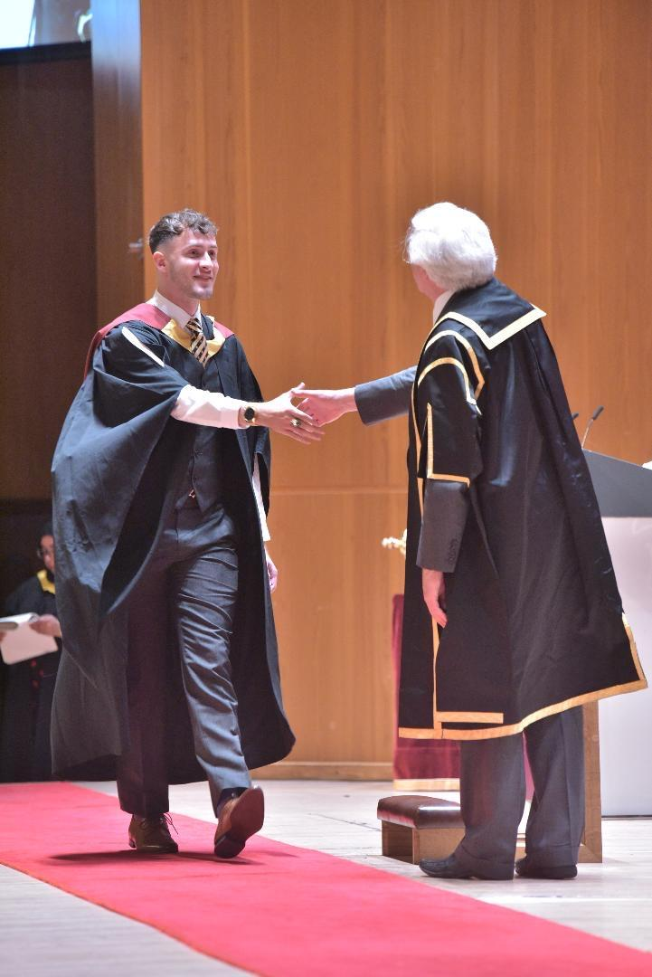
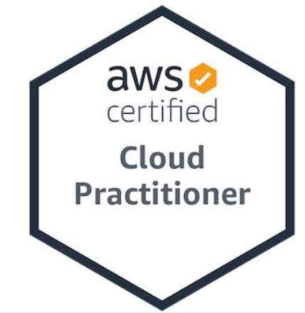
Education
City University of London
Computer Science BSc (Hons)
+
4 Years Work Experience
AWS Cloud Practitioner Certification
Taught by the best team leads and members at Glasswall:
- Core
- SRE
Google… A lot of google…

Slide 6
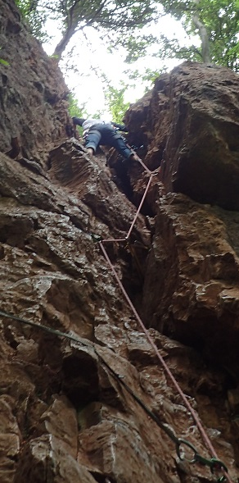
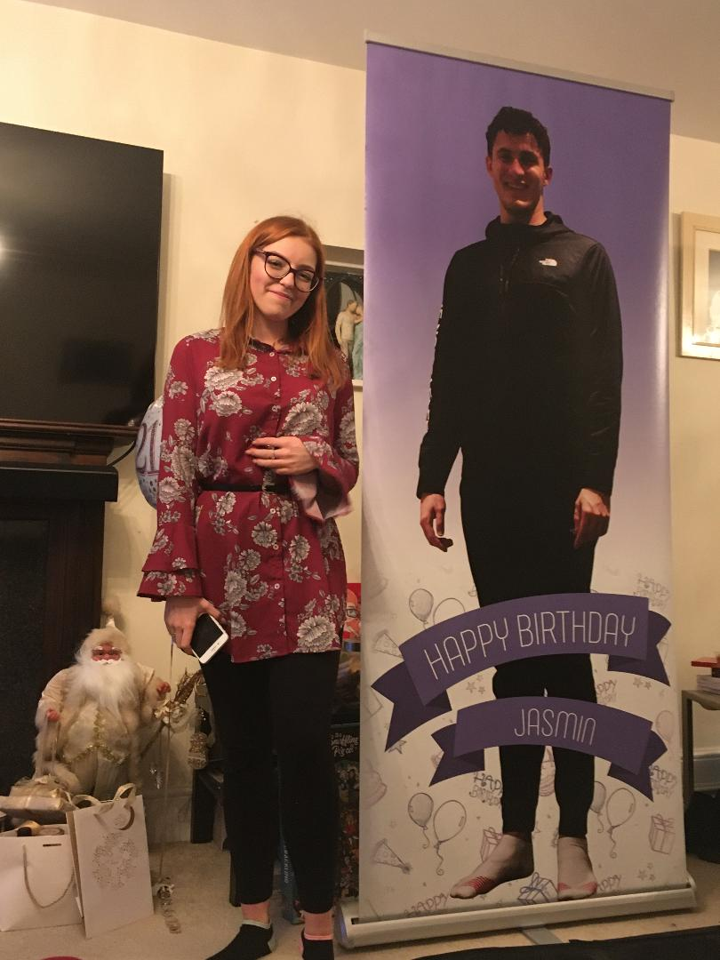
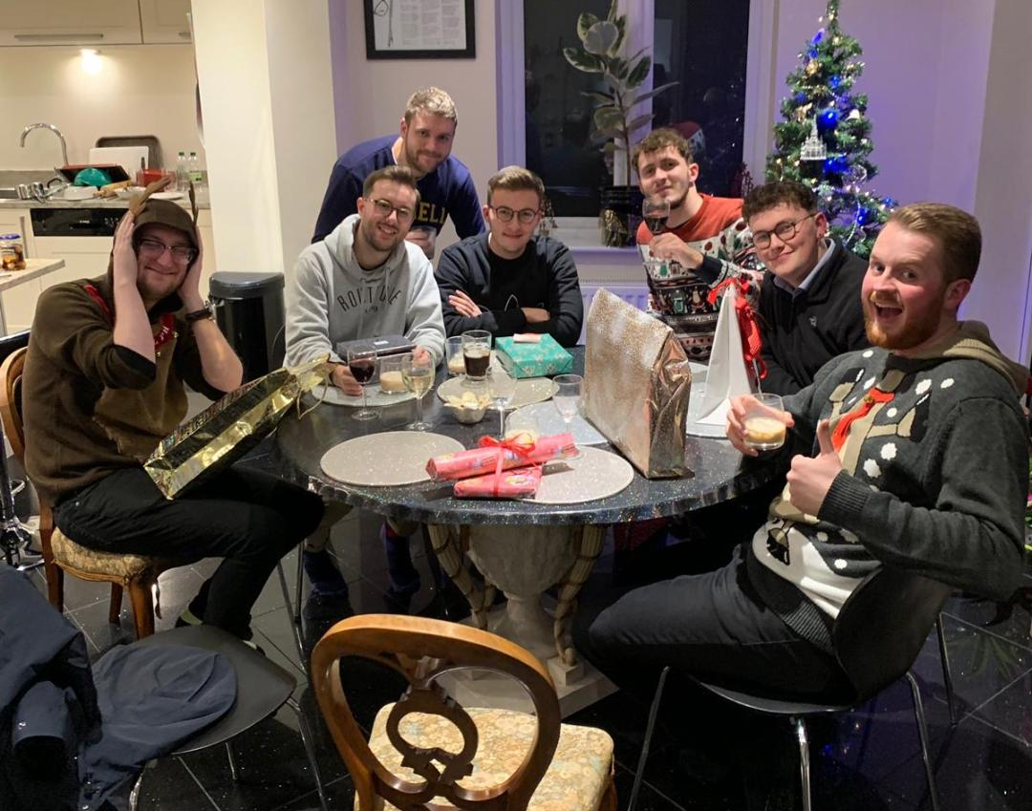
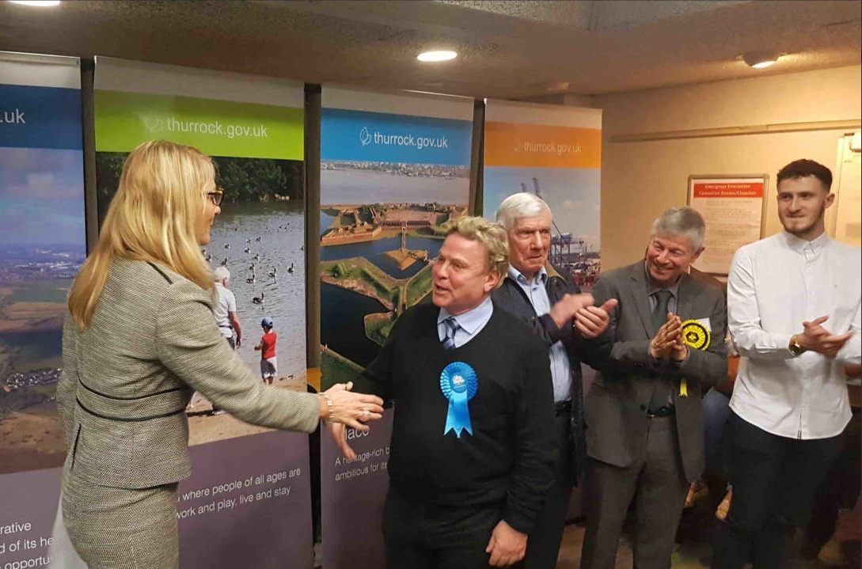
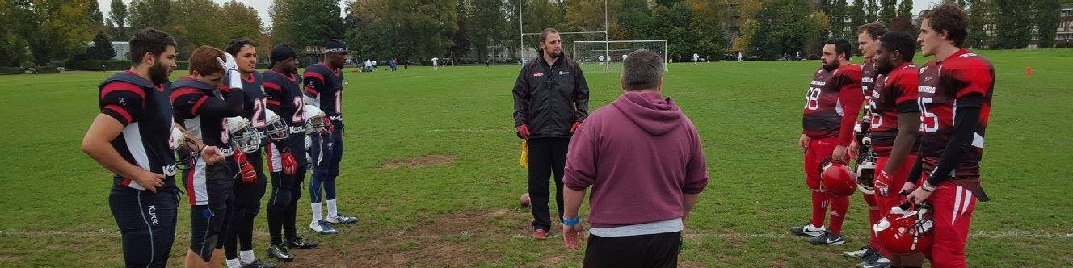
What I Enjoy
Notes:
Politics – I was chosen to represent the Liberal Democrats in Aveley and Uplands against tough competitors and elected signer/songwriter David Van Day. A loss but a 3.1% gain to the liberal democrats!
Sports – I love Climbing, American Football.
Travelling, was about to depart before COVID
The Lads – Eurovision Nights, Cheese and Wine Night, Kentucky Fridays
Love winding up my girlfriend. A life size poster of myself especially for her.

Slide 7
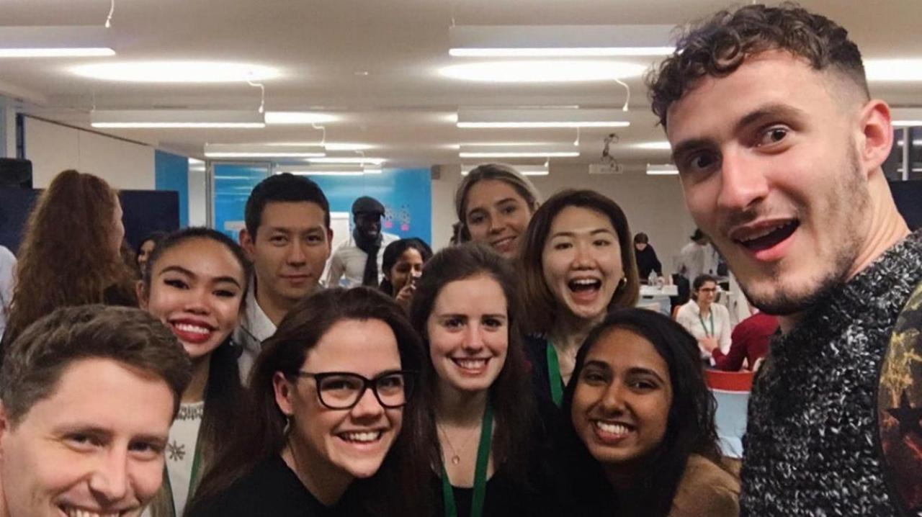
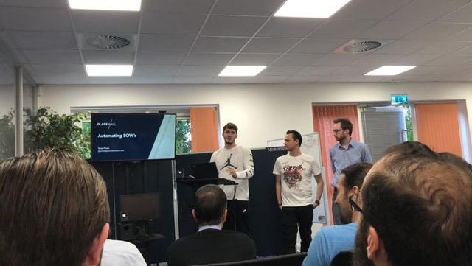
My Experience with Leadership
Accenture – Tech Visionary
Leading a team of 8 to design, develop and present to a panel our cloud solution.
Everyone in the team offered a position.
Glasswall – Test Framework
Leading a team to develop a core test framework, meet the needs of a client and potential to productise.
Vast amount of knowledge gained around the cloud.
University – American Football
Leading a team to develop a core test framework, meet the needs of a client and potential to productise.
Vast amount of knowledge gained around the cloud.

Slide 8
Why Team Lead?
Help even where I cannot
Notes:
I like to help. I’ve had to ask for help so often and working in Core that has been the case and recently in SRE. I have helped in situations I didn’t have the answer to when I started but through working together we both learn and answer questions. But I won’t pretend to know the answer.
I don’t believe I have natural leadership qualities, but where I lack I believe I can gain through hard work.

