Slide 1
Wardley Map
By Tomas Pilvelis

Slide 2
What to Wardley Map?
Glasswall Marketing?
Automating Toil?
…

Slide 3
What's the most complex system? What produces Value?
Me

Slide 4
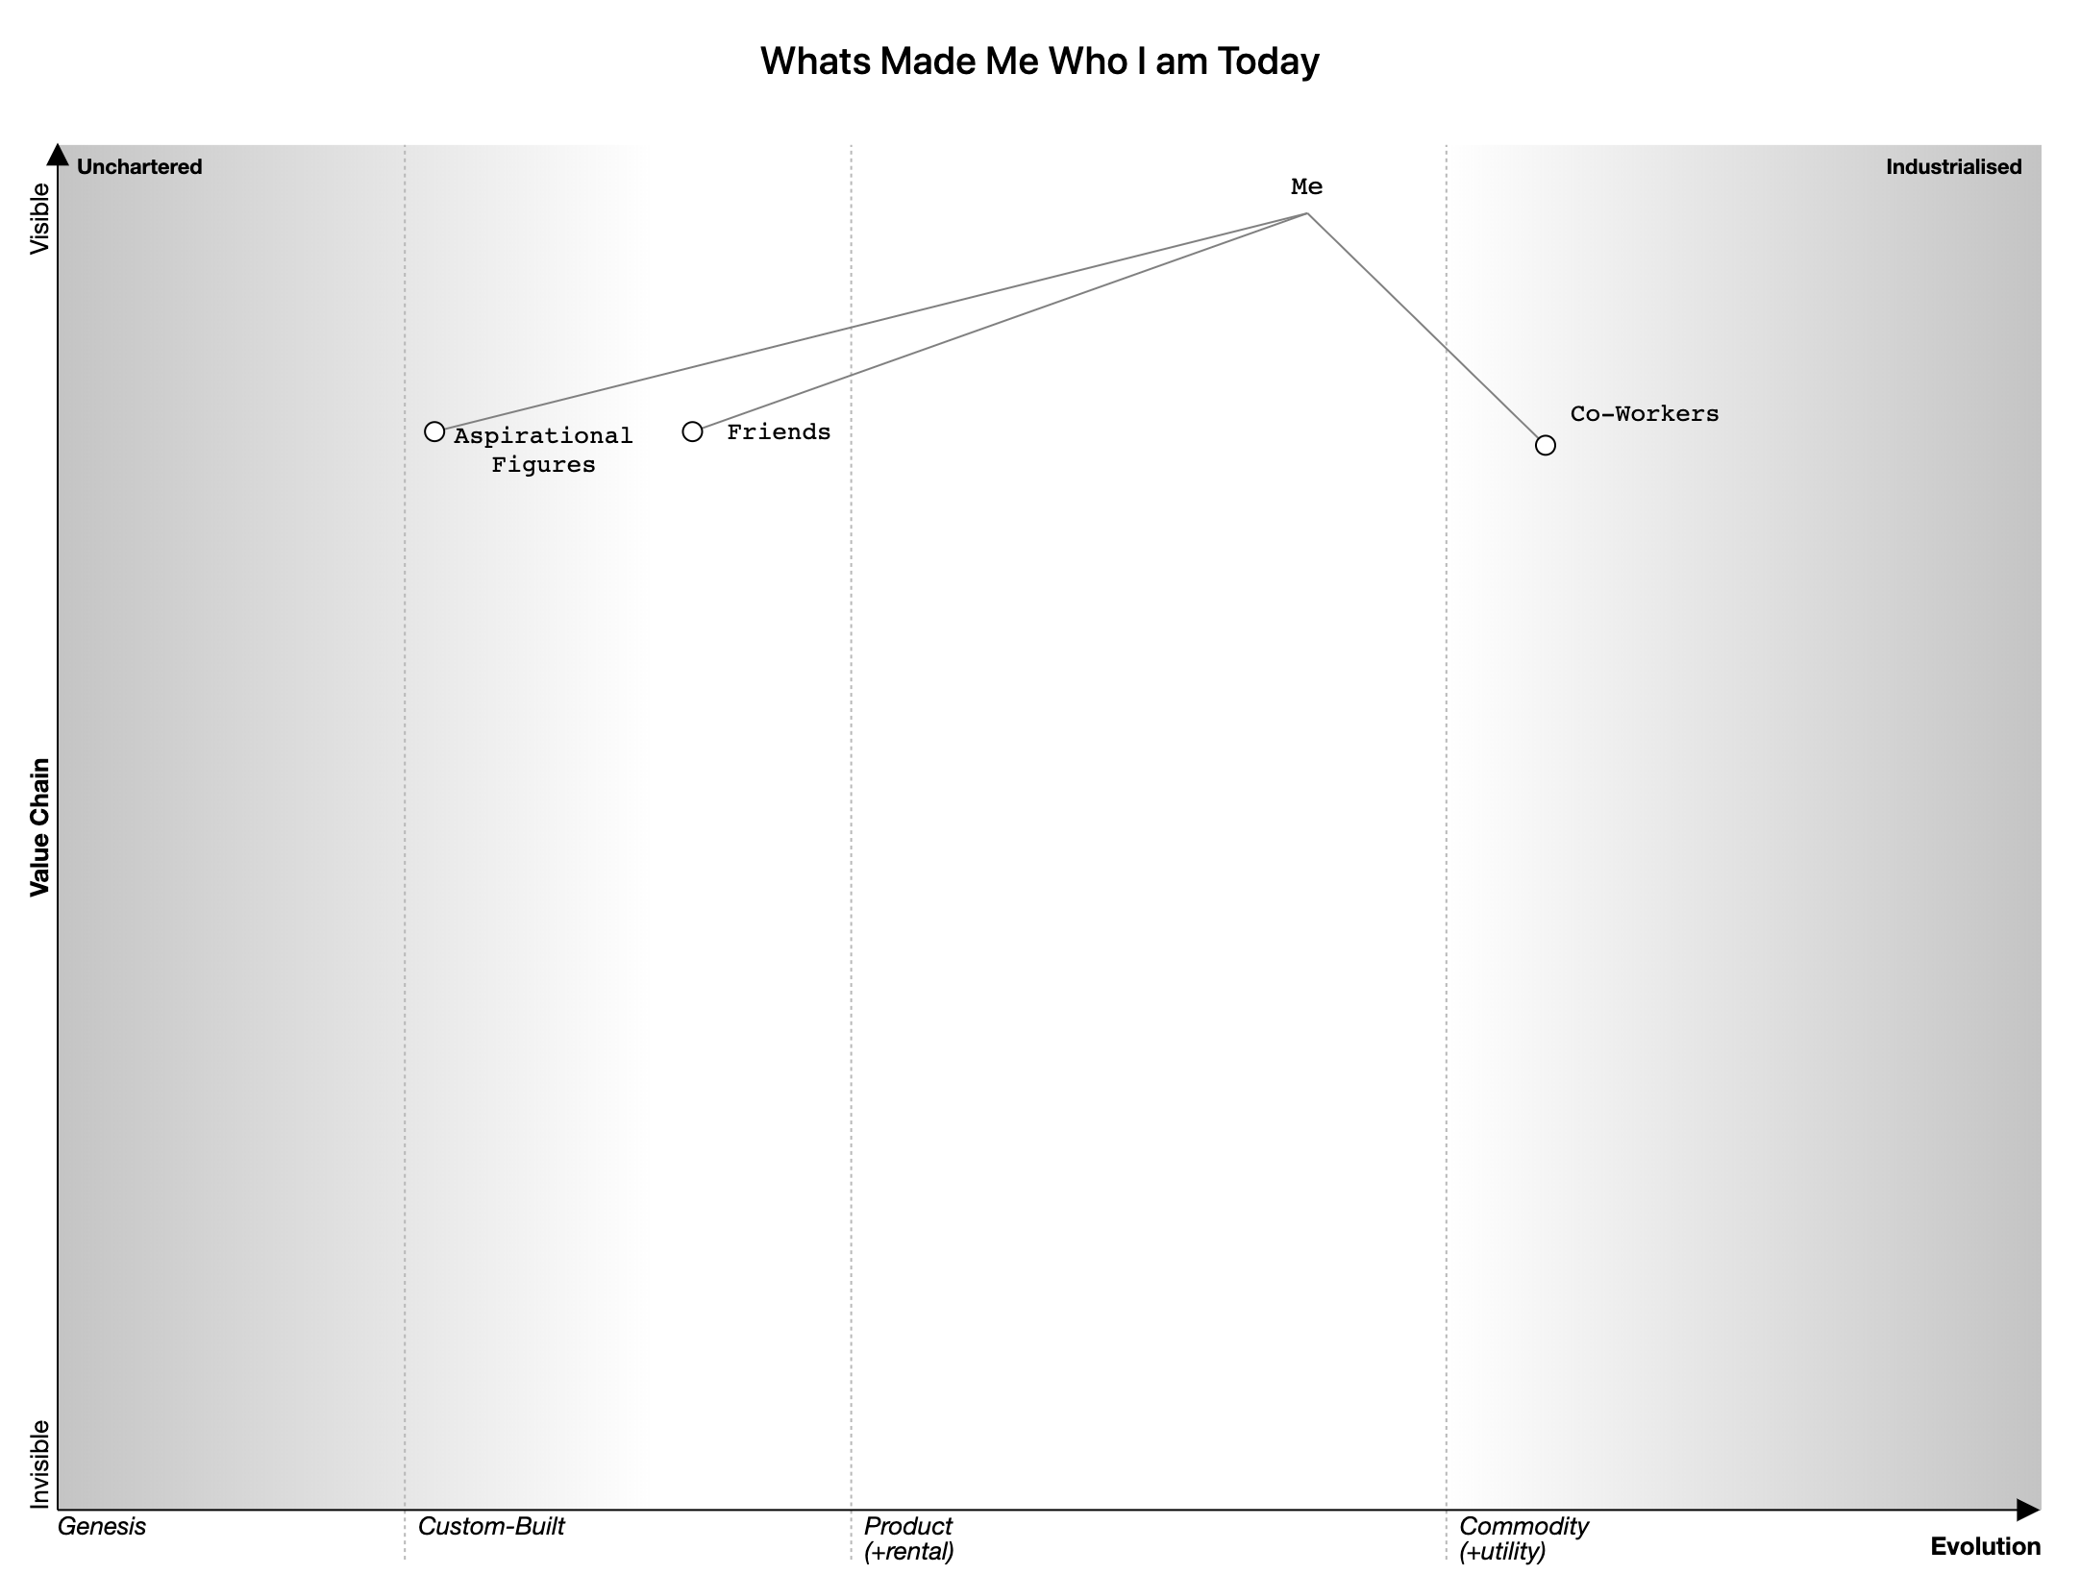
Notes:
I’m a very personal, people driven person. For that reason I would then say I depend on Friends, People I look up to and aspire and considering work takes up a significant portion of our days and also has a subset of aspiration figures, I have co-workers.
Friends In Custom Built because to me they’re one of a kind, I’ll never meet anyone quite like the friends I have, and like with a custom built system. It works and I've invested a great amount of time and wouldn’t want to change.
Aspirational Figures because again I view them as one of a kind, knowledgeable in similar interests. Arguably they could be in custom built or genesis due to the time and effort devoted in their fields and rarer to find.
Co-Workers, people I learn from to learn and understand the industry. This can be current and future, everyone of these people have a lesson to teach and they are not rare, arguably anyone with software engineering skills, not even necessarily in software development, sales, management, etc.

Slide 5
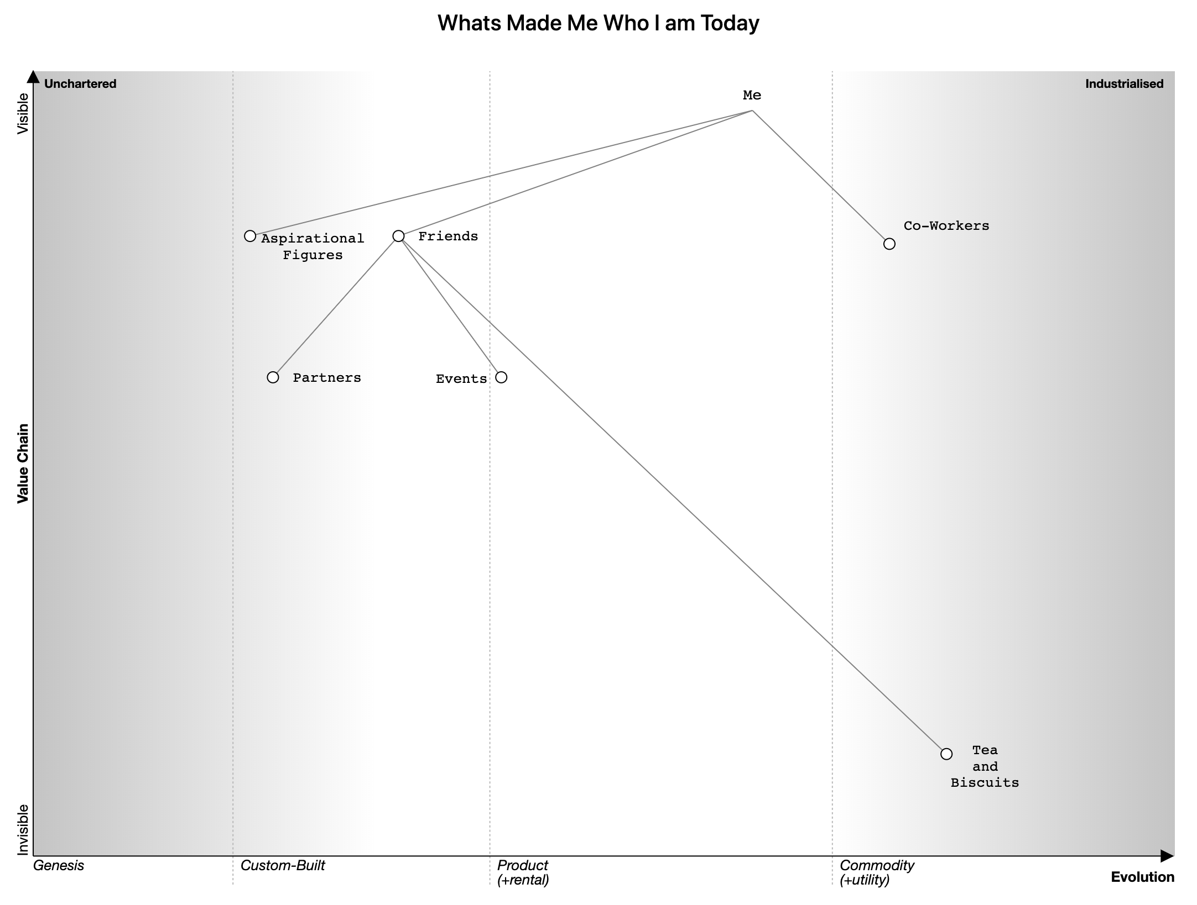
Notes:
I’d describe as 3 things being important to my friends.

