Slide 1
Face3D
Thomas Pinetz¹ and Harald Scheidl²
¹ Institute of Computer Graphics and Algorithms
Vienna University of Technology
² <insert 2nd affiliation
(institute) here>
<insert 2nd affiliation
(university) here>

Slide 2
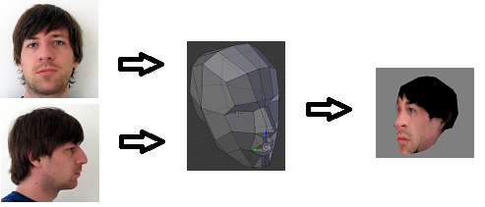
Goal
Face3d
<Foliennummer>

Slide 3
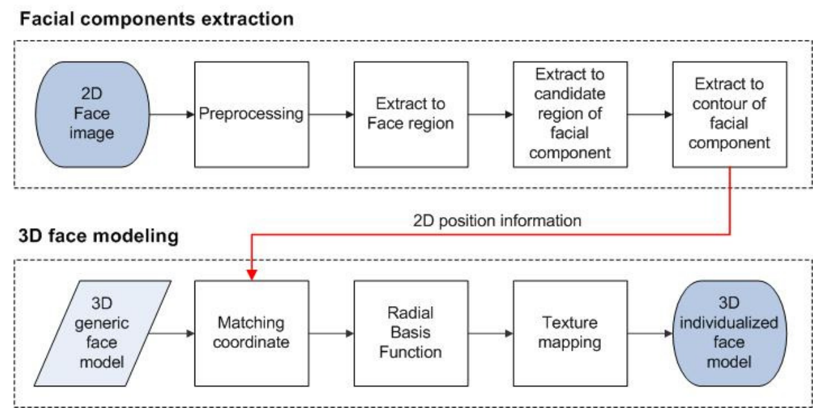
Pipeline
Face3d
<Foliennummer>

Slide 4
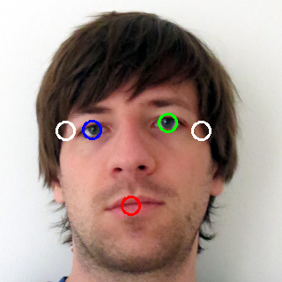
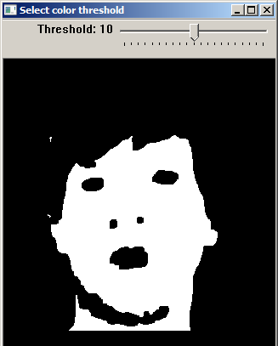
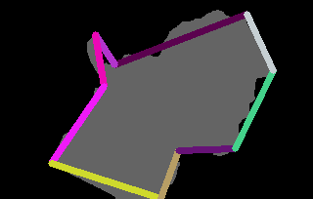
Detection (1)
Detect skin: threshold in YCrCb color space
Find facial components (mouth, eyes, ...)
Face3d
<Foliennummer>

Slide 5
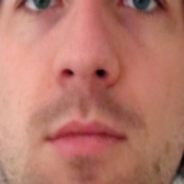
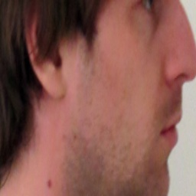
Detection (2)
calculate 3d positions (eyes, mouth, ...)
create textures
align front and side texture
output data for modelling program
Face3d
<Foliennummer>

Slide 6
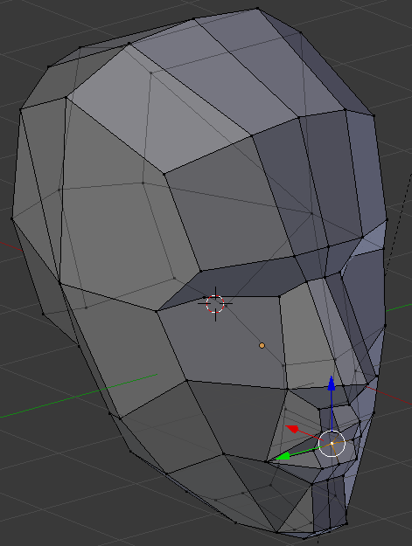
Generic model
Open source face model, edited with Blender
Kind of vertex labelling (e.g. nose) needed
Face3d
<Foliennummer>

Slide 7
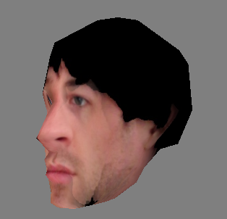
Modelling
adjust model:
according to proportions
move facial components:
nose, mouth, ...
Texturing
cylinder mapping
linear blending
perfect adjustment possible
position of components in textures is known
Face3d
<Foliennummer>

Slide 8
Demonstration of Face3d...
¹ Institute of Computer Graphics and Algorithms
Vienna University of Technology
² <insert 2nd affiliation
(institute) here>
<insert 2nd affiliation
(university) here>

