Slide 1
Face3D
Thomas Pinetz¹ and Harald Scheidl²
¹ Institute of Computer Graphics and Algorithms
Vienna University of Technology
² <insert 2nd affiliation (institute) here>
<insert 2nd affiliation (university) here>

Slide 2
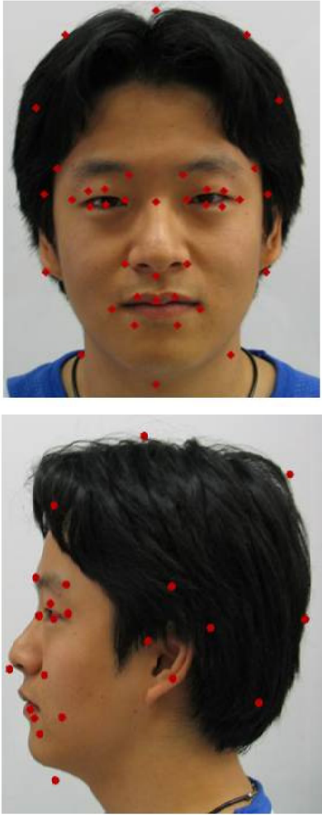
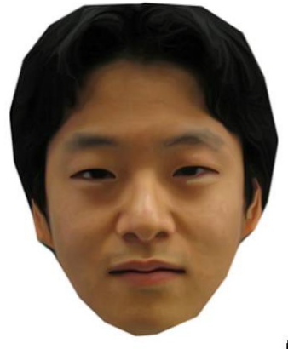
Motivation
Face3D
<Foliennummer>

Slide 3
Introduction
Used for plastic surgery or virtual Conference
3D Scanner
Expensive Equipment
No animation data.
Reconstruction from Stereo Images or videos
Non trivial.
No completely automatic way exists yet.
Face3D
<Foliennummer>

Slide 4
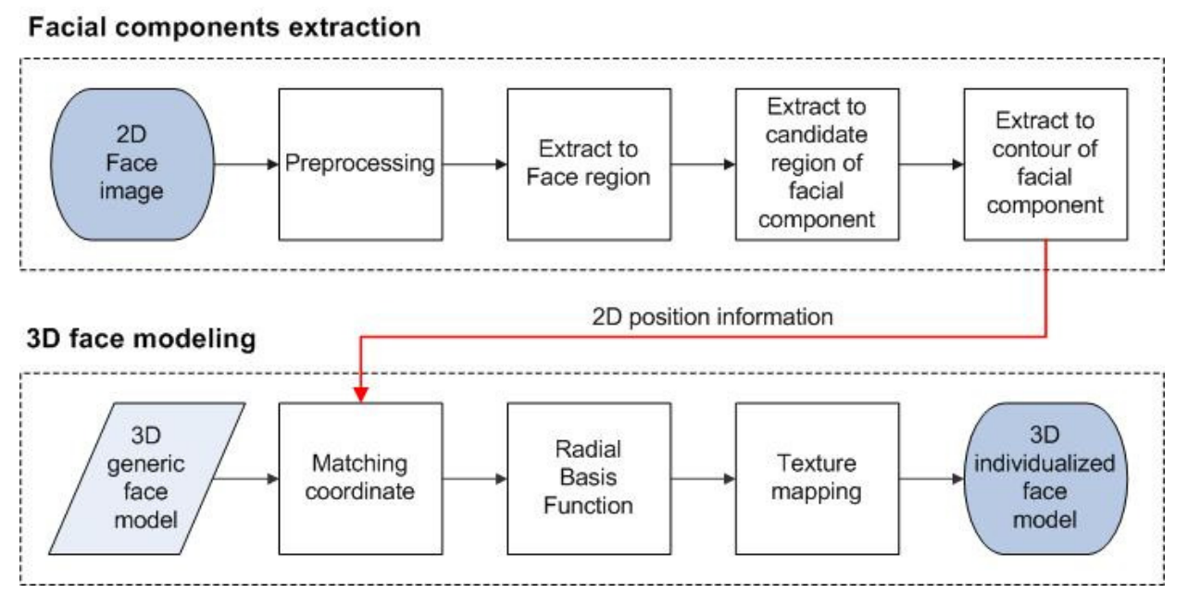
Pipeline
Face3D
<Foliennummer>

Slide 5
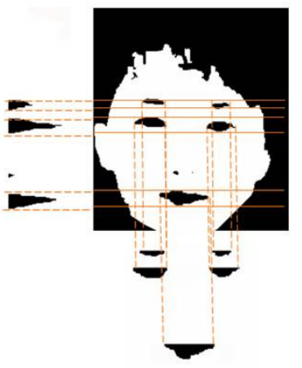
Facial components extraction
Detection of skin according to colour
Detection of countours and feature point detection
Minimization of Error
<insert your name here>
<Foliennummer>

Slide 6
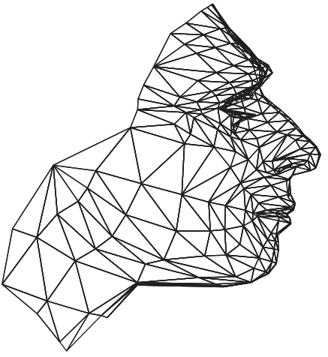
3D face modelling
Creation of generic Face Model
Creation of Labels for Control Vertices
Move Control Vertices to correct Position
Texture Mapping of the Face Model.
<insert your name here>
<Foliennummer>

Slide 7
Implementation
Language: C++
OpenCV for image processing
OpenGL for rendering of the 3D face model
MFC in case we need UI functionality
Blender for generic 3D Model
Face3D
<Foliennummer>

Slide 8
Thank you for your Attention
¹ Institute of Computer Graphics and Algorithms
Vienna University of Technology
² <insert 2nd affiliation (institute) here>
<insert 2nd affiliation (university) here>

