Slide 1
Generate Particles
MCL Complete
Yes
Are all pose locations same?
No
Apply Move
Take Reading
Calculate Weight
Resample

Slide 2
Generate Particles
Create a matrix of particle locations m x n with m = length of environment and n = width of environment.
Within the matrix check if cell at location x, y is a wall (obstruction).
If the location is not a wall place for particles in the location; each with one of the four cardinal directions.
Get cardinal direction distances for each poses that is created.
Code Logic:
For length of pose set from 0 to length of environment
For length of pose set from 0 to length of environment
If location is not an obstruction
create pose (x, y, 0°, North, South, East, West)
create pose (x, y, 90°, North, South, East, West)
create pose (x, y, 180°, North, South, East, West)
create pose (x, y, 270°, North, South, East, West)

Slide 3
Generate Particles
For loop for the length of the environment
obstruction
For loop for the width of environment
North
Heading
West
East
South

Slide 4
Same Particle
Create a for loop that checks the zero particle against all other particles in the pose set.
If the particle is the same as another particle in the set increase a counter variable by one.
If the counter variable is above the convergence criteria set for the MCL to finalize then MCL has finished.
Code Logic:
For length of pose set
If Particle(0) == Particle(i)
Increase counter
If counter is greater than convergence percentage x total pose set size
MCL have finished successfully

Slide 5
Apply Move
Select a move from one of the for possible moves (forward, backward, left, right).
Send the move to the robots computer for robot to complete move.
Apply the known move distances or rotations of the move to each particle in the pose set.
Update each pose’s values for location, heading, and distances to nearest obstruction.
Code Logic:
Select move (1-4 w/ 1: Forward, 2: Backward, 3: Left, 4: Right)
Send move to robot
For length of pose set
Update x as a function of move and current heading
Update y as a function of move and current heading
Update heading as a function of move
Update North as a function of move and current heading
Update South as a function of move and current heading
Update East as a function of move and current heading
Update West as a function of move and current heading

Slide 6
Take Reading
Send command to the robot which tells it to take a sonar reading.
Set a while loop such that the loop will only break so that the code can continue if the sonar reading reads a correct distance (<255).
This should not impede the program as there is no location in the environment where the reading will be >255 if reading is taken correctly.
Send reading from robot back to PC to be used in weight calculation.
Code Logic:
Send reading command to robot
While the reading >255
Continue to take a reading until reading is <255
Send reading back to PC for use in weight calculation

Slide 7
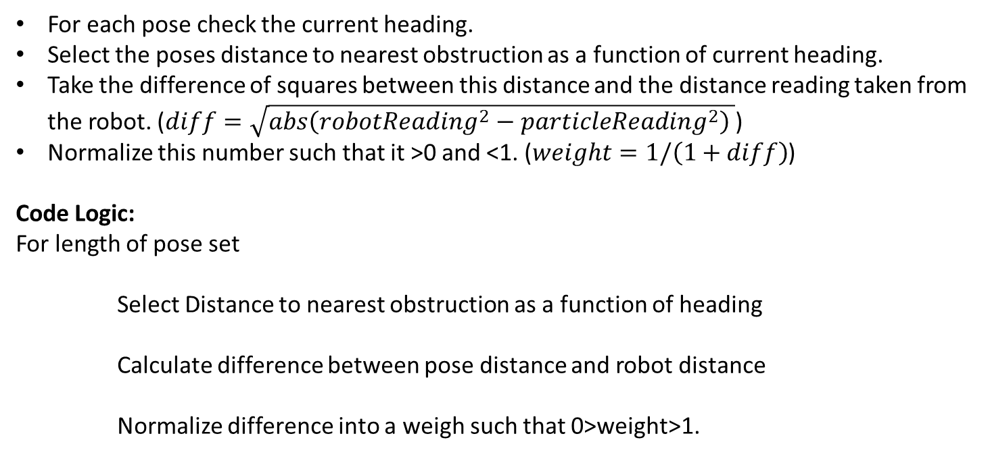
Calculate Weight
For each pose check the current heading.
Select the poses distance to nearest obstruction as a function of current heading.
Take the difference of squares between this distance and the distance reading taken from the robot. ($diff=\sqrt{abs\left(robotReading^{2}−particleReading^{2}\right) }$)
Normalize this number such that it >0 and <1. ($weight=1/\left(1+diff\right)$)
Code Logic:
For length of pose set
Select Distance to nearest obstruction as a function of heading
Calculate difference between pose distance and robot distance
Normalize difference into a weigh such that 0>weight>1.

Slide 8
Resample
Select a random number between 0.5 and 1.
Note that 0.5 was chosen to speed up convergence and thus could be lowered based on loss of accuracy due to physical movements.
Create copy of pose set
Clear original pose set to be repopulated.
Create a while loop that will break only when the repopulated pose set is of the same size as the original pose set.
For each particle check if the weight of the particle is greater than the random number and also if the distances to the nearest obstructions are greater than or equal to zero.
If true create a copy of this particle in the original pose set and increase the counter specifying that this pose set is now one particle closer to being fully populated.
Otherwise move on to next particle essentially eliminating this particle from contention in the next round of resampling.

Slide 9
Resample
Code Logic:
Select a random number 0.5>random number>1
Create old pose set = current pose set
Clear current pose set
While number of particles in current pose set < number of particles in old pose set
For length of old pose set
If particle weight > random number and distances to obstruction >= 0
Create copy of particle in current pose set
Increase counter of current pose set by 1

