Slide 1
Monte Carlo Localization
Andrew Larger
Zihao Lu
Trevor Plassman
Matt Schmucki
Alicia Zwiebel

Slide 2
Agenda
Problem Statement
Approach
Course
A* Navigation/MCL
Issues/Future Work
Demonstration/Questions

Slide 3
Problem Statement
Most robots rely on GPS
GPS is only so accurate
Have robots localize themselves
Navigate based on self localization

Slide 4
Approach
Use a Lego Mindstorm
Use A* Navigation
Use MCL
Combine all three together

Slide 5
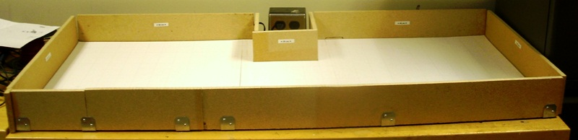
Course
140 cm x 63 cm
Movable walls

Slide 6
A* Navigation
First documented in 1968
Expanded on a 1959 formula by introducing heuristics

Slide 7
‘Cost’
Each node has a ‘cost’
G – Exact Cost
  Exact distance from the starting point
H – Heuristic Cost
  Estimated distance from end point
F – Total Cost
  F=G+H

Slide 8
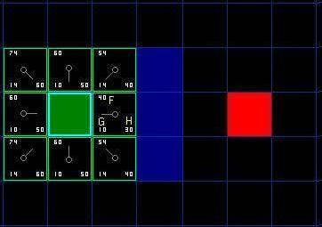
‘Cost’ Example Cont.

Slide 9
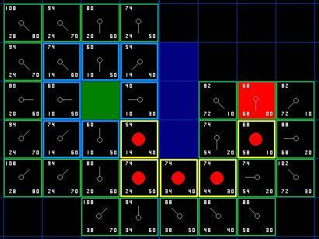
‘Cost’ Example Cont.

Slide 10
Implementing
Add the starting node to open list
Find lowest F in open list (called current)
  Move it to the closed list
Investigate current’s 8 neighbors
  If a wall or on closed list; ignore
  If not on open list, add to open; calculate F
  If on open list, compare G; if lower, change parent

Slide 11
Implementing Cont.
Repeat
When current node is the same as end node; stop
Trace path of parents
A* Demonstration
Notes:
http://www.vision.ee.ethz.ch/~cvcourse/astar/AStar.html

Slide 12
MCL
Particle filter applied to robotic localization
Random initial guesses are populated
Guesses selected based on probability of being correct location

Slide 13
Generate Particles
MCL Complete
Yes
Are all pose locations same?
No
Apply Move
Take Reading
Calculate Weight
Resample

Slide 14
Generate Particles
Create a matrix of particles
Check if location is a wall (obstruction).
If not place 4 particles
  cardinal directions.
Get cardinal distances.

Slide 15
Generate Particles
Code Logic:
For length of environment
For width of environment
If location is not an obstruction
create pose (x, y, 0°, North, South, East, West)
create pose (x, y, 90°, North, South, East, West)
create pose (x, y, 180°, North, South, East, West)
create pose (x, y, 270°, North, South, East, West)

Slide 16
Generate Particles
For loop for the length of the environment
obstruction
For loop
for the
width of environment
For loop for the width of environment
North
Heading
West
East
South

Slide 17
Generate Particles
MCL Complete
Yes
Are all pose locations same?
No
Apply Move
Take Reading
Calculate Weight
Resample

Slide 18
Same Particles
Check zero particle against all other particles.
If particles are the same increase a counter variable.
If the counter variable is above the convergence criteria MCL has finished.

Slide 19
Same Particles
Code Logic:
For length of pose set
If Particle(0) == Particle(i)
Increase counter
If counter is greater than convergence percentage x total pose set size
MCL have finished successfully

Slide 20
Generate Particles
MCL Complete
Yes
Are all pose locations same?
No
Apply Move
Take Reading
Calculate Weight
Resample

Slide 21
Apply Move
Select a move (forward, backward, left, right).
Send the move to the robot.
Apply move to each particle in the pose set.
Update each pose (location, heading, and distances to nearest obstruction).

Slide 22
Apply Move
Code Logic:
Select move (1-4 w/ 1: Forward, 2: Backward, 3: Left, 4: Right)
Send move to robot
For length of pose set
Update x as a function of move and current heading
Update y as a function of move and current heading
Update heading as a function of move
Update North as a function of move and current heading
Update South as a function of move and current heading
Update East as a function of move and current heading
Update West as a function of move and current heading

Slide 23
Generate Particles
MCL Complete
Yes
Are all pose locations same?
No
Apply Move
Take Reading
Calculate Weight
Resample

Slide 24
Take Reading
Command robot to take sonar reading.
Set a while loop to ensure distance <255.
Send reading back to PC to be used in weight calculation.

Slide 25
Take Reading
Code Logic:
Send reading command to robot
While the reading >255
Continue to take a reading until reading is <255
Send reading back to PC for use in weight calculation

Slide 26
Generate Particles
MCL Complete
Yes
Are all pose locations same?
No
Apply Move
Take Reading
Calculate Weight
Resample

Slide 27
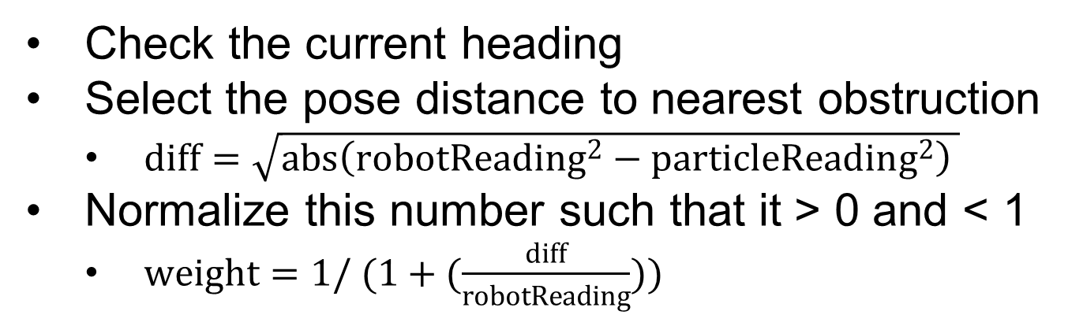
Calculate Weight

Slide 28
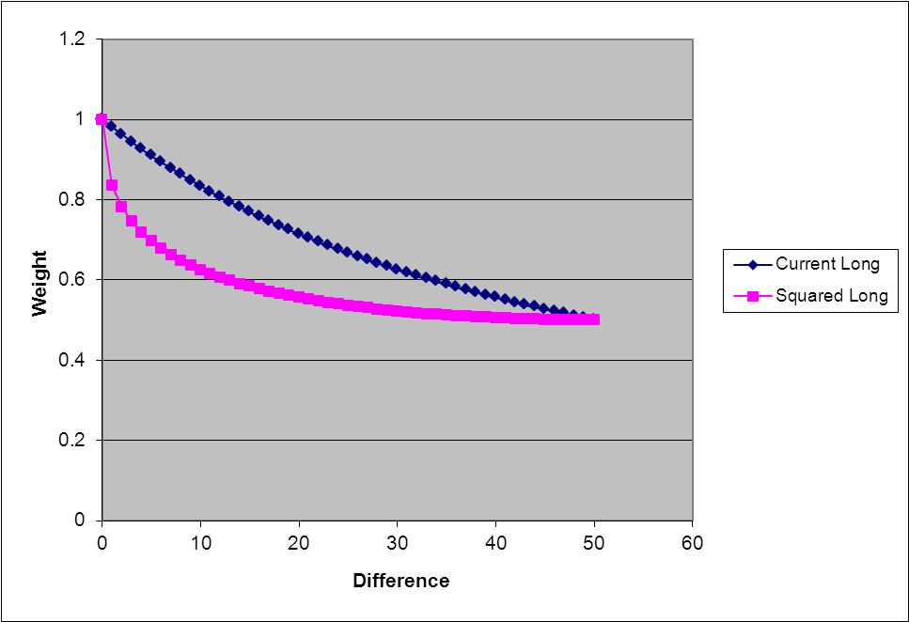
Calculate Weight

Slide 29
Calculate Weight
Code Logic:
For length of pose set
Select Distance to nearest obstruction as a function of heading
Calculate difference between pose distance and robot distance
Normalize difference into a weigh such that 0>weight>1.

Slide 30
Generate Particles
MCL Complete
Yes
Are all pose locations same?
No
Apply Move
Take Reading
Calculate Weight
Resample

Slide 31
Resample
Select a random number between 0.5 and 1.
Copy pose set
Clear pose set.
Check weight of particles in copy set against random number.
If weight > random number
  Copy particle
If weight < random number
  Move on (eliminate particle)

Slide 32
Resample
Code Logic:
Select a random number 0.5>random number>1
Create old pose set = current pose set
Clear current pose set
While number of particles in current pose set < number of particles in old pose set
For length of old pose set
If particle weight > random number and distances to obstruction >= 0
Create copy of particle in current pose set
Increase counter of current pose set by 1

Slide 33
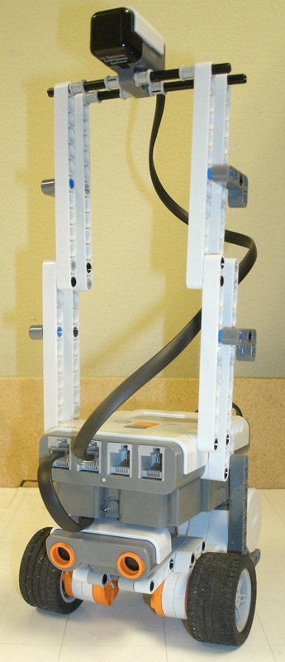
Issues
Inaccurate compass
MCL not converging
Pixel-Centimeter errors

Slide 34
Future Work
More accurate sonar
Check location
Symmetry solver
Smarter measurement algorithm

Slide 35
Demonstration
Questions?

