Slide 1
RAC-OST-POL Study
population based Polish epidemiological study on postmenopausal osteoporosis
prof. dr hab. n. med. Wojciech Pluskiewicz
Medical University of Silesia,
Metabolic Bone Diseases Unit in Zabrze
Katowice, Poland
Kraków - April 2018

Slide 2
RAC-OST-POL Study
The study was planned in 2009 in order to collect data for postmenopausal osteoporosis.
(RAC)-IBÓRZ – a name of district capital city
(OST)-EOPOROSIS
(POL)-AND

Slide 3
RAC-OST-POL Study
Design – population based epidemiological study
Population – postmenopausal women aged>55 yrs.; 10% of 17,500 all subjects living in whole disctrict were invited
Data for 978 women were collected
Study was realized in May 2010.

Slide 4
RAC-OST-POL Study
At baseline almost 200 of potential risk factors for osteoporosis and fractures were collected
Afterwards, annually data on fractures, falls and management used were collected by phone calls.

Slide 5
RAC-OST-POL Study - aims
Epidemiological data
Diet
Falls
Vision impairment
Functional status
Risk factors for osteoporosis and fracture
Development of algorithm for fracture risk.

Slide 6
RAC-OST-POL Study - publications
1. Epidemiological data on osteoporosis in women from the RAC-OST-POL study.
W. Pluskiewicz et al.. J.Clin.Densitom.2012; 15 (3): 308-314.
2. Adiponectin and resistin in relationship with skeletal status in women from the RAC-OST-POL study. W. Pluskiewicz et al. Pol.J.Endocrinol.2012; 63 (6): 427-431.
3. Calcium intake and osteoporosis: the influence of calcium intake from dairy products on hip bone mineral density and fracture incidence - a population-based study in women over 55 years of age.
D. Włodarek et al. Public Health Nutr .2014; 17 (2): 383-389.
4. Influence of education, marital status, occupation, and the place of living on skeletal status, fracture prevalence, and the course and effectiveness of osteoporotic therapy in women in the RAC-OST-POL Study.
W. Pluskiewicz et al. J.Bone Miner.Metab 2014; 32 (1): 89-95.
5. Functional status and prevalence of falls and fractures in population-based sample of postmenopausal women from the RAC-OST-POL Study. B. Drozdzowska et al. Int.J.Clin.Pract.2013; 67 (7): 673-681.
6. Common ophthalmic problems of urban and rural postmenopausal women in a population sample of Raciborz district, a RAC-OST-POL Study. W. Rokicki et al. Ann.Agric.Environ.Med.2014; 21 (1): 70-74.

Slide 7
RAC-OST-POL Study - publications
7. High fracture probability predicts fractures in a 4-year follow-up in women from the RAC-OST-POL study.
W. Pluskiewicz et al. Osteoporos.Int.2015; 26 (12): 2811-2820.
8. Relationship between visual status and functional status and the risk of falls in women. The RAC-OST-POL study.W. Rokicki et al. Arch.Med.Sci.2016; 12 (6): 1232-1238.
9. Falls in RAC-OST-POL Study: epidemiological study in postmenopausal women aged over 55 years. W. Pluskiewicz et al. Endokrynol.Pol.2016; 67 (2): 185-189.
10. Assessment of mineral intake in the diets of Polish postmenopausal women in relation to their BMI-the RAC-OST-POL study: Mineral intake in relation to BMI. Dominika Głąbska et al. Publ. Popul.Nutr.2016; 35 (23): 1-12.
11. The study of under- and over-sampling methods' utility in analysis of highly imbalanced data on osteoporosis
M. Bach et al. Inform.Sci.2017; 384: 174-190.
12. Risk factors for fractures identified in the algorithm Developed in 5-Year Follow-Up of Postmenopausal Women From RAC-OST-POL Study.P. Adamczyk et al. J.Clin.Densitom.2017, p.1-7.
13. Diagnostic accuracy of FRAX in predicting the 10-year risk of osteoporotic fractures using the USA treatment thresholds: A systematic review and meta-analysis. X. Jiang et al. Bone2017; 9:.20-25.

Slide 8
Results – epidemiological data
28% of subjects studied had prior osteoporotic fracture after the age of 40 years
9.6% of women had Femoral Neck BMD T-score <-2.5
6.7% subjects were treated.

Slide 9
Results - diet
Mean daily calcium intake was 425±270 mg
Mean calcium intake was significantly lower in subjects with osteoporosis (360±226 mg versus 431±263 mg, p<0.01)
Mean calcium intake was significantly lower in subjects with prior fracture (390±256 mg versus 438±273 mg, p<0.05).

Slide 10
Results - falls
Falls were the most common risk factor for fracture (34%) of subjects studied
Falls were also common in 7-years follow-up
In follow-up falls were present mostly in subjects with prior fall.

Slide 11
Results – functional status
Mean duration of Stand and Up test was significantly greater subjects with prior fracture than in non-fractured subjects (12.4±6.8 sec. versus 11.0±3.2 sec., p<0.001)
Mean duration of Stand and Up test was significantly greater subjects with fall than in subjects without fall (12.2±5,2 sec. versus 10.9±4.2 sec, p<0.01).

Slide 12
Results – clinical risk factors for fracture at baseline
Falls – 34%
Prior fracture – 28%
Early menopause – 15%
Smoking – 11%
Hip fracture in parents – 7%
Secondary reasons – 6%
Steroid use – 5%

Slide 13
Polish algorithm for fracture risk – baseline data and follow-up
Baseline data on potential risk factors for osteoporosis and fractures including hip BMD
Annually were collected by phone data on fractures, falls and treatment.
W. Pluskiewicz i wsp. J Clin Densitom 2017

Slide 14
Polish algorithm for fracture risk – fractures in follow-up
In years 2010-2015 were 78 fractures in 92 women
Final analysis was performed in 82% of baseline group (n=802).

Slide 15
Polish algorithm for fracture risk – significant risk factors
Steroid use (at least 5 mg of prednison for 6 weeks)
Prior fracture after the age of 40 years
Falls in last 12 months
Femoral Neck BMD
Height.

Slide 16
Polish algorithm for fracture risk – equation
Risk of fracture incidence =
11+e(9.899+1.077∗STEROIDS+0.681∗PRIOR FALLS+0.611∗PRIOR FRACTURES-0.483∗FN T-score+0.042∗HEIGHT)

Slide 17
Polish algorithm for fracture risk
www.ryzyko-zlaman.pl
concerns all osteoporotic fractures for 5 years in women aged over 55 years.

Slide 18
Polish algorithm for fracture risk
Result may be helpful in daily practice
Always final management decision should be individualised
In 3 years after a 10 years of observation an algorithm for a decade will be available.

Slide 19
Polish algorithm for fracture risk -limitations
Due the low number of hip fx. separate risk for this skeletal site is not available
Spine radiograms were not routinely performed so some spine fx. might be not identified
Duration of observation is limited to 5 years
Only women were included.

Slide 20
Polish algorithm for fracture risk - strenghts
Population studied was randomly selected
At baseline almost 200 of potential risk factors were collected
All phone calls were performed by one, experienced person.

Slide 21
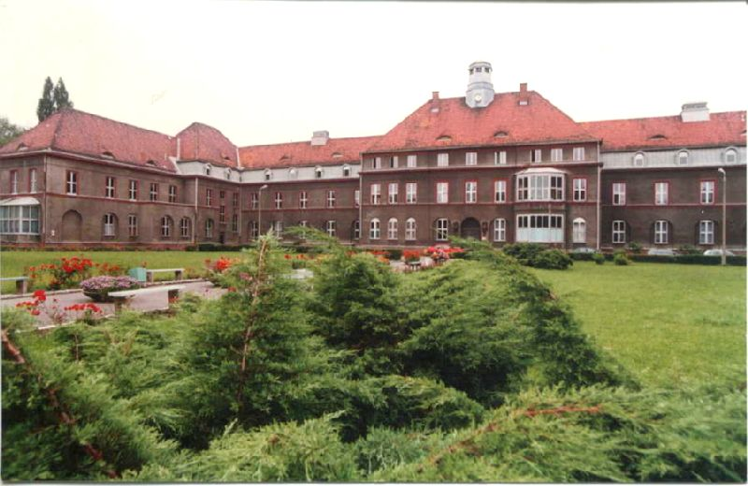
Campus of Medical University of Silesia
Thank you for attention
Notes:
16.03.17

