Slide 1
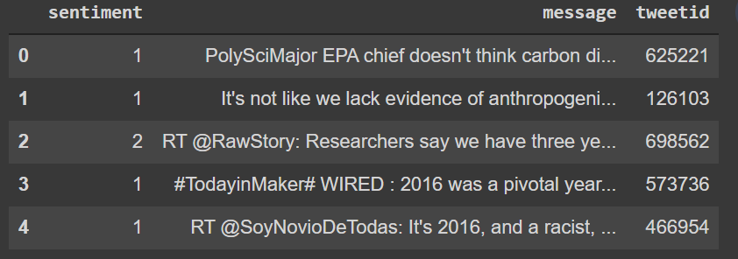


DATA PRESENTATION
Train data
Before
After
1

Slide 2

DATA PRESENTATION
Test data
Before
After

Slide 3
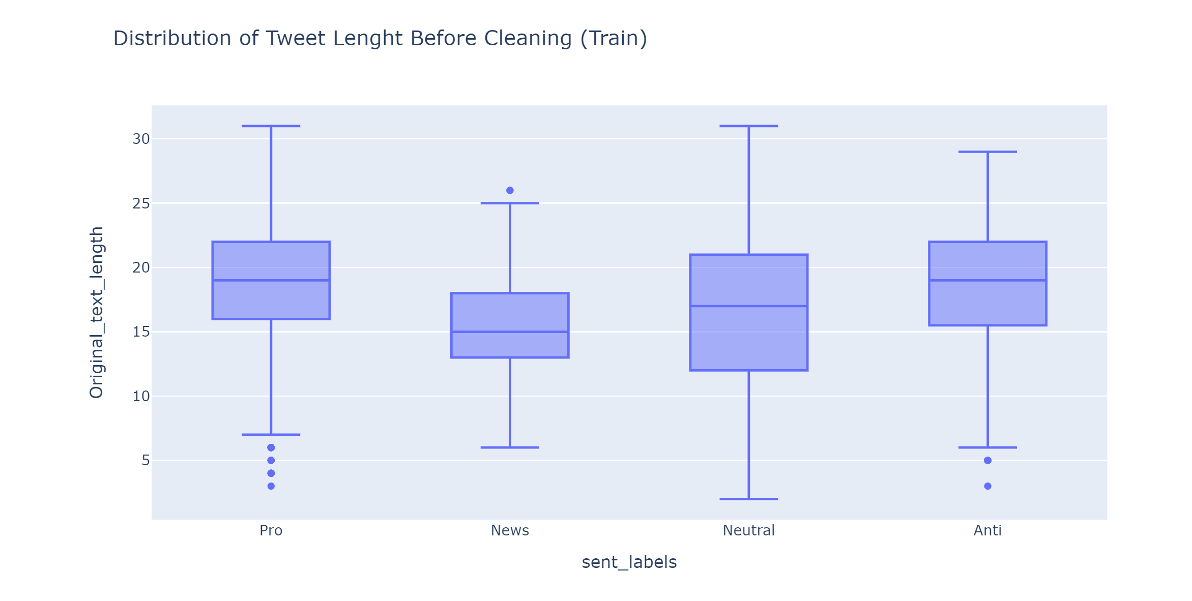

Slide 4
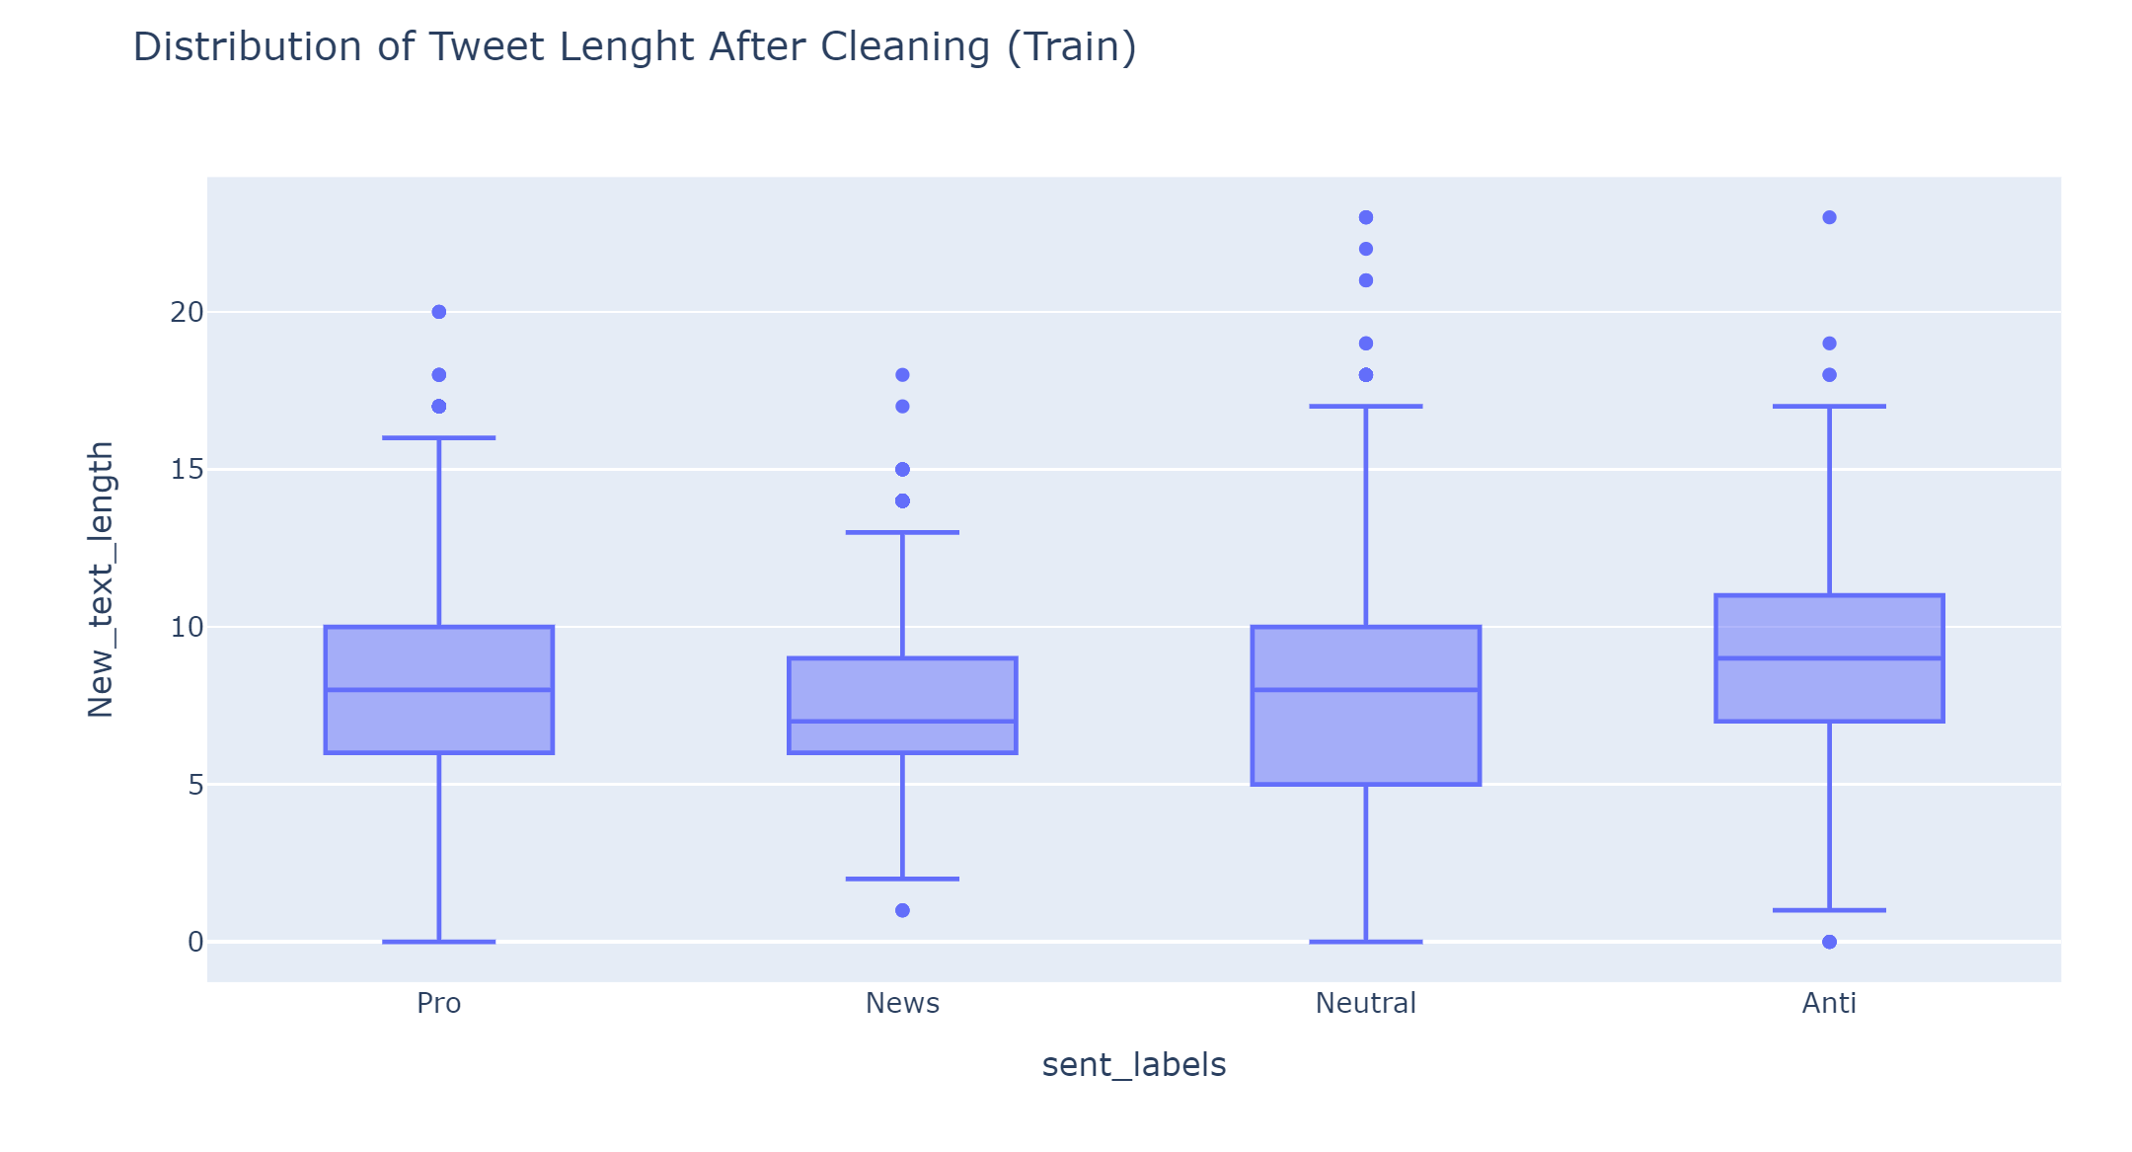

Slide 5


Slide 6


Slide 7
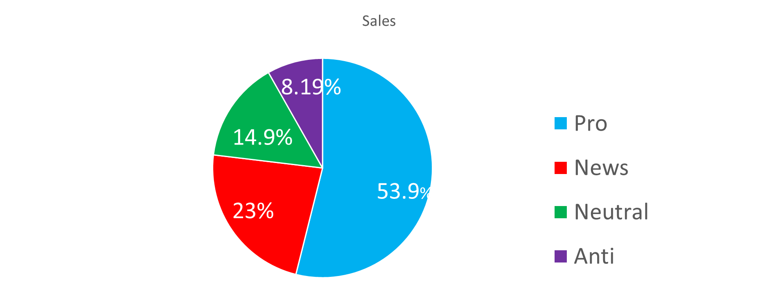
Sentiment distribution

Slide 8
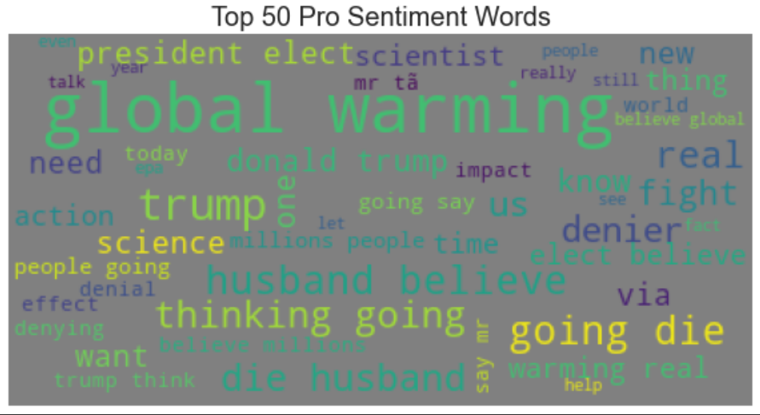
DATA EXPLORATION

Slide 9
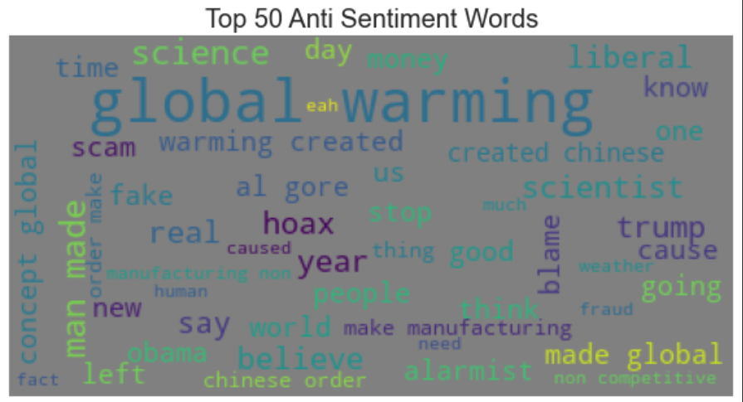
DATA EXPLORATION

Slide 10
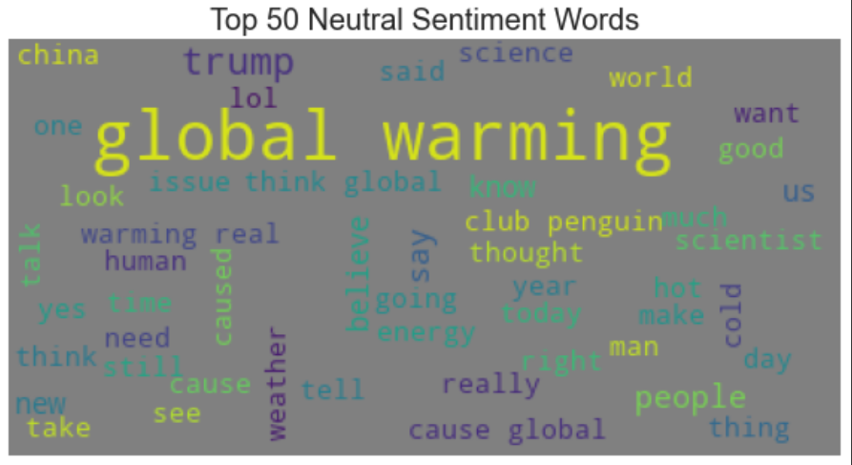
DATA EXPLORATION

