Slide 1
Graphs
intro

Slide 2
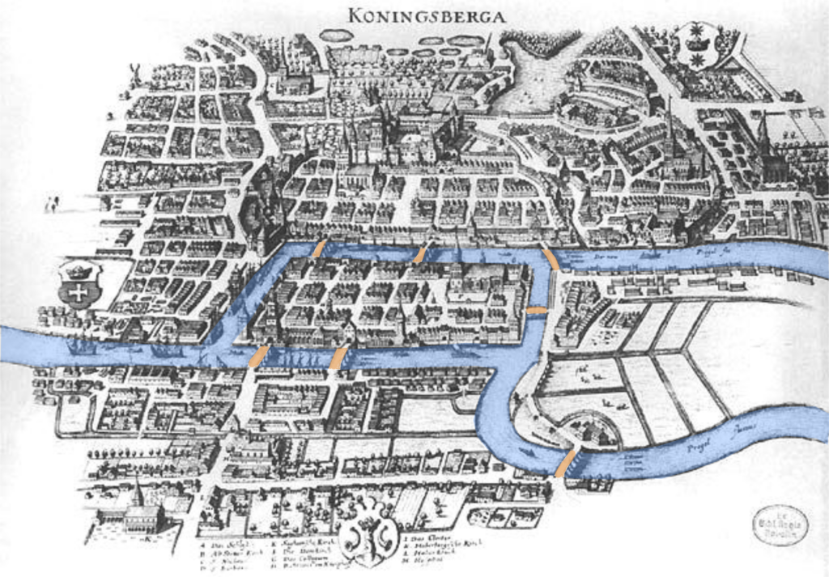
Konigsberg Bridge with blue representing the river and brown representing the bridge by Merian Erben https://commons.wikimedia.org/wiki/File:Konigsberg_Bridge.png

Slide 3
Konigsberg Bridge with blue representing the river and brown representing the bridge by Merian Erben https://commons.wikimedia.org/wiki/File:Konigsberg_Bridge.png

Slide 4
Can you walk the city crossing every bridge only once?
Konigsberg Bridge with blue representing the river and brown representing the bridge by Merian Erben https://commons.wikimedia.org/wiki/File:Konigsberg_Bridge.png

Slide 5
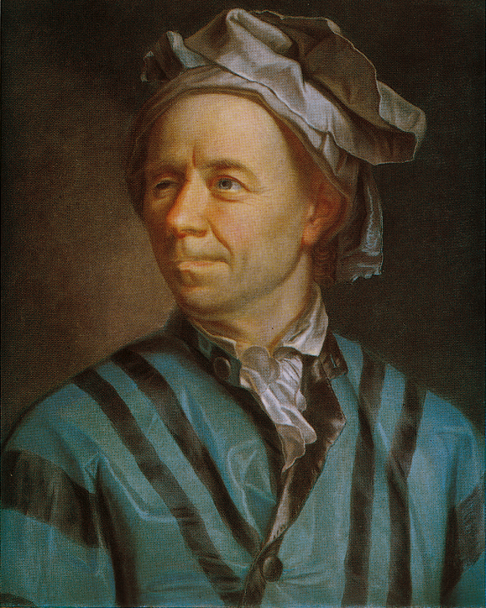
Leonhard Euler
(Basel 1707 – St. Petersburg 1783)
Portrait of Leonhard Euler (1707–1783) by Jakob Emmanuel Handmann https://commons.wikimedia.org/wiki/File:Leonhard_Euler_by_Handmann.png

Slide 6
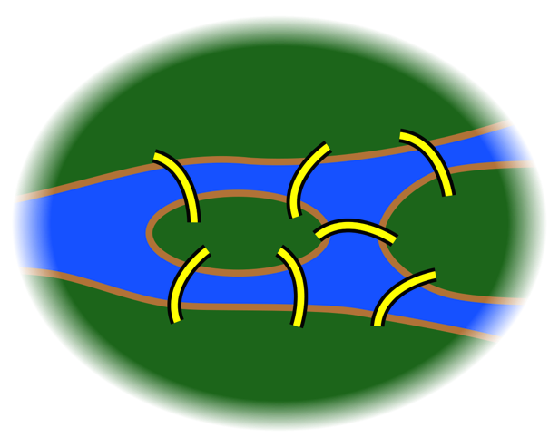
A
B
D
C
Chris-martin / CC BY-SA 3.0 / https://creativecommons.org/licenses/by-sa/3.0/deed.en

Slide 7
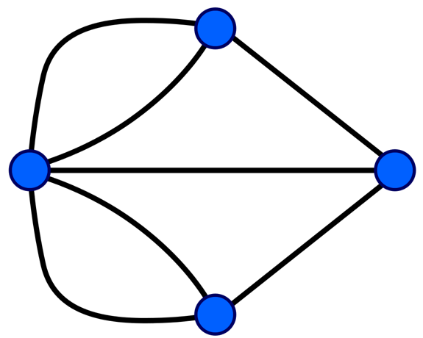
A
A
B
D
B
D
C
C
Chris-martin / CC BY-SA 3.0 / https://creativecommons.org/licenses/by-sa/3.0/deed.en
Riojajar~commonswiki / CC BY-SA 3.0 / https://creativecommons.org/licenses/by-sa/3.0/deed.en

Slide 8
A
Node (vertex)
B
D
Link (edge)
C
Riojajar~commonswiki / CC BY-SA 3.0 / https://creativecommons.org/licenses/by-sa/3.0/deed.en

Slide 9
‘Les Miserables’ book
(Gephi, gephi.org)
Every node represents a character in the book
Every edge signals interaction between characters in the book
The thickness of the edge represents the intensity of the interaction.
Vaijean and Cosette have a strong relationship
Every interaction enlarges the the character’s circle.
Vaijean must be the main character of the story.

Slide 10
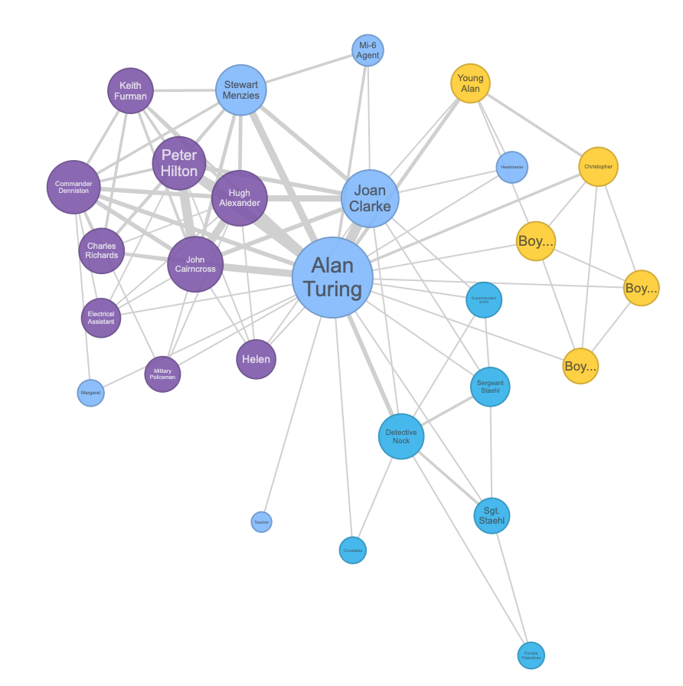
‘The Imitation Game’ movie
(moviegalaxies.com)
With the same idea:
Movies have also been represented as graphs
This graph represents the interaction between characters in the Imitation Game movie.

Slide 11
Graphs are used to represent computer networks

Slide 12
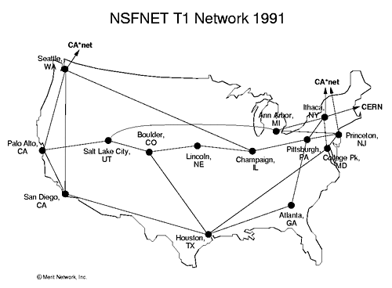
Node = Rooter
Edge = communication between rooters
© Merit Network, Inc. / CC BY-SA 3.0 / https://creativecommons.org/licenses/by-sa/3.0/deed.en

Slide 13
Graphs are used to represent social networks

Slide 14
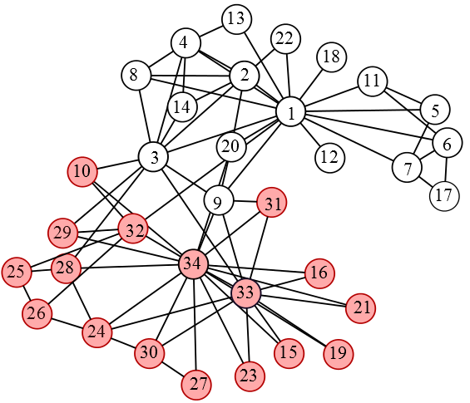
Node = person
Edge= connection between two people
CuneytAkcora / CC BY-SA 3.0 / https://creativecommons.org/licenses/by-sa/3.0/deed.en

Slide 15
CuneytAkcora / CC BY-SA 3.0 / https://creativecommons.org/licenses/by-sa/3.0/deed.en

Slide 16
Directed
Undirected

Slide 17
Directed
Undirected

Slide 18
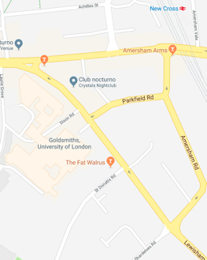
Directed
Undirected
B
A
D
C
E

Slide 19
Directed
Undirected
B
A
A
B
D
C
C
D
E
E

Slide 20
Directed
Undirected
B
A
A
B
D
C
C
D
E
E

Slide 21
Directed
Undirected
B
A
A
B
D
C
C
D
E
E

Slide 22
Weighted
Directed
Undirected
B
A
A
B
D
C
C
D
Unweighted
E
E

Slide 23
A
500
B
Weighted
200
150
C
D
600
650
E
Directed
Undirected
B
A
A
B
D
C
C
D
Unweighted
E
E

Slide 24
500
A
3
B
Weighted
A
B
200
150
2
1
C
D
C
D
600
650
1
1
E
E
Directed
Undirected
B
A
A
B
D
C
C
D
Unweighted
E
E

Slide 25
3
500
A
3
B
Weighted
A
B
2
1
200
150
2
1
C
D
C
D
1
3
600
650
1
1
E
E
Directed
Undirected
B
A
A
B
D
C
C
D
Unweighted
E
E

Slide 26
Weighted directed graphs
A
500
B
Weighted
200
150
C
D
600
650
E
Directed
Undirected
Unweighted

Slide 27
Weighted directed graphs
Weighted undirected graphs
3
A
500
B
Weighted
200
150
2
1
C
D
1
3
600
650
E
Directed
Undirected
Unweighted

Slide 28
Weighted directed graphs
Weighted undirected graphs
3
A
500
B
Weighted
200
150
2
1
C
D
1
3
600
650
E
Directed
Undirected
Unweighted undirected graphs
Unweighted

Slide 29
Weighted directed graphs
Weighted undirected graphs
3
A
500
B
Weighted
200
150
2
1
C
D
1
3
600
650
E
Directed
Undirected
Unweighted directed graphs
Unweighted undirected graphs
A
B
C
D
Unweighted
E

Slide 30
Graph Topologies
BUS
RING
TREE
MANHATTAN
MESH

